Slide 2
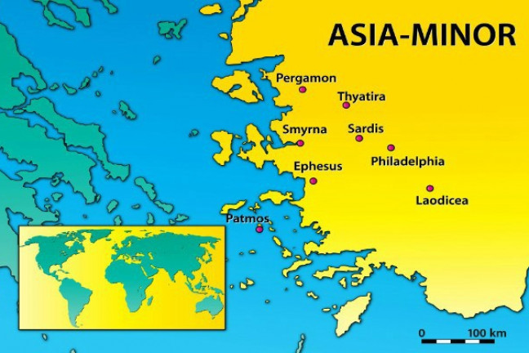
Summer Road Trip
The 7 Churches of Asia
Revelation 2-3
Laodicea
Revelation 3:14-22

Slide 3
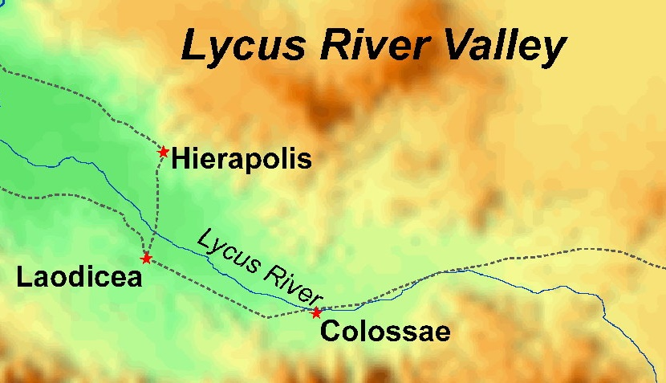
The City of Laodicea
Located 65 miles SE of Philadelphia.
Formed a tri-city triangle with Colossae and Hierapolis in the Lycus River Valley.

Slide 4
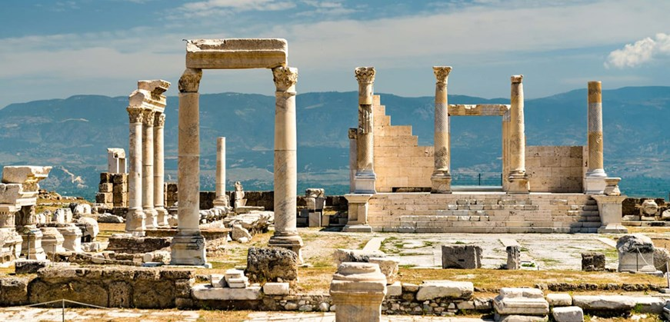
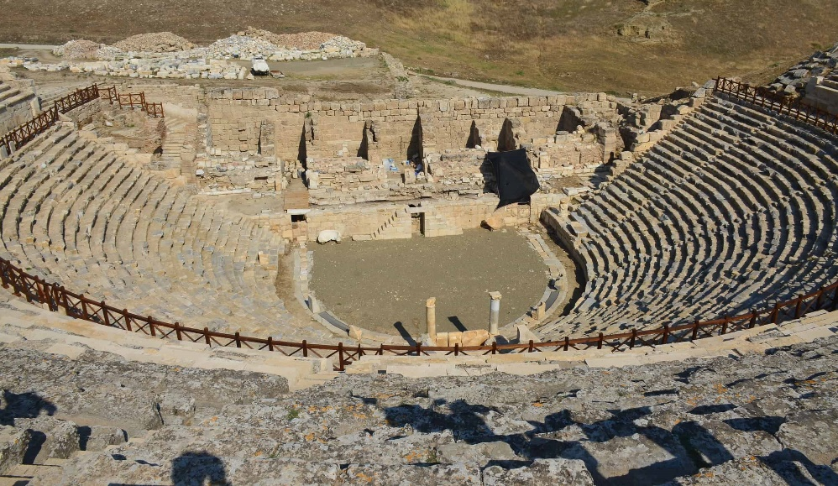
The City of Laodicea
Very wealthy city.
Noted for:
  Banking
  Wool Market
  Medical School specialized in the care of the eyes.
Spirit of
self-independence

Slide 5
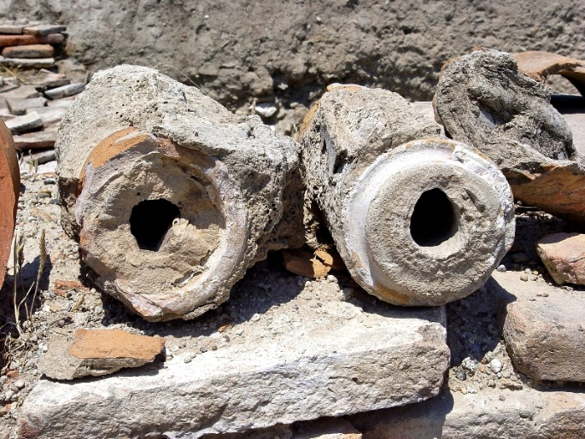
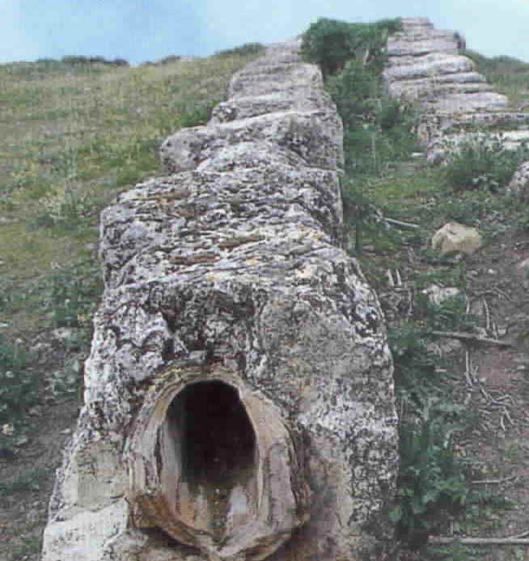
The City of Laodicea
Notorious for its terrible drinking water.
Water brought into the city from hot springs in Hierapolis and cold mountains in Colossae.
By the time it reached the city it was bitter
and “lukewarm.”

Slide 6

1. Commendation
None

Slide 7

2. Complaint
I know your works
That you are neither cold nor hot. I could wish you were cold or hot. So then, because you are lukewarm, and neither cold nor hot, I will
vomit you out of My mouth

Slide 8
2. Complaint
I know your works
That you are neither cold nor hot. I could wish you were cold or hot. So then, because you are lukewarm, and neither cold nor hot, I will
vomit you out of My mouth

Slide 9
2. Complaint
Because you say, “I am rich, have become wealthy, and have need of nothing” –
and do not know that you are wretched, miserable, poor, blind, and naked

Slide 10
2. Complaint
Because you say, “I am rich, have become wealthy, and have need of nothing” –
and do not know that you are wretched, miserable, poor, blind, and naked

Slide 11

3. Counsel
Buy from Me
Gold refined in the fire, that you may be rich
White garments, that you may be clothed,
that the shame of your nakedness may not
be revealed
And anoint your eyes with eye salve,
that you may see

Slide 12
3. Counsel
As many as I love, I rebuke and chasten.
Therefore be zealous and repent.

Slide 13
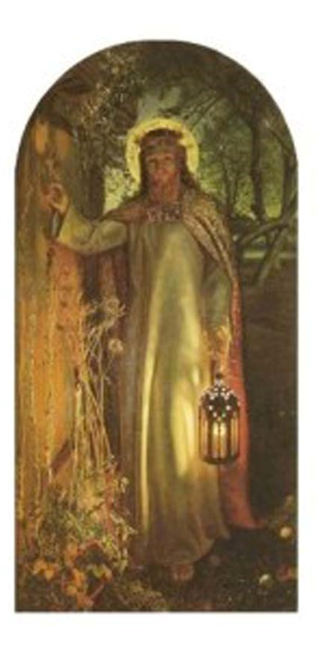
3. Counsel
Behold, I stand at the door and knock. If anyone hears My voice and opens the door, I will come in to him and dine with him, and he with Me.

Slide 14
Summer Road Trip
The 7 Churches of Asia
Revelation 2-3

