Slide 2

Comfort for the Christian
8/20/2023

Slide 3
Definition
Old Testament - terms nāḥam,. “to sigh with,” and sā˓ad, “to support and refresh,” imply an expression of sympathy, giving of encouragement.
New Testament – The term ‘parakaleō’, means “to call to one’s side” particular to help. The NT terms express the idea of strengthening, encouragement, speaking with consolation.
Charles F. Pfeiffer, Howard Frederic Vos, and John Rea, The Wycliffe Bible Encyclopedia (Moody Press, 1975).

Slide 4
Comfort
Things to remember
Things to do

Slide 5
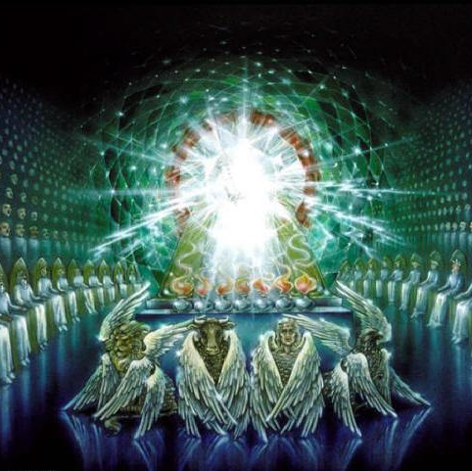
Remember – God is still on His throne
Rev. 4 The letter was written to encourage early Christians to resist the temptations and persecutions they were facing from Rome
  Unless you offer your pinch of incense to the emperor as god, you cannot work
  Some were put to death- Antipas at Pergamum (Rev. 2:13)
  The message was that God knows, God cares, and God is in control

Slide 6
Significance of God’s rule
God loves us - as individuals -
Nothing happens without His permission
  Job
  Nebuchadnezzar
  Pilate
Where is God when we are suffering?
  The same place He was when His son was crucified.

Slide 7
Behold our God - Lyrics
Who has held the oceans in His hands?
Who has numbered every grain of sand?
Kings and nations tremble at His voice
All creation rises to rejoice
Who has given counsel to the Lord?
Who can question any of His Words?
Who can teach the One who knows all things?
Who can fathom all His wondrous deeds?
[Chorus]
Behold our God seated on His throne
Come let us adore Him
Behold our King, nothing can compare
Come let us adore Him

