Slide 1
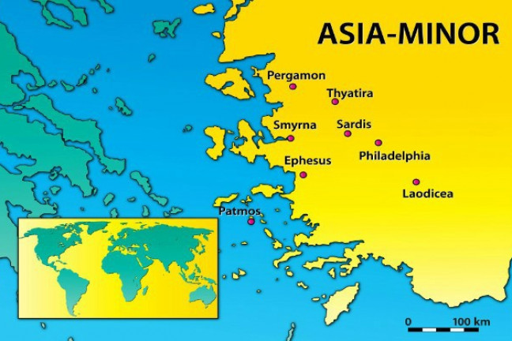
Summer Road Trip
The 7 Churches of Asia
Revelation 2-3
Philadelphia
Revelation 3:7-13

Slide 2
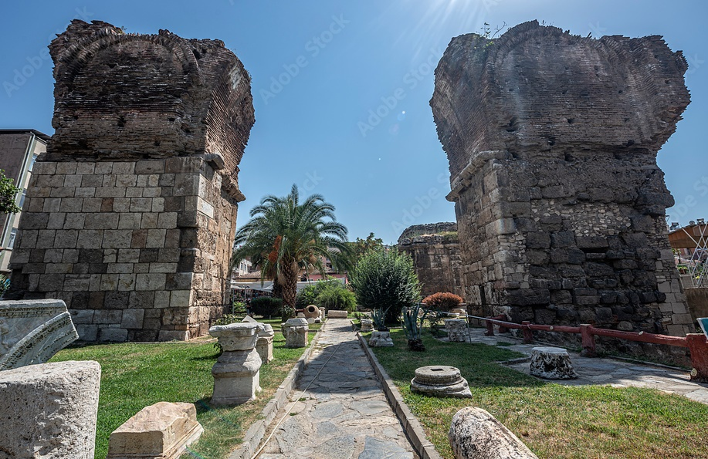
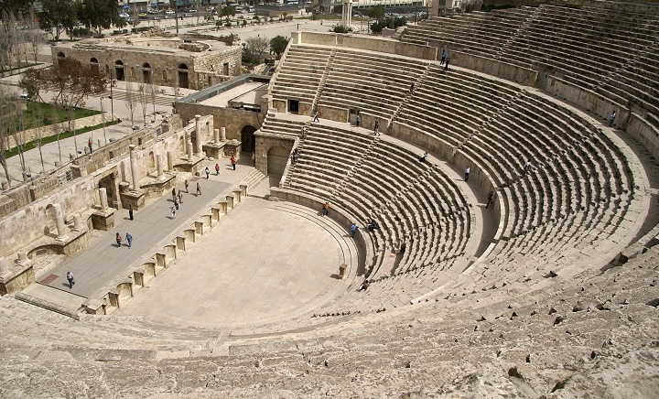
The Ancient City of Philadelphia
Located 28 miles SE of Sardis.
The youngest of these 7 cities.
Strategically located on a major road leading to the east.
Was built as a missionary city to spread Greek culture to the east.

Slide 3
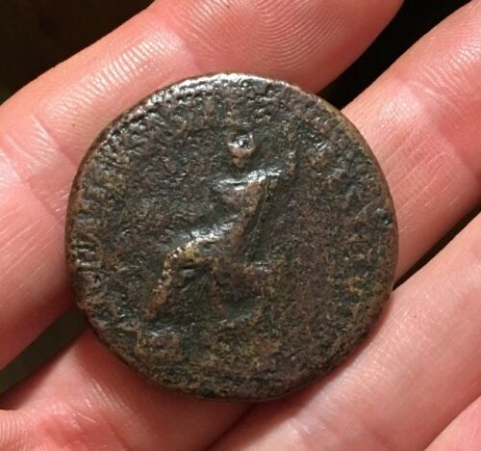
The Ancient City of Philadelphia
Earthquakes were common in the area.
City was rebuilt after being destroyed by an earthquake in 17 AD.
Citizens live in fear, were routinely seen dwelling outside the city in tents.
CIVITATIBVS ASIAE RESTITVTIS The Cities of Asia Re-established

Slide 4

1. Commendation
I know your works
I have set before you an open door, and no one can shut it
For you have a little strength, have kept My word, and have not denied My name
You have kept My command
to persevere

Slide 5

2. Complaint
Like Smyrna (2:8-11) the church in Philadelphia does not receive a complaint

Slide 6

3. Counsel

Slide 7
3. Counsel
Indeed I will make those of the synagogue of Satan, who say they are Jews and are not, but
lie - indeed I will make them come and worship before your feet, and to know that I have loved you.

Slide 8
3. Counsel
Because you have kept My command to persevere, I also will keep you from the hour of trial which shall come upon the whole world, to test those who dwell on the earth.
Behold, I am coming quickly! Hold fast what you have, that no one may take your crown.

Slide 9
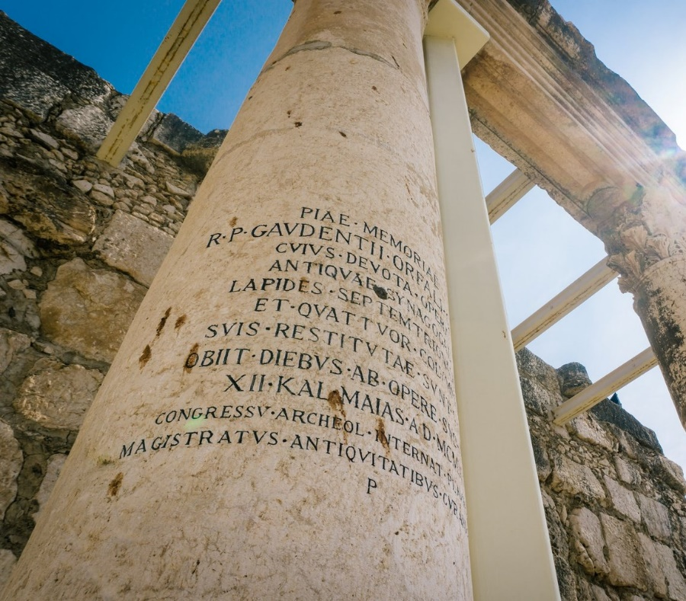
3. Counsel
He who overcomes, I will make him a pillar in the temple of My God, and he shall go out no more. I will write on him the name of My God and the name of the city of My God, the New Jerusalem, which comes down out of heaven from My God. And I will write on him My new name.

Slide 10
Summer Road Trip
The 7 Churches of Asia
Revelation 2-3
Last Stop: Laodicea
Revelation 3:14-22

