Slide 2
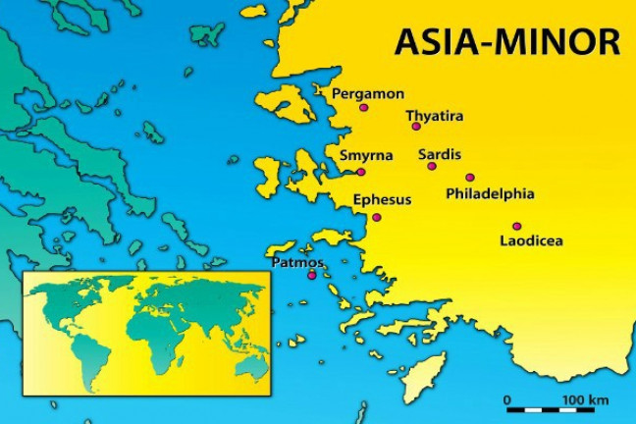
Summer Road Trip
The 7 Churches of Asia
Revelation 2-3
Sardis
Revelation 3:1-6

Slide 3
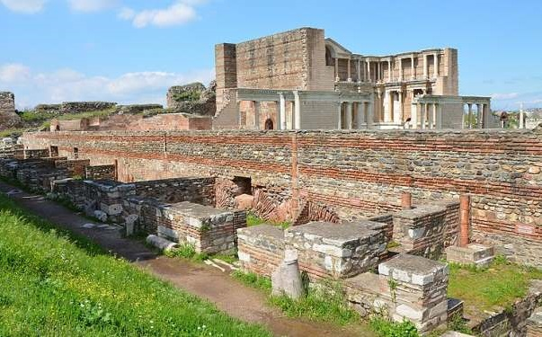
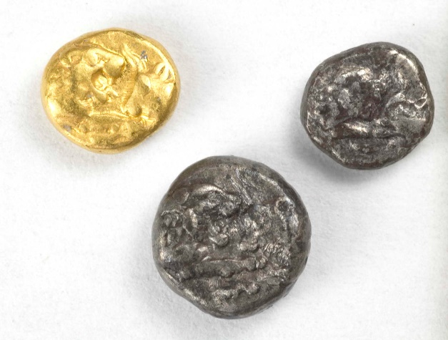
The City of Sardis
Located 30 miles SE of Thyatira.
A great trade center.
Oldest city in Asia Minor.
Birthplace of modern money:
first coins were minted in Sardis.

Slide 4
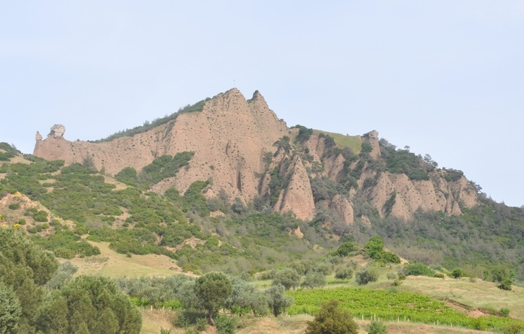
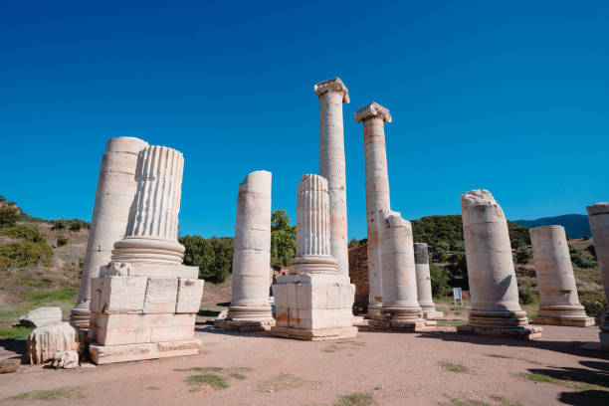
The City of Sardis
Enjoyed a very strategic location.
Gave the citizens an overconfident sense of security.
Known for its wealth and love for luxury and pleasure.

Slide 5

1. Complaint
I know your works
that you have a name that you are alive, but you are dead
I have not found your works perfect before God

Slide 6

2. Counsel
Be watchful, and strengthen the things which remain, that are ready to die (v. 2)
Remember therefore how you have received and heard; hold fast and repent (v. 3)

Slide 7
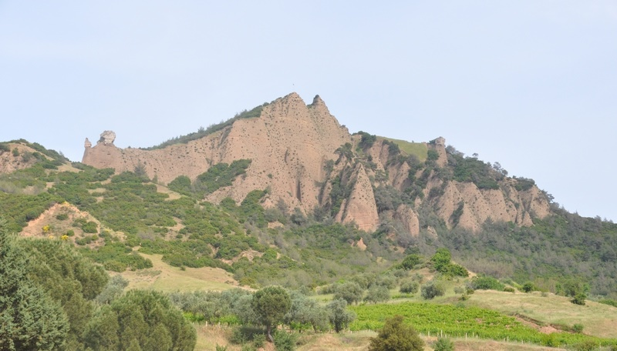
2. Counsel
Therefore if you will not watch, I will come upon you as a thief, and you will not know what hour I will come upon you (v. 3)

Slide 8

3. Commendation
You have a few names in Sardis who have not defiled their garments (v. 4)

Slide 9
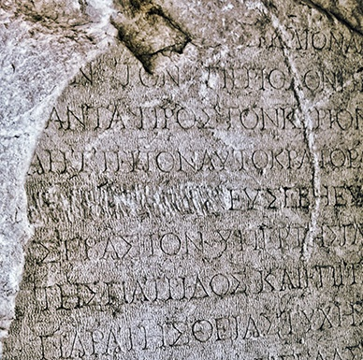
3. Commendation
He who overcomes shall be clothed in white garments, and I will not blot out his name from the Book of Life; but I will confess his name before My Father and before His angels (v. 5)

Slide 10
Summer Road Trip
The 7 Churches of Asia
Revelation 2-3
Next Stop: Philadelphia
Revelation 3:7-13

