Slide 2
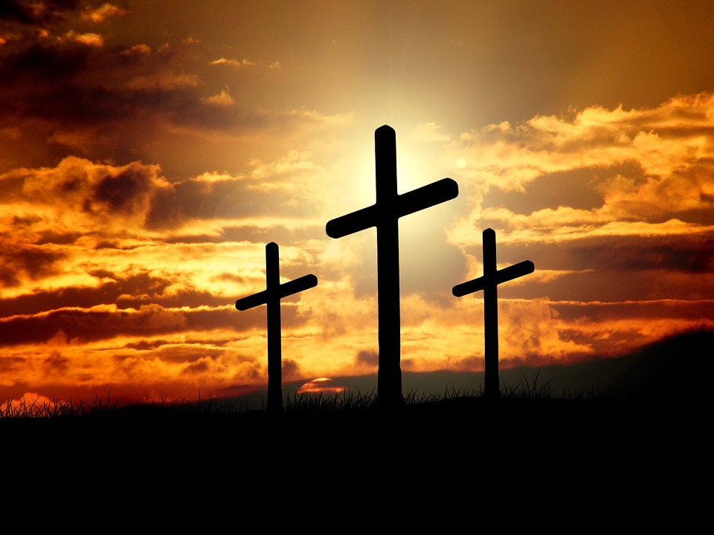
Three Crosses
Luke 23:32-43

Slide 3
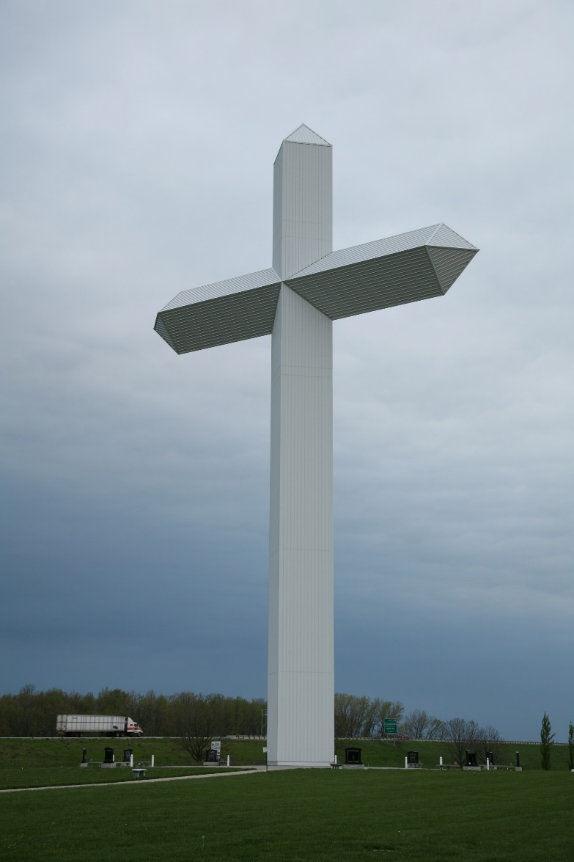
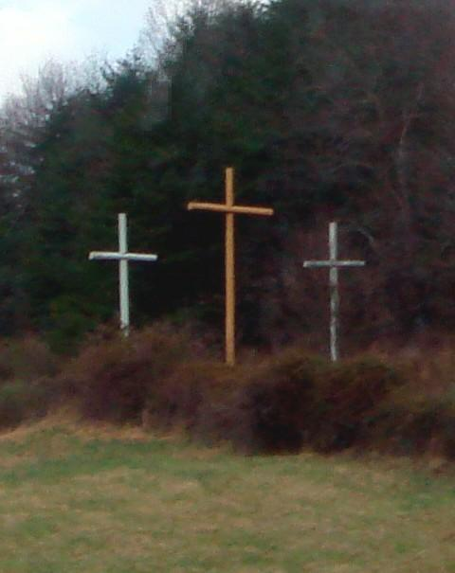

Slide 4
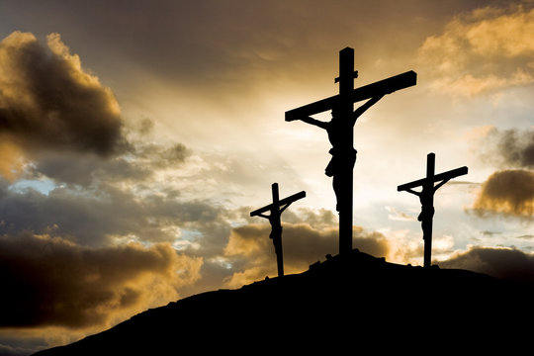

Slide 5
Luke 23:32-43 ESV
(32) Two others, who were criminals, were led away to be put to death with him. (33) And when they came to the place that is called The Skull, there they crucified him, and the criminals, one on his right and one on his left. (34) And Jesus said, "Father, forgive them, for they know not what they do." And they cast lots to divide his garments.

Slide 6
Luke 23:32-43 ESV
(35) And the people stood by, watching, but the rulers scoffed at him, saying, "He saved others; let him save himself, if he is the Christ of God, his Chosen One!" (36) The soldiers also mocked him, coming up and offering him sour wine (37) and saying, "If you are the King of the Jews, save yourself!"

Slide 7
Luke 23:32-43 ESV
(38) There was also an inscription over him, "This is the King of the Jews." (39) One of the criminals who were hanged railed at him, saying, "Are you not the Christ? Save yourself and us!" (40) But the other rebuked him, saying, "Do you not fear God, since you are under the same sentence of condemnation?

Slide 8
Luke 23:32-43 ESV
(41) And we indeed justly, for we are receiving the due reward of our deeds; but this man has done nothing wrong." (42) And he said, "Jesus, remember me when you come into your kingdom." (43) And he said to him, "Truly, I say to you, today you will be with me in Paradise."

Slide 9
Lessons from the Two Thieves
We deserve death

Slide 10
Romans 5:12-14 ESV
(12) Therefore, just as sin came into the world through one man, and death through sin, and so death spread to all men because all sinned-- (13) for sin indeed was in the world before the law was given, but sin is not counted where there is no law. (14) Yet death reigned from Adam to Moses, even over those whose sinning was not like the transgression of Adam, who was a type of the one who was to come.

Slide 11
Genesis 3:17-19 ESV
(17) And to Adam he said, "Because you have listened to the voice of your wife and have eaten of the tree of which I commanded you, 'You shall not eat of it,' cursed is the ground because of you; in pain you shall eat of it all the days of your life;

Slide 12
Genesis 3:17-19 ESV
(18) thorns and thistles it shall bring forth for you; and you shall eat the plants of the field. (19) By the sweat of your face you shall eat bread, till you return to the ground, for out of it you were taken; for you are dust, and to dust you shall return."

Slide 13
Romans 6:23 ESV
(23) For the wages of sin is death, but the free gift of God is eternal life in Christ Jesus our Lord.

Slide 14
Isaiah 64:6 ESV
(6) We have all become like one who is unclean, and all our righteous deeds are like a polluted garment. We all fade like a leaf, and our iniquities, like the wind, take us away.

Slide 15
Lessons from the Two Thieves
We deserve death
Our death comes soon

Slide 16
James 4:13-15 ESV
(13) Come now, you who say, "Today or tomorrow we will go into such and such a town and spend a year there and trade and make a profit"-- (14) yet you do not know what tomorrow will bring. What is your life? For you are a mist that appears for a little time and then vanishes. (15) Instead you ought to say, "If the Lord wills, we will live and do this or that."

Slide 17
Psalm 90:10-12 ESV
(10) The years of our life are seventy, or even by reason of strength eighty; yet their span is but toil and trouble; they are soon gone, and we fly away. (11) Who considers the power of your anger, and your wrath according to the fear of you? (12) So teach us to number our days that we may get a heart of wisdom.

Slide 18
Lessons from the Two Thieves
We deserve death
Our death comes soon
Jesus is nearby

Slide 19
Acts 17:24-28 ESV
(24) The God who made the world and everything in it, being Lord of heaven and earth, does not live in temples made by man, (25) nor is he served by human hands, as though he needed anything, since he himself gives to all mankind life and breath and everything.

Slide 20
Acts 17:24-28 ESV
(26) And he made from one man every nation of mankind to live on all the face of the earth, having determined allotted periods and the boundaries of their dwelling place,

Slide 21
Acts 17:24-28 ESV
(27) that they should seek God, and perhaps feel their way toward him and find him. Yet he is actually not far from each one of us, (28) for "'In him we live and move and have our being'; as even some of your own poets have said, "'For we are indeed his offspring.'

Slide 22
Jeremiah 23:23-24 ESV
(23) "Am I a God at hand, declares the LORD, and not a God far away? (24) Can a man hide himself in secret places so that I cannot see him? declares the LORD. Do I not fill heaven and earth? declares the LORD.

Slide 23
Psalm 119:151 ESV
(151) But you are near, O LORD, and all your commandments are true.

Slide 24
Psalm 139:1-12 ESV
(1) O LORD, you have searched me and known me! (2) You know when I sit down and when I rise up; you discern my thoughts from afar. (3) You search out my path and my lying down and are acquainted with all my ways. (4) Even before a word is on my tongue, behold, O LORD, you know it altogether.

Slide 25
Psalm 139:1-12 ESV
(5) You hem me in, behind and before, and lay your hand upon me. (6) Such knowledge is too wonderful for me; it is high; I cannot attain it. (7) Where shall I go from your Spirit? Or where shall I flee from your presence? (8) If I ascend to heaven, you are there! If I make my bed in Sheol, you are there!

Slide 26
Psalm 139:1-12 ESV
(9) If I take the wings of the morning and dwell in the uttermost parts of the sea, (10) even there your hand shall lead me, and your right hand shall hold me. (11) If I say, "Surely the darkness shall cover me, and the light about me be night,"

Slide 27
Psalm 139:1-12 ESV
(12) even the darkness is not dark to you; the night is bright as the day, for darkness is as light with you.

Slide 28
James 4:8a ESV
(8) Draw near to God, and he will draw near to you.

Slide 29
Deuteronomy 30:11-14 ESV
(11) "For this commandment that I command you today is not too hard for you, neither is it far off. (12a) It is not in heaven… (13a) Neither is it beyond the sea… (14) But the word is very near you. It is in your mouth and in your heart, so that you can do it.

Slide 30
Romans 10:8 ESV
(8) But what does it say? "The word is near you, in your mouth and in your heart" (that is, the word of faith that we proclaim);

Slide 31
Lessons from the Two Thieves
We deserve death
Our death comes soon
Jesus is nearby
We have a choice

Slide 32
Luke 23:36-43 ESV
(36) The soldiers also mocked him, coming up and offering him sour wine (37) and saying, "If you are the King of the Jews, save yourself!" (38) There was also an inscription over him, "This is the King of the Jews." (39) One of the criminals who were hanged railed at him, saying, "Are you not the Christ? Save yourself and us!"

Slide 33
Luke 23:36-43 ESV
(40) But the other rebuked him, saying, "Do you not fear God, since you are under the same sentence of condemnation? (41) And we indeed justly, for we are receiving the due reward of our deeds; but this man has done nothing wrong." (42) And he said, "Jesus, remember me when you come into your kingdom."

Slide 34
Luke 23:36-43 ESV
(43) And he said to him, "Truly, I say to you, today you will be with me in Paradise."

Slide 35
James 4:7-10 ESV
(7) Submit yourselves therefore to God. Resist the devil, and he will flee from you. (8) Draw near to God, and he will draw near to you. Cleanse your hands, you sinners, and purify your hearts, you double-minded.

Slide 36
James 4:7-10 ESV
(9) Be wretched and mourn and weep. Let your laughter be turned to mourning and your joy to gloom. (10) Humble yourselves before the Lord, and he will exalt you.

Slide 37
Matthew 25:33-34, 41 ESV
(33) And he will place the sheep on his right, but the goats on the left. (34) Then the King will say to those on his right, 'Come, you who are blessed by my Father, inherit the kingdom prepared for you from the foundation of the world. ... (41) "Then he will say to those on his left, 'Depart from me, you cursed, into the eternal fire prepared for the devil and his angels. ...

Slide 38
Mark 15:31-32 ESV
(31) So also the chief priests with the scribes mocked him to one another, saying, "He saved others; he cannot save himself. (32) Let the Christ, the King of Israel, come down now from the cross that we may see and believe." Those who were crucified with him also reviled him.

Slide 39
Lessons from the Two Thieves
We deserve death
Our death comes soon
Jesus is nearby
We have a choice

Slide 40
John 1:12-13 ESV
(12) But to all who did receive him, who believed in his name, he gave the right to become children of God, (13) who were born, not of blood nor of the will of the flesh nor of the will of man, but of God.

Slide 41
Three Crosses
Luke 23:32-43

