Slide 2
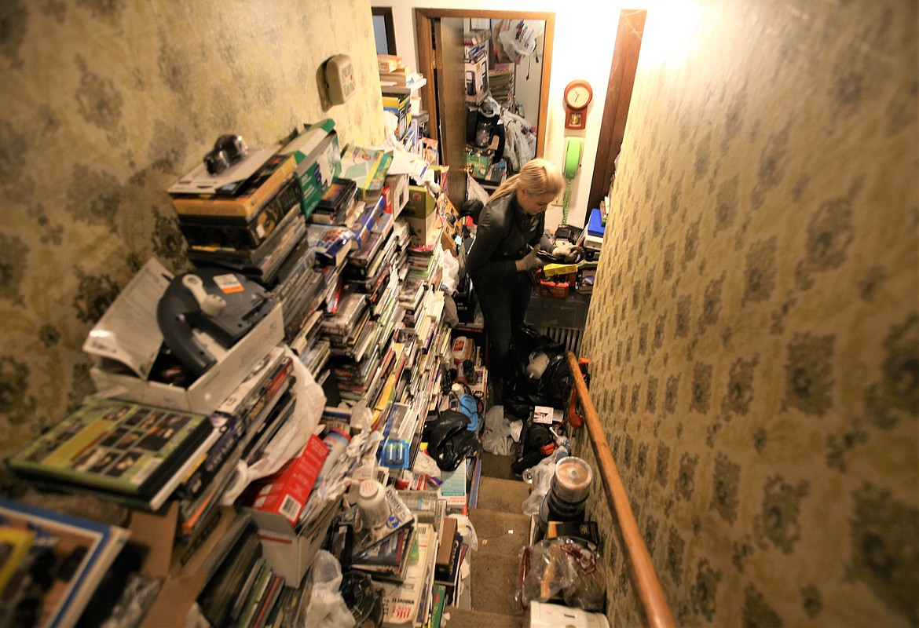


Slide 3

Six Paces:
Letting Go of Anger at God

Slide 4

David’s Six Paces
2 Samuel 6

Slide 5

Anger
Perez-uzzah means “the breaking out against Uzzah”
Others in scripture who were angry with God:
  Moses (Numbers 11: 11-15)
  Jonah (Jonah 4: 1-3)
  Cain (Genesis 4: 3-7)
  Job (various)
Anger itself is not condemned.
  Ephesians 4: 26-27, Genesis 4: 6-7
2 Samuel 6: 1-8

Slide 6

Fear
Anger
This was not the ‘Godly fear’ that leads to obedience.
  Deuteronomy 6: 13, Proverbs 1: 7
Fear like Adam and the ‘One Talent’ servant.
  Genesis 3: 10, Matthew 25: 24-25
Fear that stemmed from disobedience.
  Exodus 25: 14, Numbers 4: 15
This is a crippling fear.
  2 Samuel 6: 9
2 Samuel 6: 9

Slide 7

Fear
Anger
Inaction
Before this, David was a man of action.
  1 Samuel 5
Why bring back the Ark?
  Exodus 25: 21-22
David remained inactive for 3 months!
God expects people of action.
  James 4: 17, 1 Kings 19: 4
2 Samuel 6: 10

Slide 8

Fear
Realization
Anger
Inaction
David realizes…
  They had sinned. (God was just)
  They were missing out on blessings.
  They had nothing to fear when they obeyed.
Other examples of realizations:
  Luke 15: 17-19, Job 42: 1-2
Our realization:
  James 4:14
2 Samuel 6: 11-12a

Slide 9

Fear
Realization
Anger
Inaction
Action
The Ark is moved according to God’s word and David is successful.
  1 Chronicles 15: 1-4, 12-15, 25
THIS is what Godly fear looks like!
They did what Cain could have done, had he been able to let go of his anger.
  Genesis 4: 6-7
2 Samuel 6: 12b

Slide 10
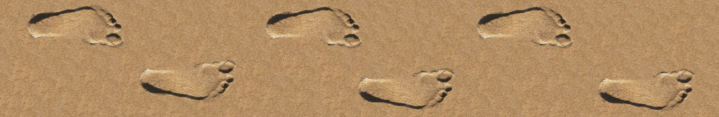
Fear
Realization
Rejoicing
Anger
Inaction
Action
Six paces.
  These six steps taken by those carrying the Ark were enough for David to let that fear and anger go, and return to a state of praise to the Lord.
God’s expectation for us today as well.
  James 1: 2-4, Hebrews 12, Psalm 94: 12
2 Samuel 6: 13-15

Slide 11
Can you rejoice today?

