Slide 1
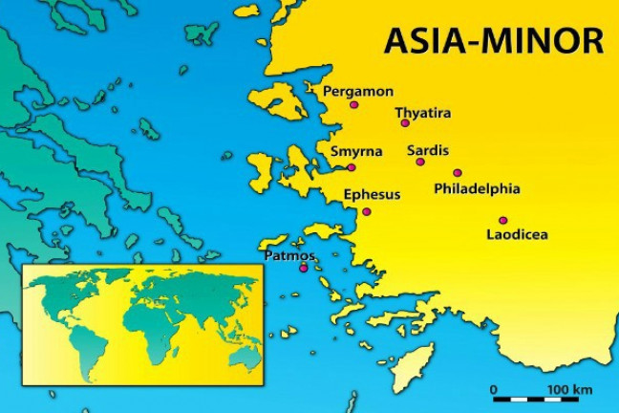
Summer Road Trip
The 7 Churches of Asia
Revelation 2-3
Smyrna
Revelation 2:8-11

Slide 2
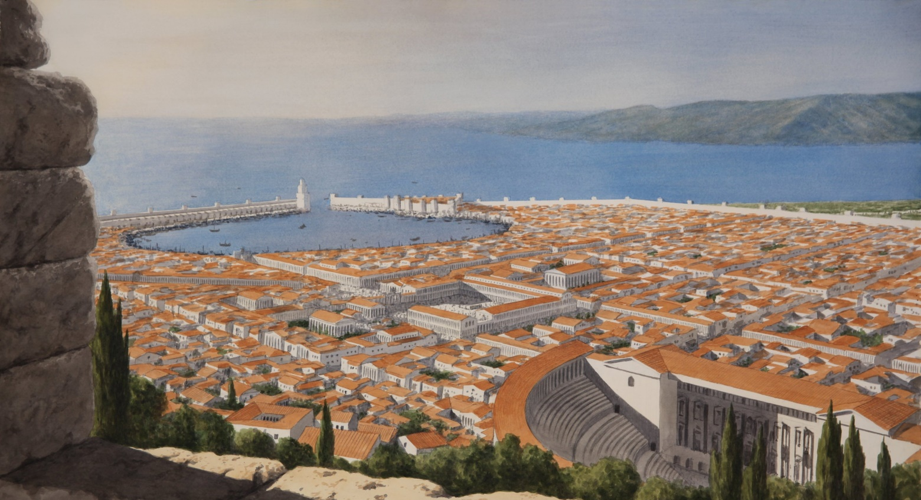
The City of Smyrna
Located 35 miles north of Ephesus.
Population of over 100,000.

Slide 3
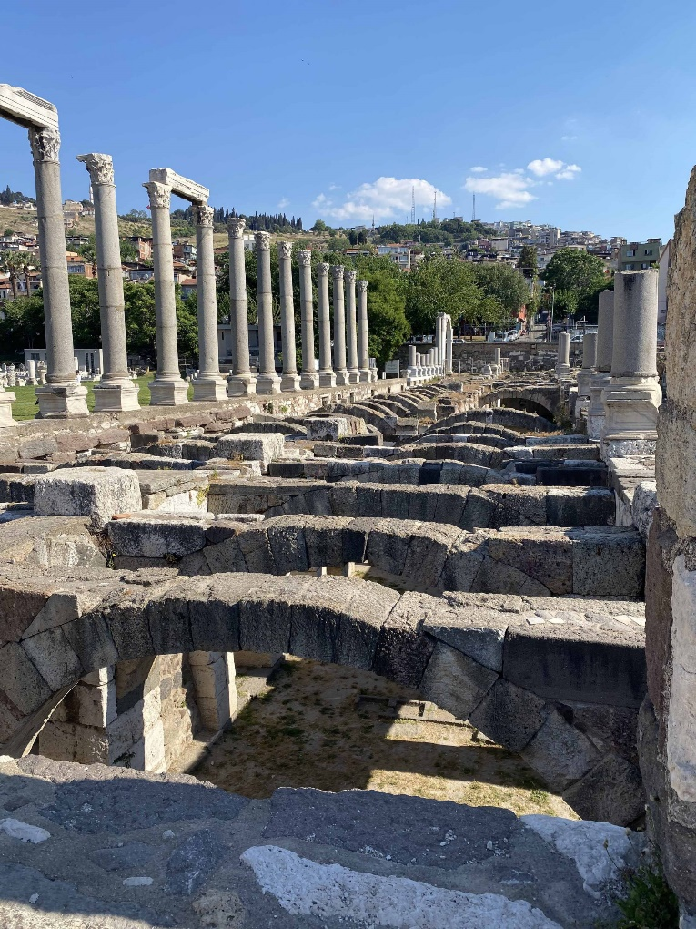
The City of Smyrna
In 26 A.D. the city was approved as the site for a temple honoring Tiberius Caesar.
Smyrna became a great center for Caesar worship.
When it was enforced, Christians in this area suffered greatly.

Slide 4
Jesus Identifies Himself
And to the angel of the church in Smyrna write, “These things says the First and the Last,
who was dead, and came to life.”
Rev. 1:8

Slide 5
Jesus Identifies Himself
And to the angel of the church in Smyrna write, “These things says the First and the Last,
who was dead, and came to life.”
Rev. 1:8

Slide 6
Jesus Identifies Himself
And to the angel of the church in Smyrna write, “These things says the First and the Last,
who was dead, and came to life.”
Rev. 1:8

Slide 7

1. Commendation
I know
works
tribulation
poverty (but you are rich)
the blasphemy of those who say
they are Jews and are not, but
are a synagogue of Satan

Slide 8

2. Complaint
None

Slide 9

3. Counsel
Do not fear.
You will have tribulation ten days.
Be faithful until death, and I will give you the crown of life.
He who overcomes shall not be hurt by the second death.

Slide 10
Summer Road Trip
The 7 Churches of Asia
Revelation 2-3
Next Stop: Pergamos
Revelation 2:12-17

