Slide 2

The Meaning of “Eternal Life”
Mark 10:17-31

Slide 3

“If a man dies, shall he live again? All the days of my hard service I will wait, till my change comes.”
Job 14:14

Slide 4
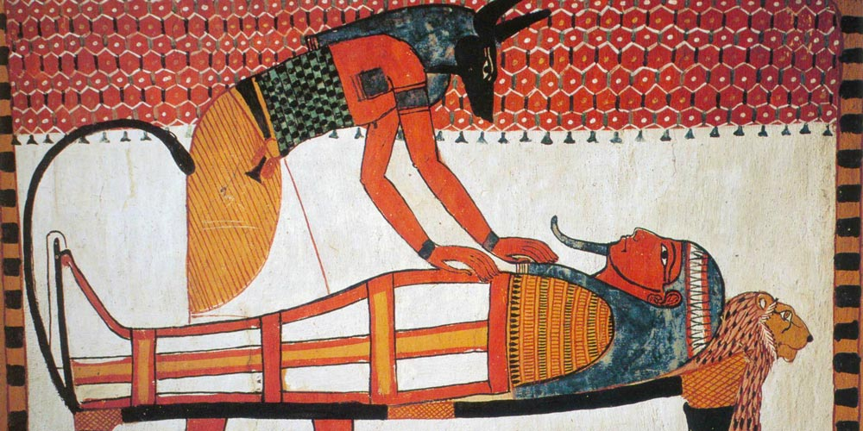



Slide 5
Jesus spoke these words, lifted up His eyes to heaven, and said: ‘Father, the hour has come. Glorify Your Son, that Your Son also may glorify You,
as You have given Him authority over all flesh, that He should give eternal life to as many as You have given Him.”
John 17:1-2

Slide 6
1. Eternal Life
“Good Teacher, what shall I do that I may inherit eternal life?” - Mark 10:17
The Jews looked for eternal life - John 5:39
Eternal life is not living forever physically but enjoying the state of being united with God in fellowship for all eternity.

Slide 7
2. Treasure in Heaven
“…sell whatever you have and give to the poor, and you will have treasure in heaven” - Mark 10:21
Eternal life is more than a mere existence. It is a precious reward awaiting us after death.
Matt. 5:12; Heb. 10:34; 1 Peter 1:3-5

Slide 8
3. Enter the Kingdom of God
“How hard it is for those who have riches to enter the kingdom of God” - Mark 10:23
Christians are presently a part of this kingdom -
Col. 1:13; Phil. 3:20
There is an aspect of the kingdom that is yet to be entered and enjoyed - Matt. 25:34; 2 Pet. 1:11

Slide 9
4. Be Saved
“Who then can be saved?” - Mark 10:26
Sin calls for wrath and punishment - Col. 3:5-6
We must be saved from this wrath and punishment to have eternal life - Rom. 5:9-10

Slide 10
The Meaning of “Eternal Life”
Eternal Life
Treasure in Heaven
Enter the Kingdom of God
Be Saved

