Slide 1
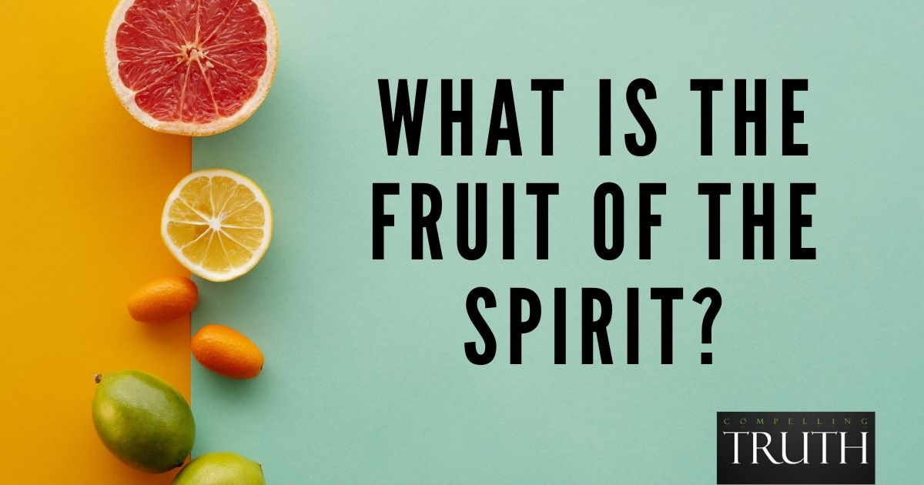
Galatians 5:22-23
SELF-CONTROL

Slide 2
SELF-CONTROL
“Temperance” in the KJV.
ENKRATEIA
“self-control”
“the virtue of one who masters his desires and passions, especially his sensual appetites” (Thayer)

Slide 3
SELF-CONTROL
ENKRATEIA
KRATOS - “power, strength, lordship”
EN - prefix meaning “self”

Slide 4
SELF-CONTROL
“He who is slow to anger is better than the mighty, and he who rules his spirit than he who takes a city” (Prov. 16:32).
“A man without self-control is like a city broken into and left without walls” (Prov. 25:28, ESV).

Slide 5
Characteristic of Deity
God is capable of self-control
  Genesis 6:5-8
  Exodus 32:11-14
  1 Chronicles 21:15
Jesus displayed incredible self-control
  Luke 9:53-56
  Matthew 27:12-14

Slide 6
Christians Are Expected to Practice Self-Control
Elders and their wives
  1 Timothy 3:2, 11
  Titus 1:8
Older men and women
  Titus 2:2-3

Slide 7
Why We Need Self-Control
Part of our call to discipleship
  Matthew 16:24; 2 Peter 1:5-7
God’s graces teaches it
  Titus 2:11-12
To escape God’s judgment
  Acts 24:25
To obtain an imperishable crown
  1 Cor. 9:24-27

Slide 8
How to Develop Self-Control
Dethrone self and enthrone Jesus
  Galatians 2:20
Submit to God’s will
  James 4:7-8; Phil. 2:5-8
Consider our influence
  Matthew 5:13
Keep working on it
  1 Cor. 9:24-27; 1 Tim. 4:7-8

Slide 9
The Fruit of the Spirit
Love
Joy
Peace
Longsuffering
Kindness
Goodness
Faithfulness
Gentleness
Self-Control
Are we
walking in
the Spirit?

