Slide 1
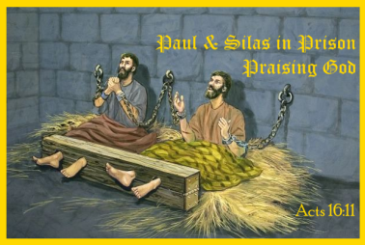
Paul and Silas in Prison
Acts 16:16-34

Slide 2
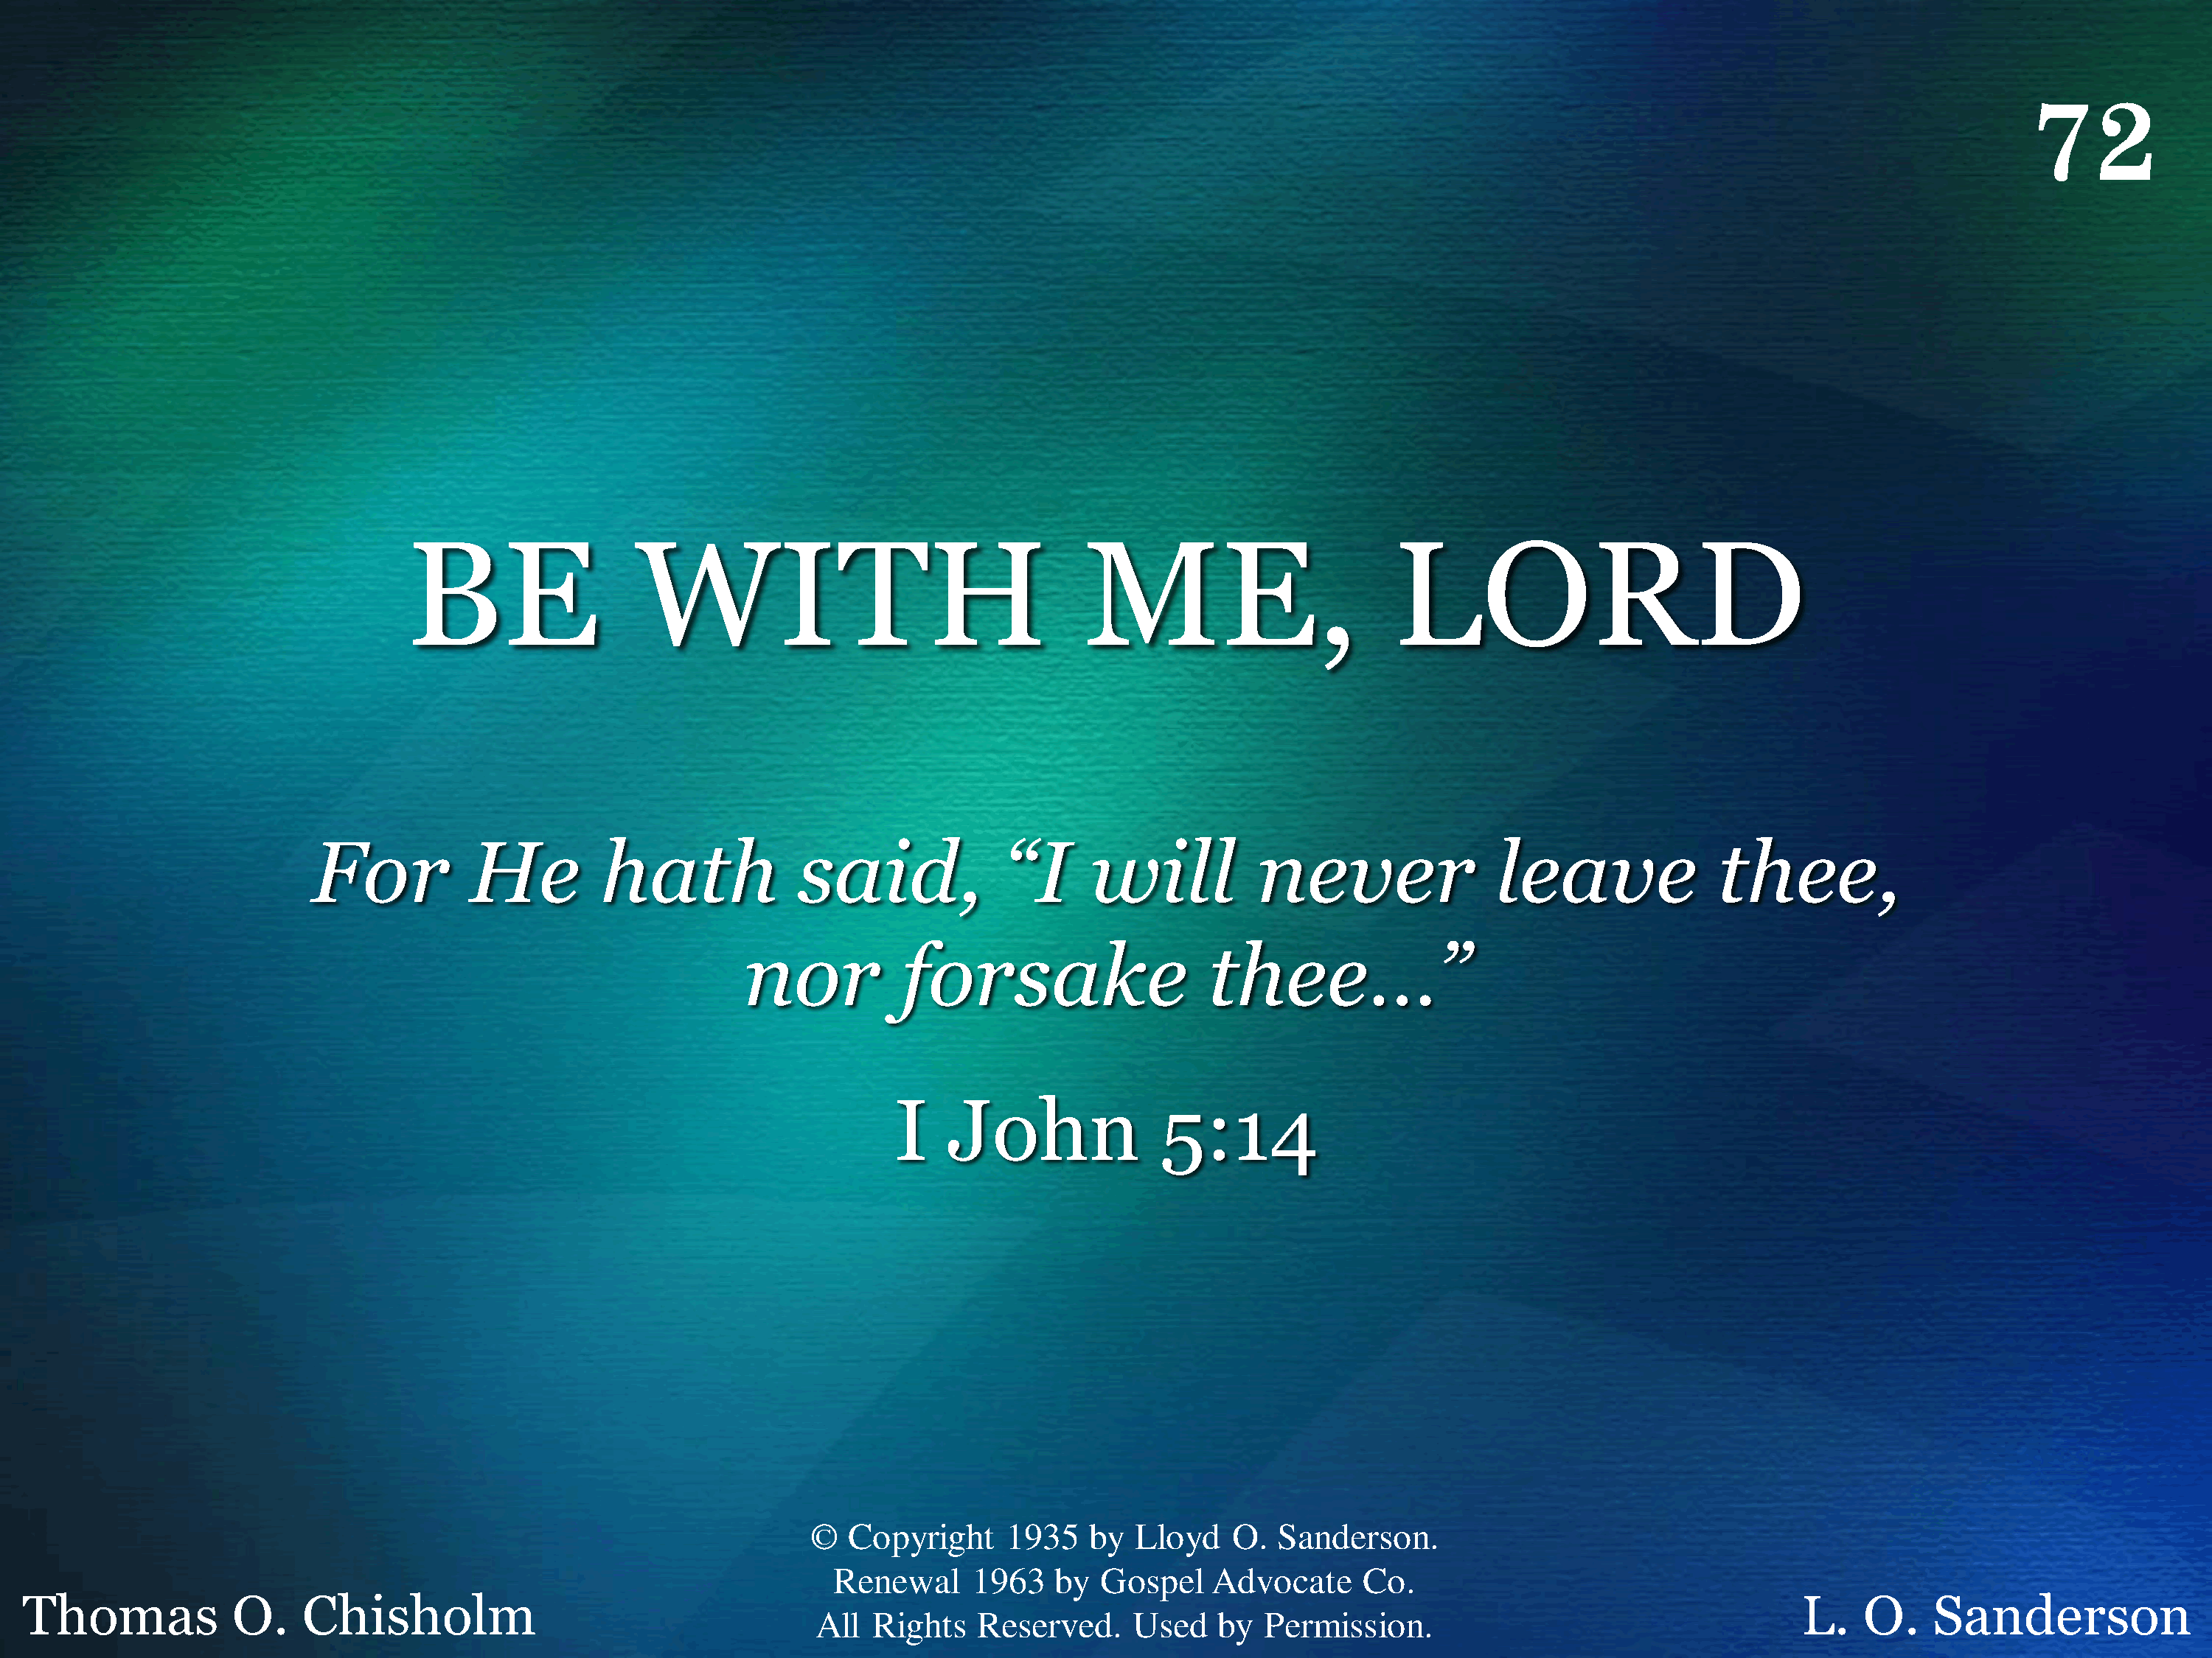
072 - Be With Me, Lord - Title

Slide 3
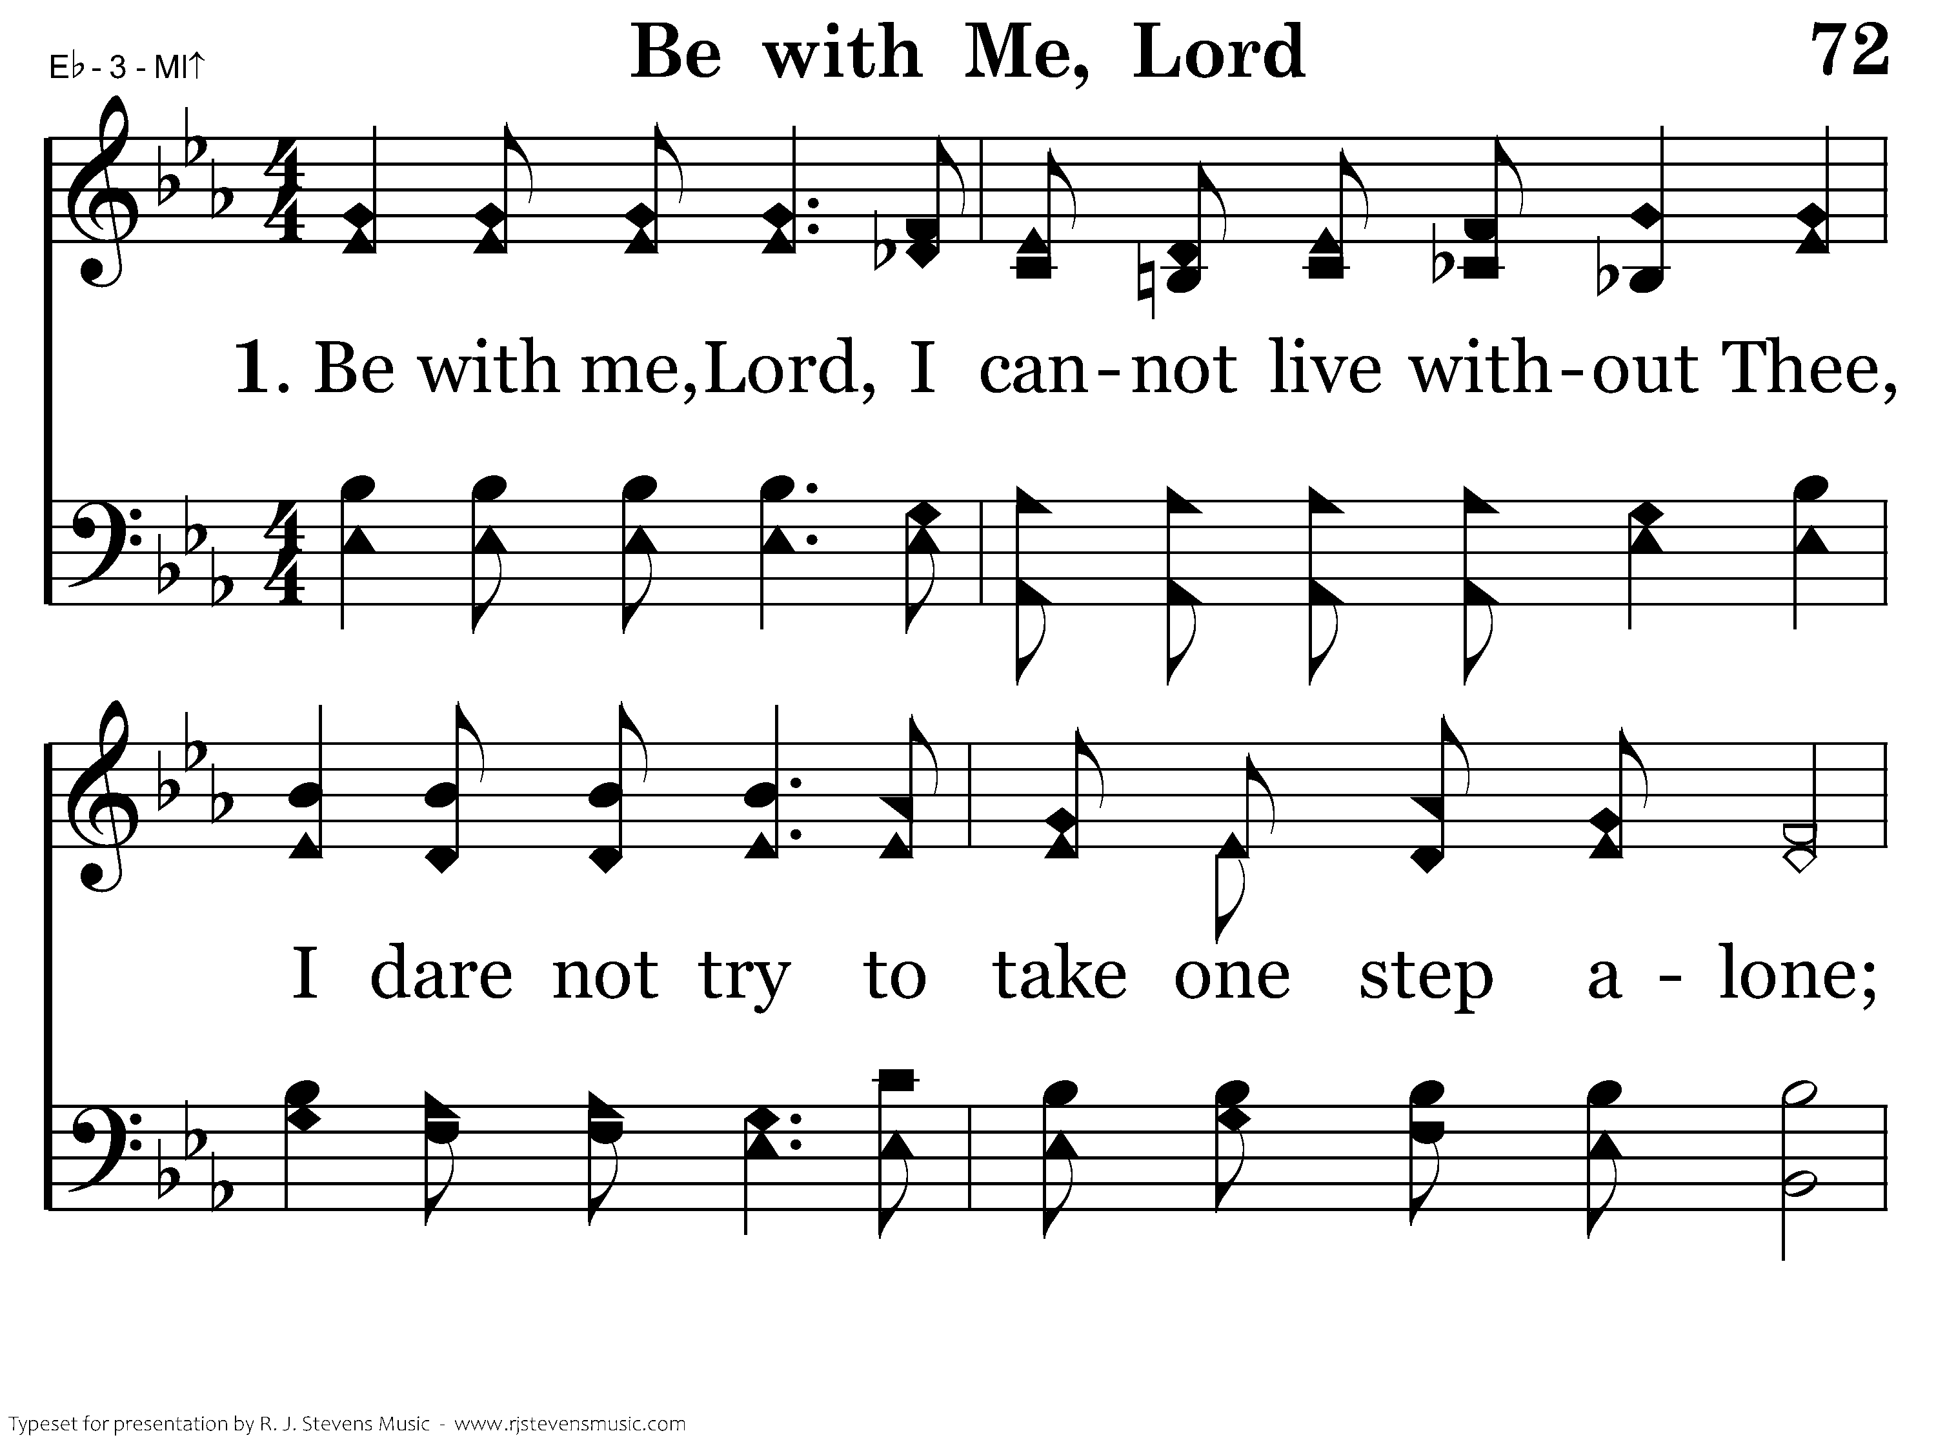
072 - Be With Me, Lord - 1.1

Slide 4
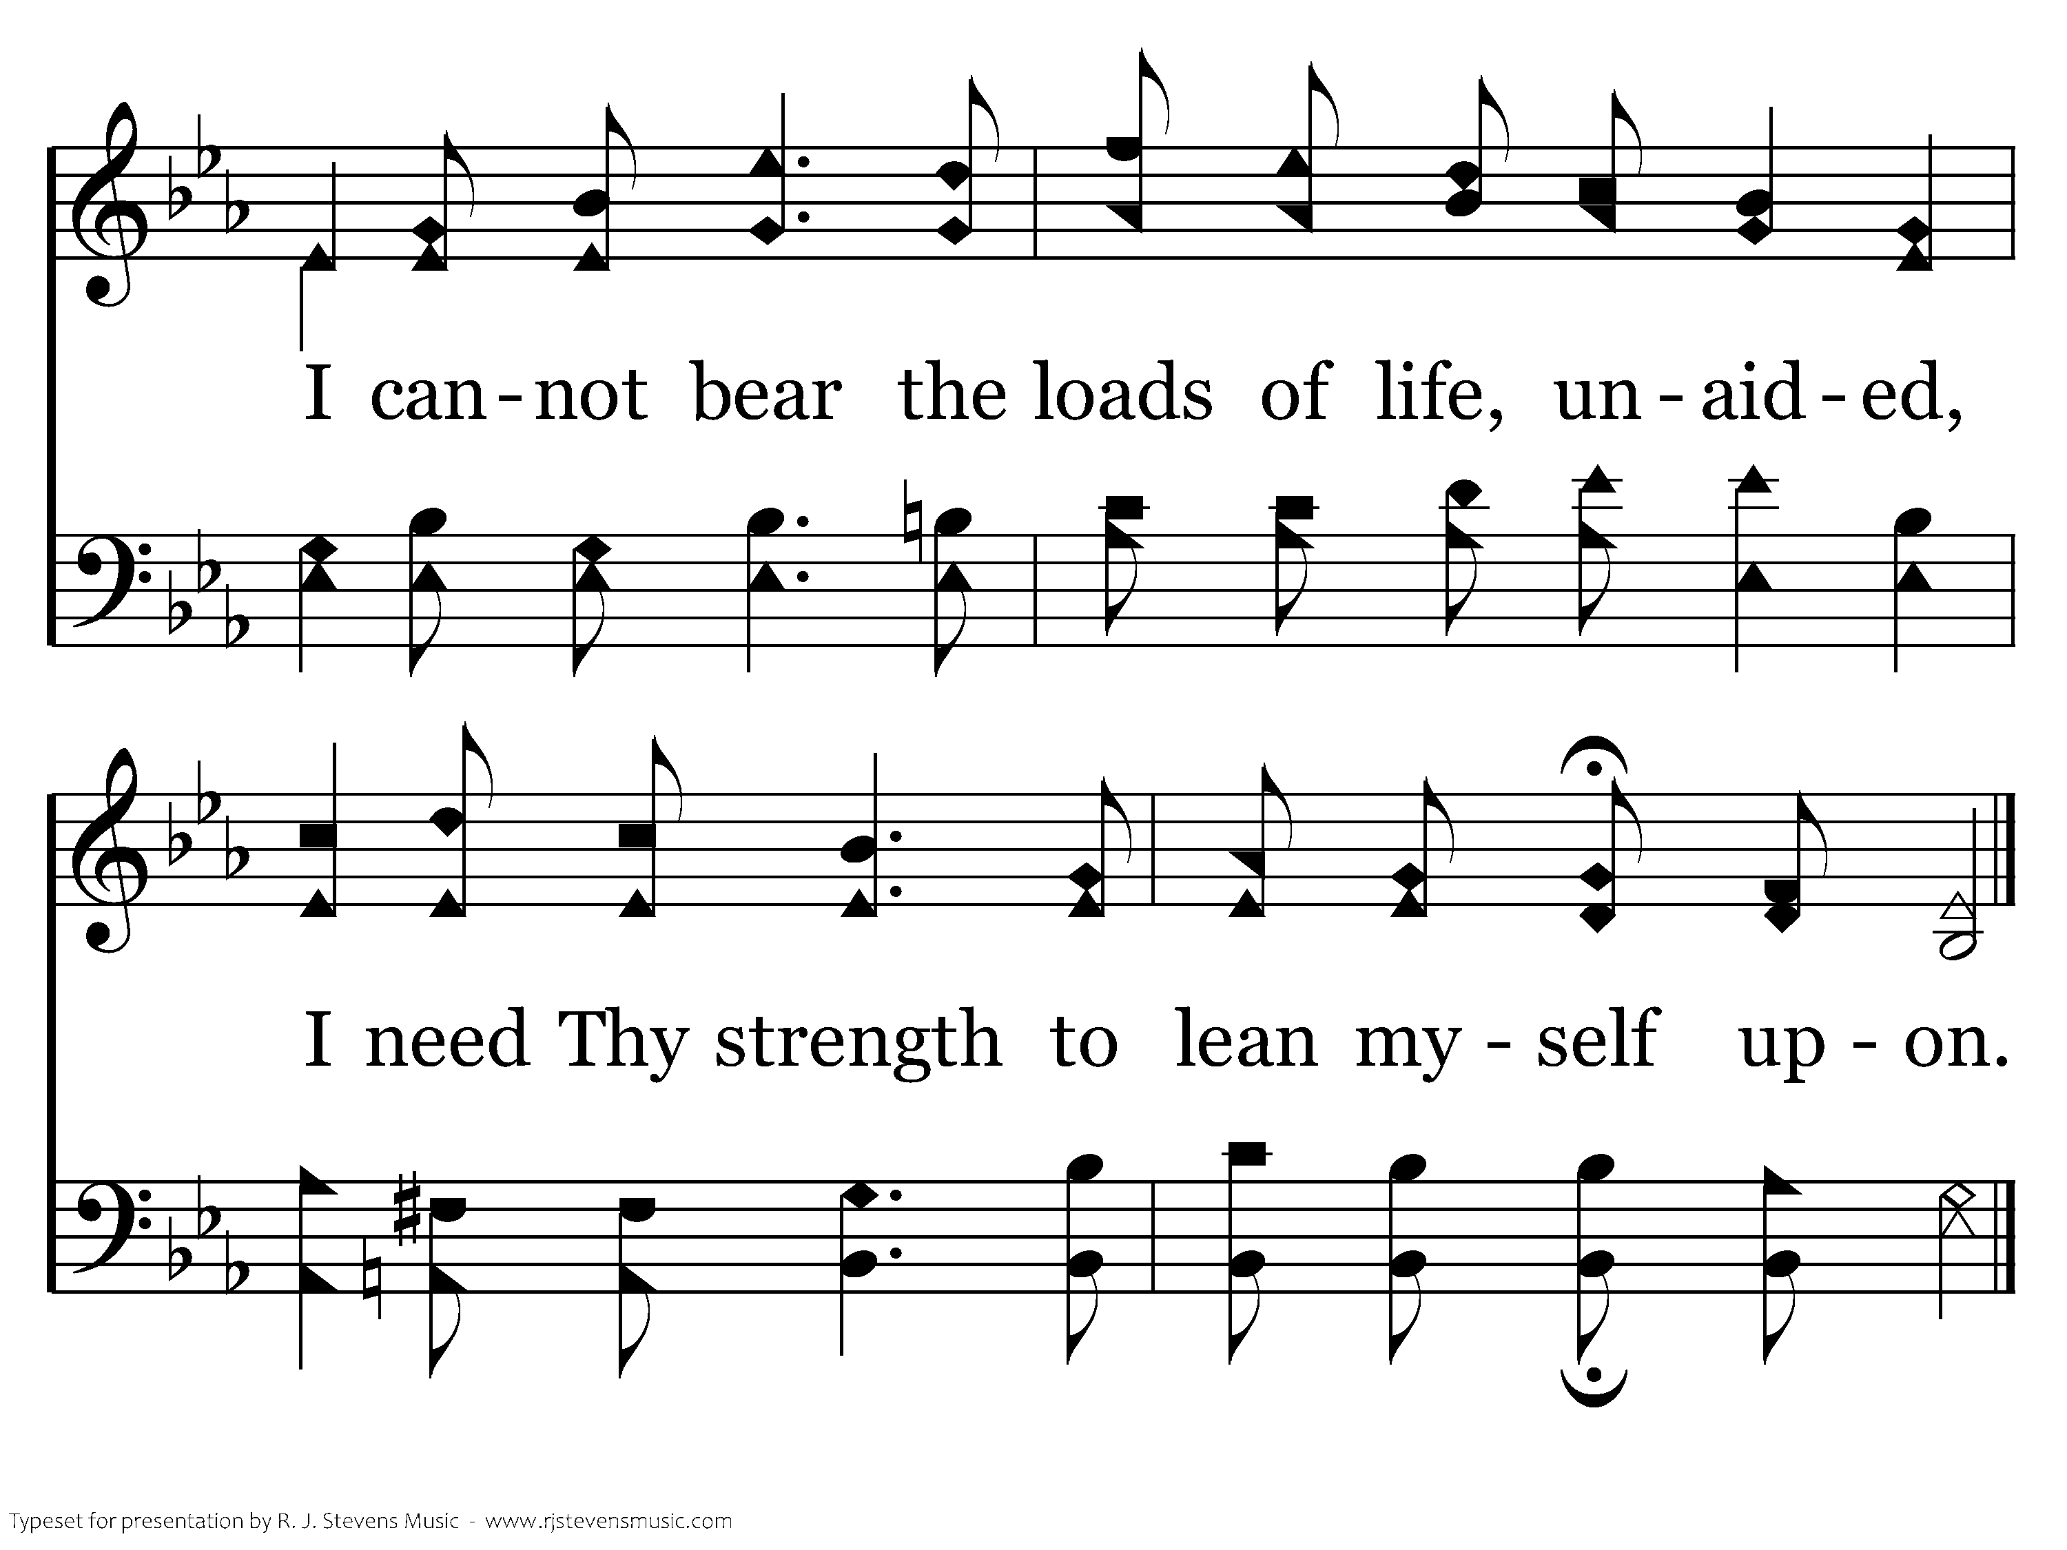
072 - Be With Me, Lord - 1.2
End of Verse 1

Slide 5
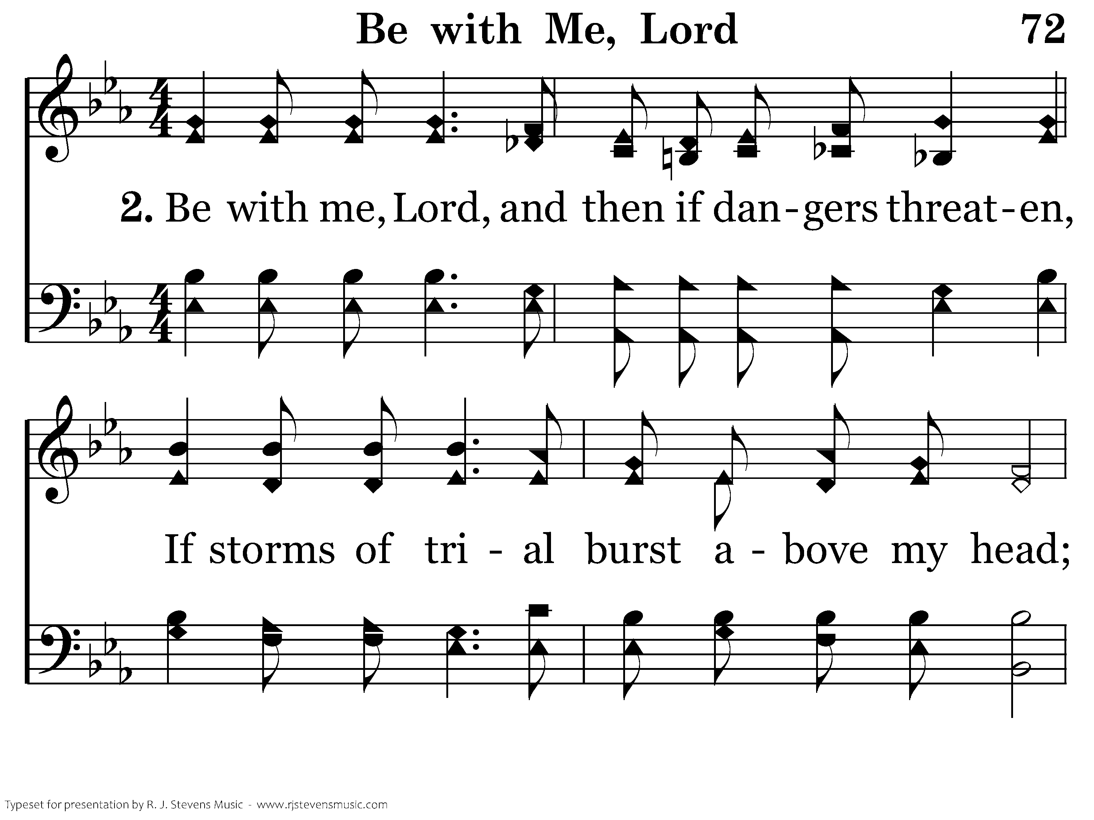
072 - Be With Me, Lord - 2.1

Slide 6
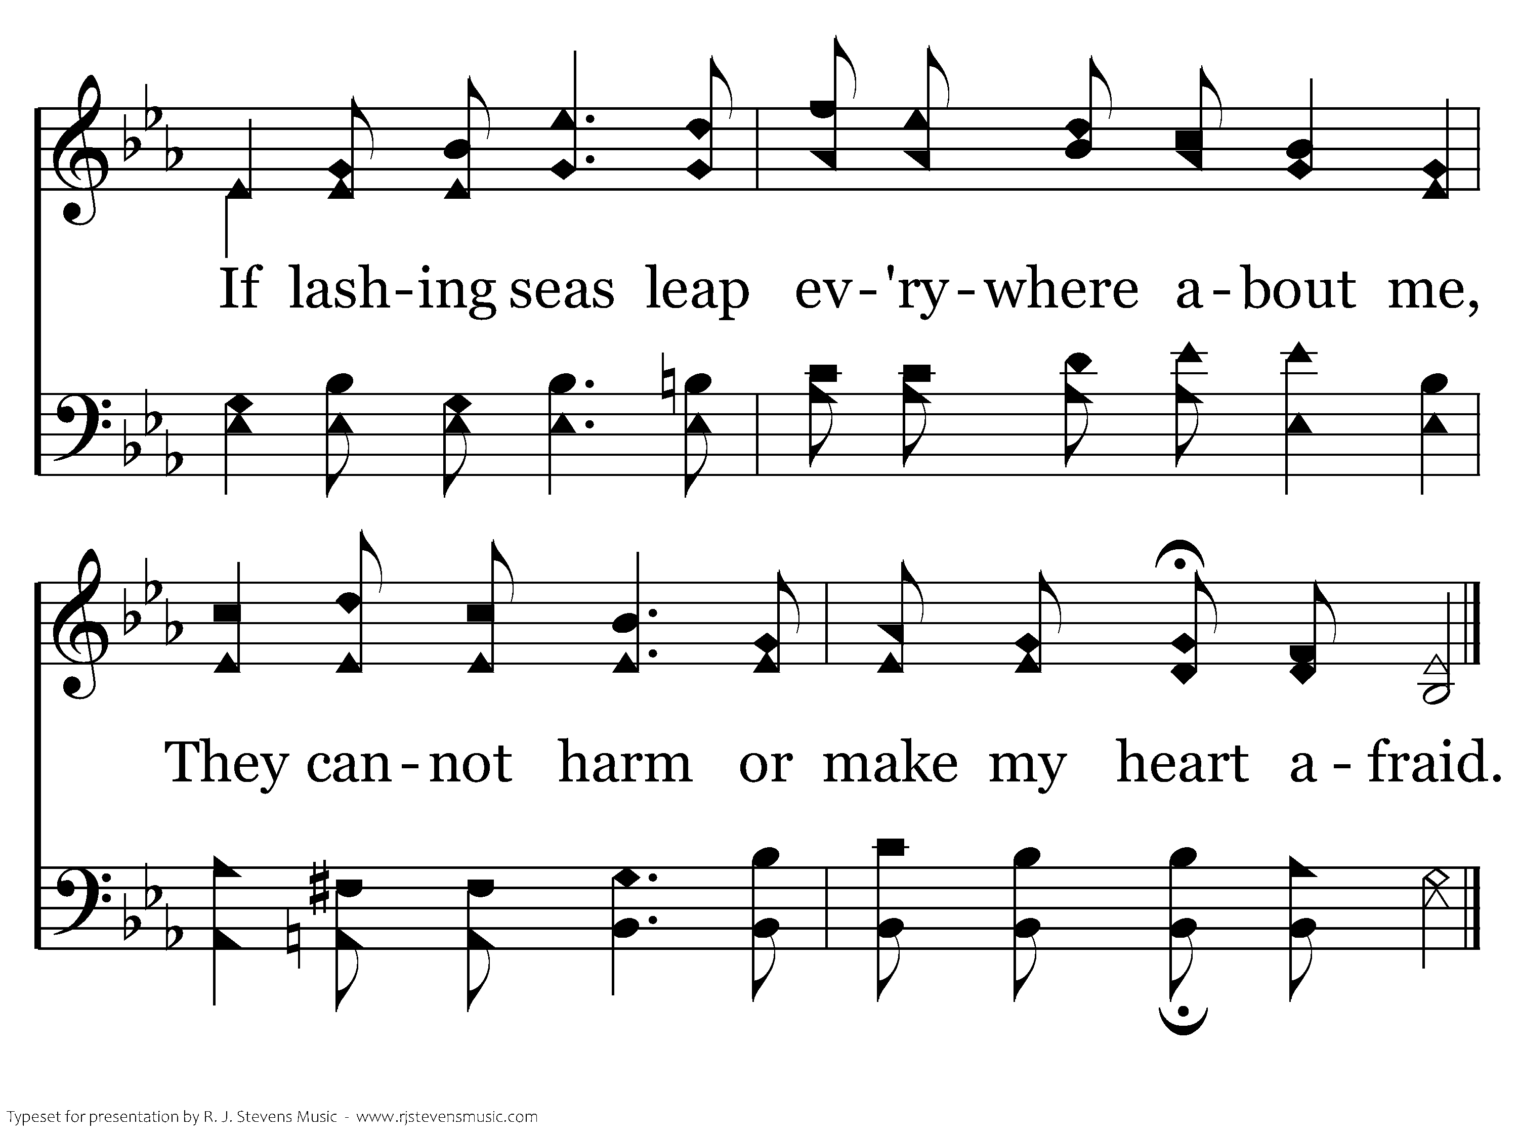
072 - Be With Me, Lord - 2.2
End of Verse 2

Slide 7
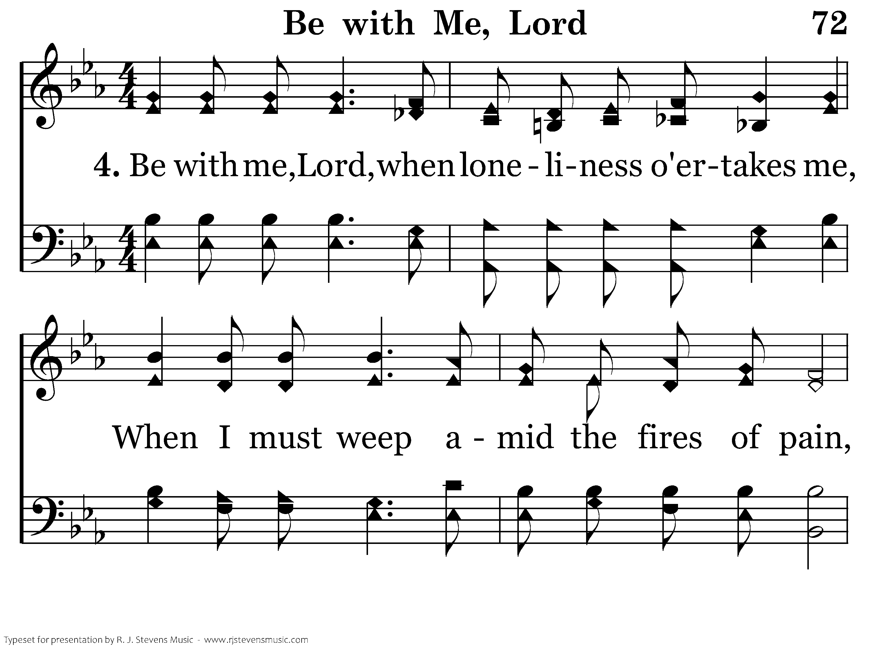
072 - Be With Me, Lord - 4.1

Slide 8
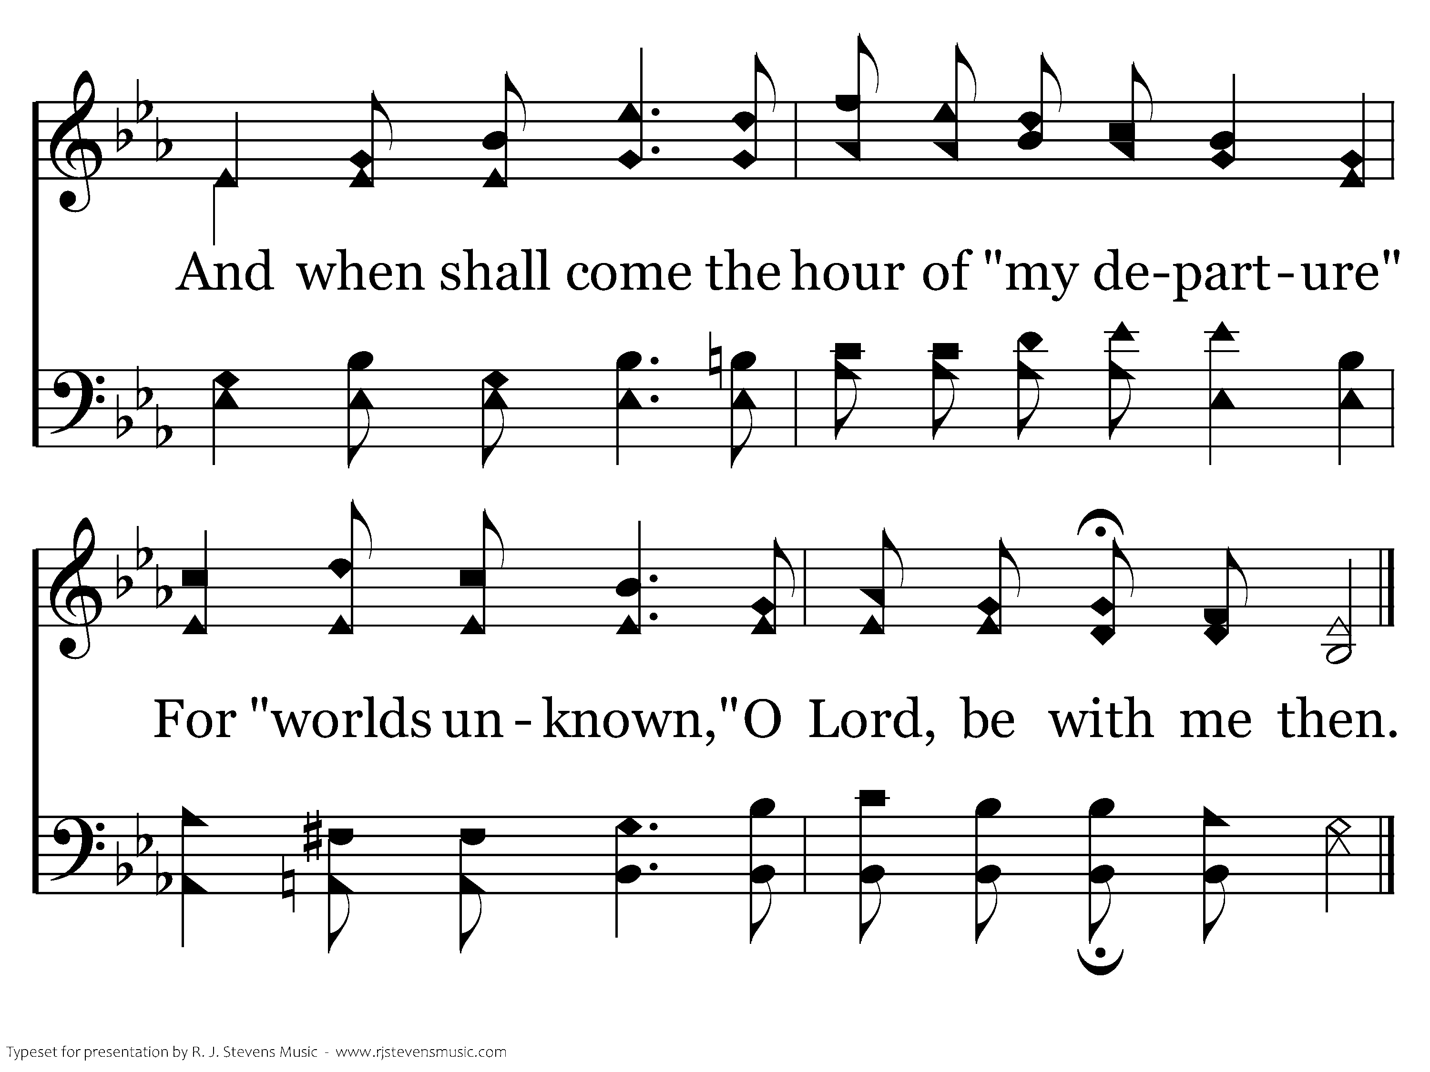
072 - Be With Me, Lord - 4.2
End of Song

Slide 10
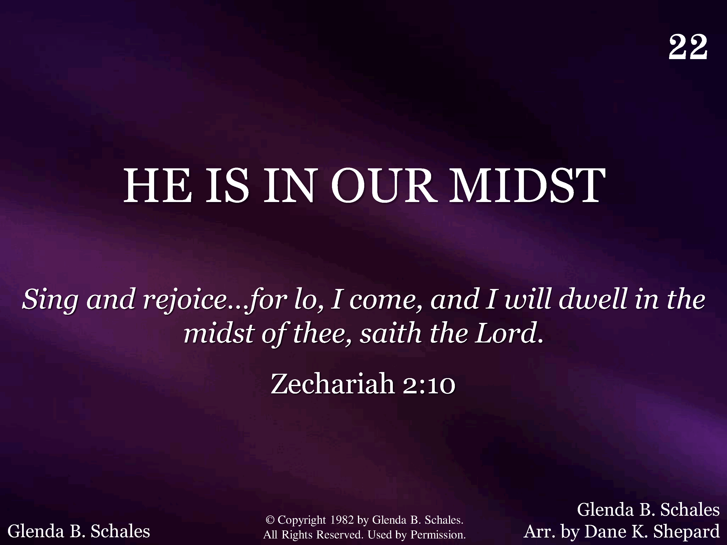
022 - He Is In Our Midst - Title

Slide 11
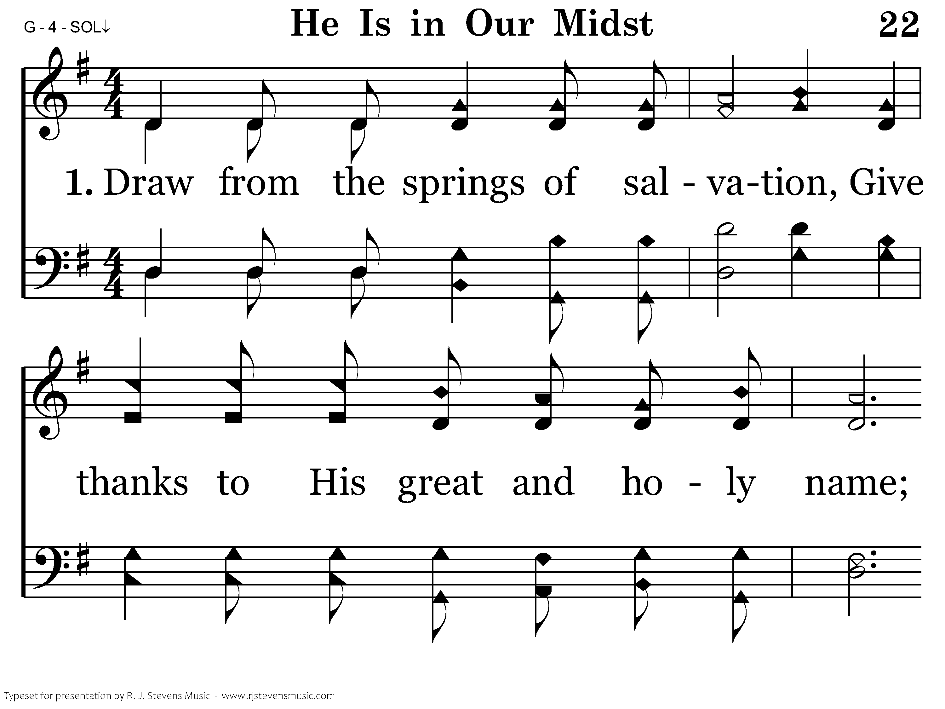
022 - He Is In Our Midst - 1.1

Slide 12
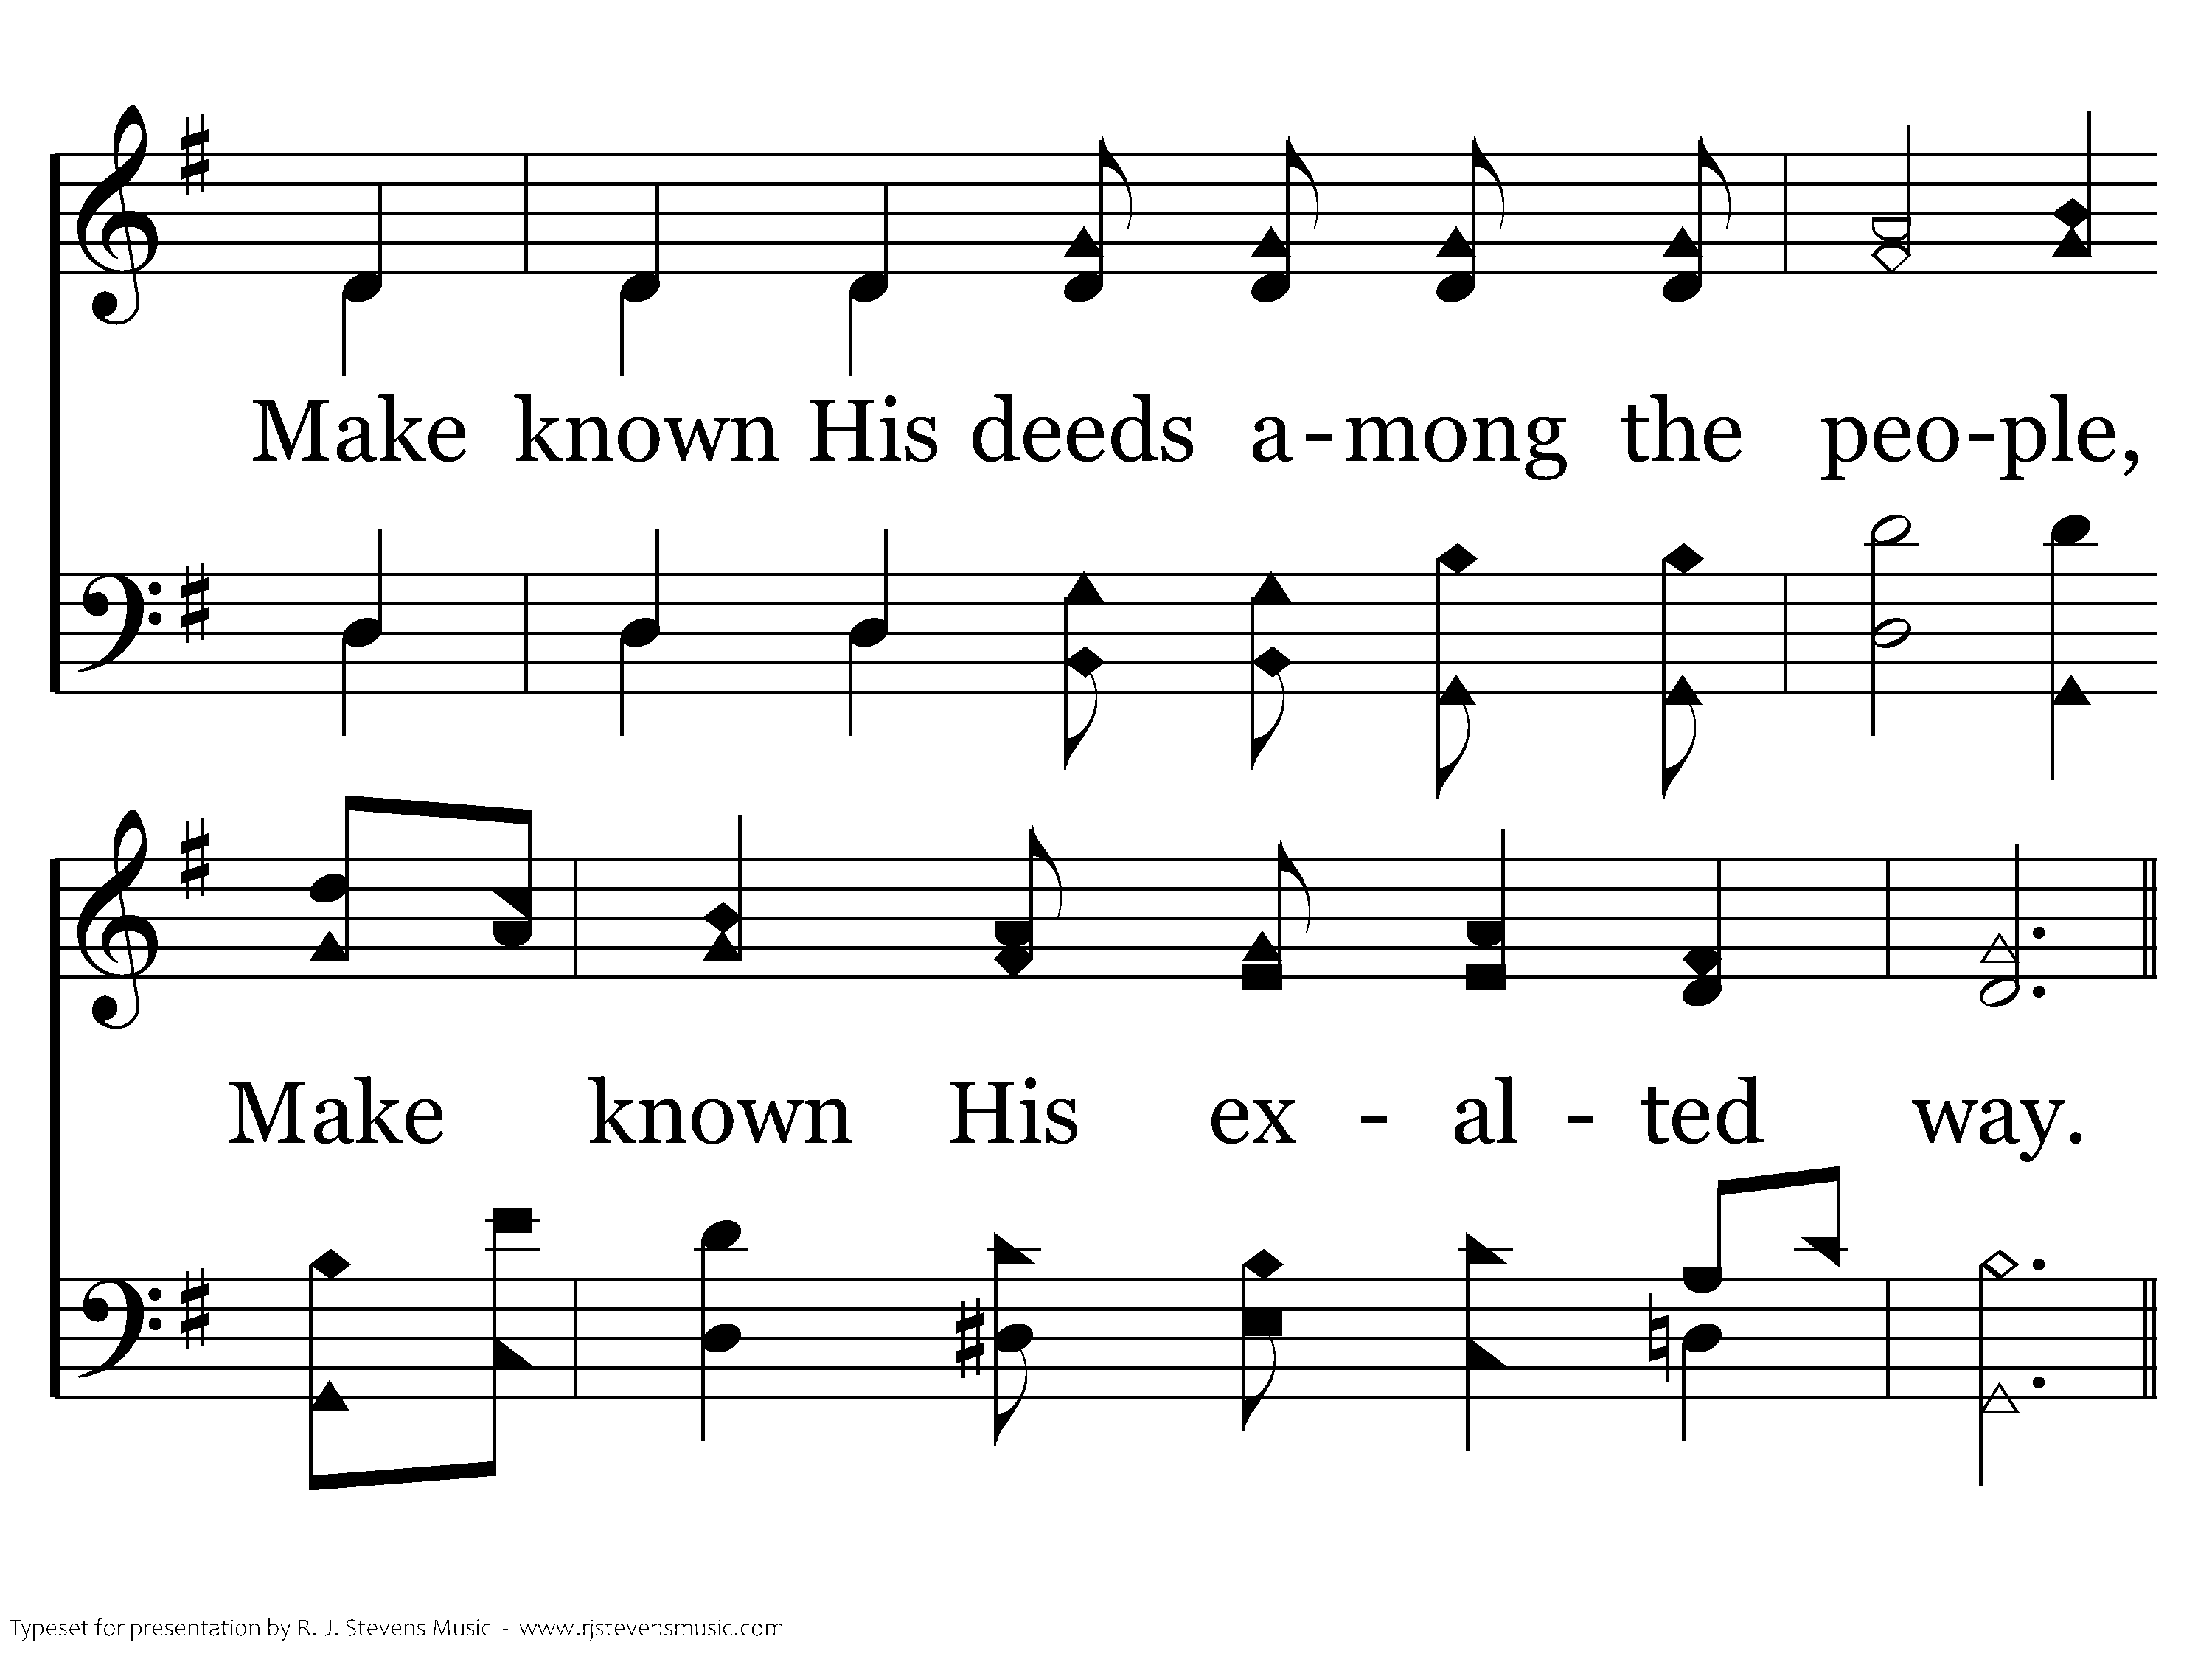
022 - He Is In Our Midst - 1.2

Slide 13
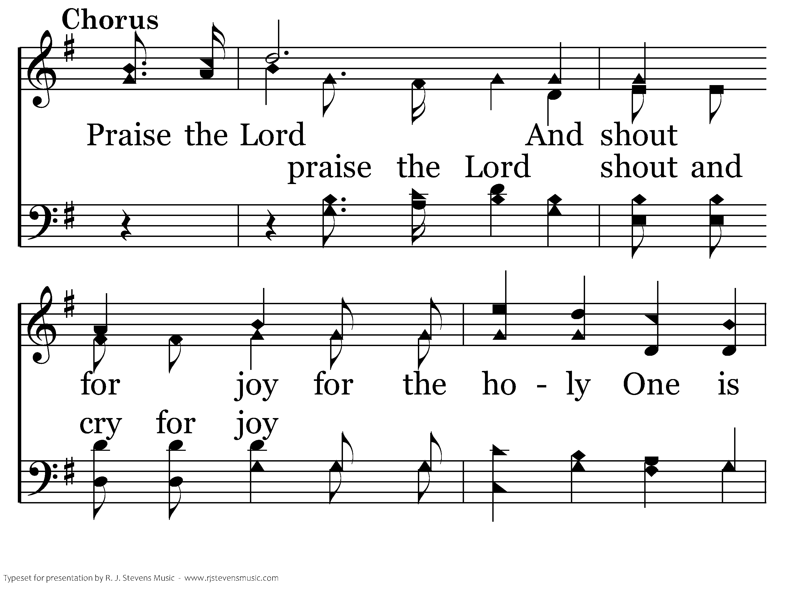
022 - He Is In Our Midst - C.1

Slide 14
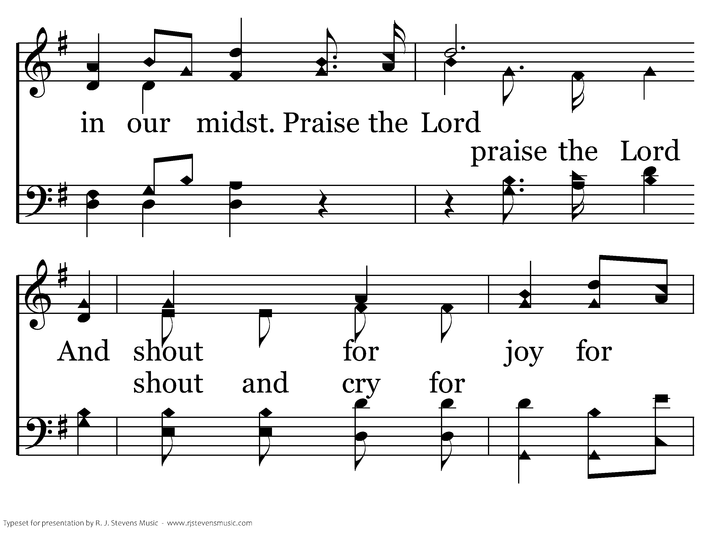
022 - He Is In Our Midst - C.2

Slide 15
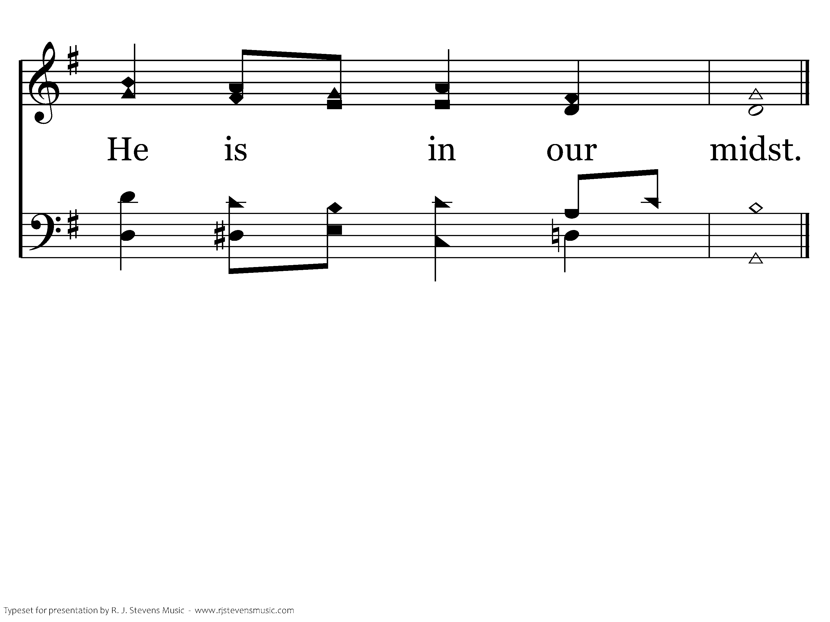
022 - He Is In Our Midst - C.3
End of Verse 1

Slide 16
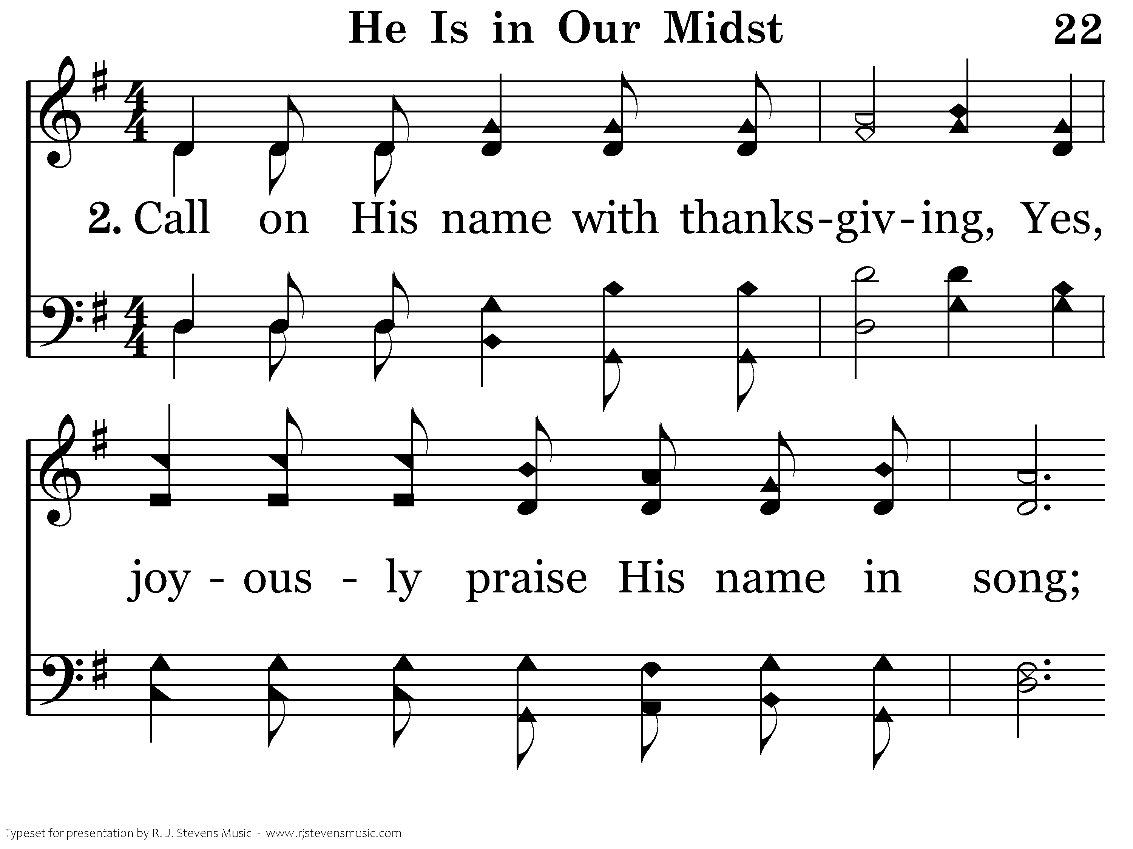
022 - He Is In Our Midst - 2.1

Slide 17
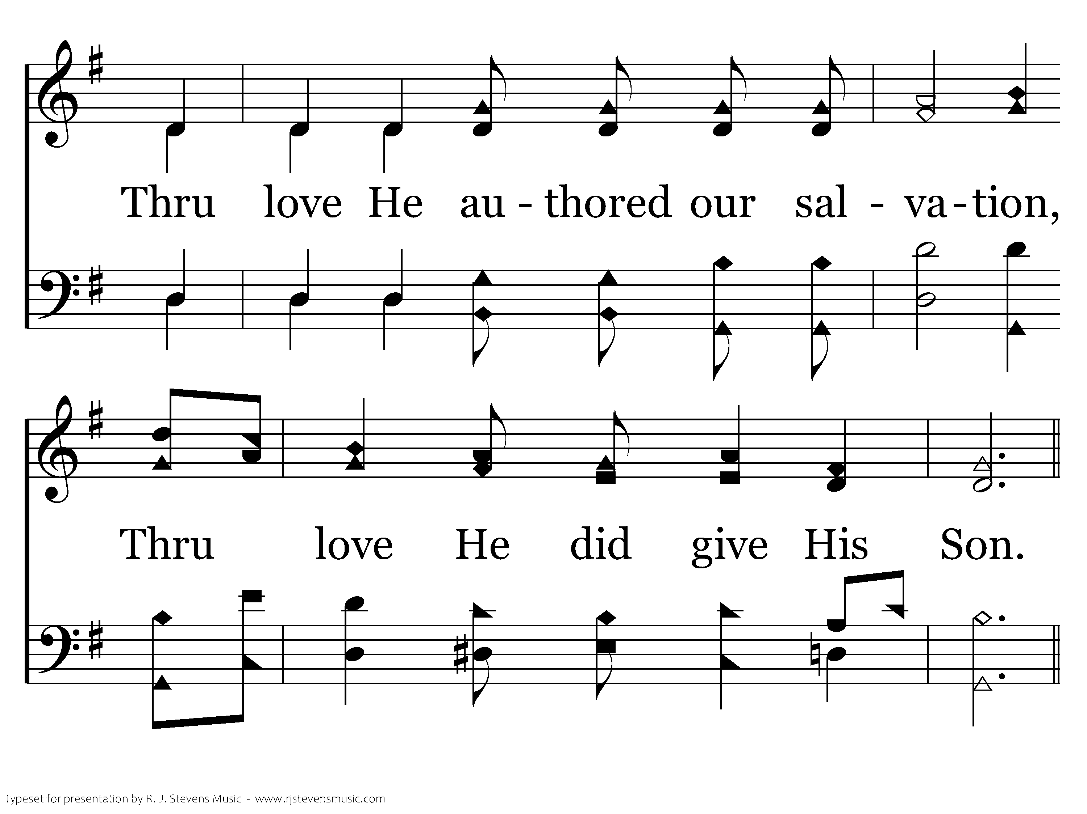
022 - He Is In Our Midst - 2.2

Slide 18
022 - He Is In Our Midst - C.1

Slide 19
022 - He Is In Our Midst - C.2

Slide 20
022 - He Is In Our Midst - C.3
End of Song

Slide 22
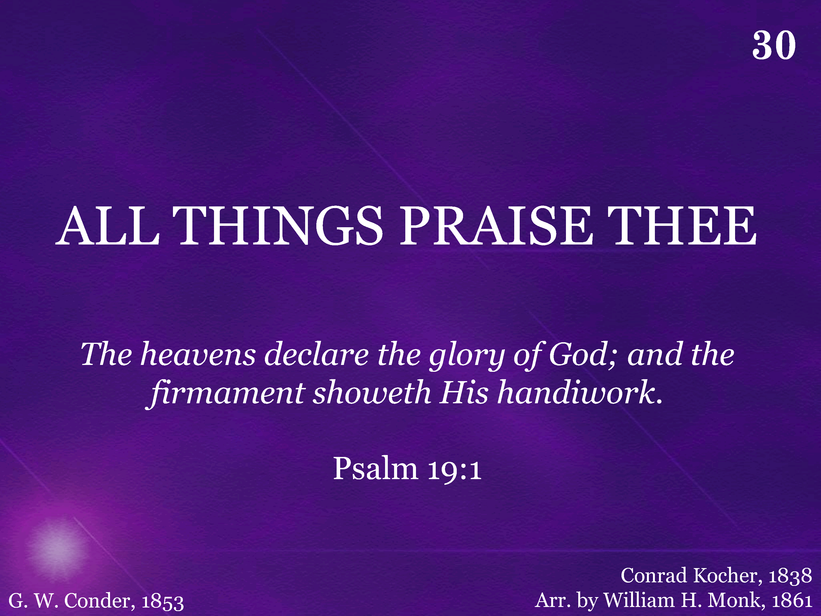
030 - All Things Praise Thee - Title

Slide 23
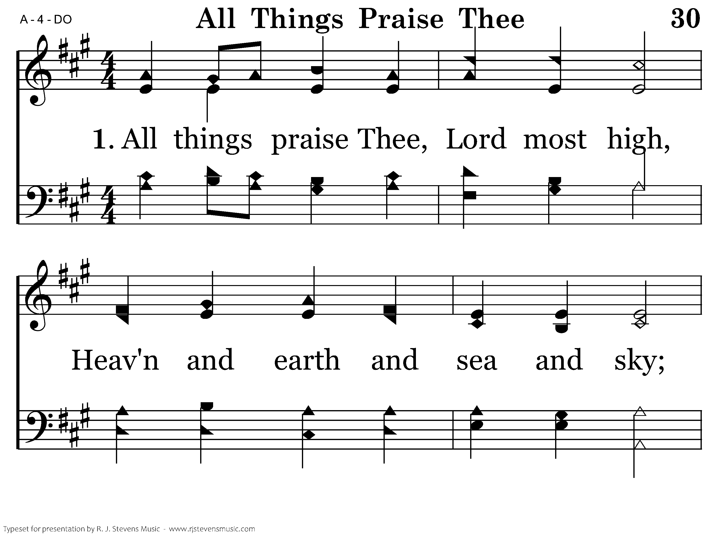
030 - All Things Praise Thee - 1.1

Slide 24
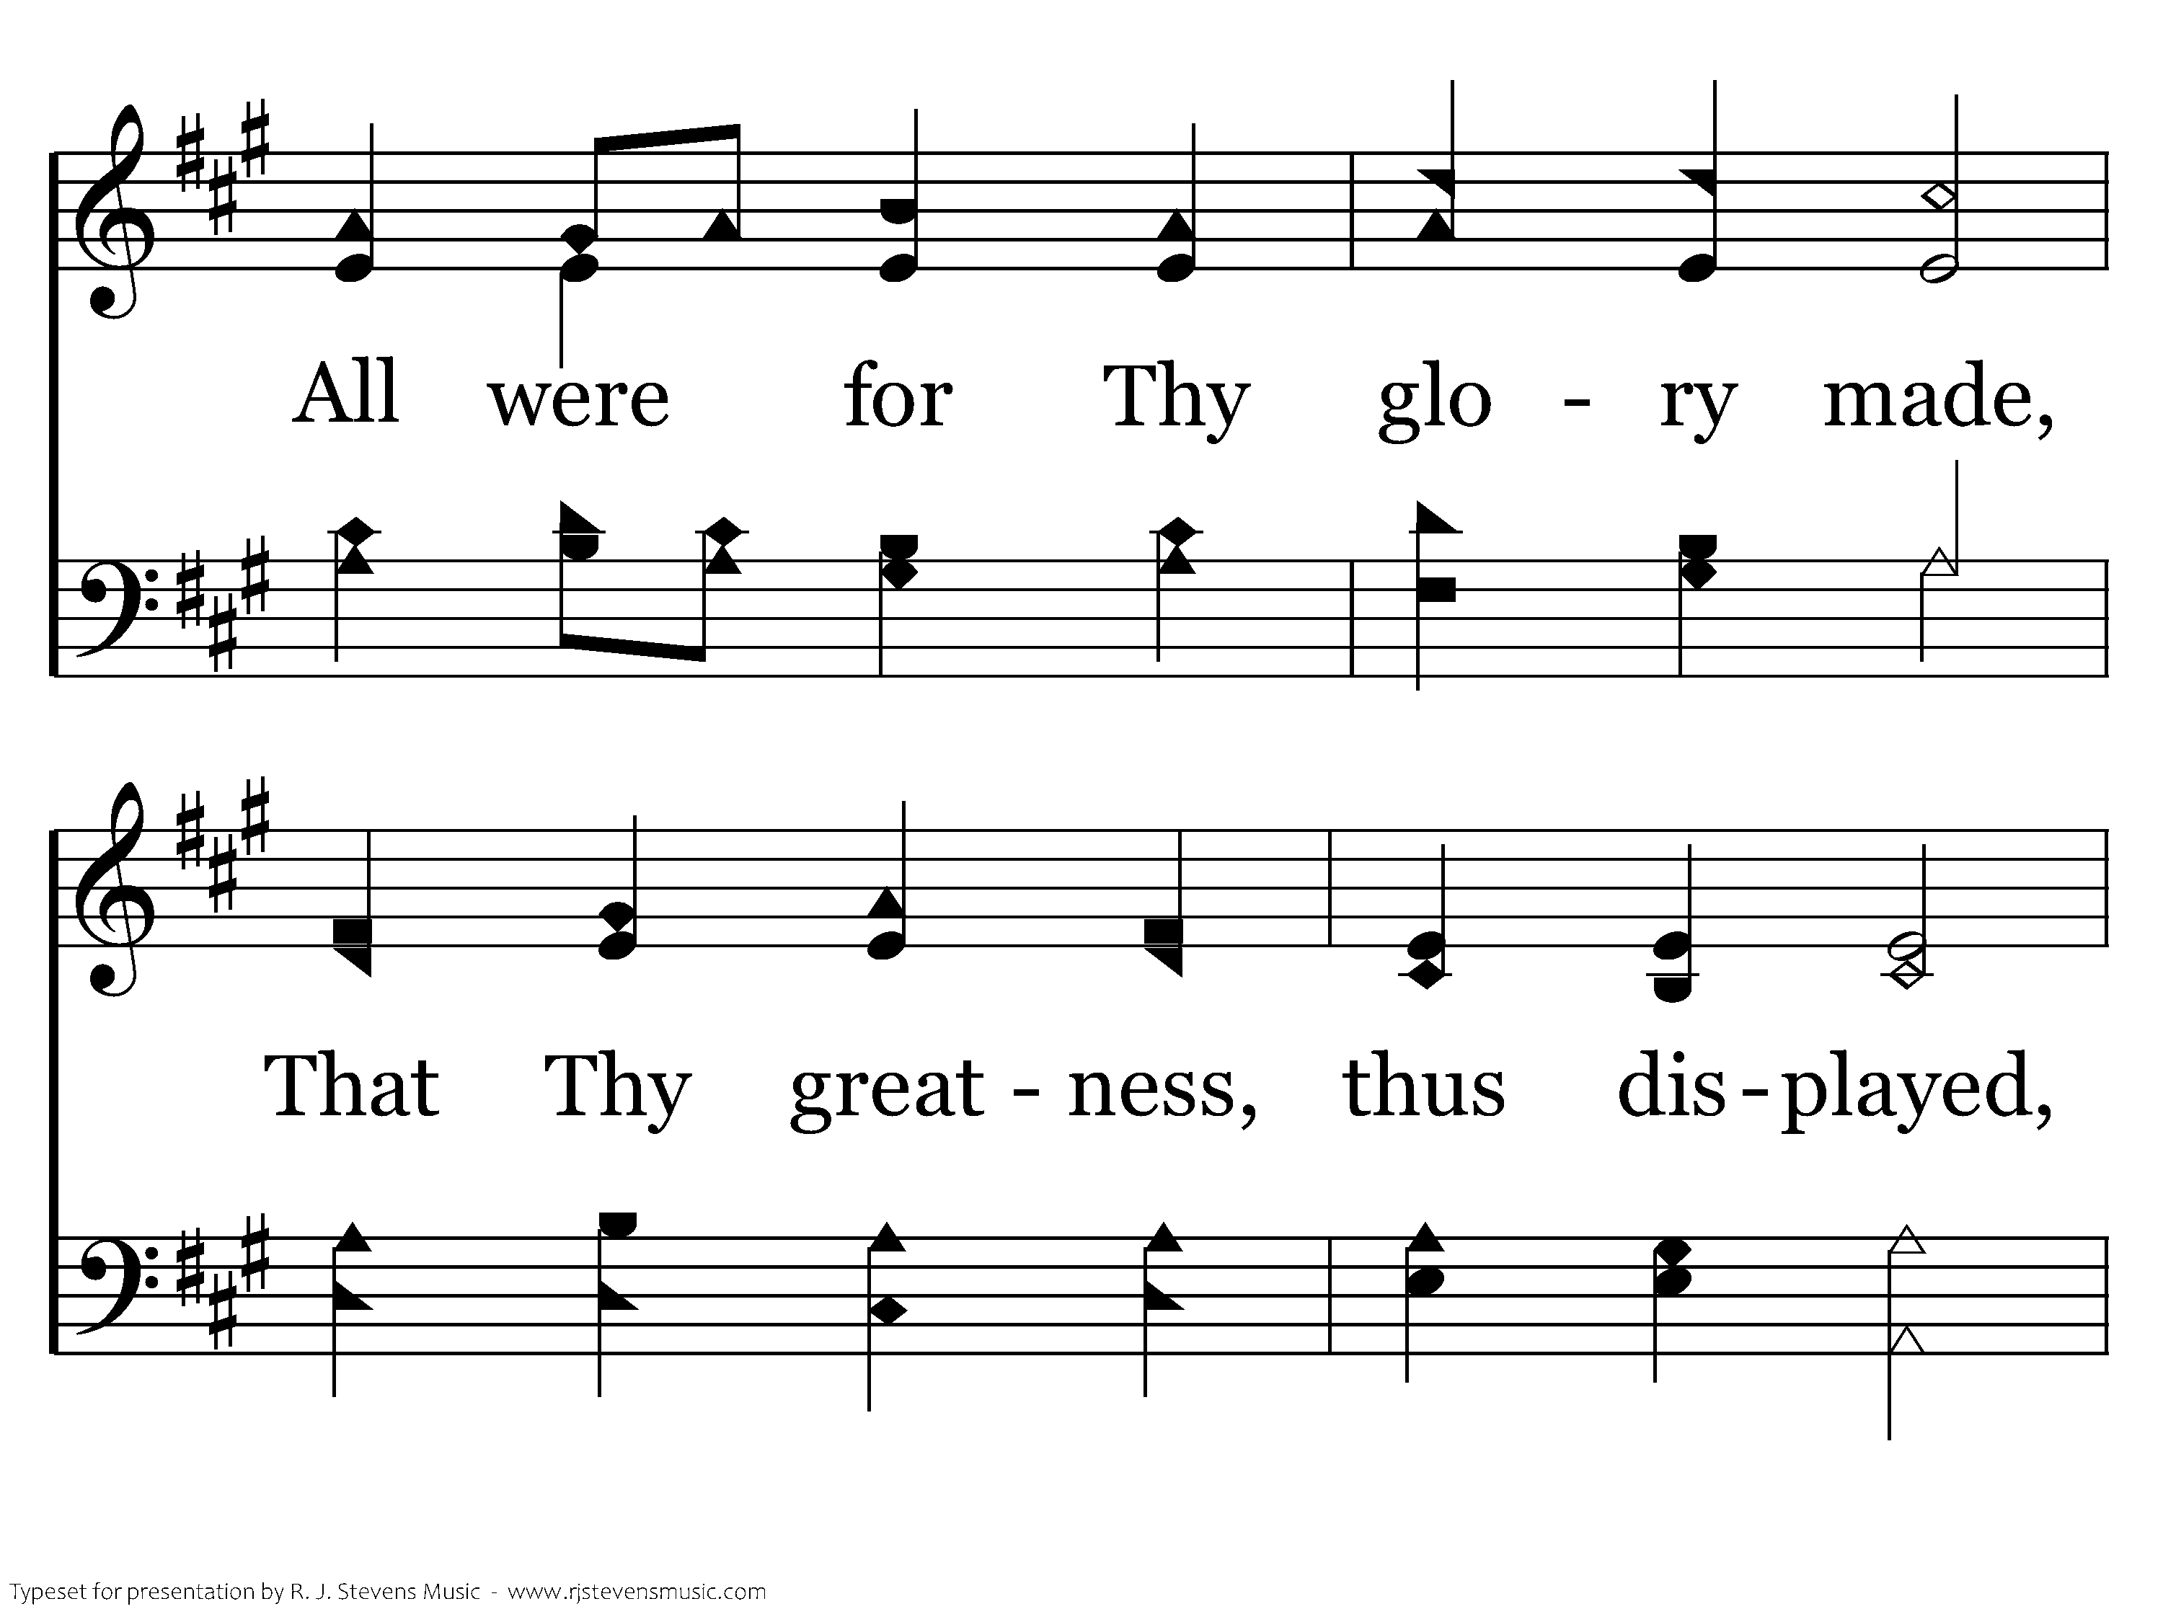
030 - All Things Praise Thee - 1.2

Slide 25
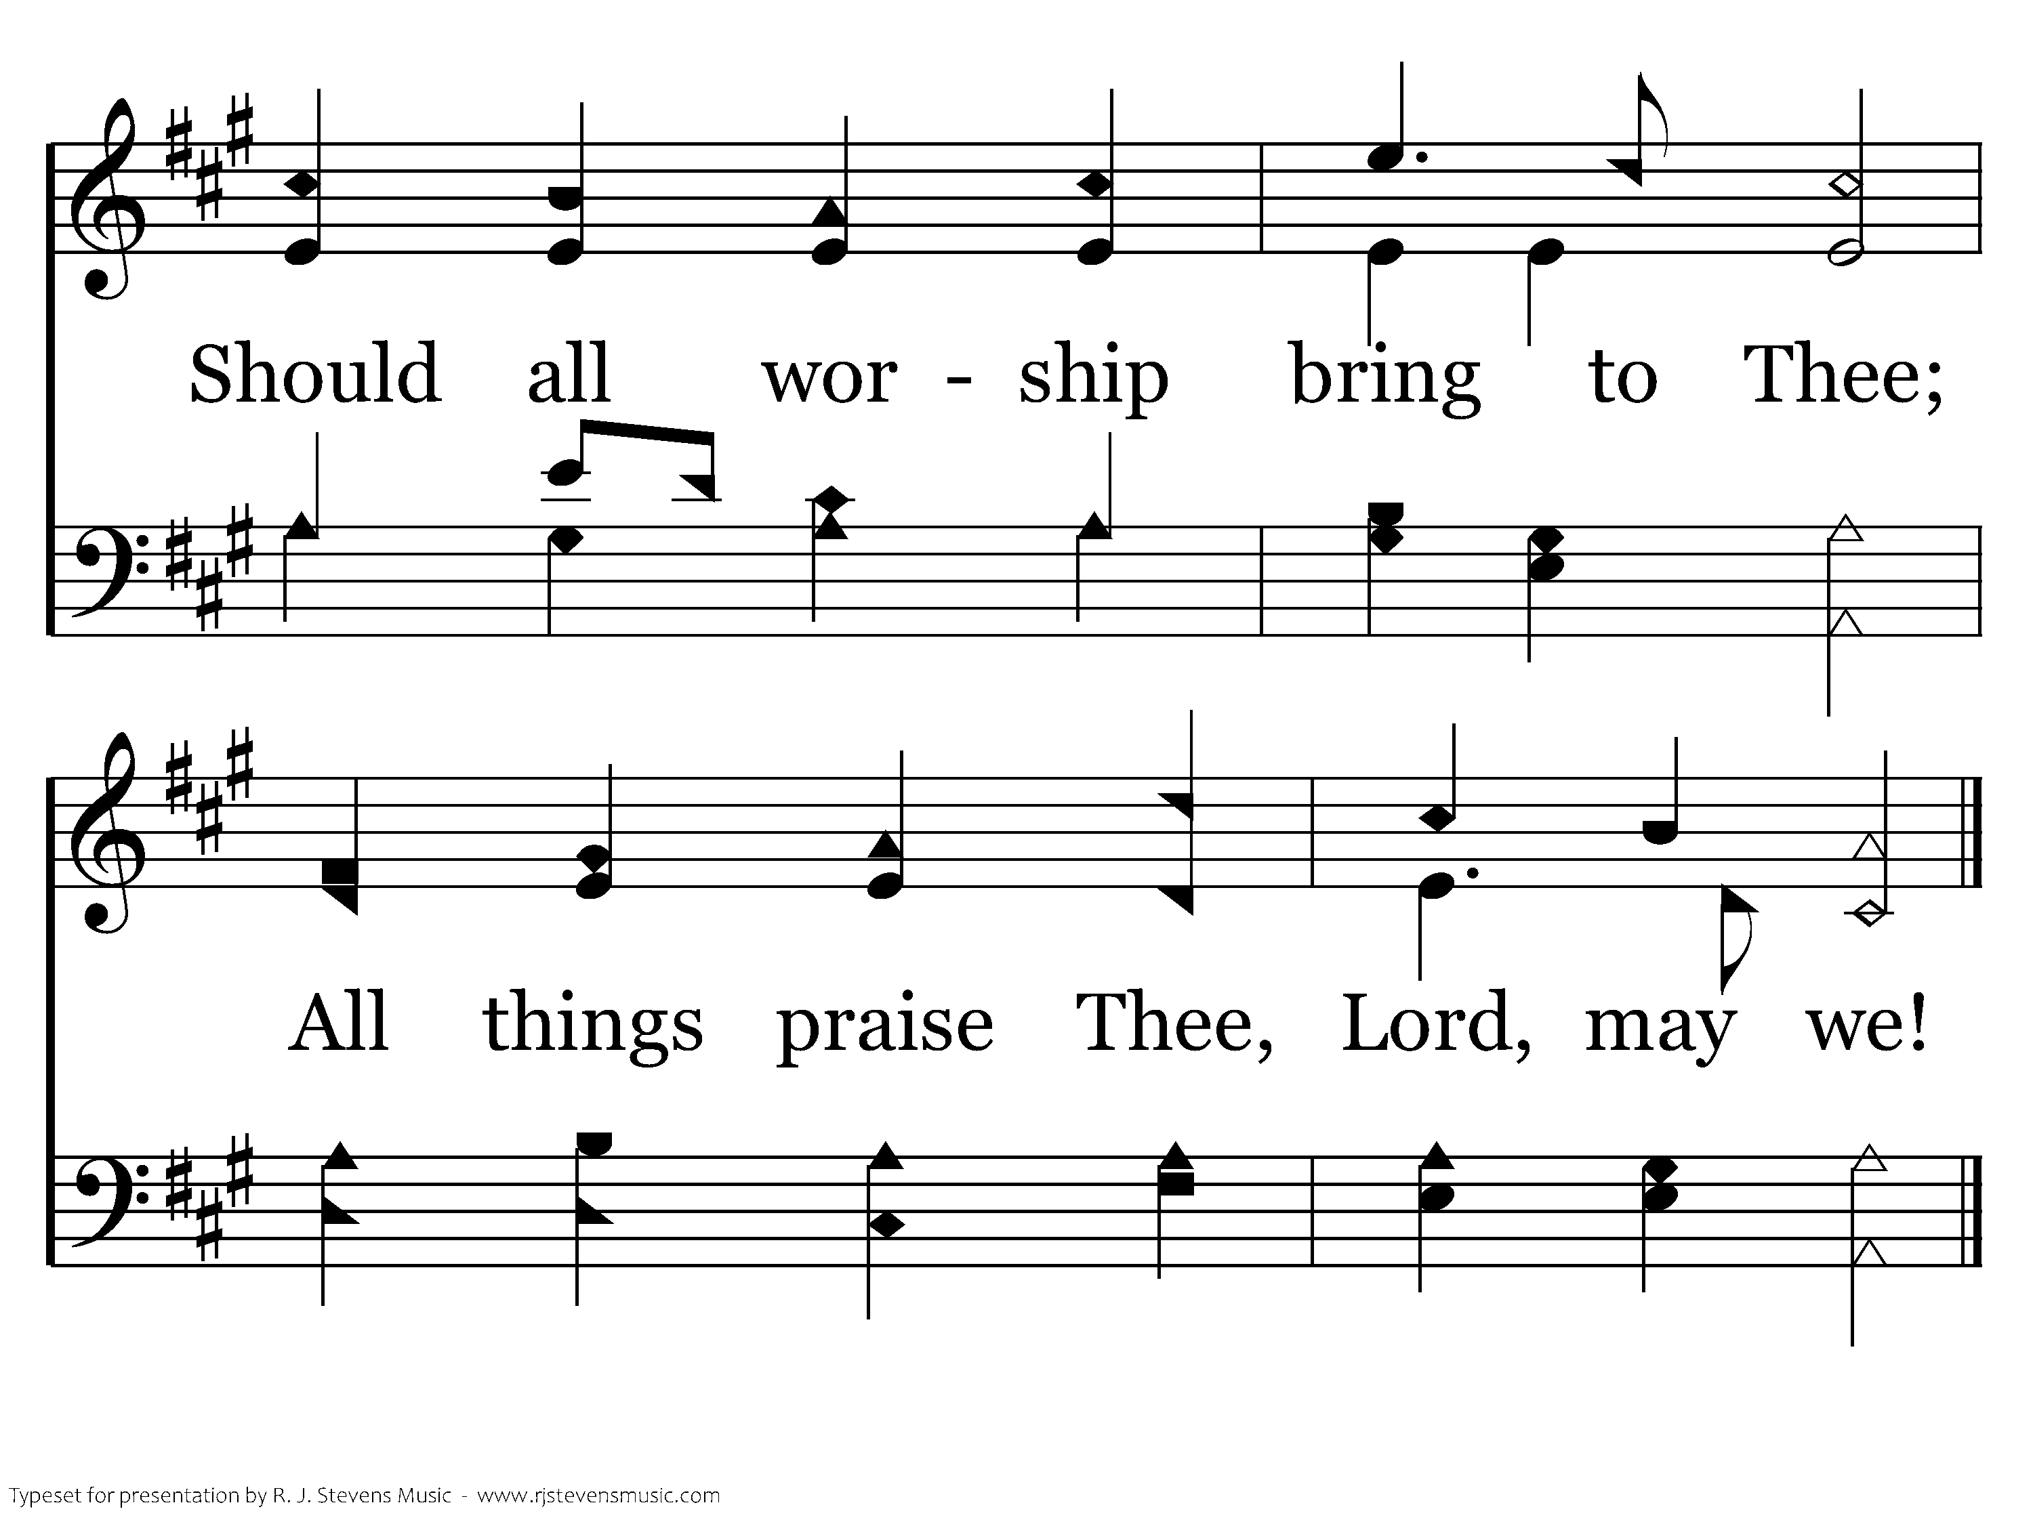
030 - All Things Praise Thee - 1.3
End of Verse 1

Slide 26
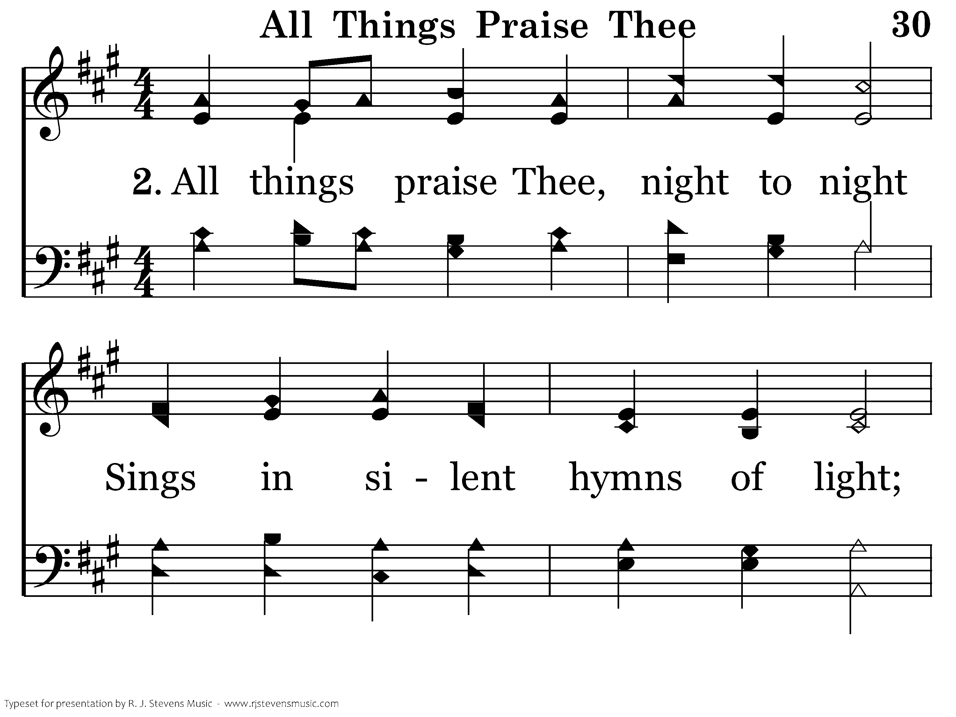
030 - All Things Praise Thee - 2.1

Slide 27
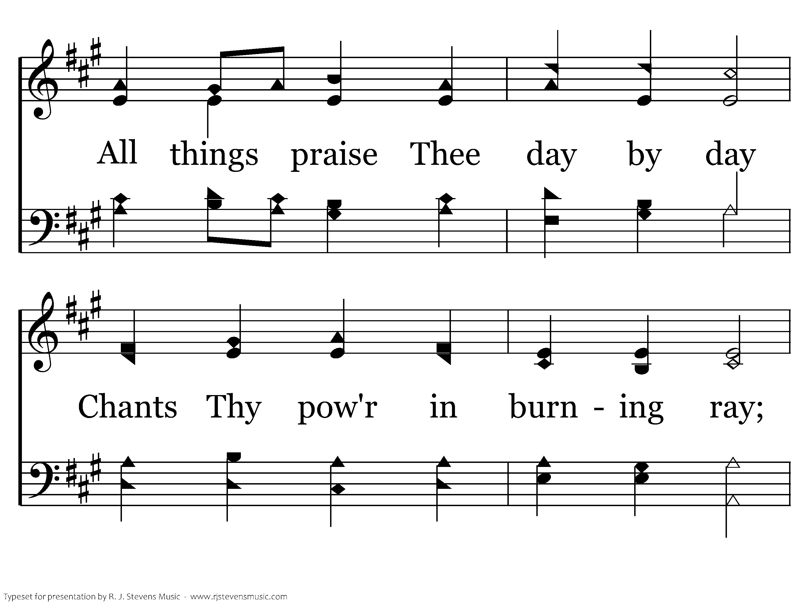
030 - All Things Praise Thee - 2.2

Slide 28
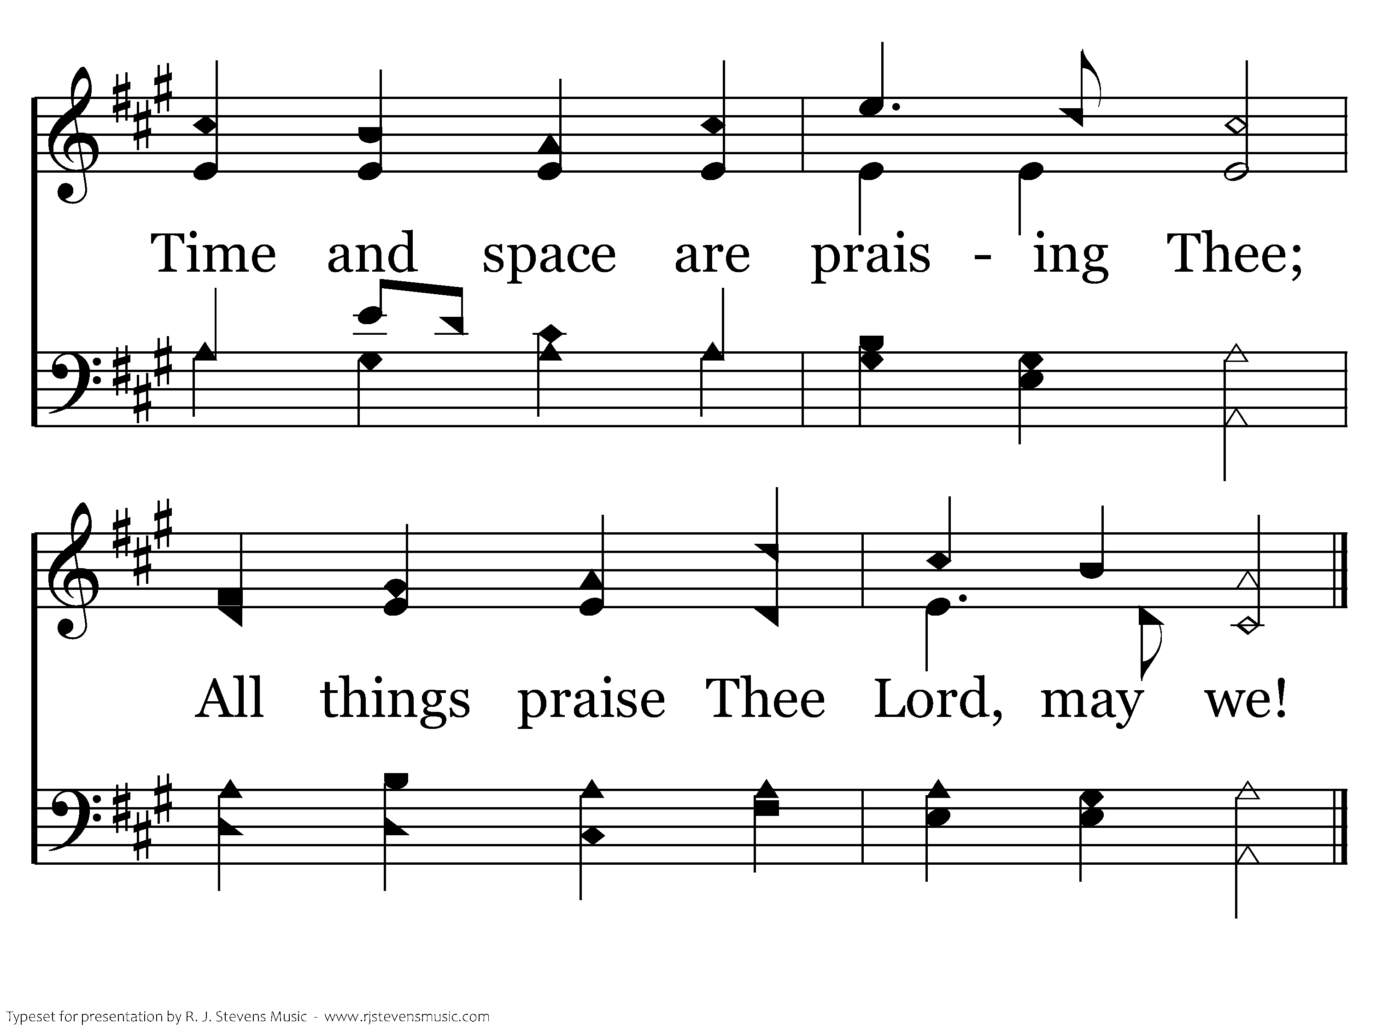
030 - All Things Praise Thee - 2.3
End of Verse 2

Slide 29
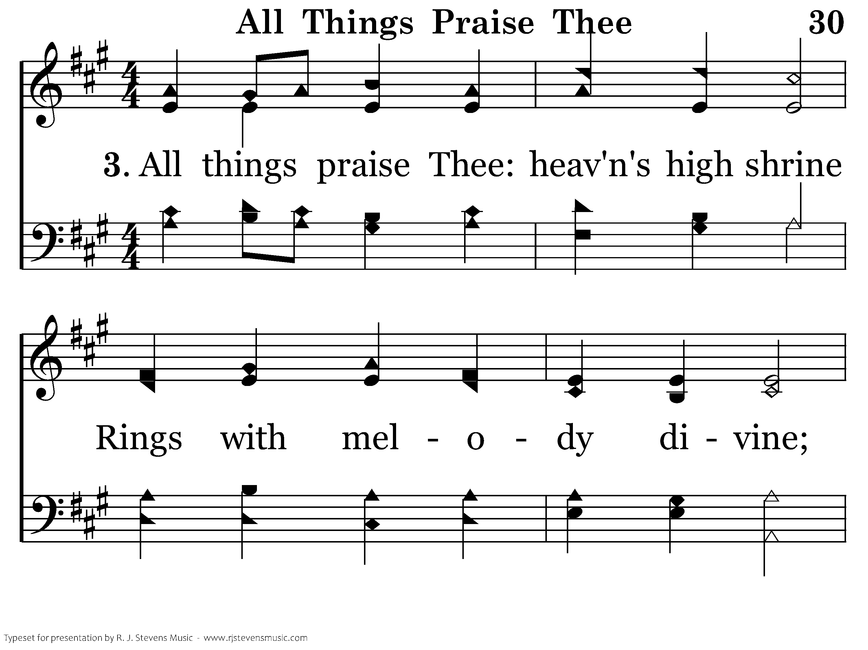
030 - All Things Praise Thee - 3.1

Slide 30
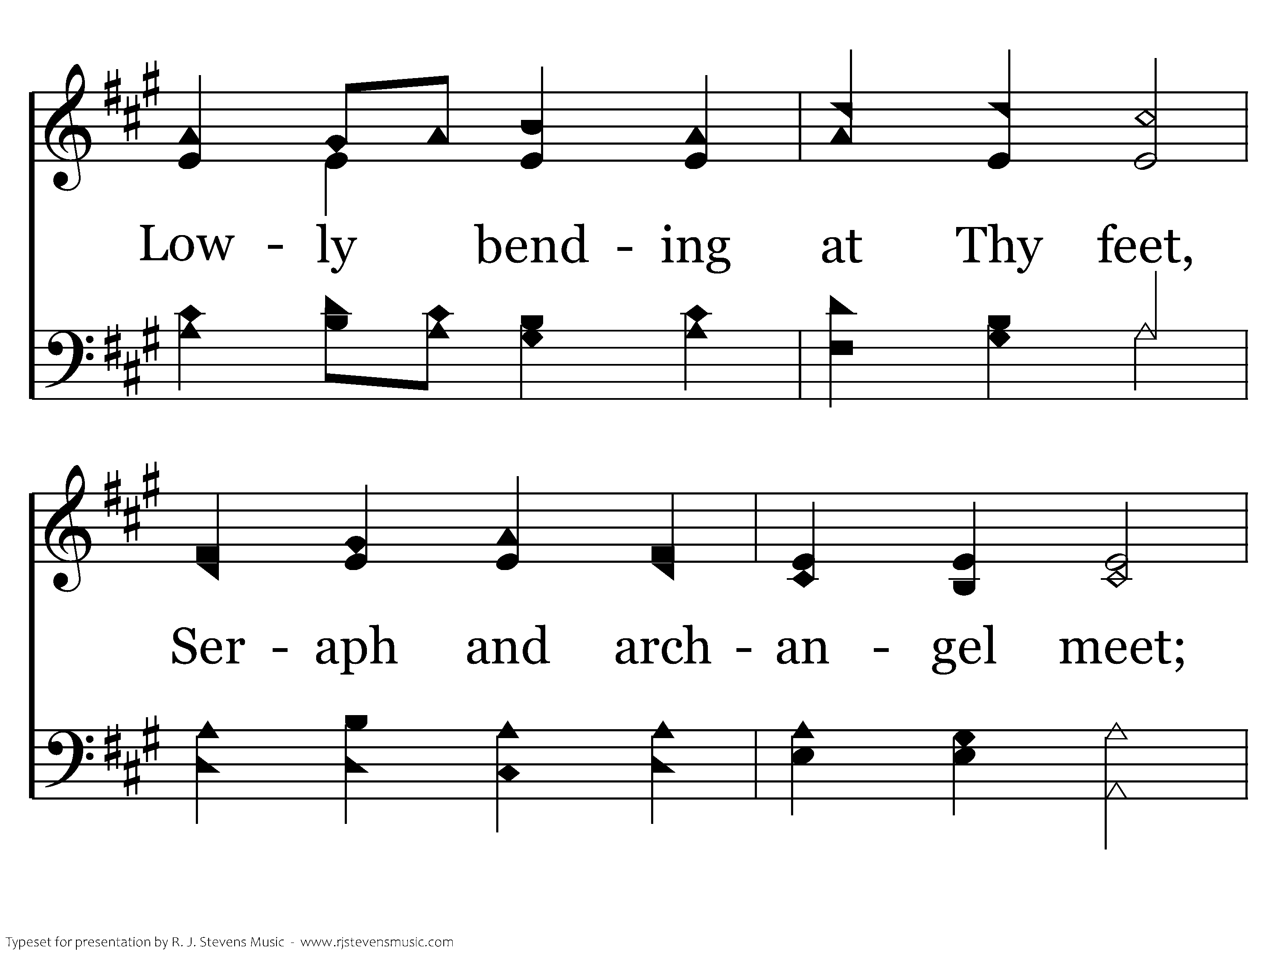
030 - All Things Praise Thee - 3.2

Slide 31
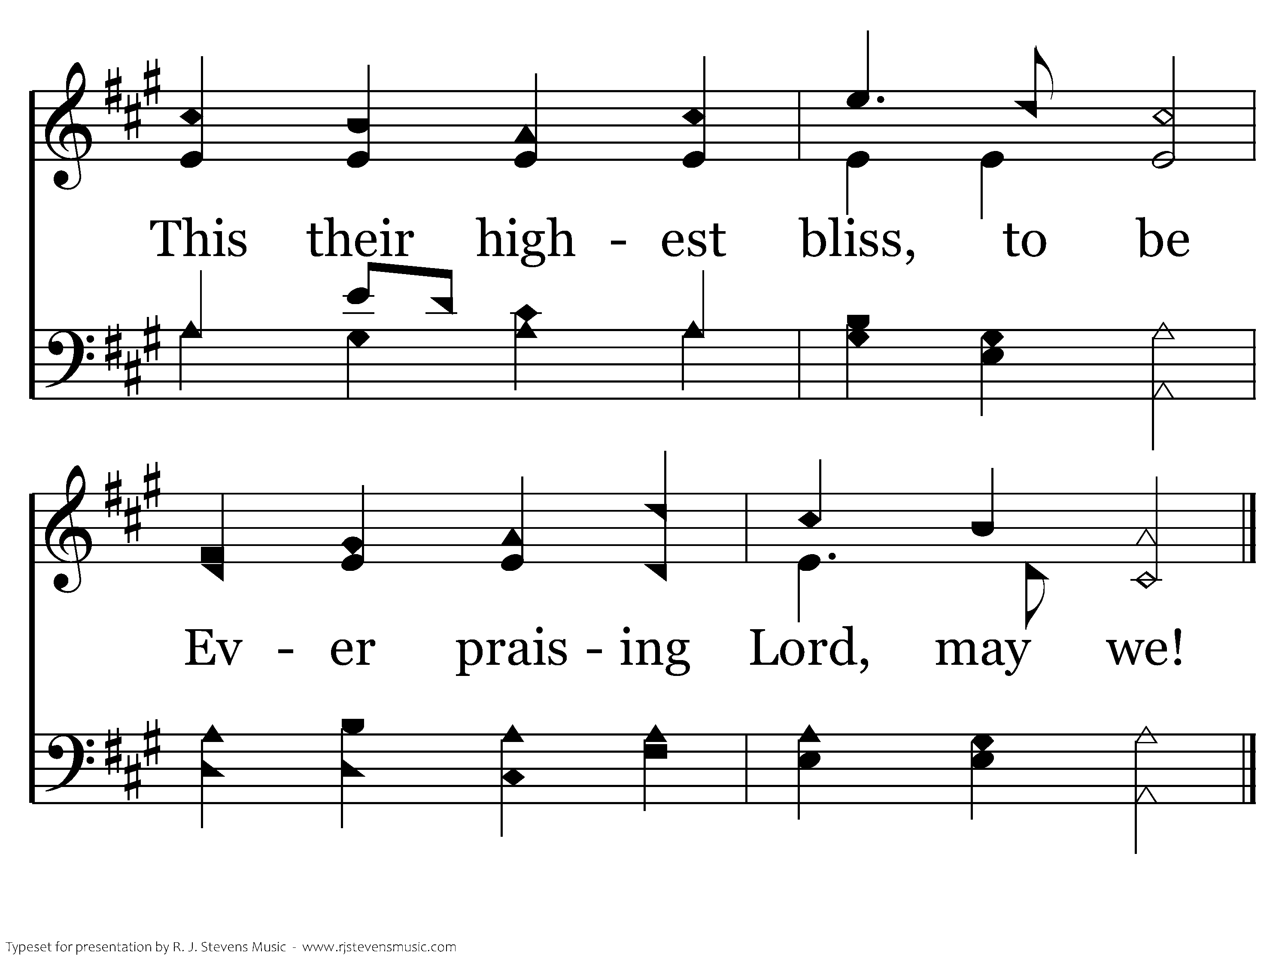
030 - All Things Praise Thee - 3.3
End of Song

Slide 33
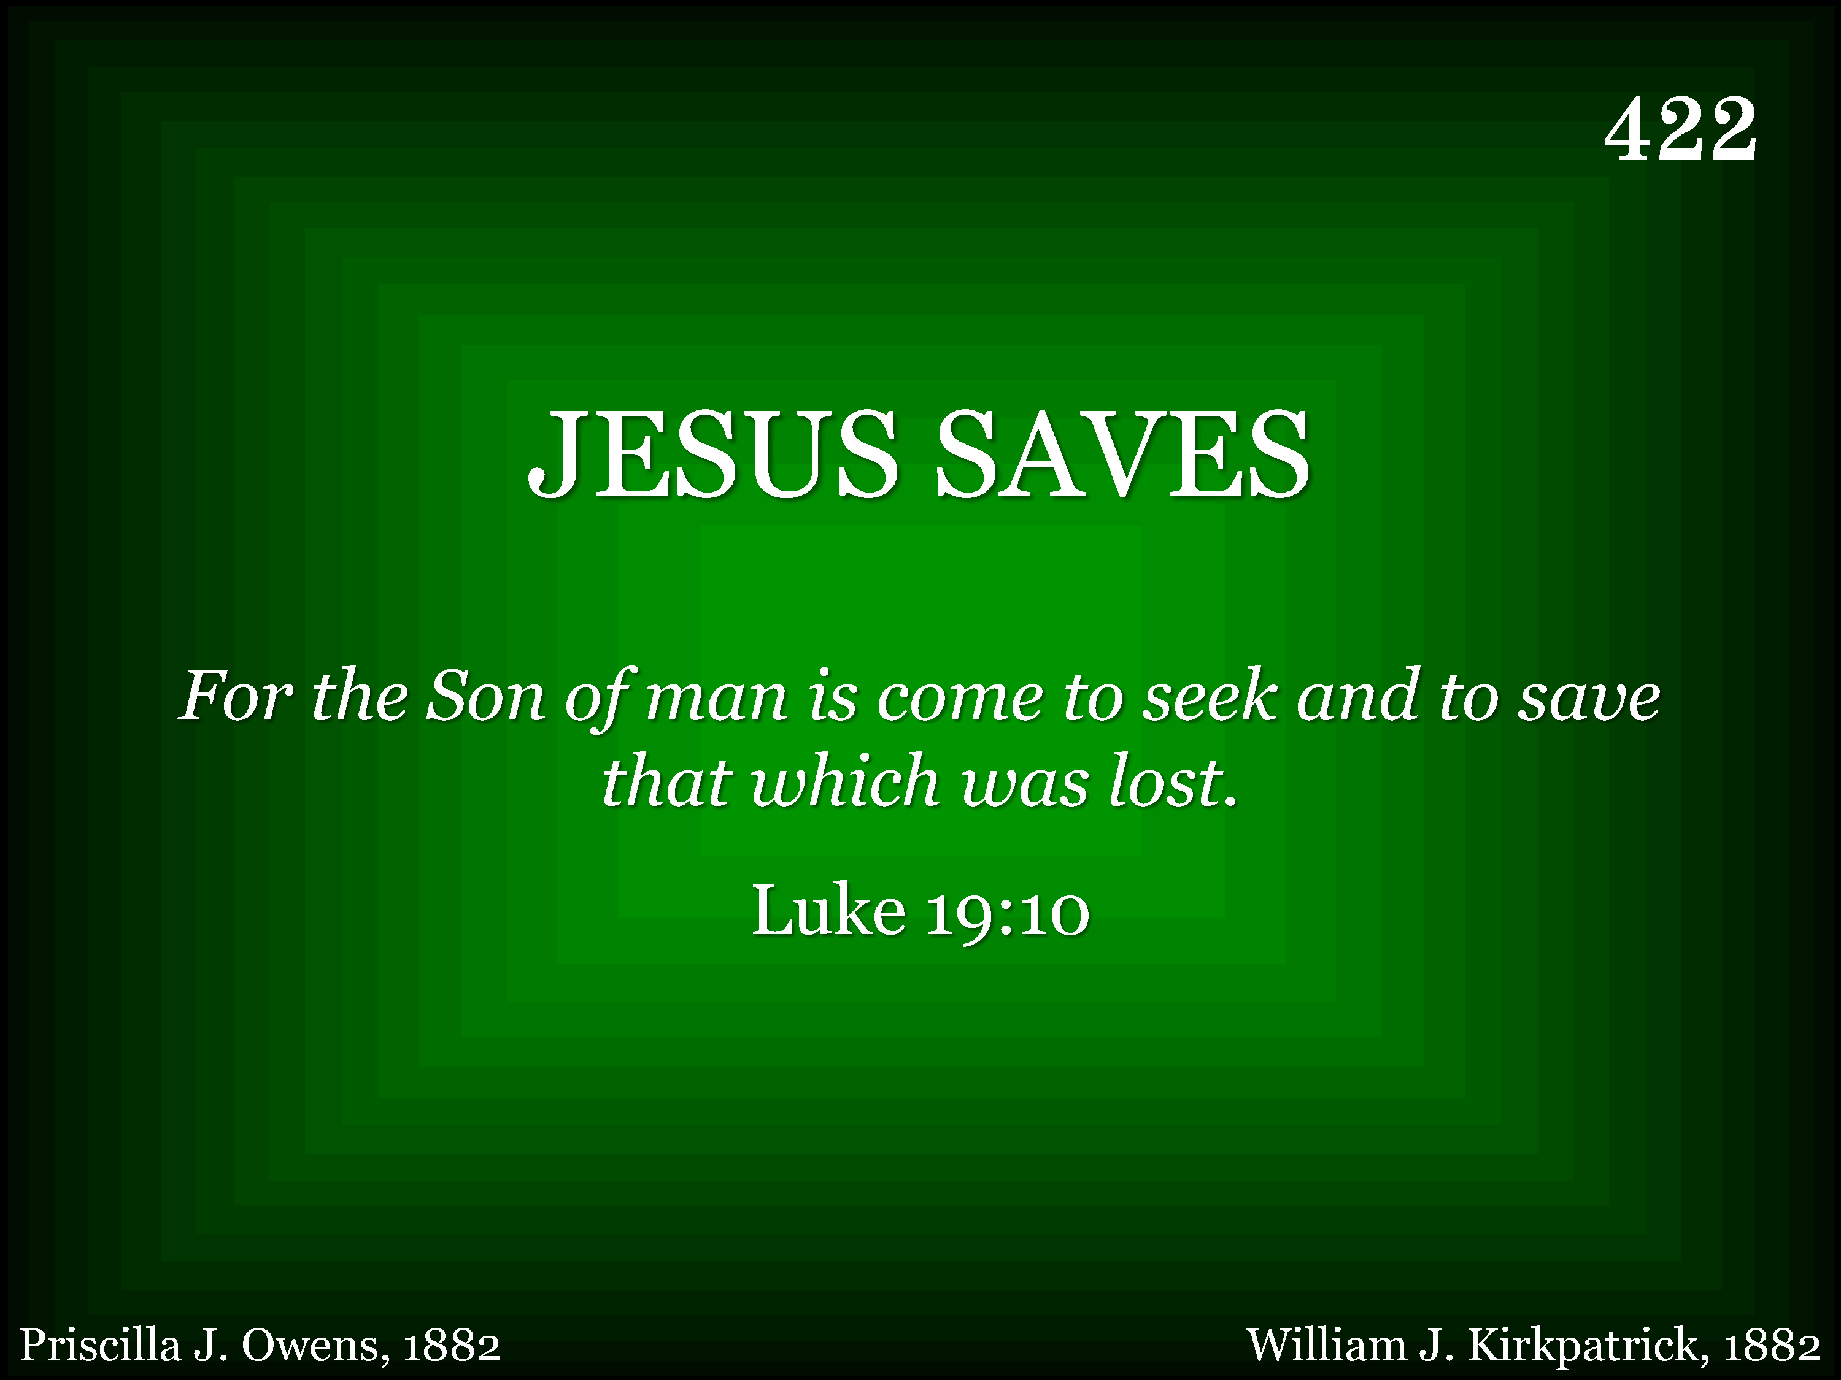
422 - Jesus Saves - Title

Slide 34
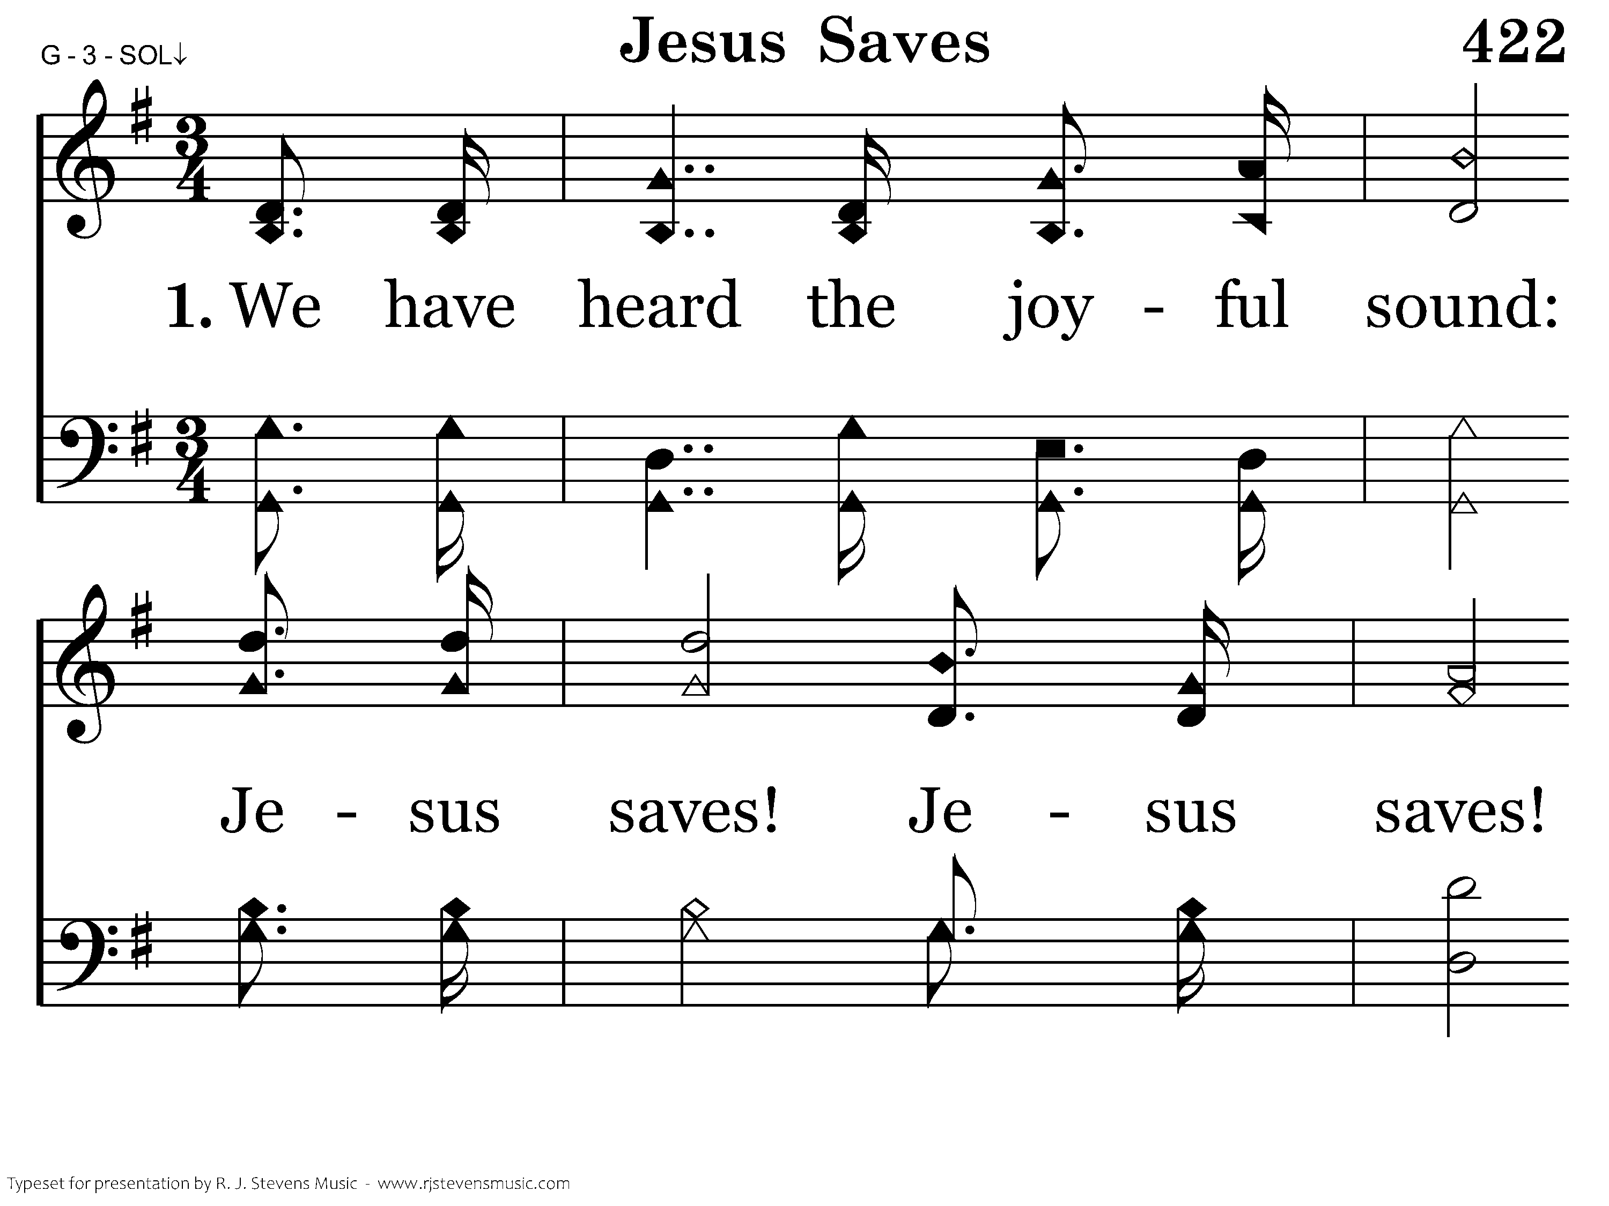
422 - Jesus Saves - 1.1

Slide 35
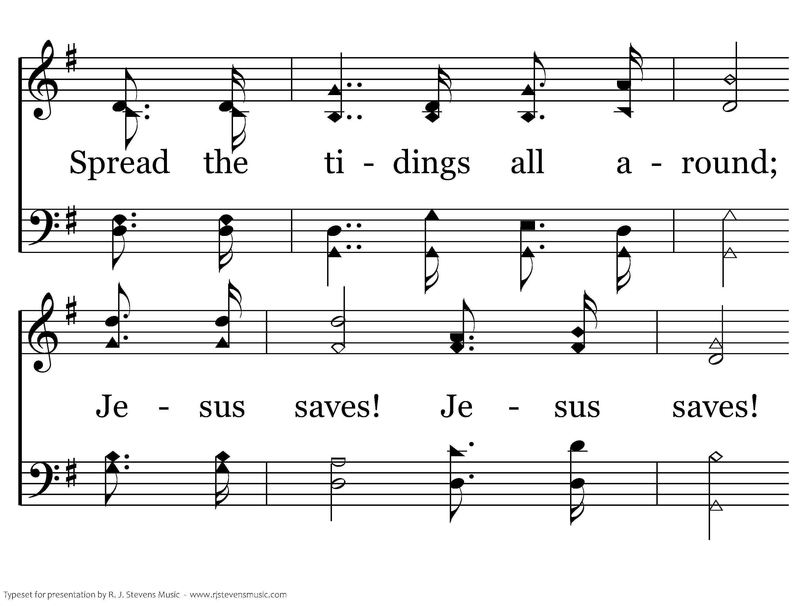
422 - Jesus Saves - 1.2

Slide 36
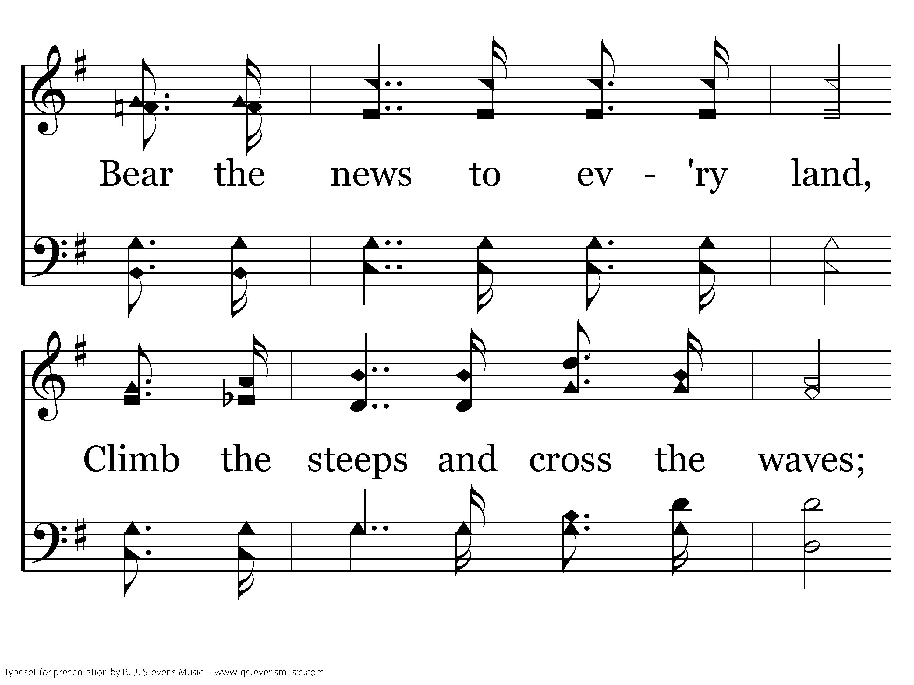
422 - Jesus Saves - 1.3

Slide 37
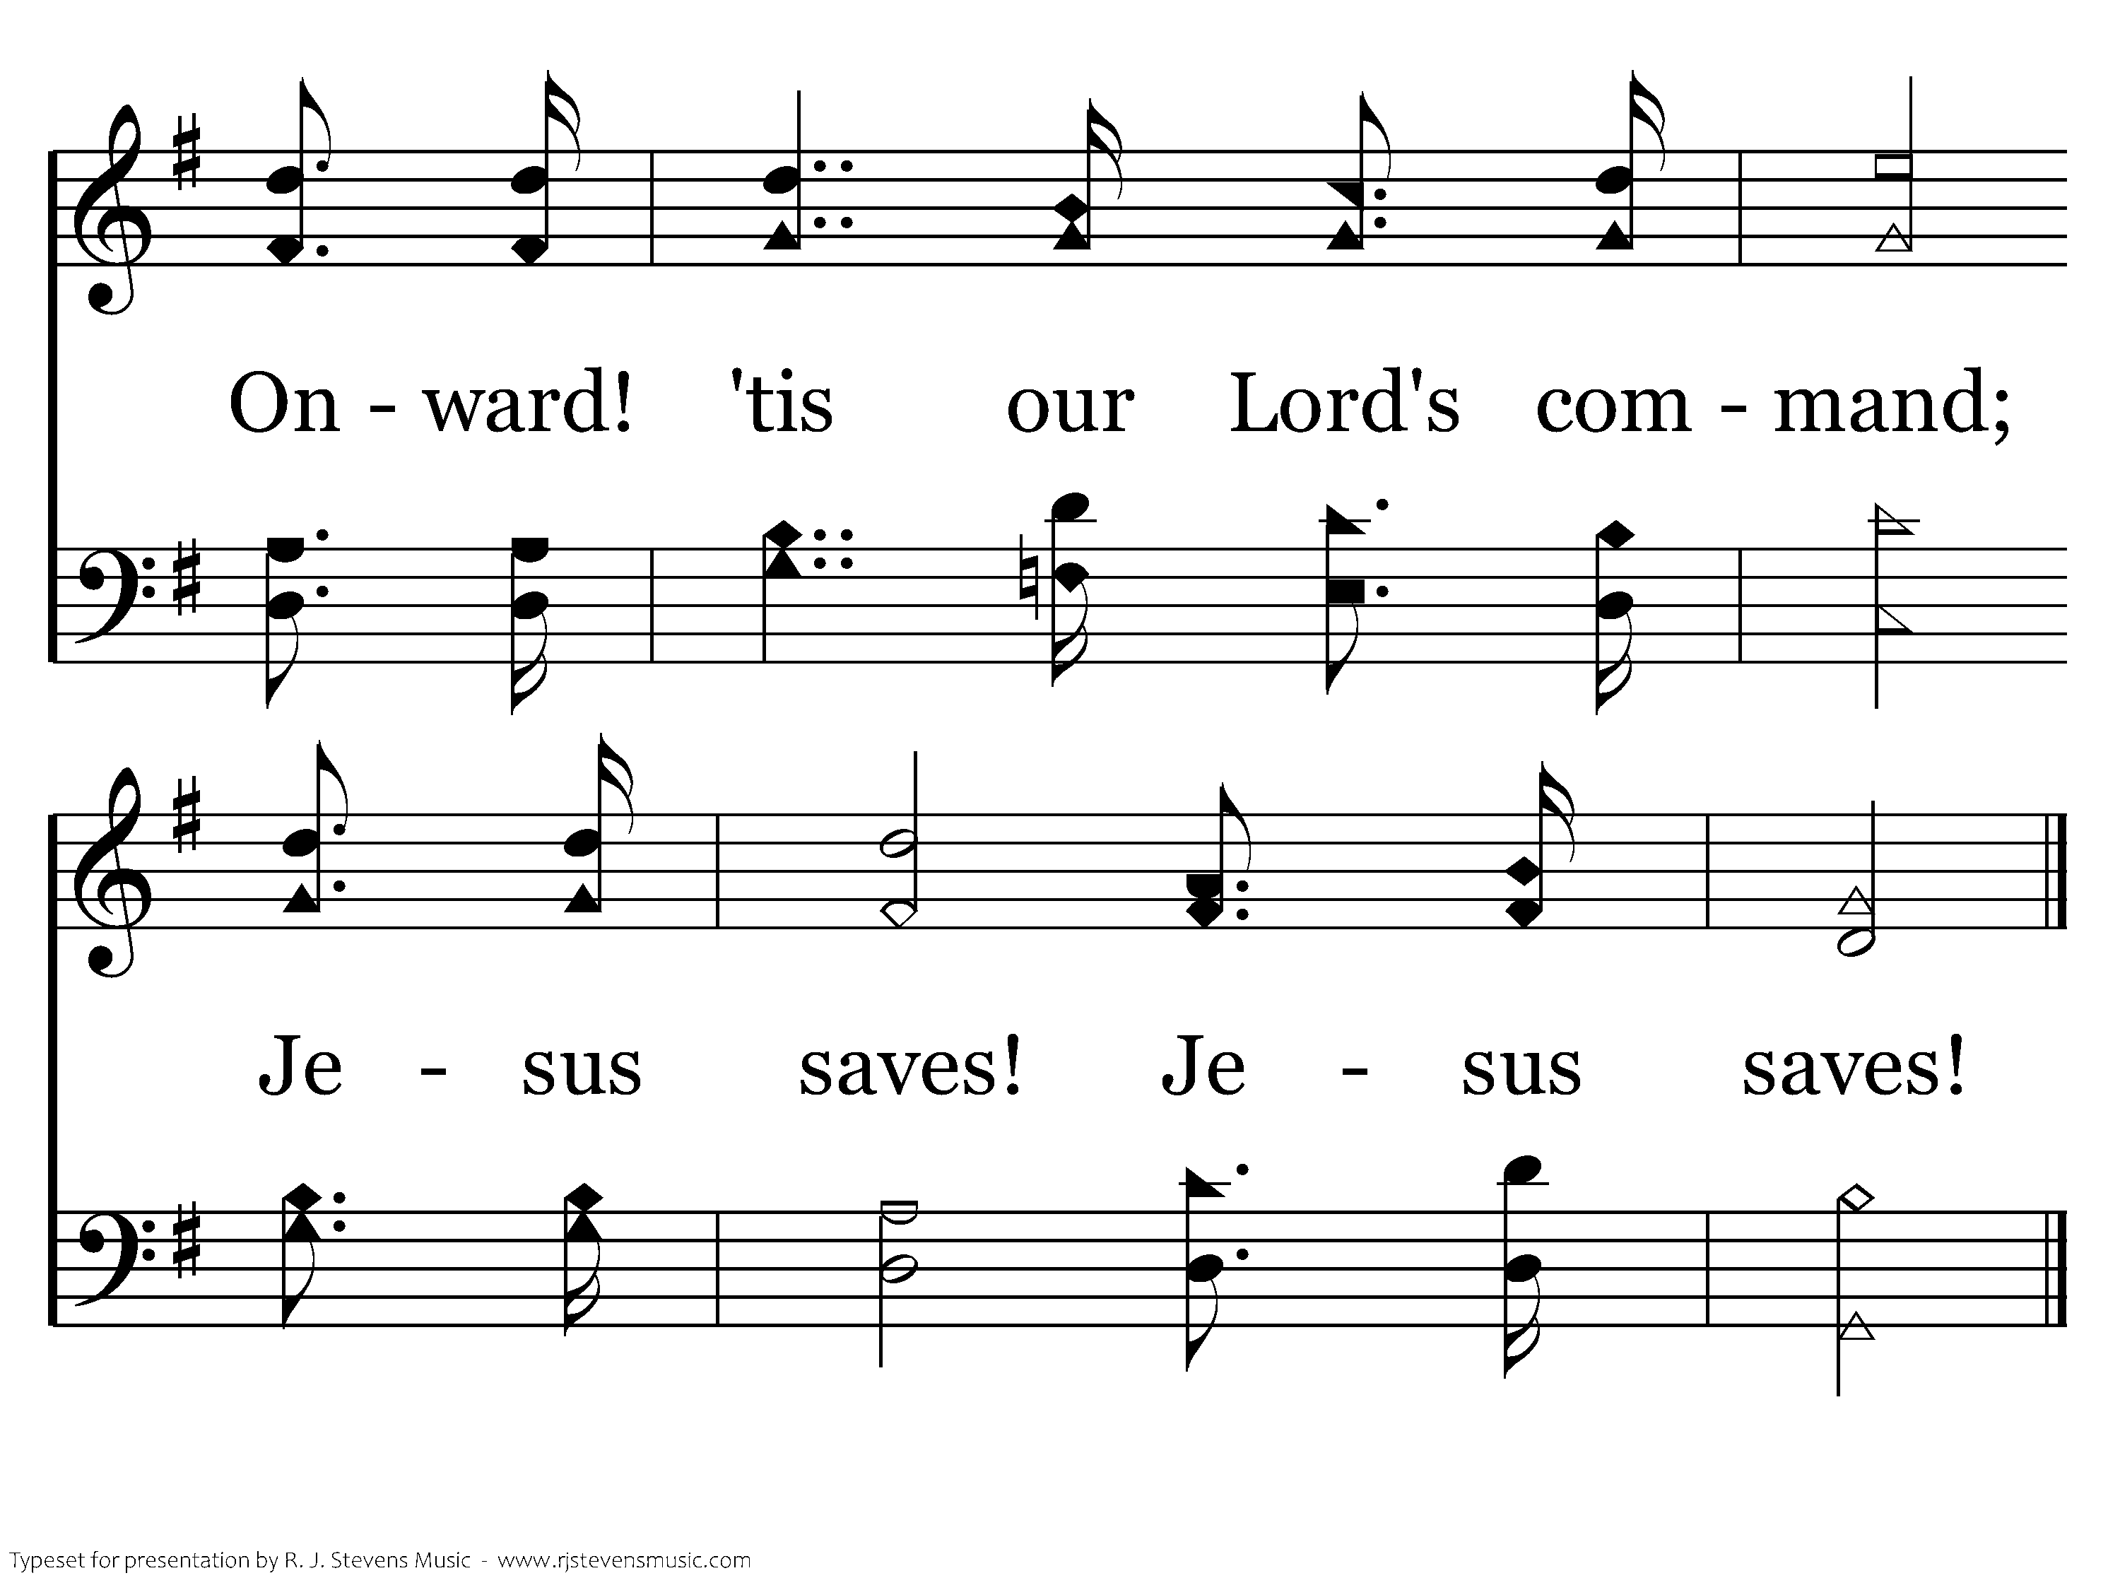
422 - Jesus Saves - 1.4
End of Verse 1

Slide 38
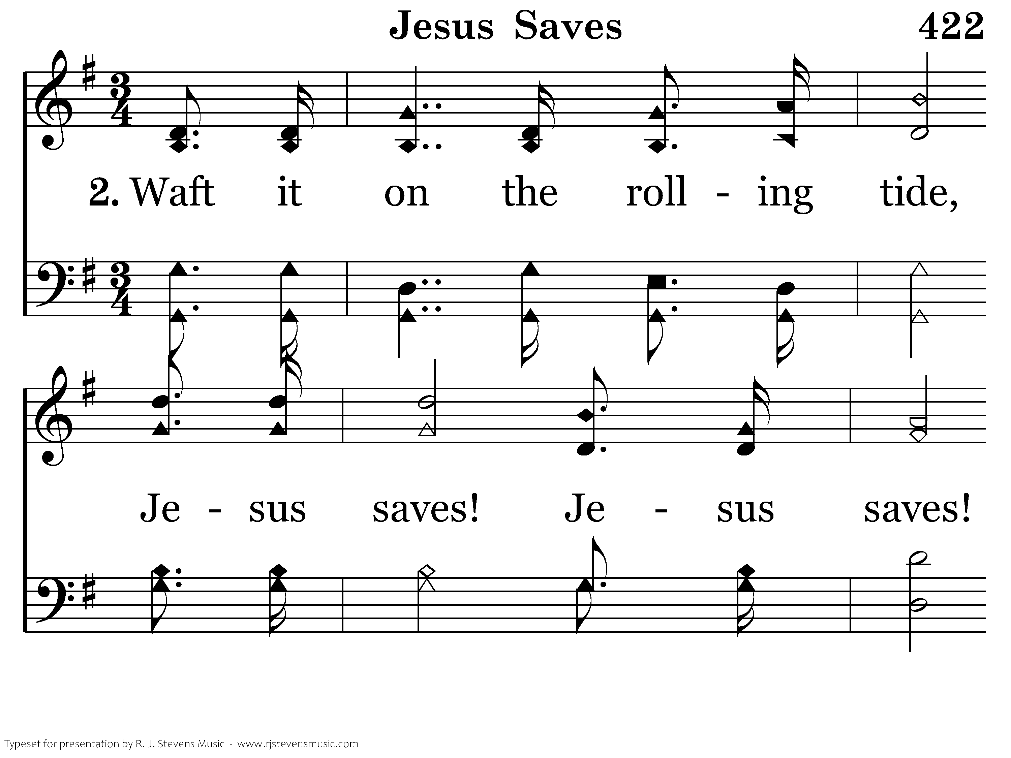
422 - Jesus Saves - 2.1

Slide 39
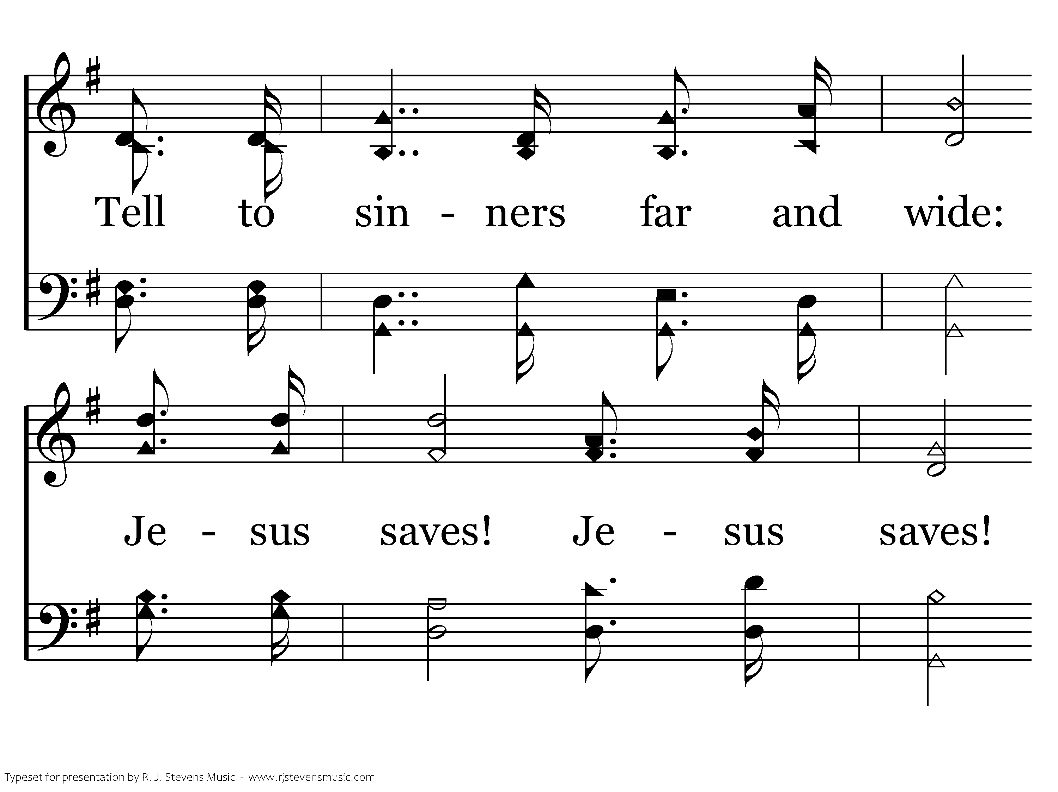
422 - Jesus Saves - 2.2

Slide 40
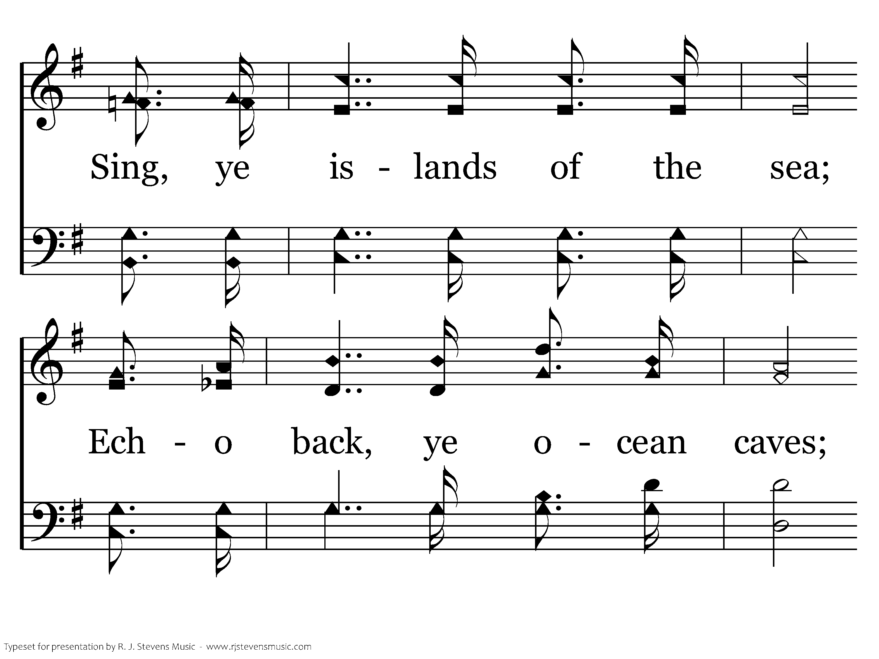
422 - Jesus Saves - 2.3

Slide 41
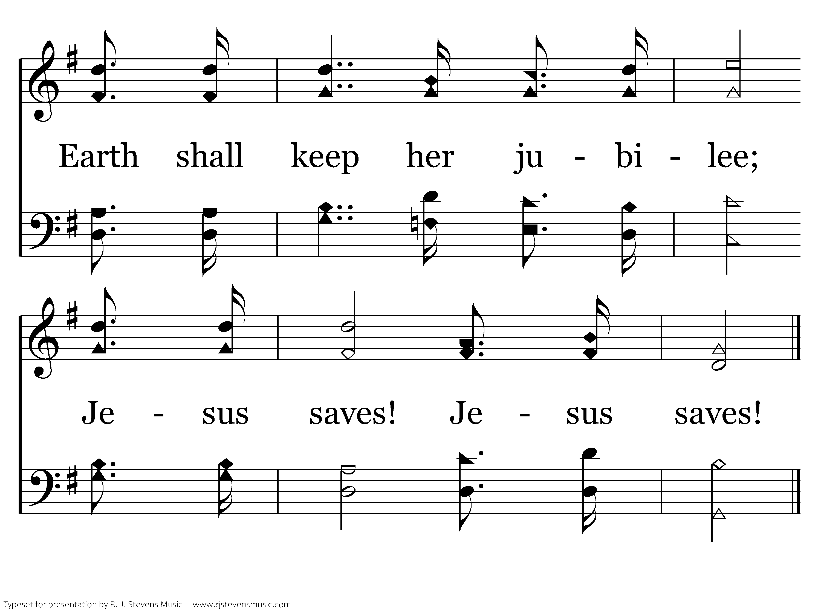
422 - Jesus Saves - 2.4
End of Verse 2

Slide 42
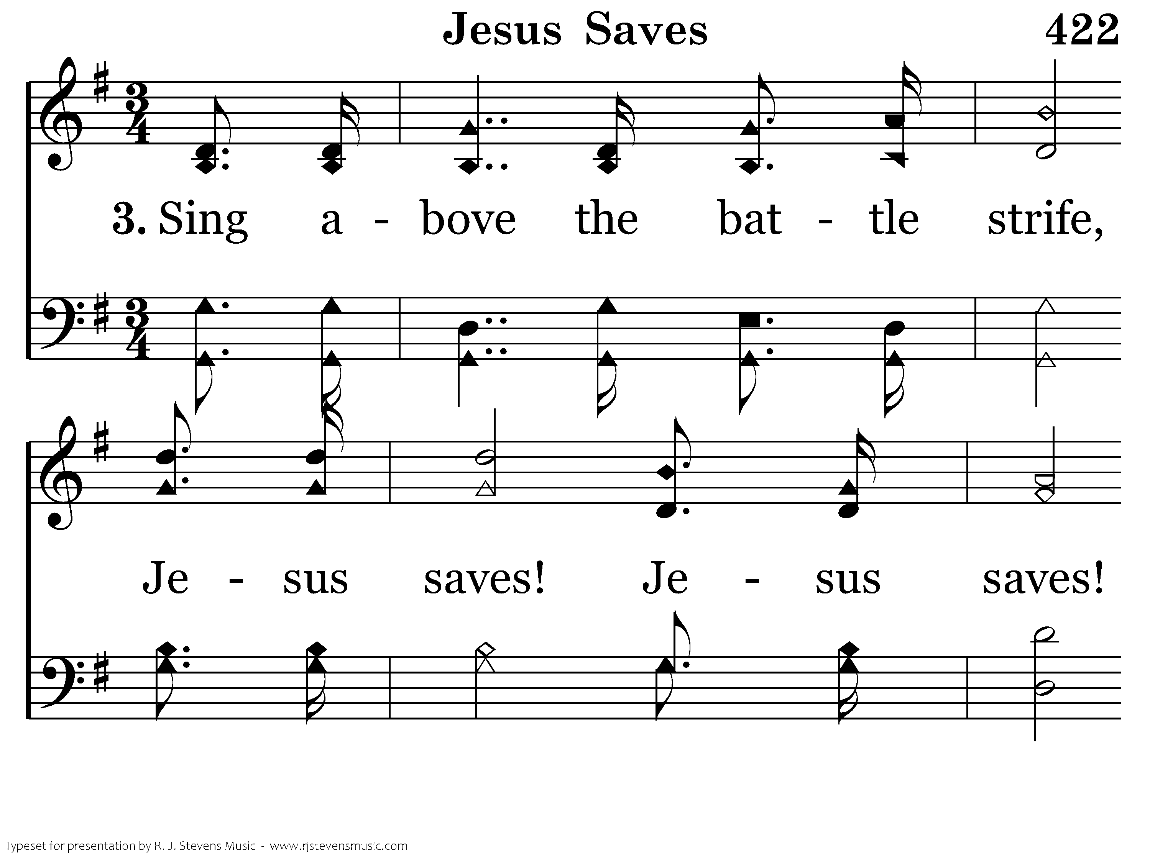
422 - Jesus Saves - 3.1

Slide 43
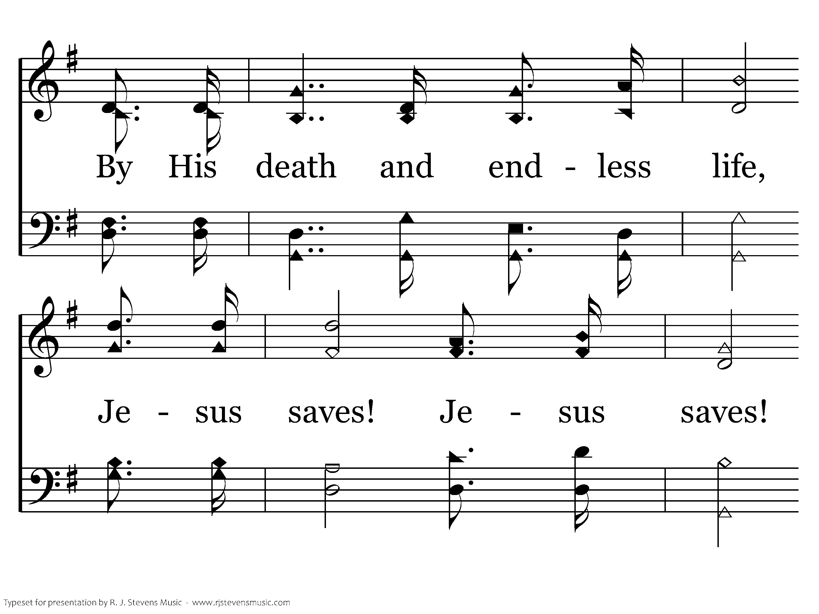
422 - Jesus Saves - 3.2

Slide 44
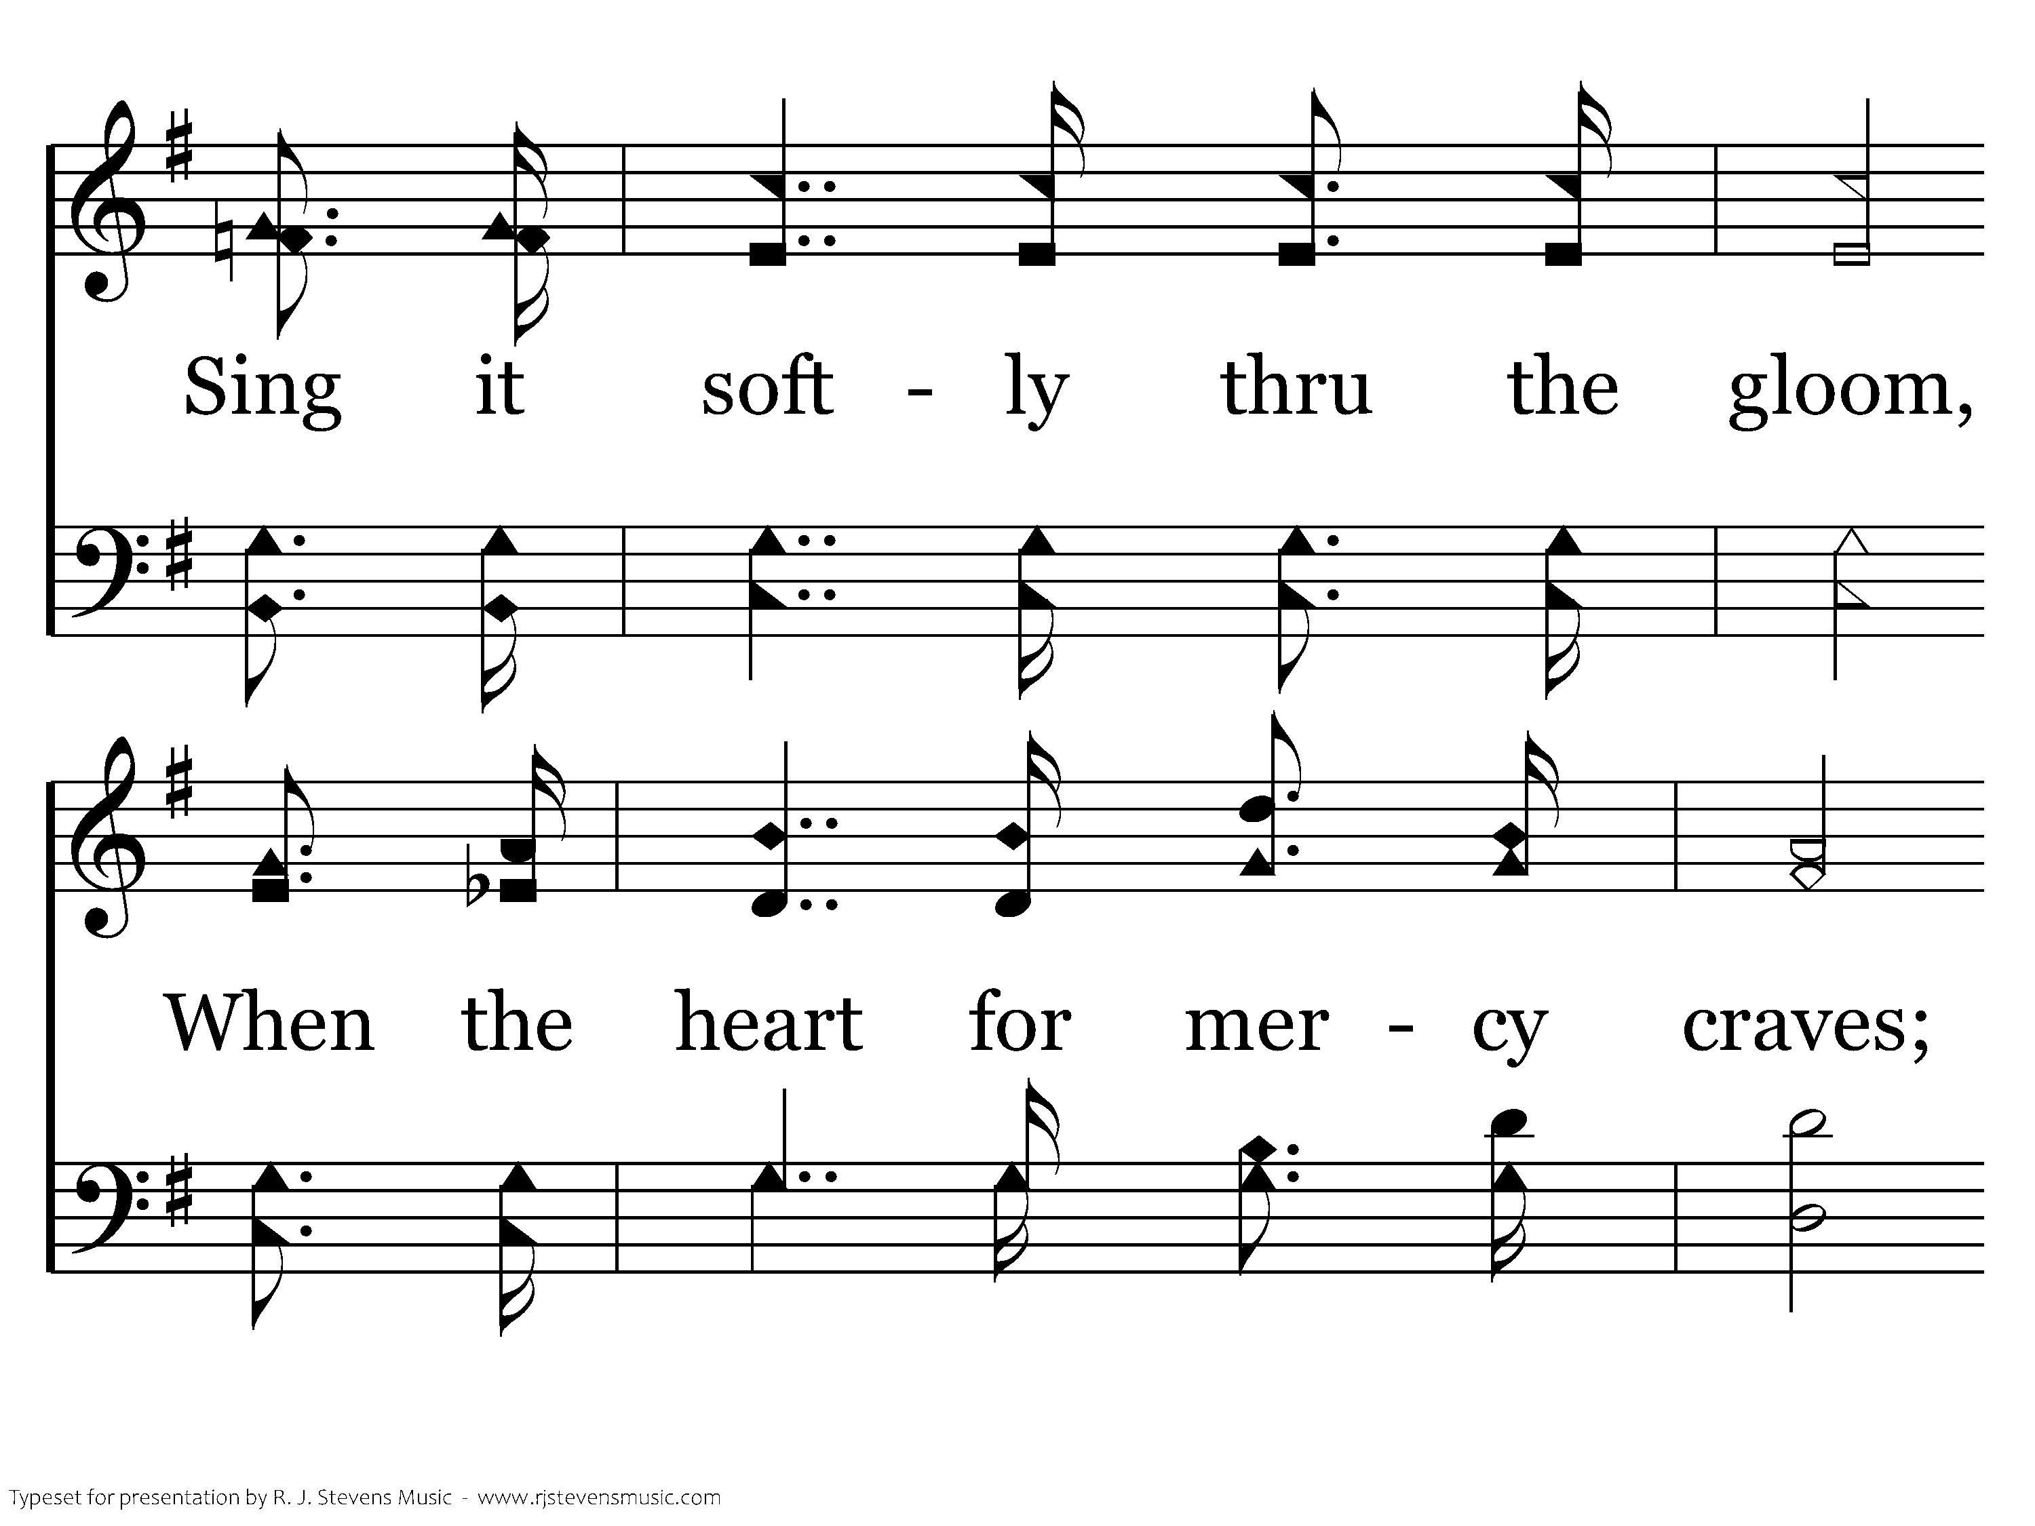
422 - Jesus Saves - 3.3

Slide 45
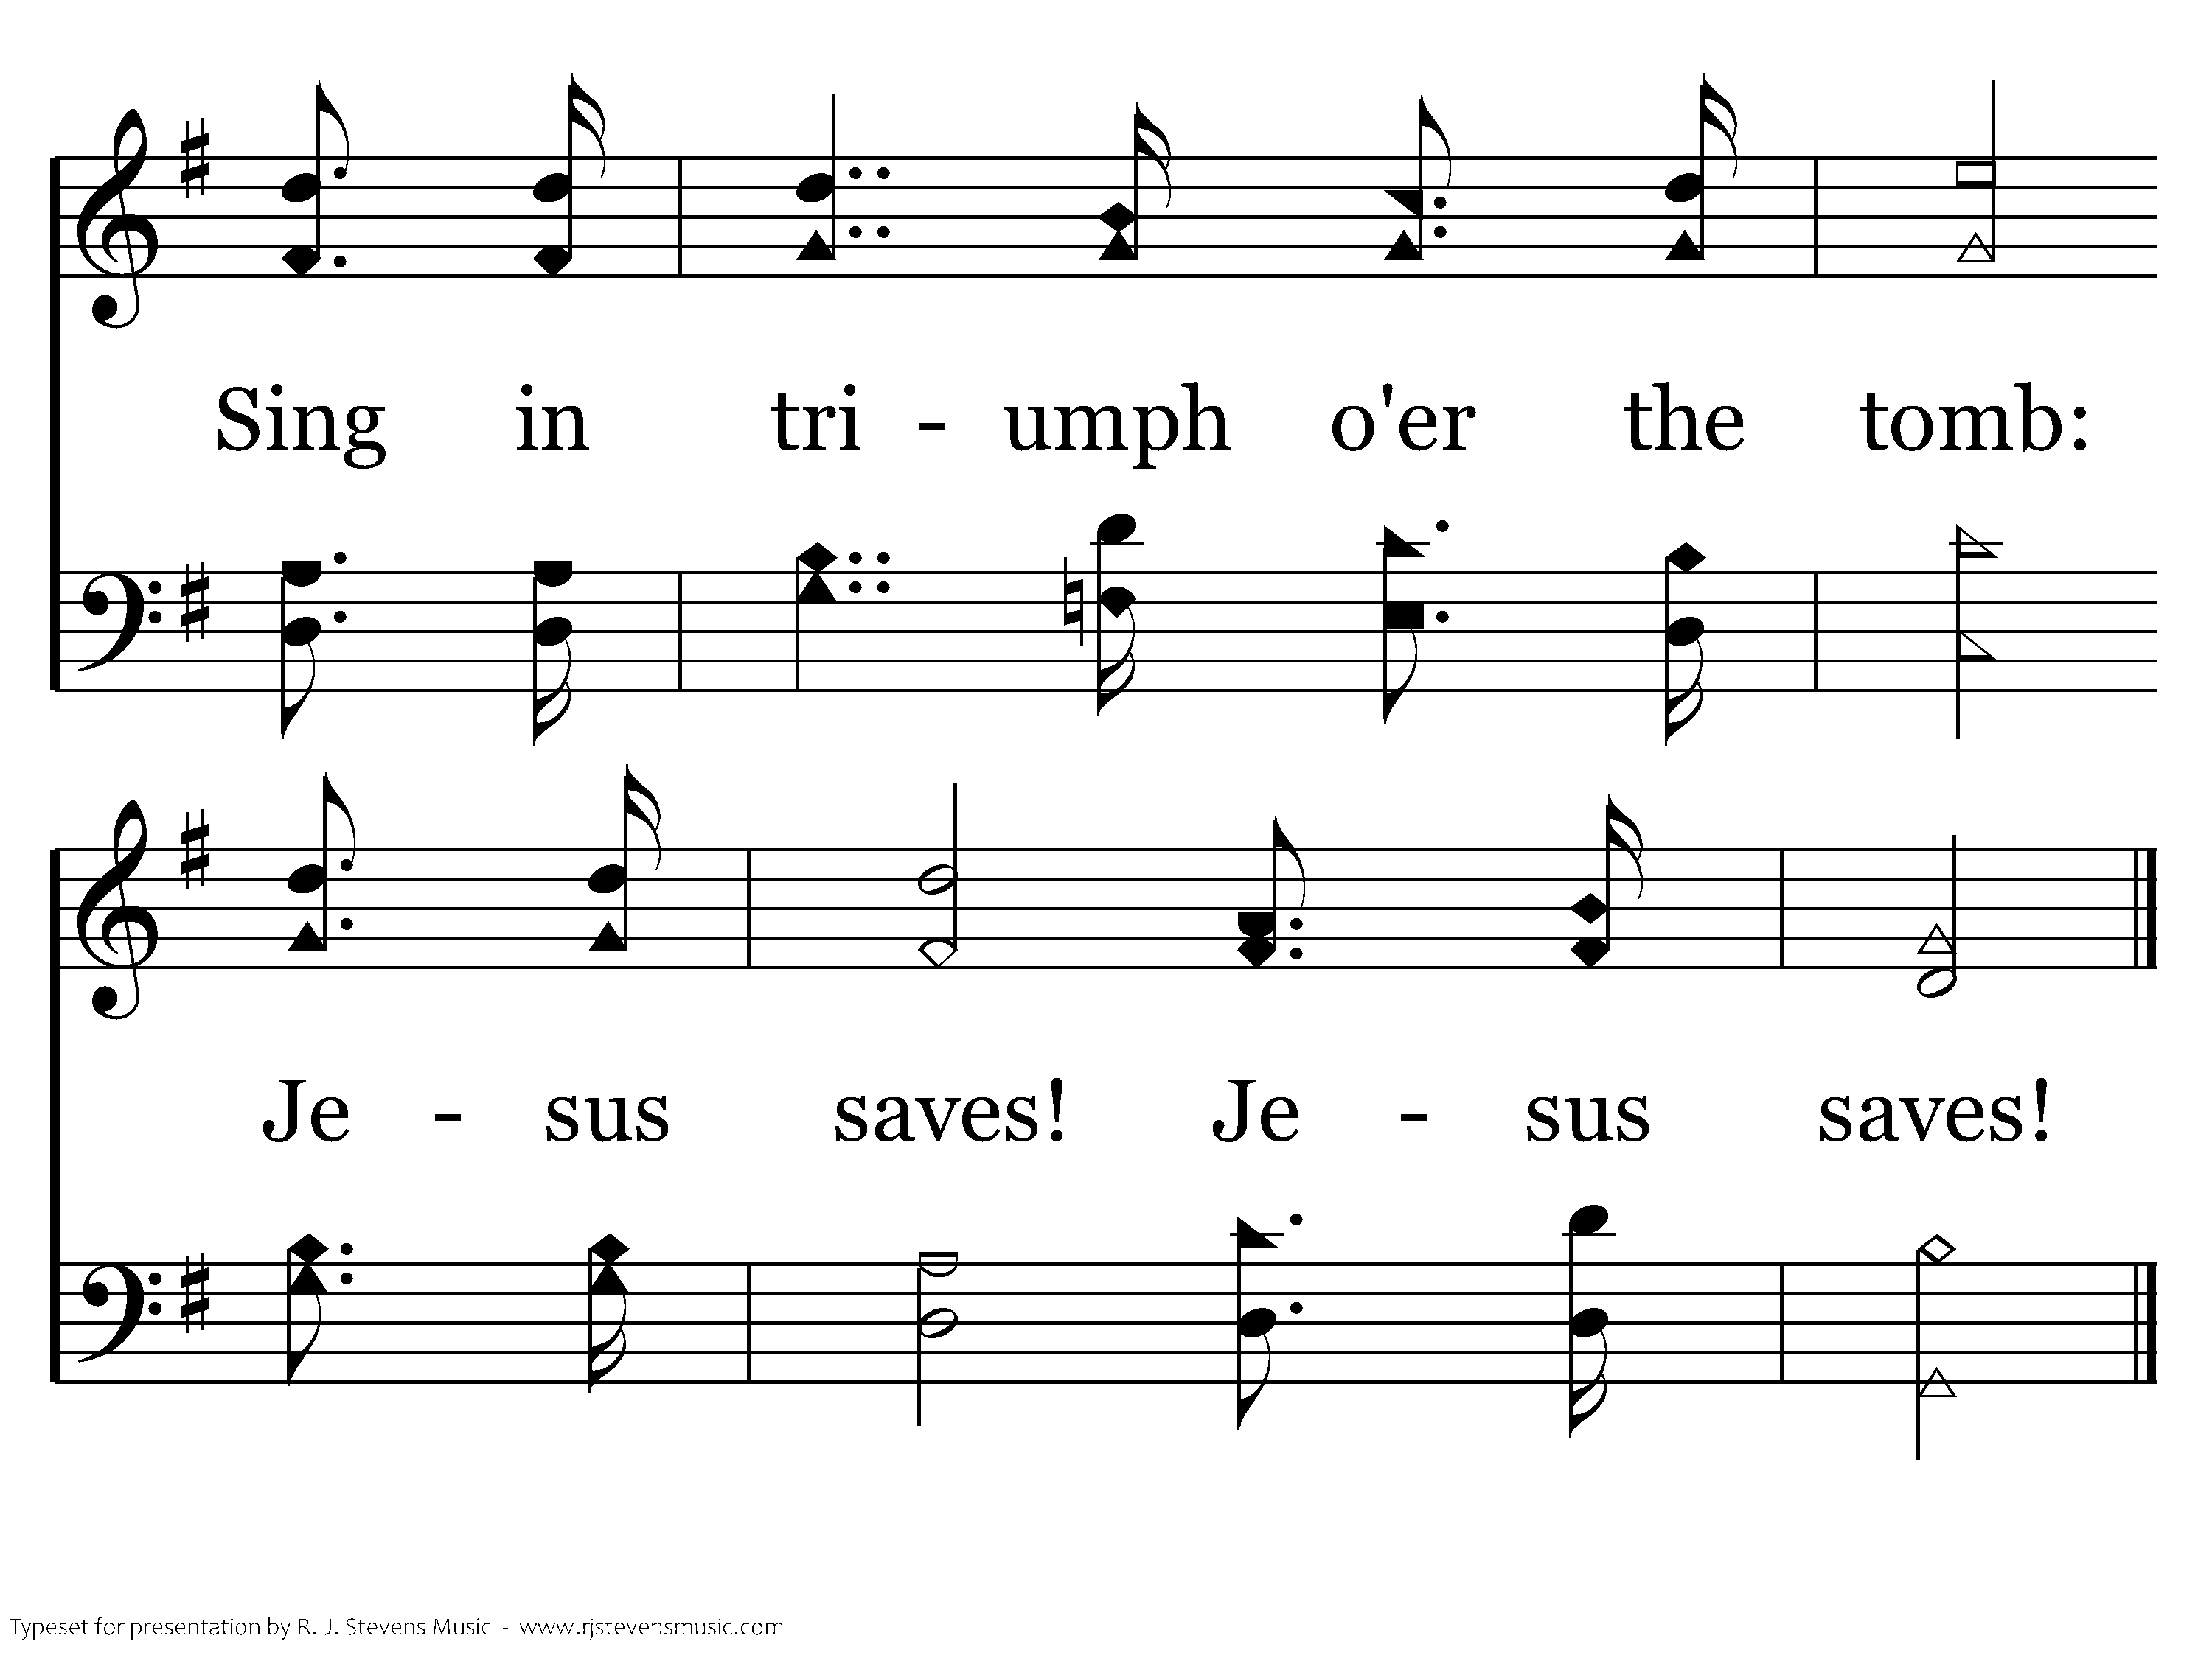
422 - Jesus Saves - 3.4
End of Verse 3

Slide 46
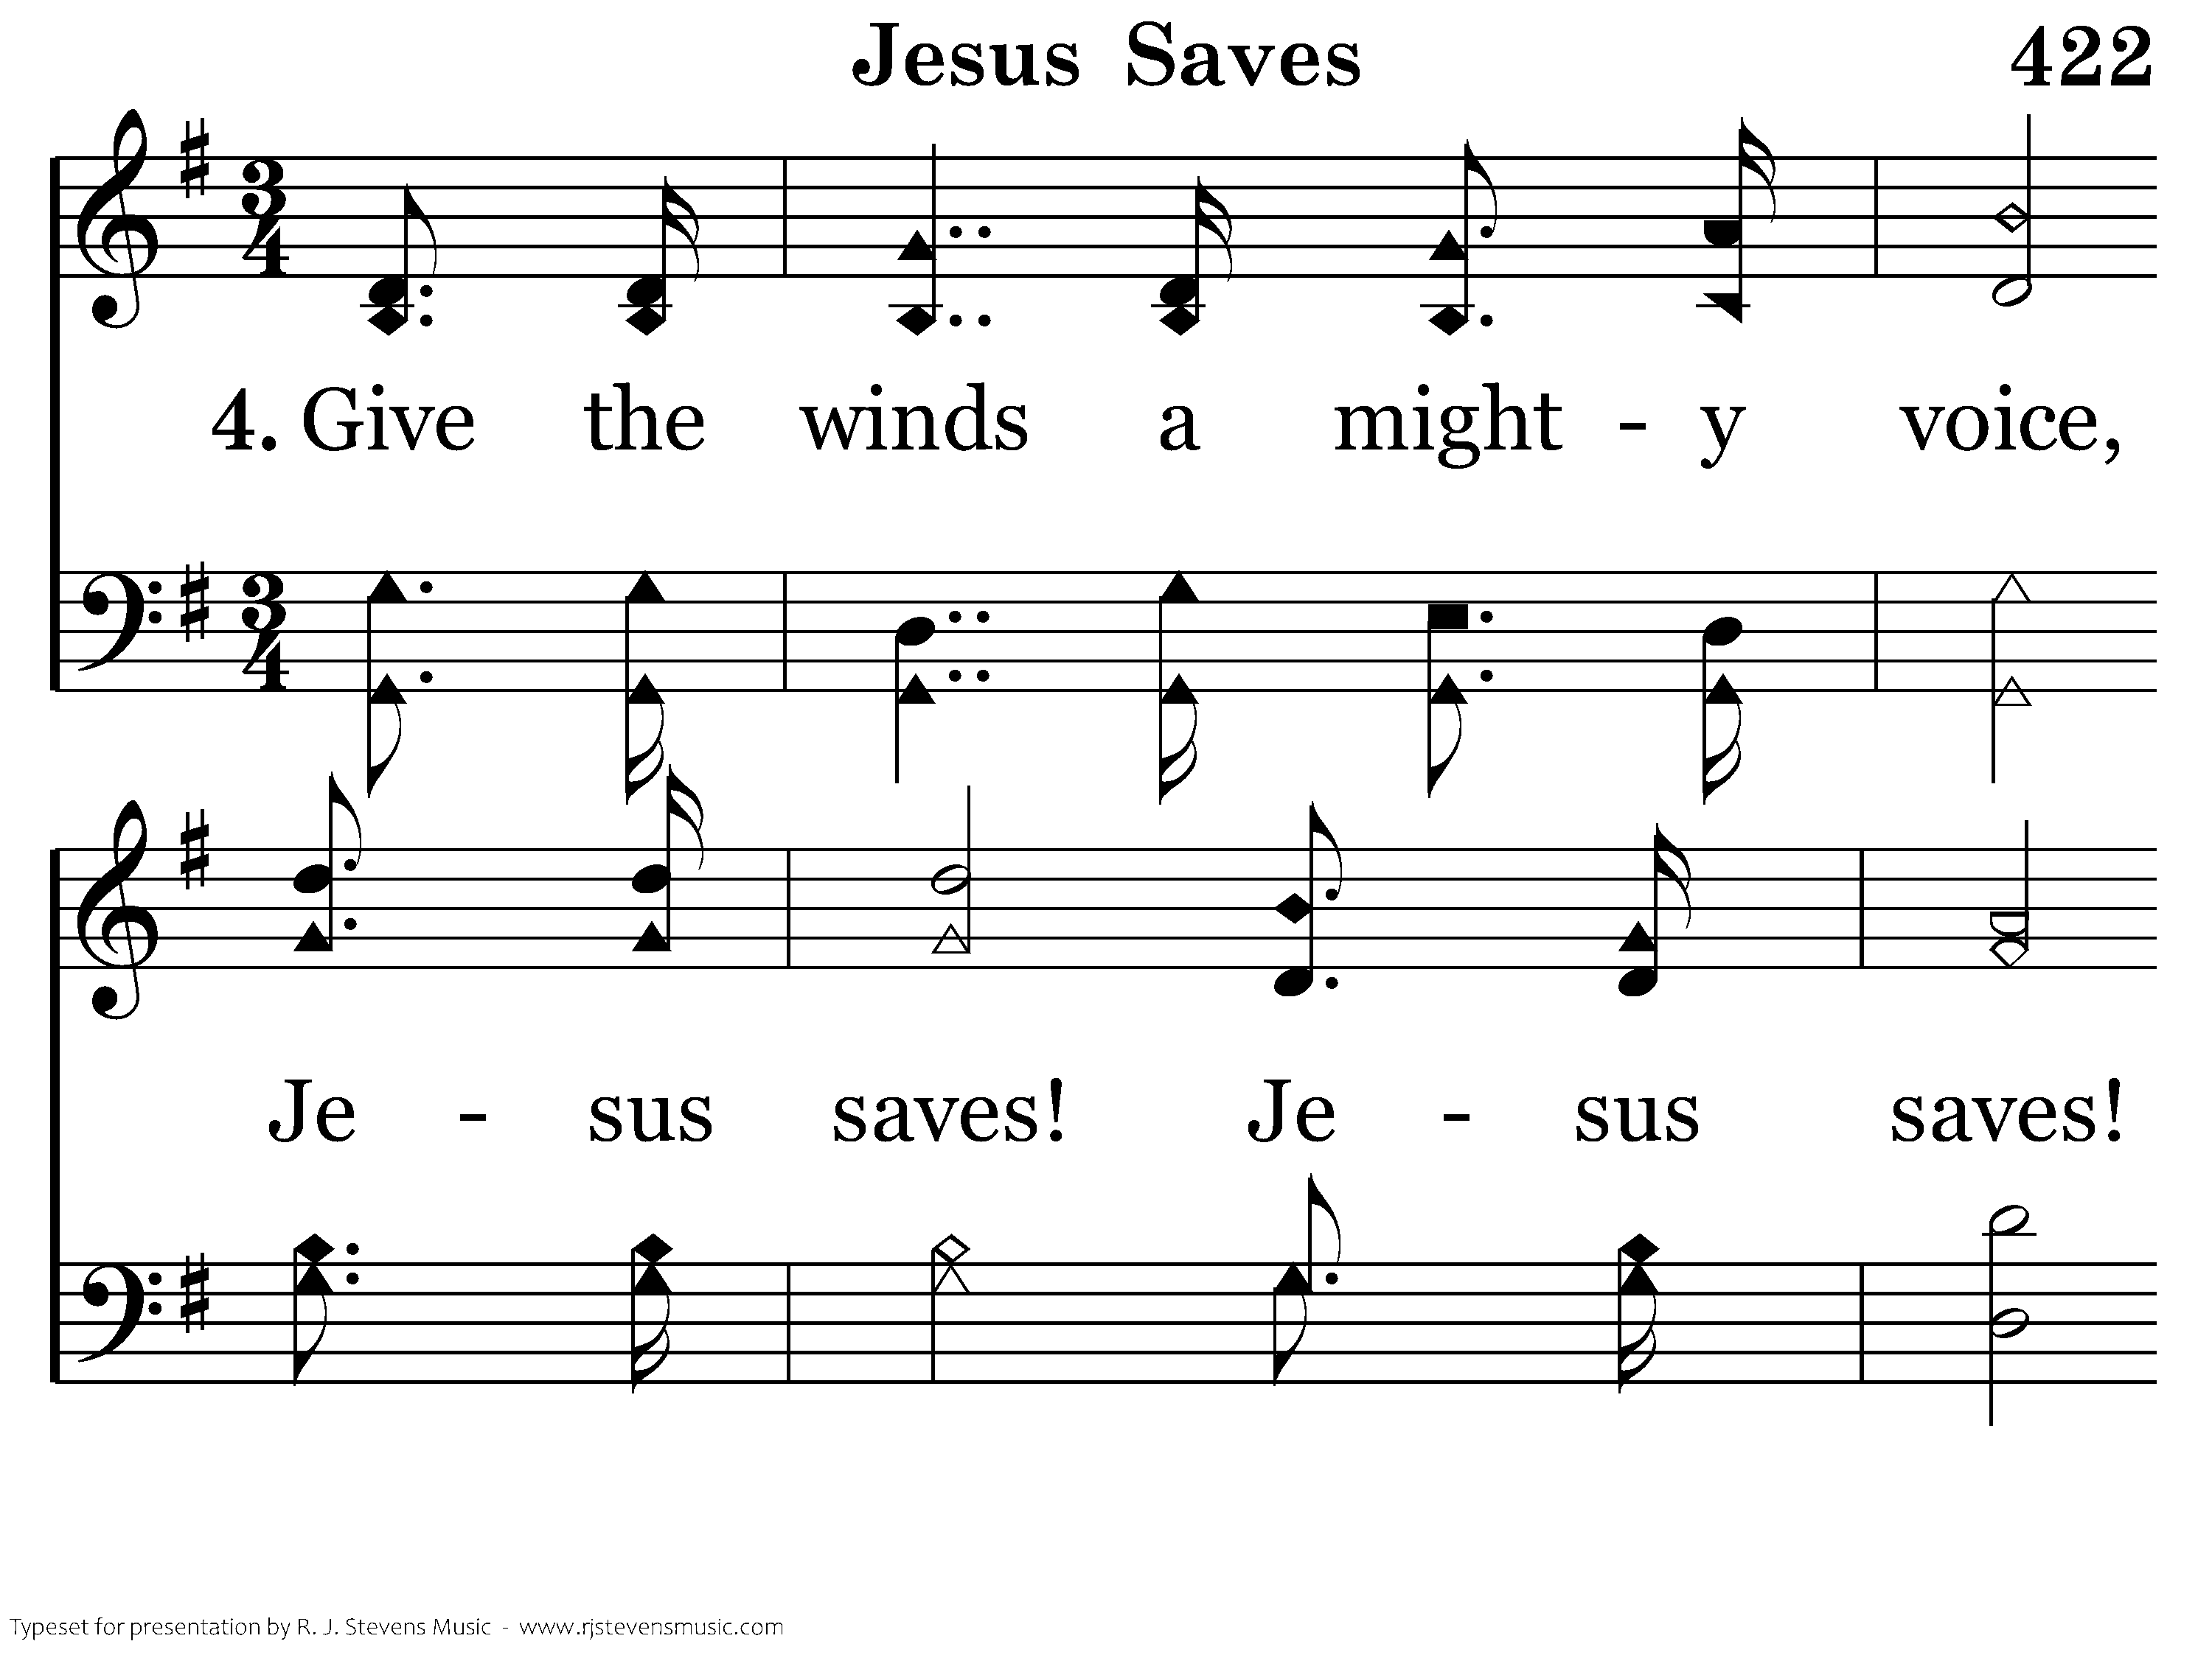
422 - Jesus Saves - 4.1

Slide 47
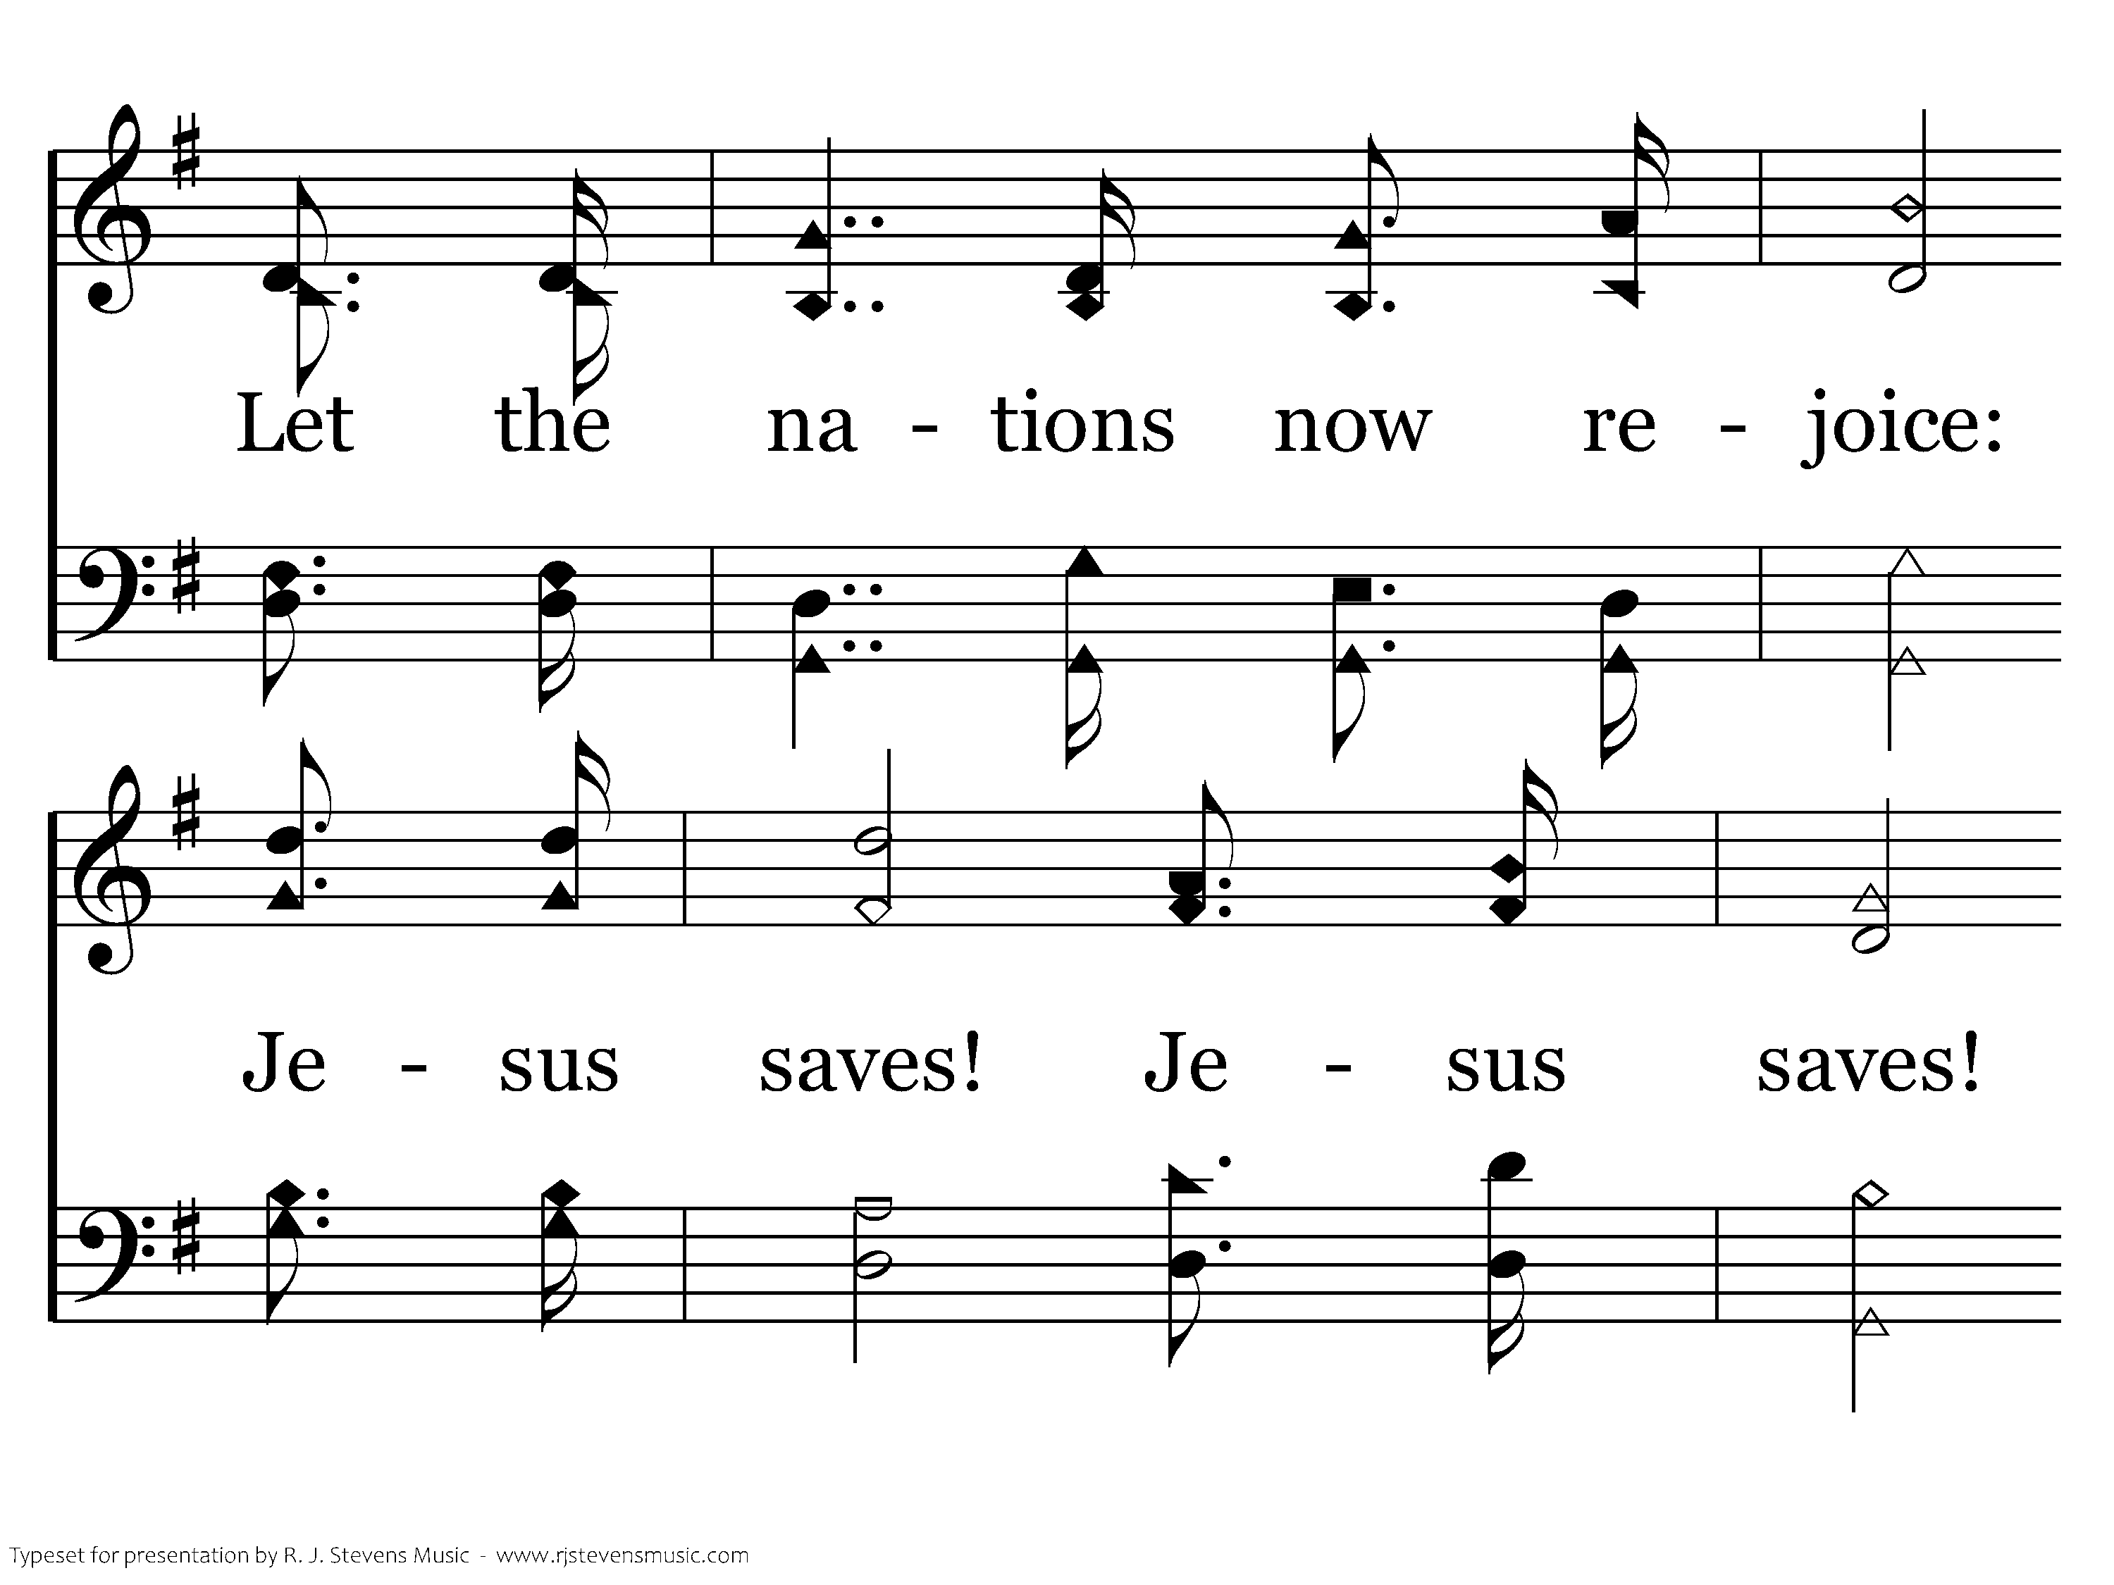
422 - Jesus Saves - 4.2

Slide 48
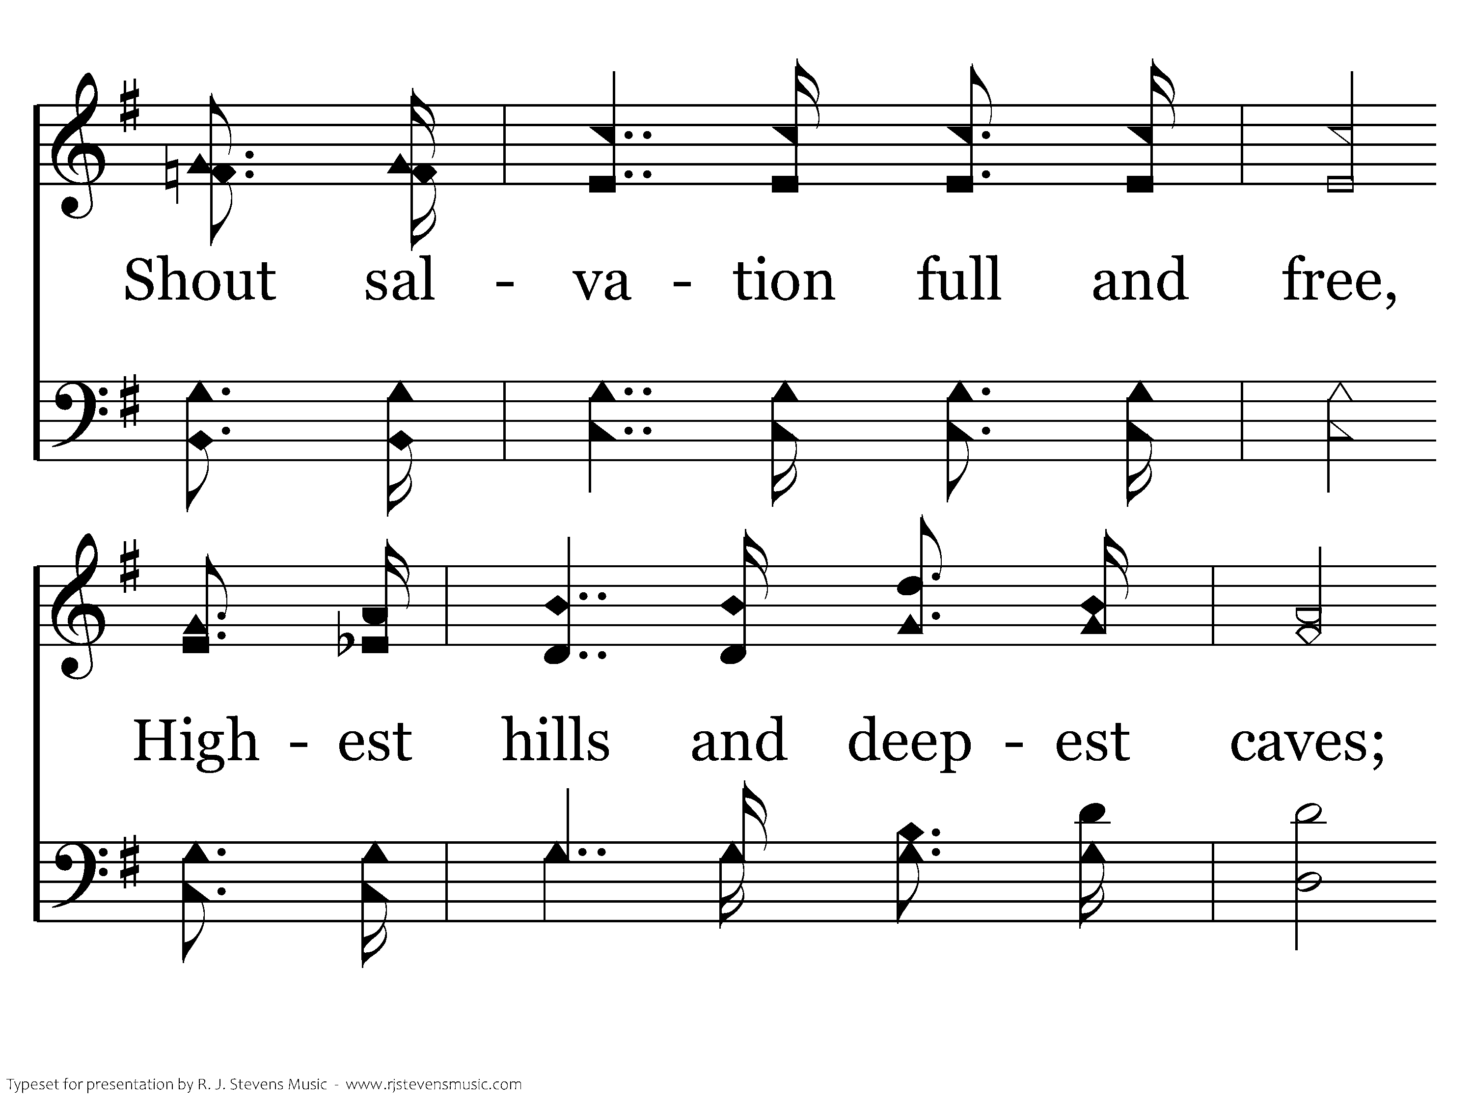
422 - Jesus Saves - 4.3

Slide 49
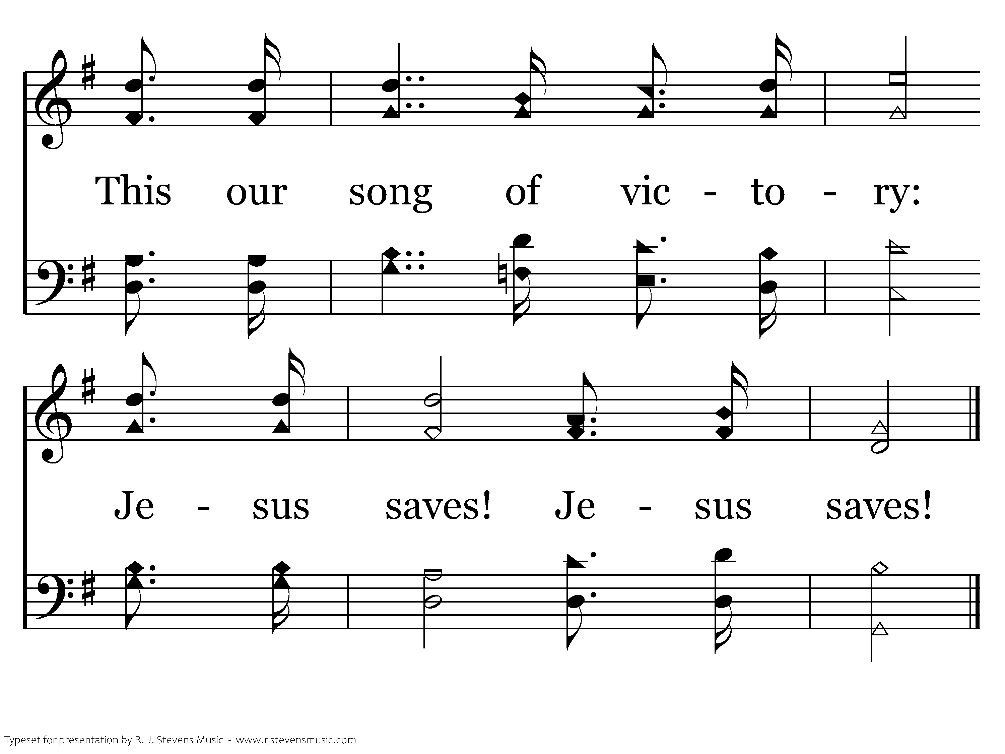
422 - Jesus Saves - 4.4
End of Song

Slide 51
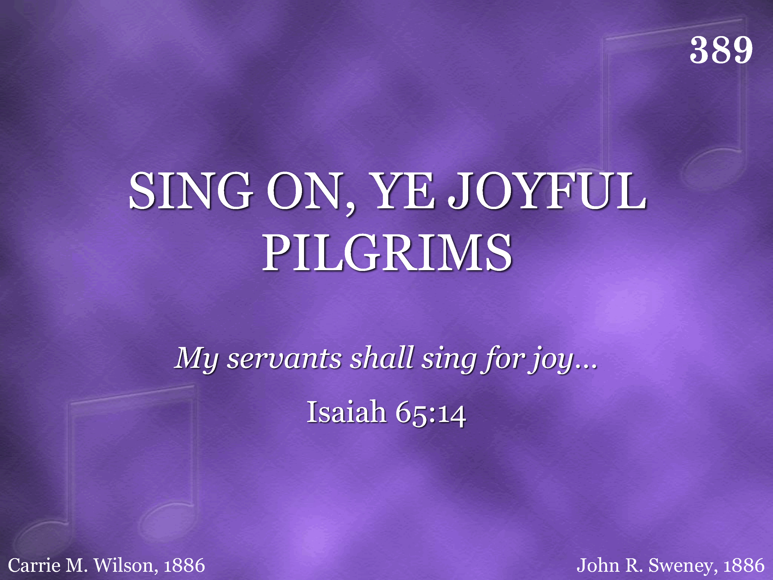
389 - Sing On, Ye Joyful Pilgrims - Title

Slide 52
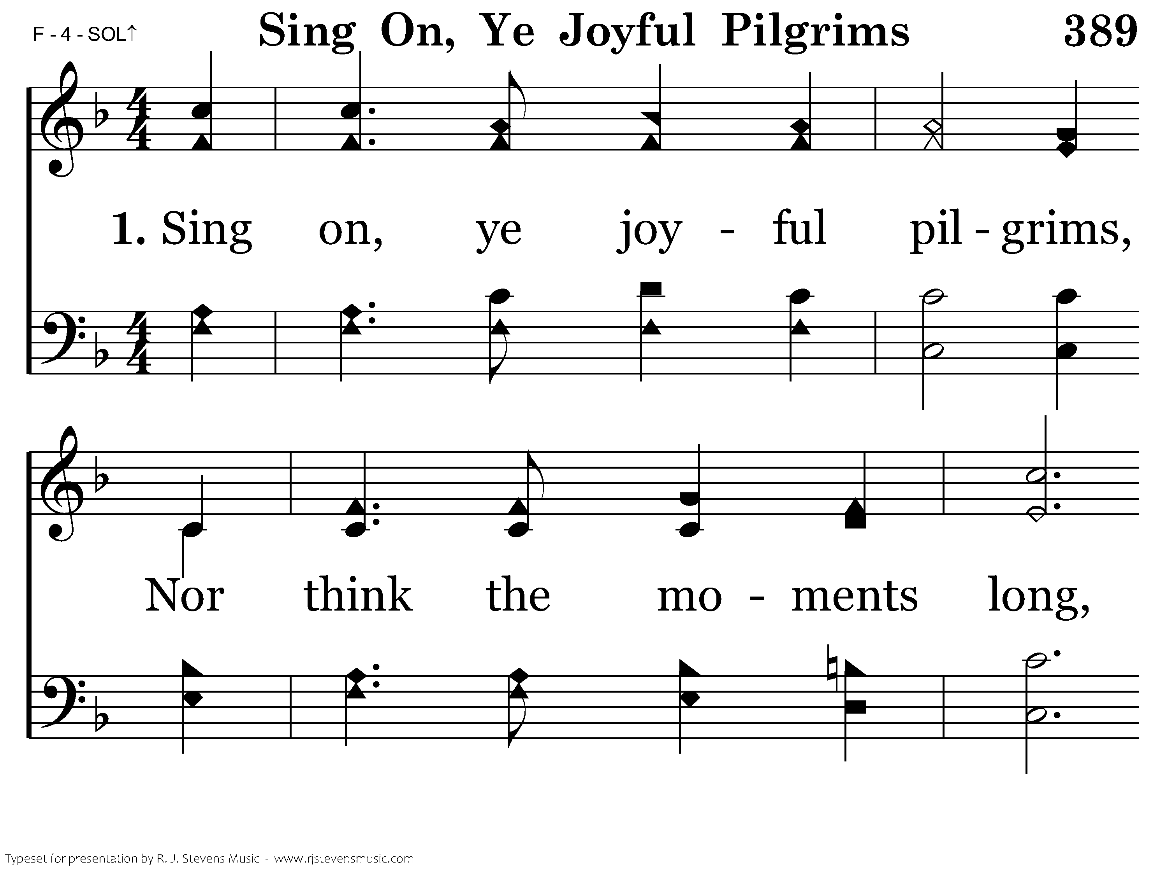
389 - Sing On, Ye Joyful Pilgrims - 1.1

Slide 53
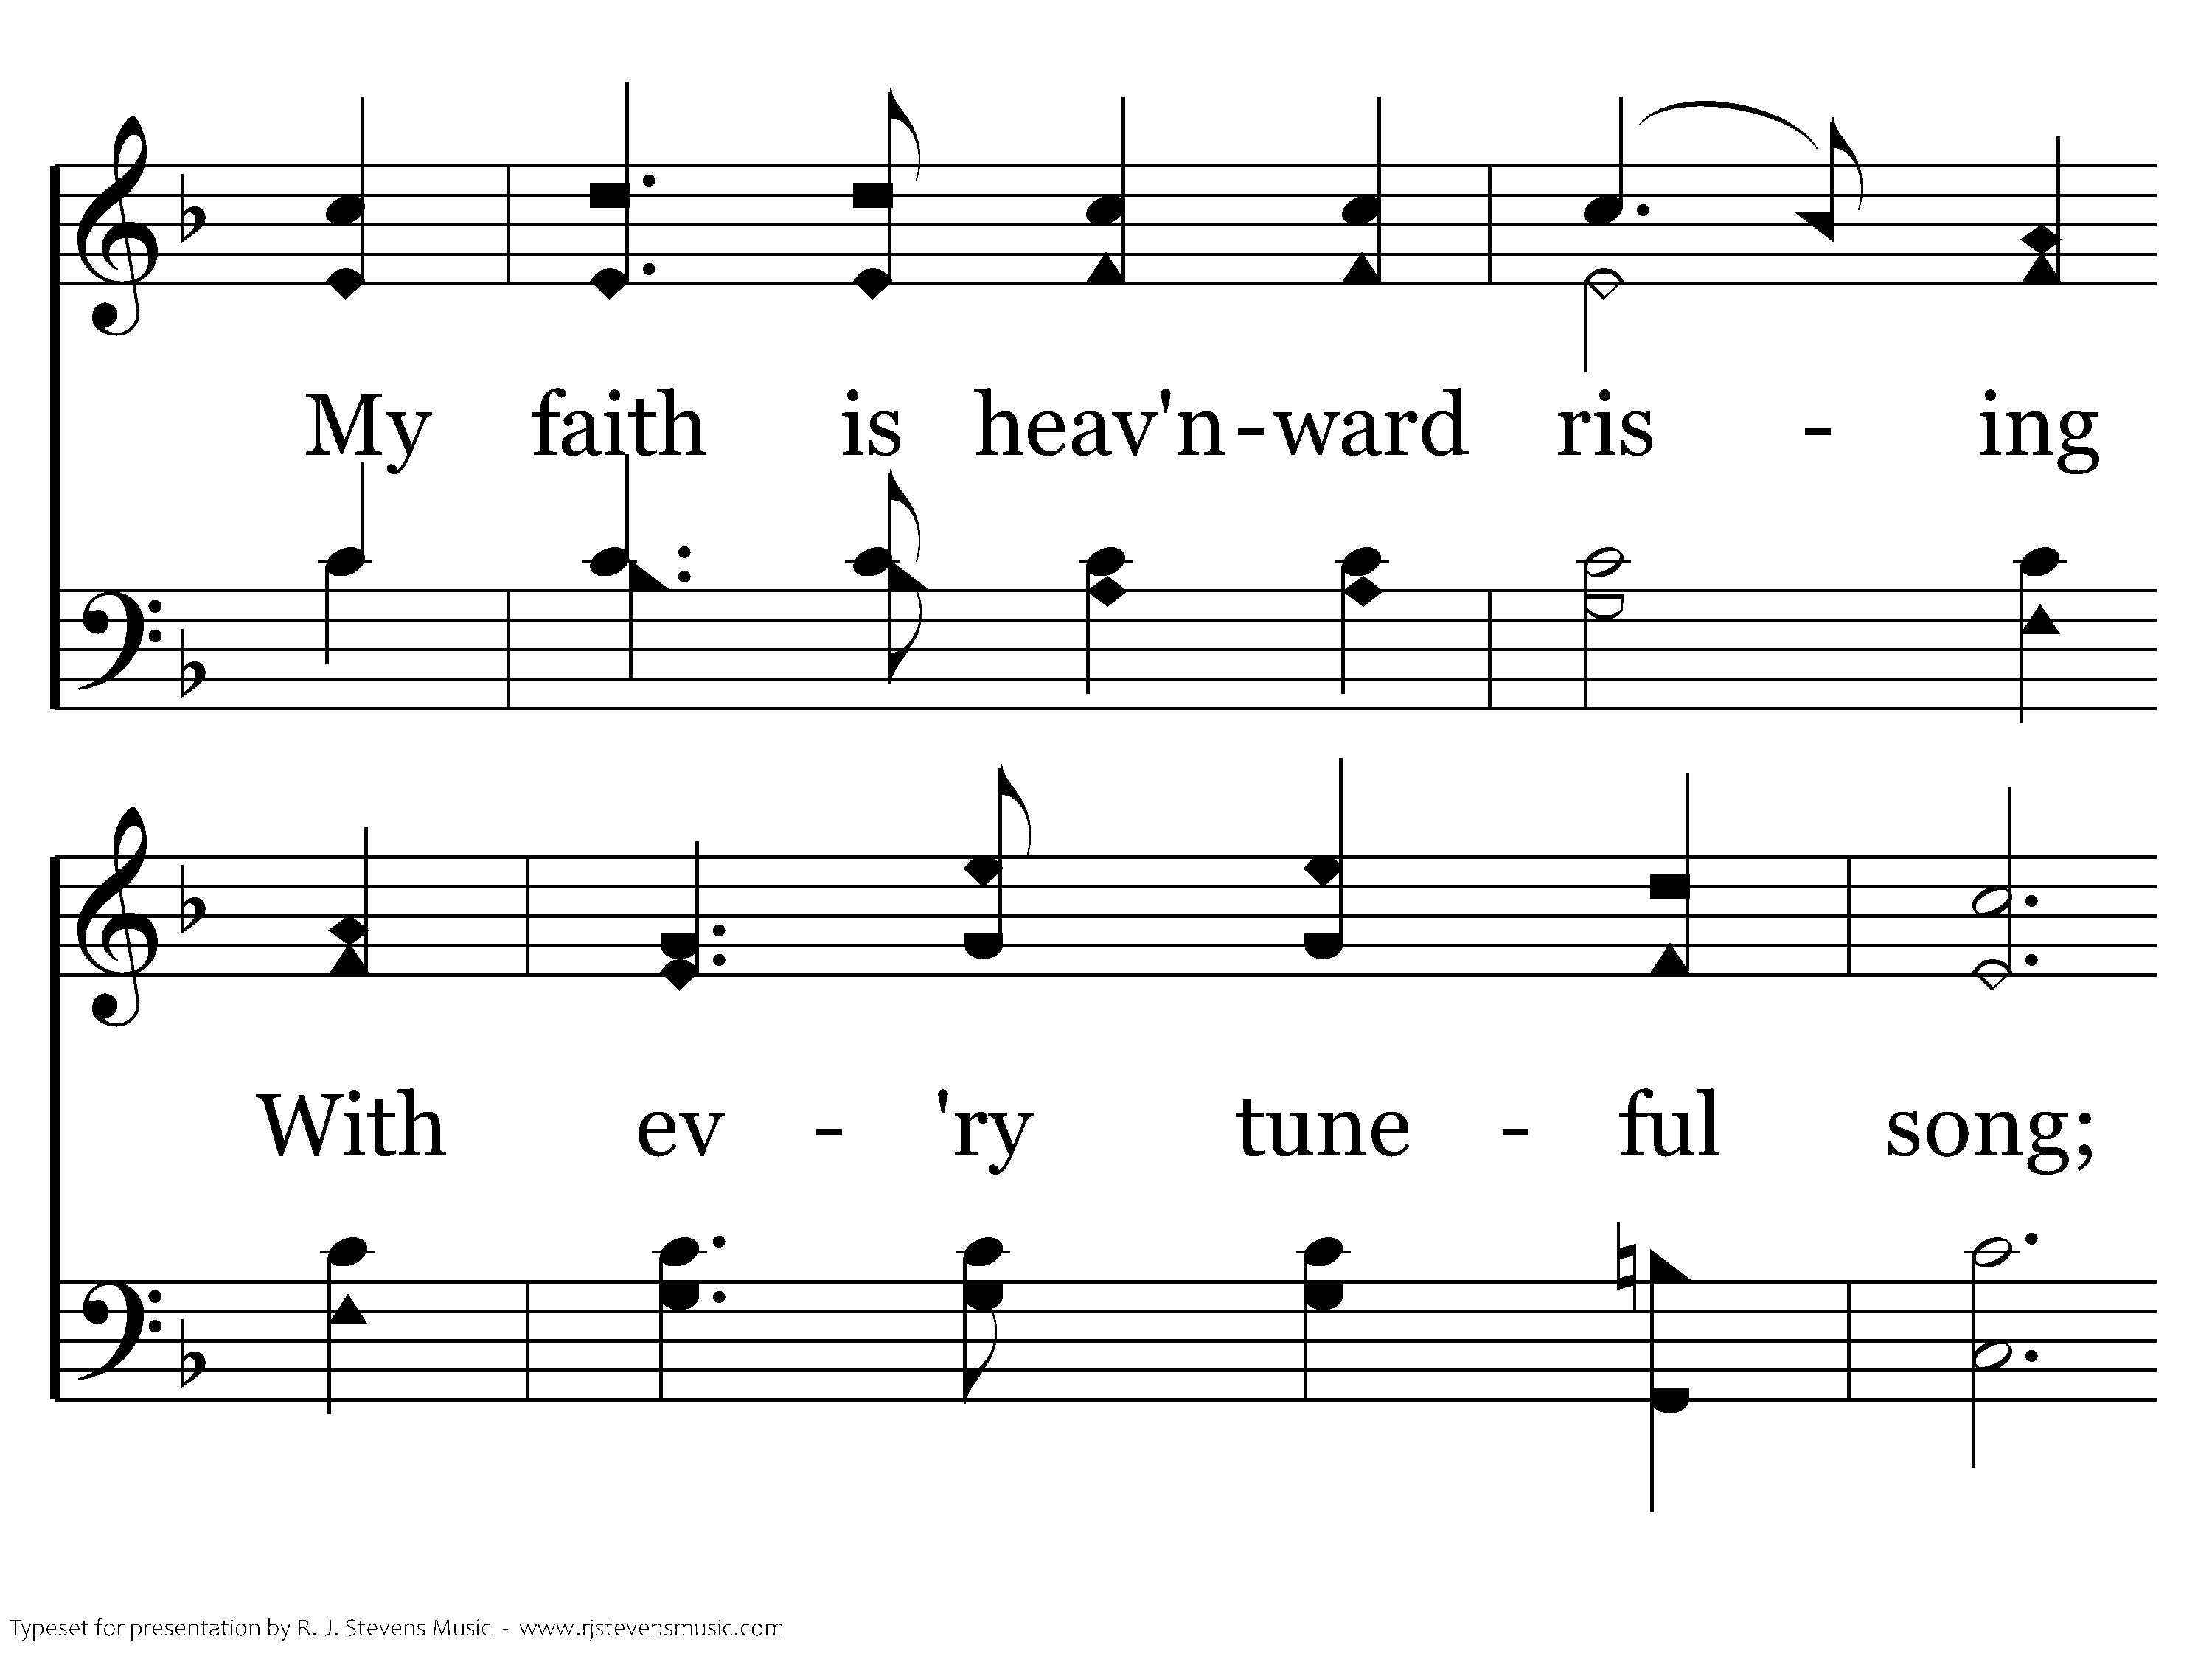
389 - Sing On, Ye Joyful Pilgrims - 1.2

Slide 54
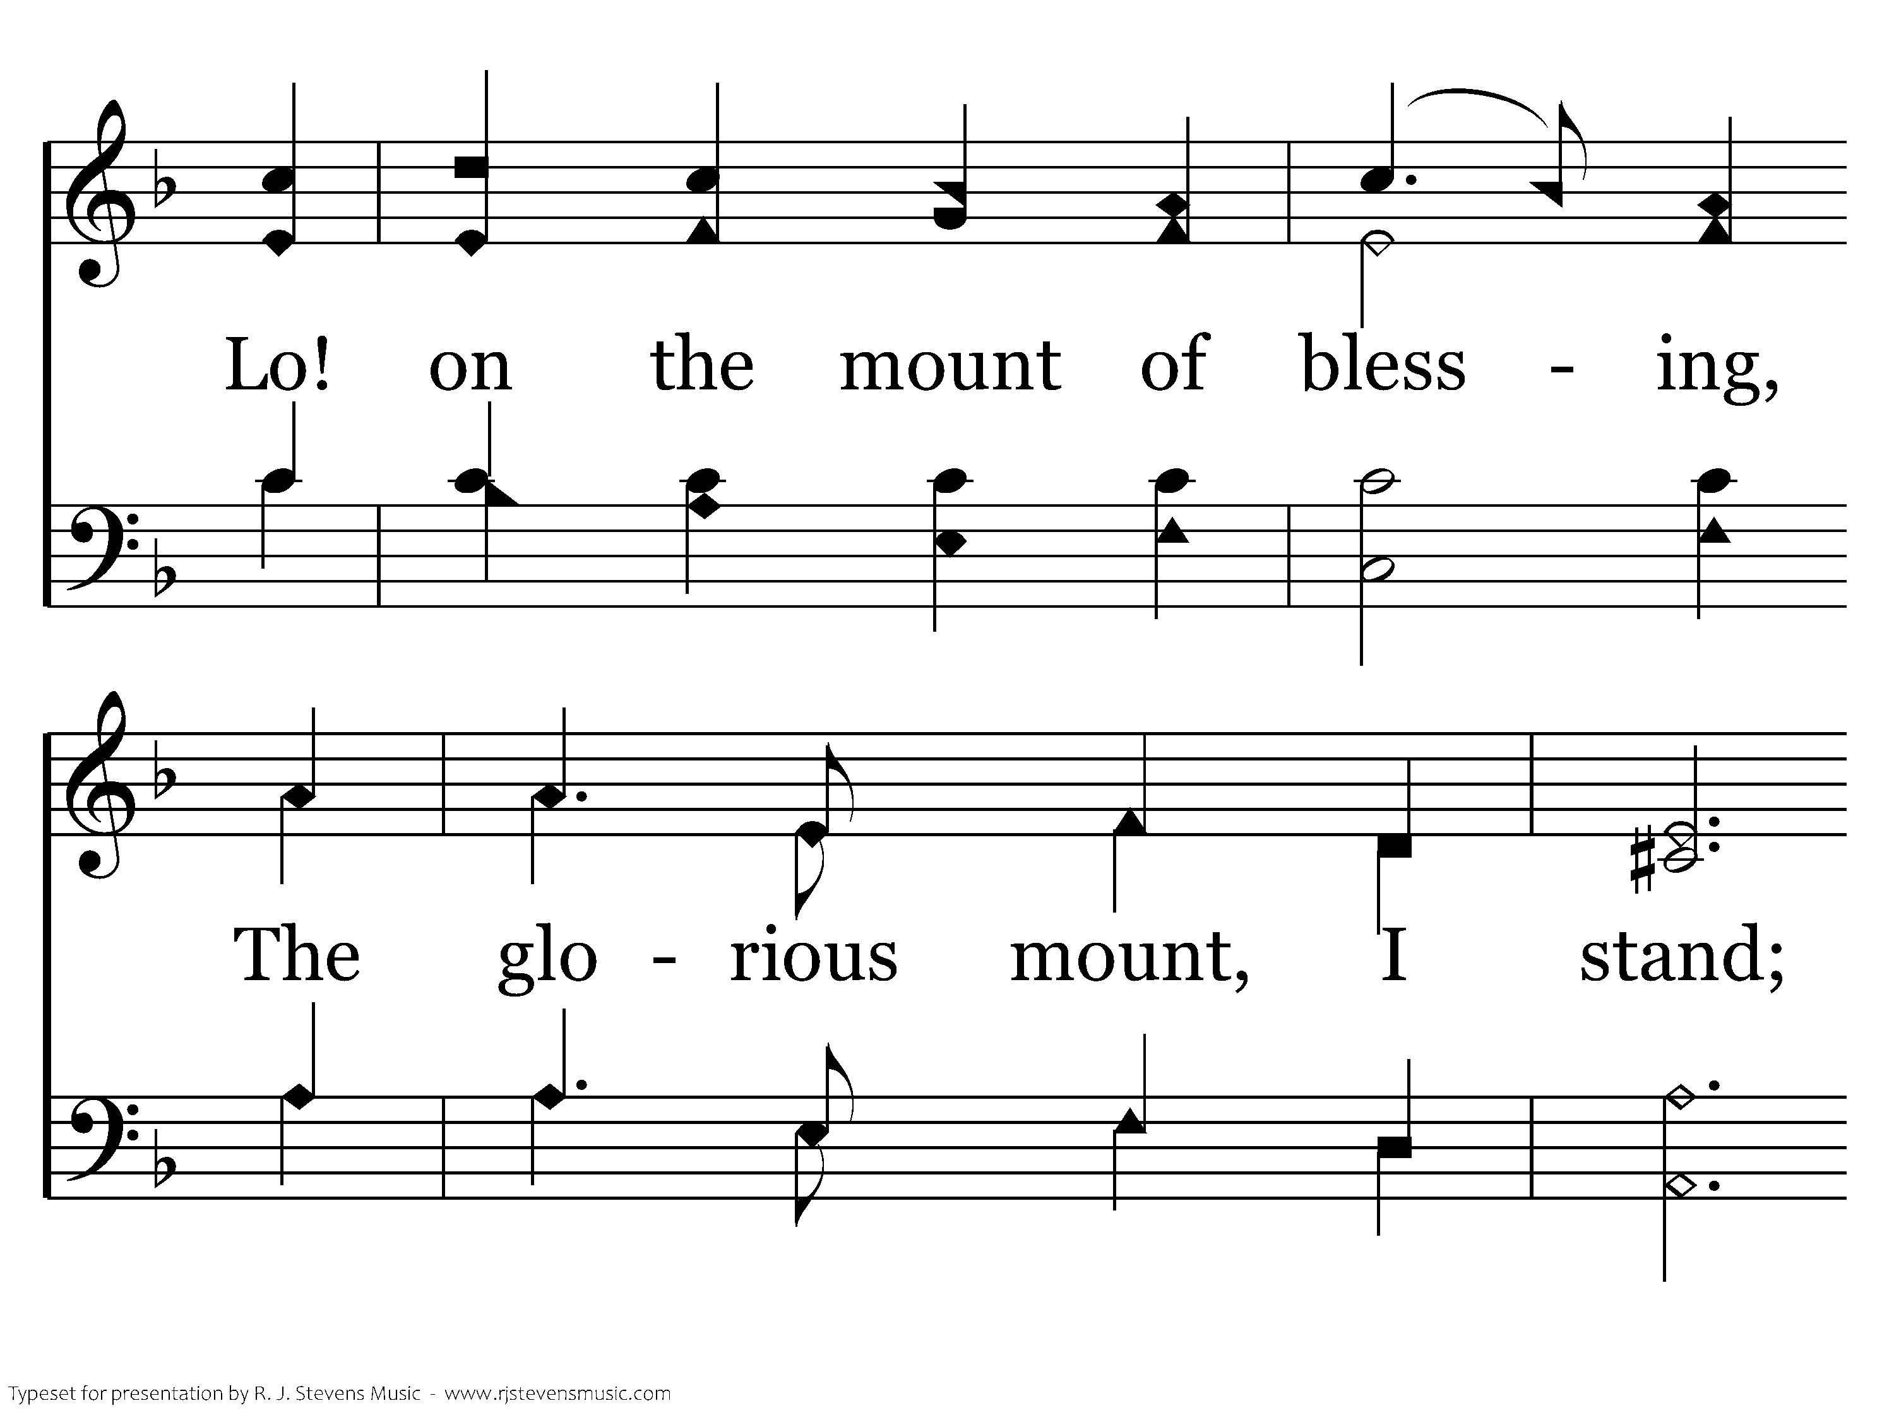
389 - Sing On, Ye Joyful Pilgrims - 1.3

Slide 55
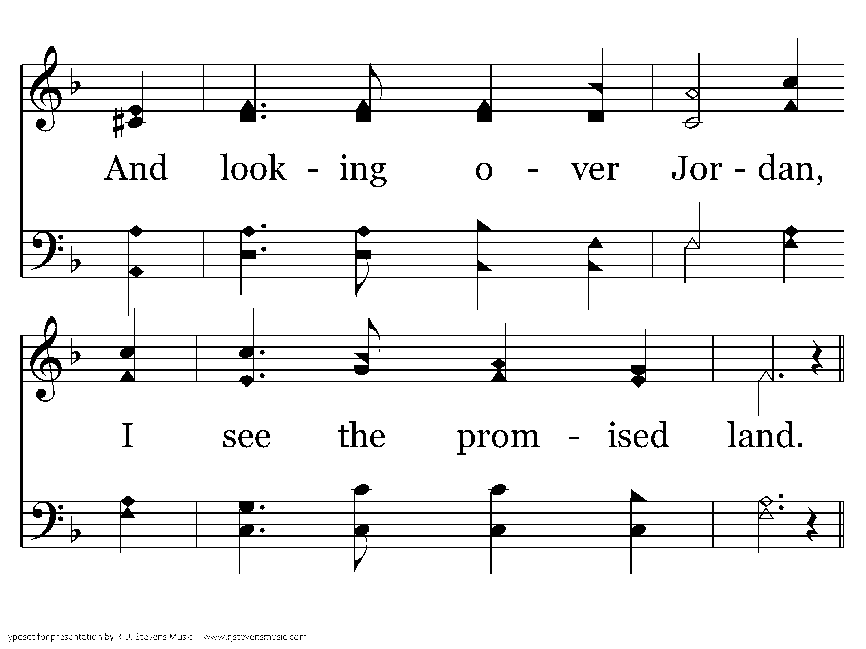
389 - Sing On, Ye Joyful Pilgrims - 1.4

Slide 56
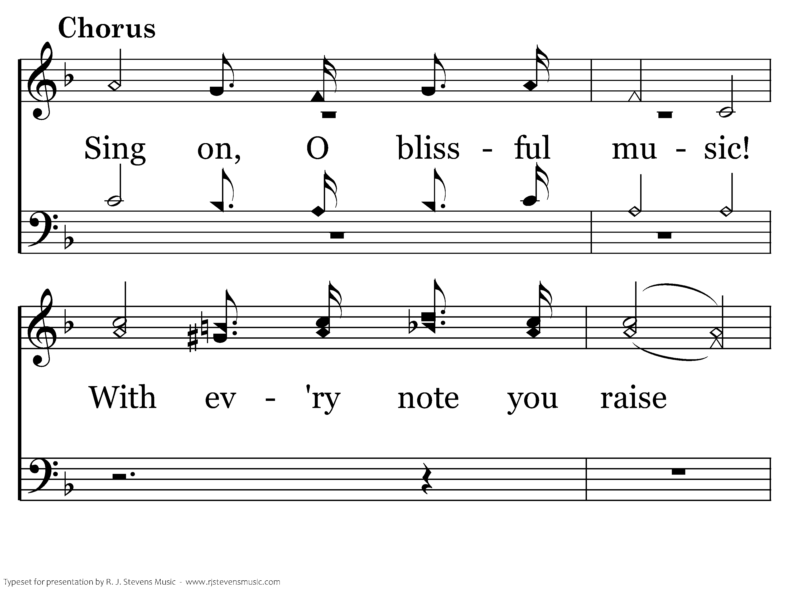
389 - Sing On, Ye Joyful Pilgrims - C.1

Slide 57
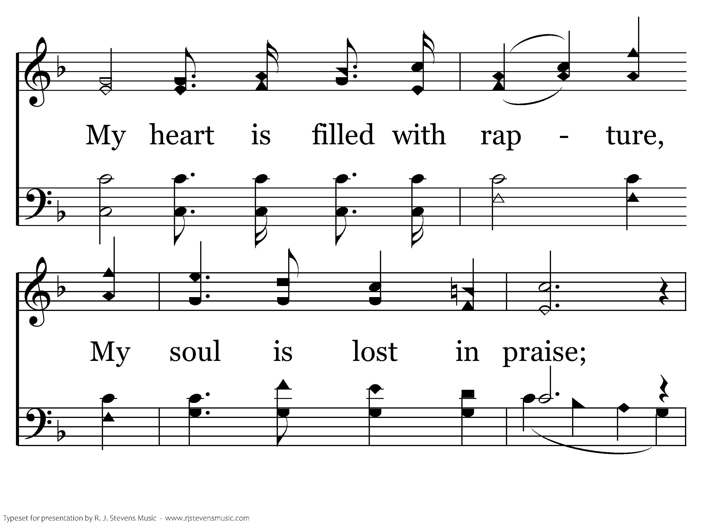
389 - Sing On, Ye Joyful Pilgrims - C.2

Slide 58

389 - Sing On, Ye Joyful Pilgrims - C.3

Slide 59

389 - Sing On, Ye Joyful Pilgrims - C.4
End of Verse 1

Slide 60

389 - Sing On, Ye Joyful Pilgrims - 2.1

Slide 61

389 - Sing On, Ye Joyful Pilgrims - 2.2

Slide 62

389 - Sing On, Ye Joyful Pilgrims - 2.3

Slide 63

389 - Sing On, Ye Joyful Pilgrims - 2.4

Slide 64
389 - Sing On, Ye Joyful Pilgrims - C.1

Slide 65
389 - Sing On, Ye Joyful Pilgrims - C.2

Slide 66
389 - Sing On, Ye Joyful Pilgrims - C.3

Slide 67
389 - Sing On, Ye Joyful Pilgrims - C.4
End of Verse 2

Slide 68

389 - Sing On, Ye Joyful Pilgrims - 3.1

Slide 69

389 - Sing On, Ye Joyful Pilgrims - 3.2

Slide 70

389 - Sing On, Ye Joyful Pilgrims - 3.3

Slide 71

389 - Sing On, Ye Joyful Pilgrims - 3.4

Slide 72
389 - Sing On, Ye Joyful Pilgrims - C.1

Slide 73
389 - Sing On, Ye Joyful Pilgrims - C.2

Slide 74
389 - Sing On, Ye Joyful Pilgrims - C.3

Slide 75
389 - Sing On, Ye Joyful Pilgrims - C.4
End of Song

Slide 76
Paul and Silas in Prison
Acts 16:16-34
What Have We Learned?
There is Power in Prayer
There is Power in Singing Praises to God
The Gospel can be spread through Prayer and Song
There is Joy in Believing
Lost Souls are Watching and Listening

Slide 78

322 - Bring Christ Your Broken Life - Title

Slide 79

322 - Bring Christ Your Broken Life - 1.1

Slide 80

322 - Bring Christ Your Broken Life - 1.2
End of Verse 1

Slide 81

322 - Bring Christ Your Broken Life - 2.1

Slide 82

322 - Bring Christ Your Broken Life - 2.2
End of Verse 2

Slide 83

322 - Bring Christ Your Broken Life - 3.1

Slide 84

322 - Bring Christ Your Broken Life - 3.2
End of Song

