Slide 2
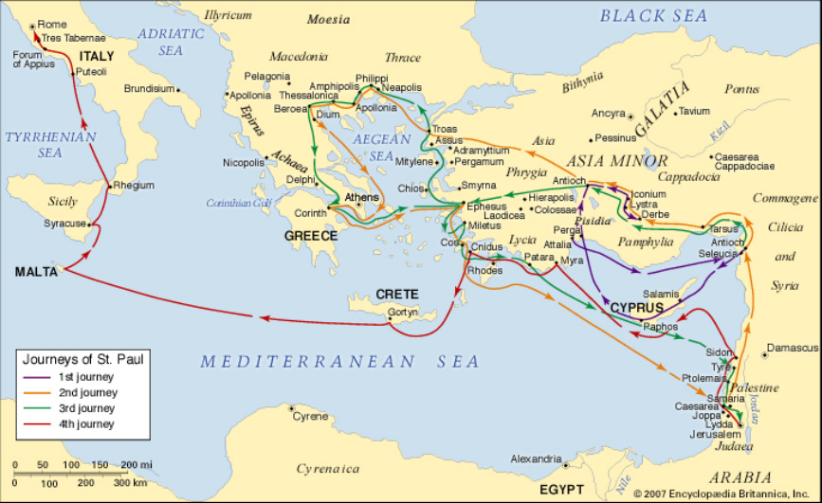
The Apostle Paul
A Man of Great Zeal

Slide 3
Zeal
“great energy or enthusiasm in pursuit of a cause of objective”
Zelos – “to be hot, or heat” (Strong’s)
Biblical zeal is likened to a fire.

Slide 4
Before Saul’s Conversion
Acts 22:3-5
Philippians 3:6
Galatians 1:13-14
1 Timothy 1:13

Slide 5
Zeal in Saving the Lost
Acts 26:15-20

Slide 6
Zeal in Saving the Lost
Brethren, my heart’s desire and prayer to God for Israel is that they may be saved.
Romans 10:1
I am a debtor both to Greeks and to barbarians, both to wise and to unwise. So, as much as is in me, I am ready to preach the gospel to you who are in Rome also.
Romans 1:14-15

Slide 7
Zeal in Saving the Lost
For if I preach the gospel, I have nothing to boast of, for necessity is laid upon me; yes, woe is me if I do not preach the gospel!
1 Corinthians 9:16

Slide 8
Zeal in Saving the Lost
Romans 15:20-21

Slide 9
Zeal in Saving the Lost
Acts 20:18-21
He labored tirelessly.
Took advantage of every opportunity.
Taught the gospel to everyone.

Slide 10
Zeal in Strengthening Christians

Slide 11
Zeal in Strengthening Christians
My little children, for whom I labor in birth again until Christ is formed in you.
Galatians 4:19

Slide 12
Zeal in Strengthening Christians
For I want you to know what a great conflict
I have for you and those in Laodicea, and for as many as have not seen my face in the flesh.
Colossians 2:1

Slide 13
Zeal in Strengthening Christians
1 Thessalonians 3:1-2
Acts 14:21-23

Slide 14
Zeal in Protecting the Church
For I am jealous for you with godly jealousy. For I have betrothed you to one husband, that I may present you as a chaste virgin to Christ.
2 Corinthians 11:2

Slide 15
Paul was a man of great zeal.
Strong part of his character before his conversion.
Zeal in saving the lost.
Zeal in strengthening the saved.
Zeal in protecting the church.
“Brethren, join in following my example,
and note those who so walk, as you have us
for a pattern” (Phil. 3:17).

