Slide 1
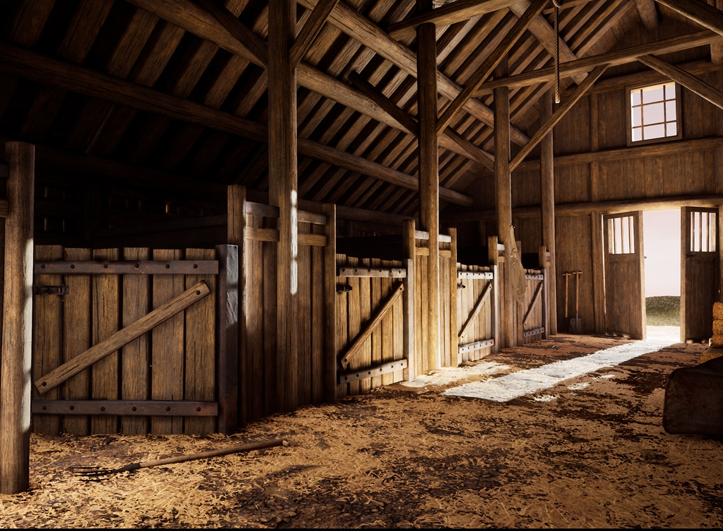

Slide 2
Proverbs 14:4
[ESV] Where there are no oxen, the manger is clean, but abundant crops come by the strength of the ox.
[NLT] Without oxen a stable stays clean, but you need a strong ox for a large harvest.

Slide 3
Revelation 3:2
Wake up, and strengthen what remains and is about to die, for I have not found your works complete in the sight of my God.

Slide 4
Revelation 3:15-17
(15) "'I know your works: you are neither cold nor hot. Would that you were either cold or hot! (16) So, because you are lukewarm, and neither hot nor cold, I will spit you out of my mouth.

Slide 5
Revelation 3:15-17
(17) For you say, I am rich, I have prospered, and I need nothing, not realizing that you are wretched, pitiable, poor, blind, and naked.

Slide 6
Proverbs 14:4
Without oxen a stable stays clean, but you need a strong ox for a large harvest.

Slide 7
Isaiah 65:25
The wolf and the lamb shall graze together; the lion shall eat straw like the ox, and dust shall be the serpent's food. They shall not hurt or destroy in all my holy mountain," says the LORD.

Slide 8
Colossians 3:11-14
(11) Here there is not Greek and Jew, circumcised and uncircumcised, barbarian, Scythian, slave, free; but Christ is all, and in all. …

Slide 9
Proverbs 14:4
Without oxen a stable stays clean, but you need a strong ox for a large harvest.

Slide 10
Proverbs 22:13
The sluggard says, “There is a lion outside! I shall be killed in the streets!”

Slide 11
Proverbs 14:4
Without oxen a stable stays clean, but you need a strong ox for a large harvest.

