Slide 2
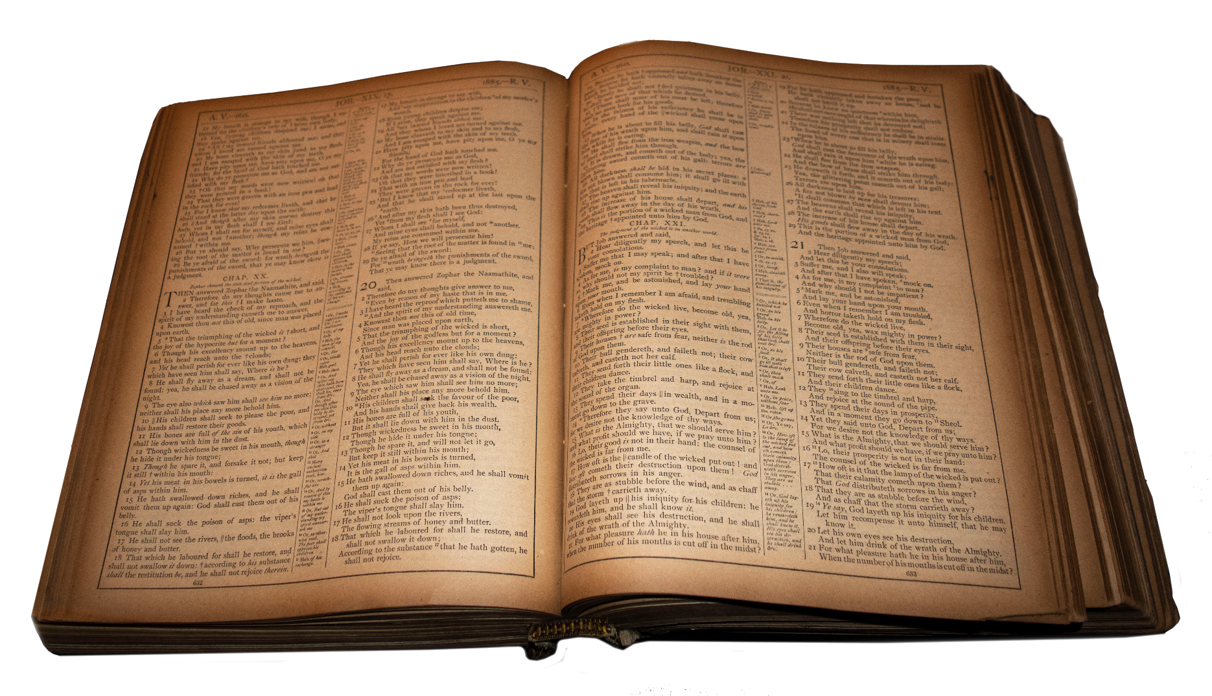
Power Beyond Comprehension
Job 26.5-9

Slide 3
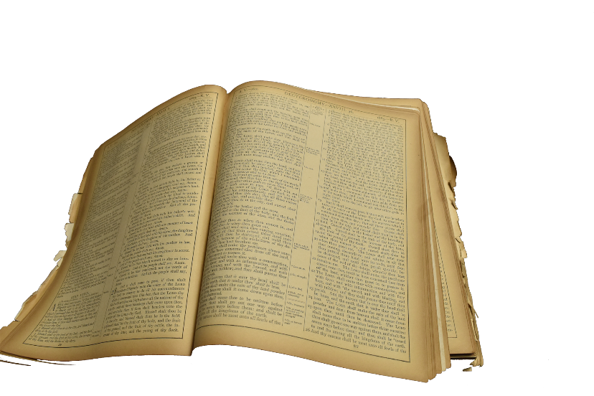
A Sound Rebuttal
Job 26.2
Job 26.3
Job 26.4
How hast thou helped him that is without power? how savest thou the arm that hath no strength?

Slide 4
A Sound Rebuttal
Job 26.2
Job 26.3
Job 26.4
How hast thou counselled him that hath no wisdom? and how hast thou plentifully declared the thing as it is?

Slide 5
A Sound Rebuttal
Job 26.2
Job 26.3
Job 26.4
To whom hast thou uttered words? and whose spirit came from thee?

Slide 6
God’s Presence & Vision
Job 26.6
Psm 139.7-8
Prov 15.11
Jonah 2.1-2
Hell is naked before him, and destruction hath no covering.

Slide 7
God’s Presence & Vision
Job 26.6
Psm 139.7-8
Prov 15.11
Jonah 2.1-2
Whither shall I go from thy spirit? or whither shall I flee from thy presence? If I ascend up into heaven, thou art there: if I make my bed in hell, behold, thou art there.

Slide 8
God’s Presence & Vision
Job 26.6
Psm 139.7-8
Prov 15.11
Jonah 2.1-2
Hell and destruction are before the LORD: how much more then the hearts of the children of men?

Slide 9
God’s Presence & Vision
Job 26.6
Psm 139.7-8
Prov 15.11
Jonah 2.1-2
Then Jonah prayed unto the LORD his God out of the fish's belly, And said, I cried by reason of mine affliction unto the LORD, and he heard me; out of the belly of hell cried I, and thou heardest my voice.

Slide 10
God’s Power To Create
Job 26.7
Psm 104.2
Isa 40.21-22
He stretcheth out the north over the empty place, and hangeth the earth upon nothing.

Slide 11
God’s Power To Create
Job 26.7
Psm 104.2
Isa 40.21-22
Who coverest thyself with light as with a garment: who stretchest out the heavens like a curtain:

Slide 12
God’s Power To Create
Job 26.7
Psm 104.2
Isa 40.21-22
Have ye not known? have ye not heard? hath it not been told you from the beginning? have ye not understood from the foundations of the earth? It is he that sitteth upon the circle of the earth, and the inhabitants thereof are as grasshoppers; that stretcheth out the heavens as a curtain, and spreadeth them out as a tent to dwell in:

Slide 13
God’s Power Over The Elements
Job 26.8
Prov 30.4
Isa 40.12
He bindeth up the waters in his thick clouds; and the cloud is not rent under them

Slide 14
God’s Power Over The Elements
Job 26.8
Prov 30.4
Isa 40.12
Who hath ascended up into heaven, or descended? who hath gathered the wind in his fists? who hath bound the waters in a garment? who hath established all the ends of the earth? what is his name, and what is his son's name, if thou canst tell?

Slide 15
God’s Power Over The Elements
Job 26.8
Prov 30.4
Isa 40.12
Who hath measured the waters in the hollow of his hand, and meted out heaven with the span, and comprehended the dust of the earth in a measure, and weighed the mountains in scales, and the hills in a balance?

Slide 16
God’s Concealment
Job 26.9
Psm 104.3
Eccl 3.11
He holdeth back the face of his throne, and spreadeth his cloud upon it.

Slide 17
God’s Concealment
Job 26.9
Psm 104.3
Eccl 3.11
Who layeth the beams of his chambers in the waters: who maketh the clouds his chariot: who walketh upon the wings of the wind:

Slide 18
God’s Concealment
Job 26.9
Psm 104.3
Eccl 3.11
He hath made every thing beautiful in his time: also he hath set the world in their heart, so that no man can find out the work that God maketh from the beginning to the end.

Slide 19
God’s Judgment & Salvation
Heb 1.3
John 14.9
Rom 11.22
2 Cor 5.11
Who being the brightness of his glory, and the express image of his person

Slide 20
God’s Judgment & Salvation
Heb 1.3
John 14.9
Rom 11.22
2 Cor 5.11
Have I been so long time with you, and yet hast thou not known me, Philip? he that hath seen me hath seen the Father; and how sayest thou then, Shew us the Father?

Slide 21
God’s Judgment & Salvation
Heb 1.3
John 14.9
Rom 11.22
2 Cor 5.11
Behold therefore the goodness and severity of God: on them which fell, severity; but toward thee, goodness, if thou continue in his goodness: otherwise thou also shalt be cut off.

Slide 22
God’s Judgment & Salvation
Heb 1.3
John 14.9
Rom 11.22
2 Cor 5.11
Knowing therefore the terror of the Lord, we persuade men

Slide 23
God’s Judgment & Salvation
Acts 17.31
2 Thess 1.7-8
Matt 10.28
Because he hath appointed a day, in the which he will judge the world in righteousness by that man whom he hath ordained; whereof he hath given assurance unto all men, in that he hath raised him from the dead.

Slide 24
God’s Judgment & Salvation
Acts 17.31
2 Thess 1.7-9
Matt 10.28
The Lord Jesus shall be revealed from heaven with his mighty angels, In flaming fire taking vengeance on them that know not God, and that obey not the gospel of our Lord Jesus Christ: Who shall be punished with everlasting destruction from the presence of the Lord, and from the glory of his power

Slide 25
God’s Judgment & Salvation
Acts 17.31
2 Thess 1.7-8
Matt 10.28
And fear not them which kill the body, but are not able to kill the soul: but rather fear him which is able to destroy both soul and body in hell.

Slide 26
God, Reconciliaton & Resurrection
Acts 4.10
Acts 13.30
1 Cor 15.27-28
Be it known unto you all, and to all the people of Israel, that by the name of Jesus Christ of Nazareth, whom ye crucified, whom God raised from the dead, even by him doth this man stand here before you whole.

Slide 27
God, Reconciliaton & Resurrection
Acts 4.10
Acts 13.30
1 Cor 15.27-28
But God raised him from the dead

Slide 28
God, Reconciliaton & Resurrection
Acts 4.10
Acts 13.30
1 Cor 15.27-28
For he hath put all things under his feet. But when he saith all things are put under him, it is manifest that he is excepted, which did put all things under him. And when all things shall be subdued unto him, then shall the Son also himself be subject unto him that put all things under him, that God may be all in all.

Slide 29

1 Cor 15.24
Then cometh the end, when he shall have delivered up the kingdom to God, even the Father; when he shall have put down all rule and all authority and power.

