Slide 2
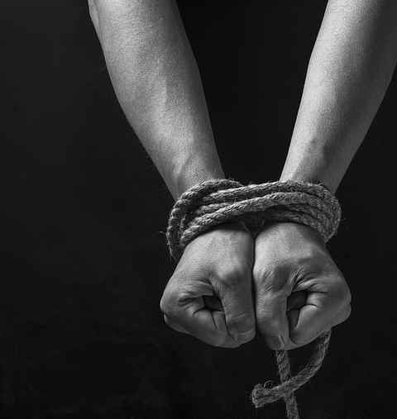
The Consequences of
Doing the Right Thing
Genesis 39:7-20

Slide 3
Experiences of Joseph
He was hated by his brothers. They sold him to the Midianites who took him to Egypt and sold him as a slave (Gen. 37).
He did the right thing by God and Potiphar - but ended up in prison (Gen. 39).
He was forgotten by the butler and spent 2 additional years in prison (Gen. 40).

Slide 4
Others Have Suffered Unfairly
Job
Jeremiah
John the Baptist
Apostles
Stephen

Slide 5
The End Intended by the Lord
My brethren, take the prophets, who spoke in the name of the Lord, as an example of suffering and patience.
Indeed we count them blessed who endure. You have heard of the perseverance of Job and seen the end intended by the Lord - that the Lord is very compassionate and merciful.
James 5:10-11

Slide 6
The End Intended by the Lord
Joseph got to see the blessings of his faithfulness.
“for God sent me before you to preserve life”
“And God sent me before you to preserve a posterity for you in the earth”
“So now it was not you who sent me here, but God”
“God has made me lord of all Egypt”
Genesis 45:4-9

Slide 7
The End Intended by the Lord
Suffering can mean we are on the right track -
Matthew 5:10-12
Suffering can build character - 1 Pet. 1:6-7
Suffering can equip us to better serve others -
2 Corinthians 1:3-4
Suffering can help us long for heaven -
2 Cor. 4:16-18; Rom. 1:18

