Slide 2

Plucking Calvin’s TULIP
Refuting the 5 Points of Calvinism

Slide 3
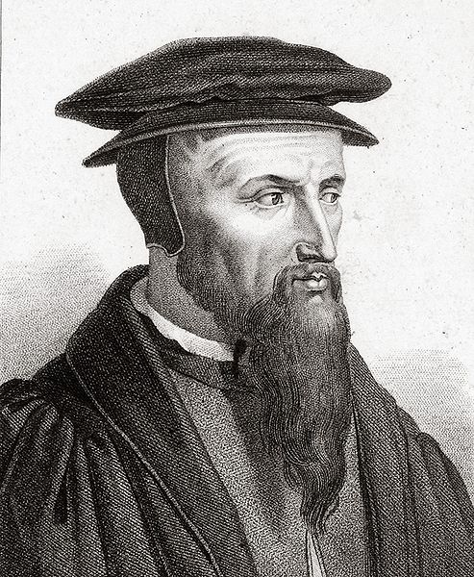
Calvinism
John Calvin (1509-1564)
Influenced by writings of Augustine (354-430 A.D.)
Today, Calvinism is also known as Reformed Theology.

Slide 4
Calvinism
Few denominations today are fully Calvinistic:
  Presbyterian Churches
  United Reformed Churches
  Reformed Baptist Churches
However, most Protestant churches hold to some tenets of Calvinism.
  Lutheran Churches
  Baptist Churches
  Methodist Churches

Slide 5
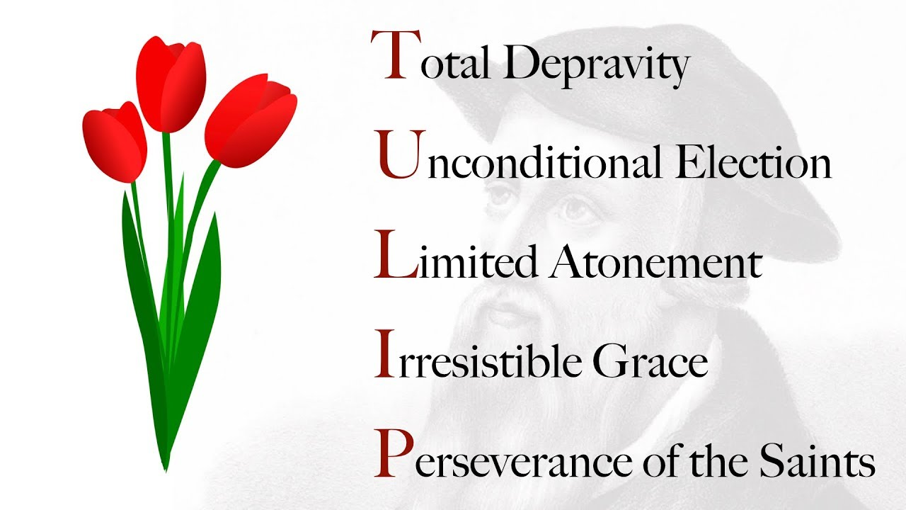

Slide 6
1. Total Depravity
Because of the sin of Adam, all people are born totally depraved (sinful, corrupted).
This is inherited from our parents, who got it from their parents.
All people are depraved sinners because the sin of Adam has been passed down to all of mankind.

Slide 7
1. Total Depravity
Because of the sin of Adam, all people are born totally depraved (sinful, corrupted).
This is inherited from our parents, who got it from their parents.
All people are depraved sinners because the sin of Adam has been passed down to all of mankind.
The soul who sins shall die. The son shall not bear the guilt of the father, nor the father bear the guilt of the son. The righteousness of the righteous shall be upon himself, and the wickedness of the wicked shall be upon himself.
Ezekiel 18:20

Slide 8
1. Total Depravity
Because of the sin of Adam, all people are born totally depraved (sinful, corrupted).
This is inherited from our parents, who got it from their parents.
All people are depraved sinners because the sin of Adam has been passed down to all of mankind.
I call heaven and earth as witnesses today against you, that I have set before you life and death, blessing and cursing; therefore choose life, that both you and your descendants may live.
Deuteronomy 30:19

Slide 9
2. Unconditional Election
Since we are totally depraved from birth, it is impossible for us to choose to serve God.
Only an act of God can make us spiritually minded in any way.
Therefore – God chooses who will be saved.
Consequently, He also chooses who will be lost.
“Unconditional” means this choice was not based on us, only on God’s sovereignty and good pleasure.

Slide 10
2. Unconditional Election
Since we are totally depraved from birth, it is impossible for us to choose to serve God.
Only an act of God can make us spiritually minded in any way.
Therefore – God chooses who will be saved.
Consequently, He also chooses who will be lost.
“Unconditional” means this choice was not based on us, only on God’s sovereignty and good pleasure.
Then Peter opened his mouth and said: “In truth I perceive that God shows no partiality. But in every nation whoever fears Him and works righteousness is accepted by Him.”
Acts 10:34-35

Slide 11
2. Unconditional Election
Since we are totally depraved from birth, it is impossible for us to choose to serve God.
Only an act of God can make us spiritually minded in any way.
Therefore – God chooses who will be saved.
Consequently, He also chooses who will be lost.
“Unconditional” means this choice was not based on us, only on God’s sovereignty and good pleasure.
For this is good and acceptable in the sight of God our Savior, who desires all men to be saved and to come to the knowledge of the truth.
1 Timothy 2:3-4

Slide 12
2. Unconditional Election
Since we are totally depraved from birth, it is impossible for us to choose to serve God.
Only an act of God can make us spiritually minded in any way.
Therefore – God chooses who will be saved.
Consequently, He also chooses who will be lost.
“Unconditional” means this choice was not based on us, only on God’s sovereignty and good pleasure.
The Lord is not slack concerning His promise, as some count slackness, but is longsuffering toward us, not willing that any should perish but that all should come to repentance.
2 Peter 3:9

Slide 13
3. Limited Atonement
Since God knew He would only save certain individuals whom He had chosen, He sent Christ to die only for those individuals.
The blood Jesus shed on the cross was not for everyone, but only those whom God had already chosen to save.

Slide 14
3. Limited Atonement
Since God knew He would only save certain individuals whom He had chosen, He sent Christ to die only for those individuals.
The blood Jesus shed on the cross was not for everyone, but only those whom God had already chosen to save.
For the love of Christ compels us, because we judge thus: that if One died for all, then all died; and He died for all, that those who live should live no longer for themselves, but for Him who died for them and rose again.
2 Corinthians 5:14-15

Slide 15
3. Limited Atonement
Since God knew He would only save certain individuals whom He had chosen, He sent Christ to die only for those individuals.
The blood Jesus shed on the cross was not for everyone, but only those whom God had already chosen to save.
But we see Jesus, who was made a little lower than the angels, for the suffering of death crowned with glory and honor, that He, by the grace of God, might taste death for everyone.
Hebrews 2:9

Slide 16
3. Limited Atonement
Since God knew He would only save certain individuals whom He had chosen, He sent Christ to die only for those individuals.
The blood Jesus shed on the cross was not for everyone, but only those whom God had already chosen to save.
And He Himself is the propitiation for our sins, and not for ours only but also for the whole world...
And we have seen and testify that the Father has sent the Son as Savior of the world.
1 John 2:2; 4:14

Slide 17
4. Irresistible Grace
Because we are not capable of choosing to be saved, God must act directly upon our hearts.
Those who are saved are called through the power of the Holy Spirit.
“Irresistible” – it is impossible for us to reject this special calling from the Holy Spirit.

Slide 18
4. Irresistible Grace
Because we are not capable of choosing to be saved, God must act directly upon our hearts.
Those who are saved are called through the power of the Holy Spirit.
“Irresistible” – it is impossible for us to reject this special calling from the Holy Spirit.
The Gospel is God’s Power to Salvation
For I am not ashamed of the gospel of Christ, for it is the power of God to salvation for everyone who believes, for the Jew first and also for the Greek.
Romans 1:16

Slide 19
4. Irresistible Grace
Because we are not capable of choosing to be saved, God must act directly upon our hearts.
Those who are saved are called through the power of the Holy Spirit.
“Irresistible” – it is impossible for us to reject this special calling from the Holy Spirit.
The Holy Spirit Can Be Resisted
You stiff-necked and uncircumcised in heart and ears! You always resist the Holy Spirit; as your fathers did, so do you.
Acts 7:51

Slide 20
5. Perseverance of the Saints
Christians are kept in the power of God and can never do anything to cause themselves to be lost.
“Once Saved - Always Saved”

Slide 22
5. Perseverance of the Saints
Christians are kept in the power of God and can never do anything to cause themselves to be lost.
“Once Saved - Always Saved”
You have become estranged from Christ,
you who attempt to be justified by law;
you have fallen from grace.
Galatians 5:4

Slide 23
Calvinism
Does NOT Scripturally reconcile God’s sovereignty and man’s freewill.
Does NOT defend the honor and majesty of God.
Appeals to those who are spiritually lazy.
Can influence Christians if we are not careful!

