Slide 1
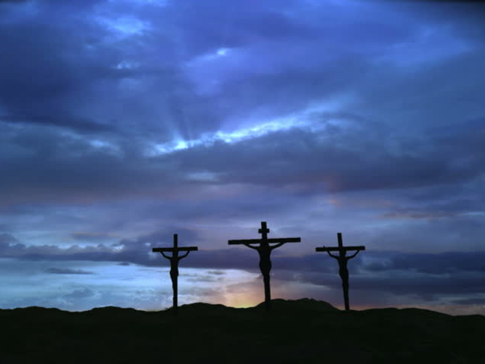
How Deep the Father’s Love
A Hymn Study

Slide 2
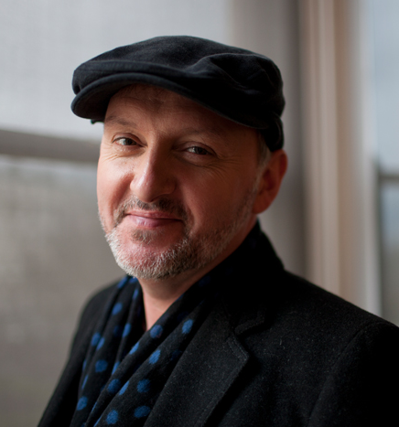
“How Deep the Father’s Love”
Written in 1995 by Stuart Townend.
Born in West Yorkshire, England,
in 1963.
A worship leader and writer of hymns and contemporary worship music.
Also wrote “In Christ Alone.”

Slide 3
Verse 1
How deep the Father’s love for us!
How vast beyond all measure!
That He should give His only Son
to make a wretch His treasure!
How great the pain of searing loss!
The Father turns His face away
as wounds which mar the Chosen One
bring many sons to glory.

Slide 4
Verse 1
How deep the Father’s love for us!
How vast beyond all measure!
That He should give His only Son
to make a wretch His treasure!
How great the pain of searing loss!
The Father turns His face away
as wounds which mar the Chosen One
bring many sons to glory.

Slide 5
Verse 1
How deep the Father’s love for us!
How vast beyond all measure!
That He should give His only Son
to make a wretch His treasure!
How great the pain of searing loss!
The Father turns His face away
as wounds which mar the Chosen One
bring many sons to glory.
Romans 5:7-8

Slide 6
Verse 1
Wretch:
“inferior, contemptible, despicable”
Isaiah 64:6
1 Peter 2:9-10
How deep the Father’s love for us!
How vast beyond all measure!
That He should give His only Son
to make a wretch His treasure!
How great the pain of searing loss!
The Father turns His face away
as wounds which mar the Chosen One
bring many sons to glory.

Slide 7
Verse 1
How deep the Father’s love for us!
How vast beyond all measure!
That He should give His only Son
to make a wretch His treasure!
How great the pain of searing loss!
The Father turns His face away
as wounds which mar the Chosen One
bring many sons to glory.
Matt. 27:45-46

Slide 8
Verse 2
Behold the Man upon the cross,
My sin upon His shoulders;
Ashamed I hear my mocking voice
call out among the scoffers.
It was my sin that held Him there
Until it was accomplished.
His dying breath has bro’t me life;
I know that it is finished.

Slide 9
Verse 2
Behold the Man upon the cross,
My sin upon His shoulders;
Ashamed I hear my mocking voice
call out among the scoffers.
It was my sin that held Him there
Until it was accomplished.
His dying breath has bro’t me life;
I know that it is finished.

Slide 10
Verse 2
Behold the Man upon the cross,
My sin upon His shoulders;
Ashamed I hear my mocking voice
call out among the scoffers.
It was my sin that held Him there
Until it was accomplished.
His dying breath has bro’t me life;
I know that it is finished.
John 19:5

Slide 11
Verse 2
Behold the Man upon the cross,
My sin upon His shoulders;
Ashamed I hear my mocking voice
call out among the scoffers.
It was my sin that held Him there
Until it was accomplished.
His dying breath has bro’t me life;
I know that it is finished.
“The Lord has laid on Him the iniquity
of us all.”
Isaiah 53:6

Slide 12
Verse 2
Behold the Man upon the cross,
My sin upon His shoulders;
Ashamed I hear my mocking voice
call out among the scoffers.
It was my sin that held Him there
Until it was accomplished.
His dying breath has bro’t me life;
I know that it is finished.
Matthew 27:29, 39-44

Slide 13
Verse 2
Behold the Man upon the cross,
My sin upon His shoulders;
Ashamed I hear my mocking voice
call out among the scoffers.
It was my sin that held Him there
Until it was accomplished.
His dying breath has bro’t me life;
I know that it is finished.
1 John 4:10
Propitiation:
“an appeasing sacrifice,
that which satisfies.”

Slide 14
Verse 3
I will not boast in anything:
No gifts, no pow’r, no wisdom;
But I will boast in Jesus Christ,
His death and resurrection.
Why should I gain from His reward?
I cannot give an answer.
But this I know with all my heart -
His wounds have paid my ransom.

Slide 15
Verse 3
I will not boast in anything:
No gifts, no pow’r, no wisdom;
But I will boast in Jesus Christ,
His death and resurrection.
Why should I gain from His reward?
I cannot give an answer.
But this I know with all my heart -
His wounds have paid my ransom.
Galatians 6:14

Slide 16
Verse 3
I will not boast in anything:
No gifts, no pow’r, no wisdom;
But I will boast in Jesus Christ,
His death and resurrection.
Why should I gain from His reward?
I cannot give an answer.
But this I know with all my heart -
His wounds have paid my ransom.
Philippians 2:9-11

Slide 17
Verse 3
I will not boast in anything:
No gifts, no pow’r, no wisdom;
But I will boast in Jesus Christ,
His death and resurrection.
Why should I gain from His reward?
I cannot give an answer.
But this I know with all my heart -
His wounds have paid my ransom.
Isaiah 53:5
Mark 10:45

