Slide 2
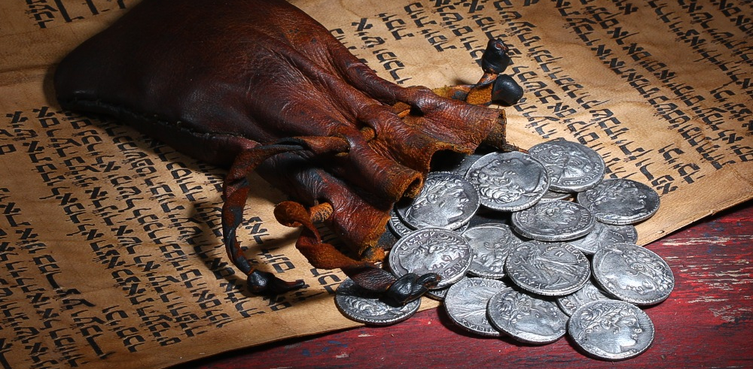
The Blinding Power of Sin
Matthew 27:3-10

Slide 3
The Treachery of Judas
The chief priests were plotting to murder Jesus (Matt. 26:3-5).
Judas was losing his battle with covetousness.
He was a thief (John 12:6).
He was deprived of money and publicly rebuked by the Lord (vs. 3-8).
His response – Matt. 26:14-16

Slide 4
The Treachery of Judas
“Then Satan entered Judas…” (Luke 22:3).
“‘Be angry, and do not sin’: do not let the sun go down on your wrath, nor give place to the devil” (Eph. 4:26-27).

Slide 5
The Treachery of Judas
Judas was not thinking of a way to get Jesus killed, only a way to get money at His expense.
Judas was surprised that Jesus was condemned to death (Matt. 27:3).
Judas had seen Jesus escape attempts to kill Him before (Luke 4:28-30; John 8:59; 10:39).

Slide 6
The Treachery of Judas
Treachery: “a violation of faith; betrayal of trust, treason.”
“Even my own familiar friend in whom I trusted, who ate my bread, has lifted up his heel against me” (Psalm 41:9).

Slide 7
The Treachery of Judas
For it is not an enemy who reproaches me; then I could bear it. Nor is it one who hates me who has exalted himself against me; then I could hide from him.
But it was you, a man my equal, my companion and my acquaintance.
We took sweet counsel together, and walked to the house of God in the throng.
Psalm 55:12-14

Slide 8
The Treachery of Judas
But those who desire to be rich fall into temptation and a snare, and into many foolish and harmful lusts which drown men in destruction and perdition.
For the love of money is a root of all kinds of evil, for which some have strayed from the faith in their greediness, and pierced themselves through with many sorrows.
1 Timothy 6:9-10

Slide 9
The Remorse of Judas
Matthew 27:3-5
He was deeply sorrowful; regretting what he had done.
He confessed his sin.
He attempted retribution (sought to return the
30 pieces of silver).
But, he “departed and hanged himself.”

Slide 10
The Remorse of Judas
Now I rejoice, not that you were made sorry, but that your sorrow led to repentance. For you were made sorry in a godly manner, that you might suffer loss from us in nothing.
For godly sorrow produces repentance leading to salvation, not to be regretted; but the sorrow of the world produces death.
2 Corinthians 7:9-10

Slide 11
The Remorse of Judas
Judas’ sin blinded him to the proper avenue of forgiveness.
His remorse blinded him to the hope of salvation.
How many other people have chosen suicide to escape the pain of their guilt because they were blinded to the hope of true forgiveness from God?

Slide 12
The Hypocrisy of the Chief Priests
“What is that to us? You see to it.”
These religious leaders were not interested in justice or truth; right or wrong.
These religious leaders showed cold indifference to a man who was struggling with the guilt of sin, a sin in which they played a role!

Slide 13
The Hypocrisy of the Chief Priests
“It is not lawful to put them into the treasury, because they are the price of blood.”
They hired false witnesses, bribed officials, plotted a murder, paid Judas to betray Jesus…
but NOW they are concerned with doing what is “lawful”!

Slide 14
The Hypocrisy of the Chief Priests
Then I said to them, “If it is agreeable to you, give me my wages; and if not, refrain.”
So they weighed out for my wages thirty pieces of silver.
And the Lord said to me, “Throw it to the potter” - that princely price they set on me. So I took the thirty pieces of silver and threw them into the house of the Lord for the potter.
Zechariah 11:12-13

Slide 15
The Blinding Power of Sin
Blinded Judas to the consequences of his anger and covetousness.
Blinded Judas to the avenue and hope of forgiveness.
Blinded the chief priests to their hypocrisy.
“Therefore let him who thinks he stands
take heed lest he fall” (1 Cor. 10:12).

