Slide 1
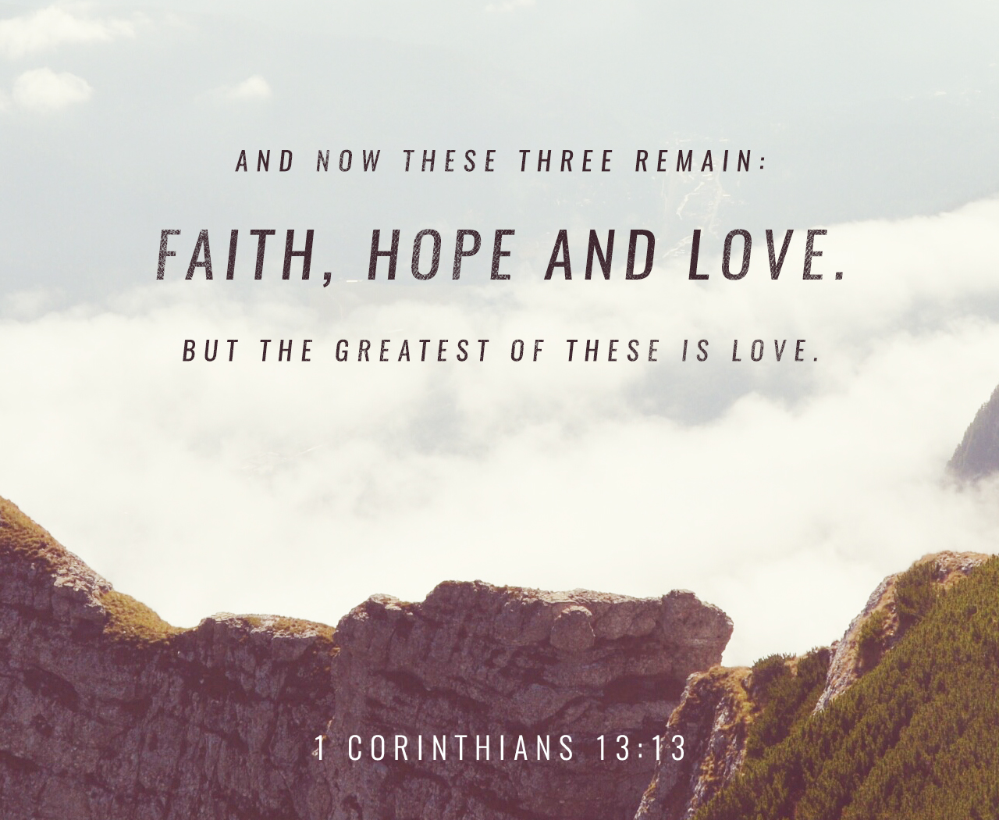

Slide 2
The greatest gifts God has given to sustain the church.
And now abide faith, hope, love, these three; but the greatest of these is love.
1 Corinthians 13:13

Slide 3
“Now faith is the substance of things hoped for, the evidence of things not seen” (Heb. 11:1, KJV).
“Now faith is the assurance of things hoped for, the conviction of things not seen” (Heb. 11:1, ESV).

