Slide 2
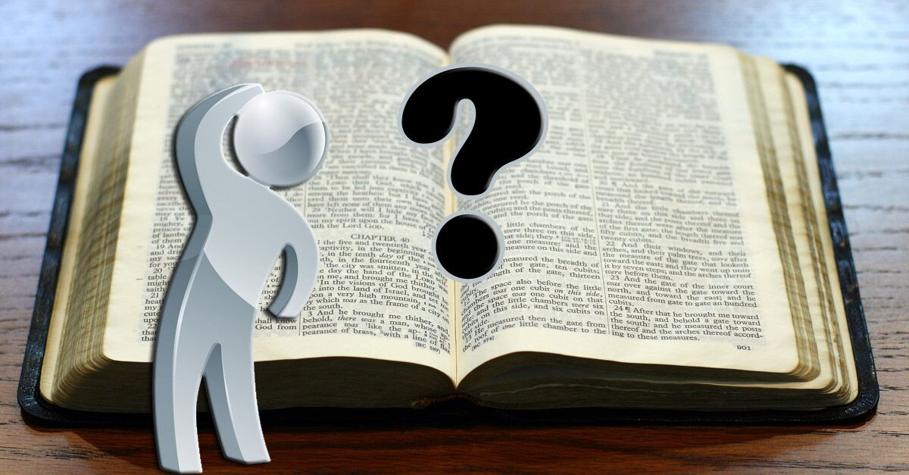
Questions About
Works and Salvation

Slide 3
“We have several friends who believe that baptism is not required for salvation because baptism is, allegedly, a work. Can you address this?”

Slide 4
Are we saved by works?
Paul seems to say “no.”
Others say “yes.”
Rom. 4:1-5
Rom. 11:5-6
Eph. 2:8-9
Titus 3:5
James - James 2:14-26
Peter - 1 Pet. 1:22
Hebrews writer -
Heb. 5:8-9
Luke - Acts 2:36-38
Paul

Slide 5
“Obedience” in Romans
Romans is bookended with a statement expressing the purpose of the epistle.
“for obedience to the faith” (Rom. 1:5; 16:26)
Obedience requires works.

Slide 6
“Obedience” in Romans
But God be thanked that though you were slaves of sin, yet you obeyed from the heart that form of doctrine to which you were delivered.
And having been set free from sin, you became slaves of righteousness.
Romans 6:17-18

Slide 7
“Obedience” in Romans
Or do you not know that as many of us as were baptized into Christ Jesus were baptized into His death?
Therefore we were buried with Him through baptism into death, that just as Christ was raised from the dead by the glory of the Father, even so we also should walk in newness of life.
Romans 6:3-4

Slide 8
Are we saved by works?
Paul seems to say “no.”
Others say “yes.”
Rom. 4:1-5
Rom. 11:5-6
Eph. 2:8-9
Titus 3:5
James - James 2:14-26
Peter - 1 Pet. 1:22
Hebrews writer -
Heb. 5:8-9
Luke - Acts 2:36-38
Paul
The Bible does not contradict itself!
What’s going on here?

Slide 9
“Works” in the New Testament

Slide 10
“Works” in the New Testament
Good Works
  Matt. 5:16
  Eph. 2:10

Slide 11
“Works” in the New Testament
Bad Works
  works of darkness - Rom. 13:12
  unfruitful works of darkness - Eph. 5:11
  works of the flesh - Gal. 5:19
  wicked works - Col. 1:21
  dead works - Heb. 6:1; 9:14

Slide 12
“Works” in the New Testament
Works of the Law of Moses
  Rom. 3:20, 27-28
  Rom. 4:13-15
  Rom. 9:30-32
  Gal. 2:16

Slide 13
“Works” in the New Testament
Works of Obedience
  Rom. 1:5; 16:26
  Rom. 6:17

Slide 14
4. Works of Obedience
Therefore lay aside all filthiness and overflow of wickedness, and receive with meekness the implanted word, which is able to save your souls.
But be doers of the word, and not hearers only, deceiving yourselves.
James 1:21-22

Slide 15
4. Works of Obedience
Was not Abraham our father justified by works when he offered Isaac his son on the altar?
Do you see that faith was working together with his works, and by works faith was made perfect?
And the Scripture was fulfilled which says, “Abraham believed God, and it was accounted to him for righteousness.” And he was called the friend of God.
James 2:21-23

Slide 16
4. Works of Obedience
Hebrews 11
v. 4 – “by faith Able offered…”
v. 7 – “by faith Noah… prepared an ark…”
v. 8 – “by faith Abraham obeyed…”
v. 17 – “by faith Abraham… offered up Isaac…”
vs. 23-28 – “by faith Moses… was hidden… refused to be called son of Pharaoh’s daughter… forsook Egypt… kept the Passover…”

Slide 17
Different Kinds of Works
In doing works of the Law of Moses, which has been done away with, one is seeking a right standing before God on their own merit.
  Such action negates God’s grace and can never save.
In doing works of obedience to the Gospel, one is demonstrating complete reliance on God by meeting the conditions God has set forth.
  This has always been the kind of faith that saves.

Slide 18
Act on your faith in Jesus!
Repent of your sins – which requires works
(Acts 26:20)
Confess your faith – which is different than just believing (Rom. 10:9-10)
Be baptized – because baptism now saves us
(1 Pet. 3:21)

