Slide 1


Slide 2
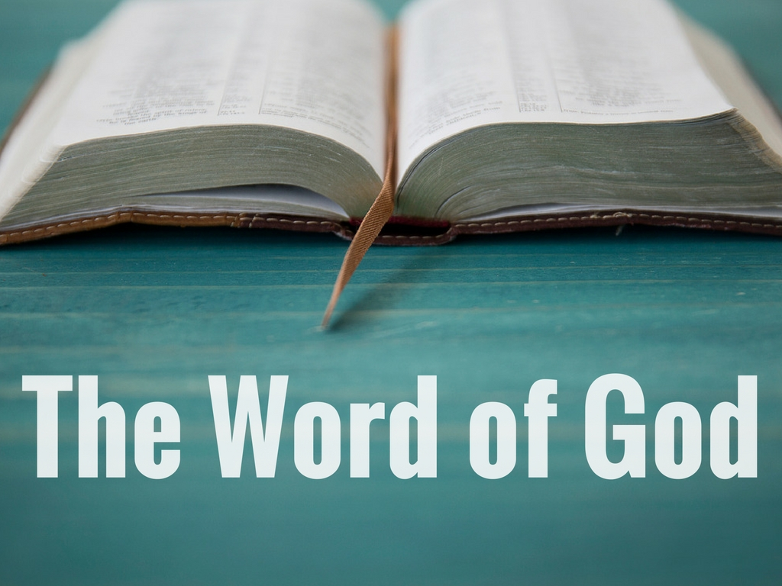

Slide 3

The Word of God Has Life

Slide 4
“For the word of God is living and active, sharper than any two-edged sword, piercing to the division of soul and of spirit, of joints and of marrow, and discerning the thoughts and intentions of the heart.”
Hebrews 4:12

Slide 5
“Heaven and earth will pass away, but my words will not pass away.”
Matthew 24:35

Slide 6
The Word of God Gives Life

Slide 7
The Word of God Nourishes Life

Slide 8
“Your words were found, and I ate them, and your words became to me a joy and the delight of my heart…”
Jeremiah 15:16

Slide 9
“But grow in the grace and knowledge of our Lord and Savior Jesus Christ…”
2 Peter 3:18

Slide 10
The Word of God Transforms Life

Slide 11
The Benefits Only Come Through “Tasting”

