Slide 1

Deut. 8:1 "Every commandment which I command you today you must be careful to observe, that you may live and multiply, and go in and possess the land of which the LORD swore to your fathers.
2 "And you shall remember that the LORD your God led you all the way these forty years in the wilderness, to humble you and test you, to know what was in your heart, whether you would keep His commandments or not.
1

Slide 2

Please open your hearts, your ears, and your Bible and follow along.
If you have any questions about anything I say, if you disagree anything I say, please say something to me after the service and I will be glad to sit down with you and God’s word and study so that we can come to know His truth
2

Slide 3
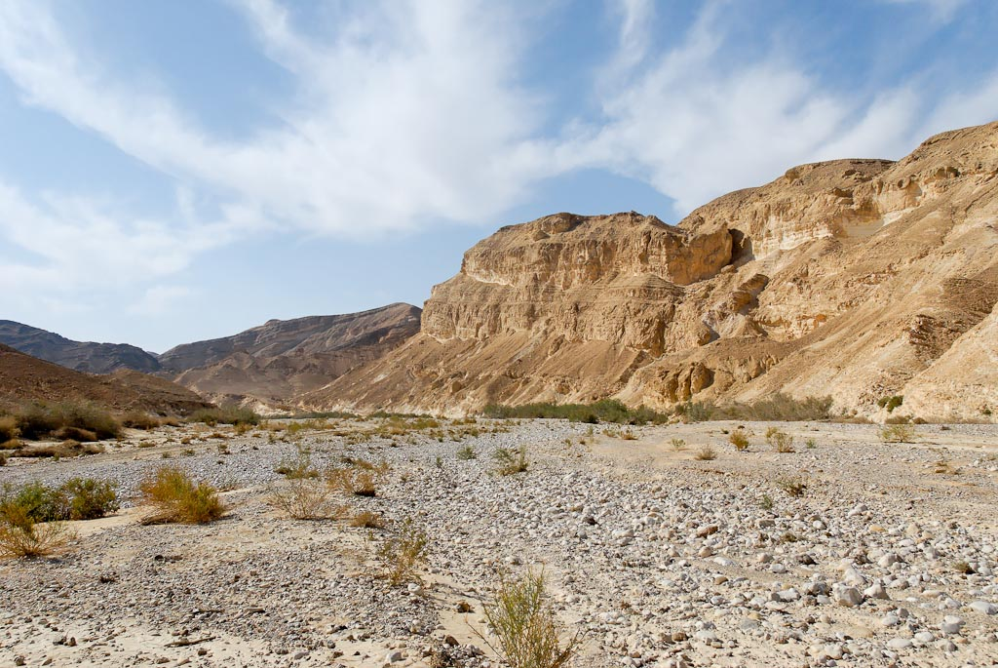
Lessons from a Wilderness Experience
Deut. 8:1-20
3

Slide 4
Deut. 4:2 You shall not add to the word which I command you, nor take from it, that you may keep the commandments of the LORD your God which I command you.
Deut. 5:27 You go near and hear all that the LORD our God may say, and tell us all that the LORD our God says to you, and we will hear and do it.
Deut. 5:29 Oh, that they had such a heart in them that they would fear Me and always keep all My commandments, that it might be well with them and with their children forever!
Deut. 6:4 Hear, O Israel: The LORD our God, the LORD is one! 5 "You shall…
Deut. 8:1 "Every commandment which I command you today you must be careful to observe,
To Hear = to Obey

Slide 5
Deut. 8:1 "Every commandment which I command you today you must be careful to observe, that you may live and multiply, and go in and possess the land of which the LORD swore to your fathers.
four blessings mentioned in the first verse as the result of obedience.
(1) Life: “You may live.”
(2) Fruitfulness: “Multiply.”
(3) Progress: “Go in.”
(4) Possession: “Possess the land.”
Lessons from a Wilderness Experience
4

Slide 6
A life under the guidance of God
Lessons from a Wilderness Experience
5

Slide 7
A life life of humility before God
Lessons from a Wilderness Experience
6

Slide 8
Gen. 22:12;
And He said, "Do not lay your hand on the lad, or do anything to him; for now I know that you fear God, since you have not withheld your son, your only son, from Me."
Lessons from a Wilderness Experience
7

Slide 9
2 Chron. 31:20 Thus Hezekiah did throughout all Judah, and he did what was good and right and true before the LORD his God.
21 And in every work that he began in the service of the house of God, in the law and in the commandment, to seek his God, he did it with all his heart. So he prospered.
Lessons from a Wilderness Experience
8

Slide 10
A life sustained by God
Lessons from a Wilderness Experience
9

Slide 11
Christ not only saves
but also satisfies
(Phil. 4:19). And my God shall supply all your need according to His riches in glory by Christ Jesus.
Lessons from a Wilderness Experience
10

Slide 12
A life of dependence on God
Lessons from a Wilderness Experience
11

Slide 13
A life of hope in God
Lessons from a Wilderness Experience
12

Slide 14
Philippians 3:12 Not that I have already attained, or am already perfected; but I press on, that I may lay hold of that for which Christ Jesus has also laid hold of me.
13 Brethren, I do not count myself to have apprehended; but one thing I do, forgetting those things which are behind and reaching forward to those things which are ahead,
14 I press toward the goal for the prize of the upward call of God in Christ Jesus.
Lessons from a Wilderness Experience
13

Slide 15
A life of praise to God
Lessons from a Wilderness Experience
14

Slide 16
(Psa. 103:1–5). Bless the LORD, O my soul; And all that is within me, bless His holy name!
2 Bless the LORD, O my soul, And forget not all His benefits:
3 Who forgives all your iniquities, Who heals all your diseases,
4 Who redeems your life from destruction, Who crowns you with lovingkindness and tender mercies,
5 Who satisfies your mouth with good things, So that your youth is renewed like the eagle's.
Lessons from a Wilderness Experience
15

Slide 17
A life empowered by God
Lessons from a Wilderness Experience
16

Slide 18
The Israelites could not enter the promised land because of what was in their heart.
Friend, what is in your Heart?
Lessons from a Wilderness Experience

Slide 19
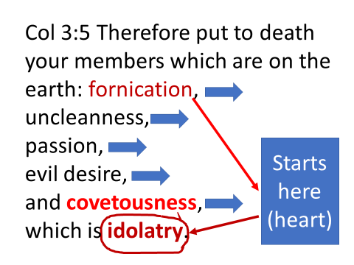
Ex. 20:3 You shall have no other gods before Me. (idolatry)
1st commandment
Ex 20:17 You shall not covet your neighbor's house; you shall not covet your neighbor's wife, nor his male servant, nor his female servant, nor his ox, nor his donkey, nor anything that is your neighbor's.
Col.3:5
Last commandment

Slide 20
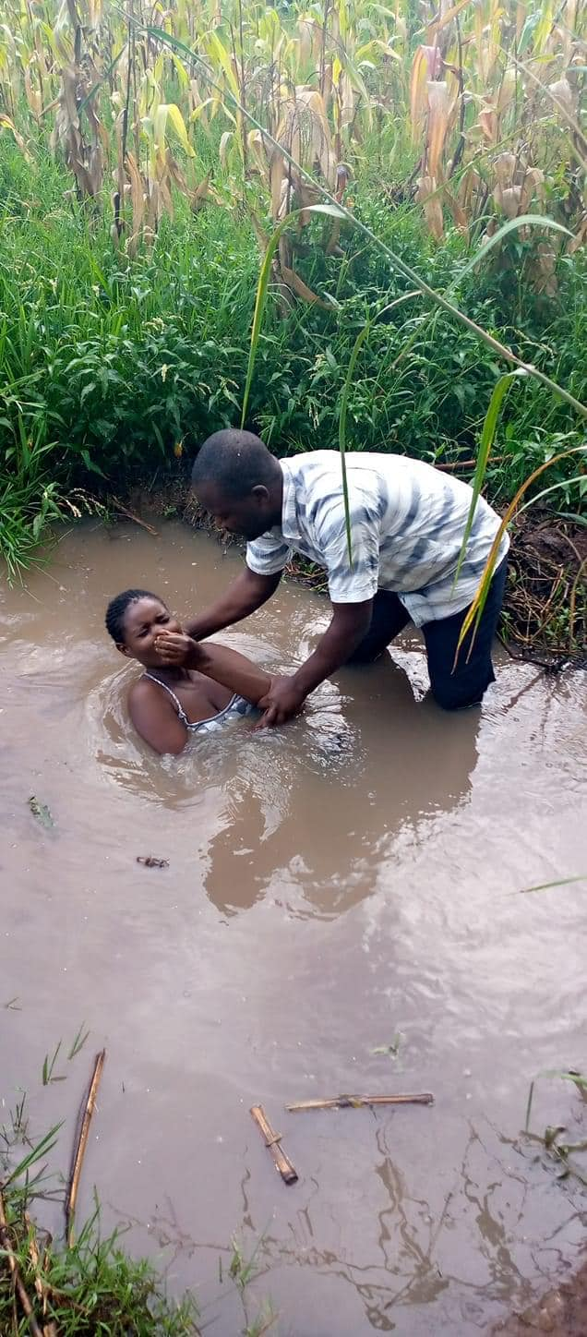
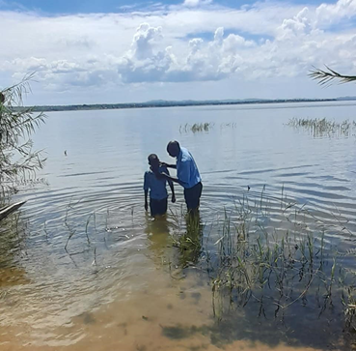
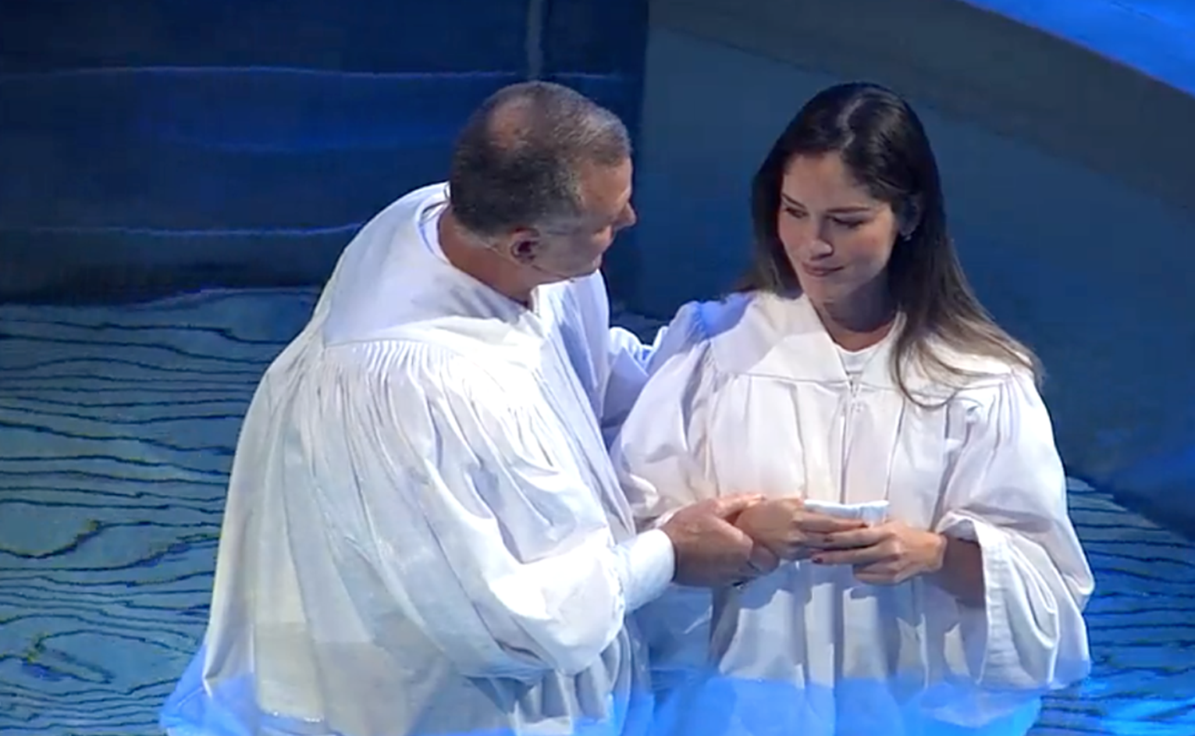
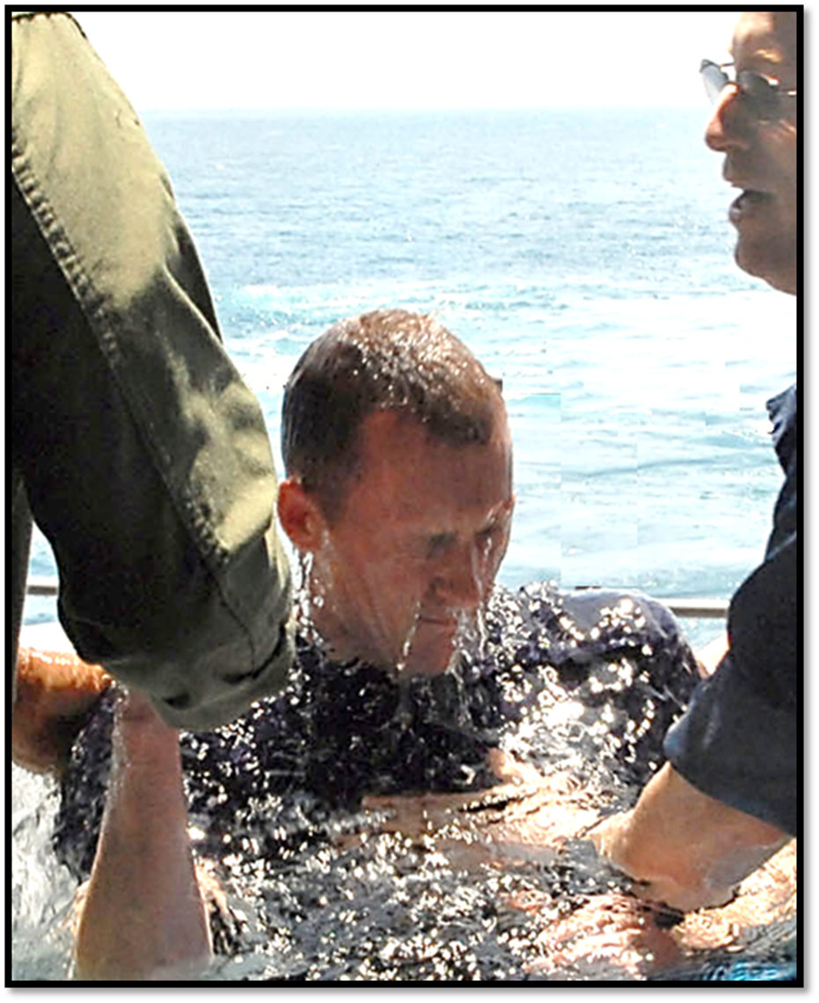
1Cor. 10:1-2 Moreover, brethren, I do not want you to be unaware that all our fathers were under the cloud,
all passed through the sea,
all were baptized into Moses
in the cloud and in the sea,
18

