Slide 1


Slide 2
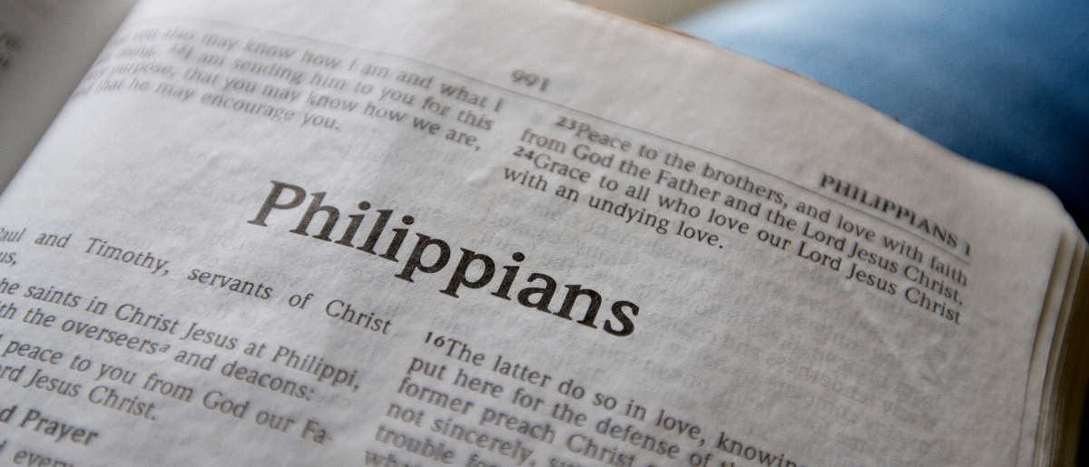
Our Citizenship is in Heaven
Philippians 3:17-21

Slide 3
A Pattern to Acknowledge
Brethren, join in following my example, and note those who so walk, as you have us for a pattern.
Philippians 3:17

Slide 4
A Pattern to Acknowledge
Brethren, join in following my example, and note those who so walk, as you have us for a pattern.
Philippians 3:17

Slide 5
A Pattern to Acknowledge
Brethren, join in following my example, and note those who so walk, as you have us for a pattern.
Philippians 3:17

Slide 6
A Pattern to Acknowledge
Brethren, join in following my example, and note those who so walk, as you have us for a pattern.
Philippians 3:17
tupos
English word “type.”
The mark or impression from a blow.
A model for imitation.

Slide 7
A People to Avoid
For many walk, of whom I have told you often, and now tell you even weeping, that they are the enemies of the cross of Christ:
whose end is destruction, whose god is their belly, and whose glory is in their shame — who set their mind on earthly things.
Philippians 3:18-19

Slide 8
A People to Avoid
For many walk, of whom I have told you often, and now tell you even weeping, that they are the enemies of the cross of Christ:
whose end is destruction, whose god is their belly, and whose glory is in their shame — who set their mind on earthly things.
Philippians 3:18-19

Slide 9
A People to Avoid
For many walk, of whom I have told you often, and now tell you even weeping, that they are the enemies of the cross of Christ:
whose end is destruction, whose god is their belly, and whose glory is in their shame — who set their mind on earthly things.
Philippians 3:18-19

Slide 10
A People to Avoid
For many walk, of whom I have told you often, and now tell you even weeping, that they are the enemies of the cross of Christ:
whose end is destruction, whose god is their belly, and whose glory is in their shame — who set their mind on earthly things.
Philippians 3:18-19

Slide 11
A People to Avoid
For many walk, of whom I have told you often, and now tell you even weeping, that they are the enemies of the cross of Christ:
whose end is destruction, whose god is their belly, and whose glory is in their shame — who set their mind on earthly things.
Philippians 3:18-19

Slide 12
A People to Avoid
For many walk, of whom I have told you often, and now tell you even weeping, that they are the enemies of the cross of Christ:
whose end is destruction, whose god is their belly, and whose glory is in their shame — who set their mind on earthly things.
Philippians 3:18-19

Slide 13
A Purpose to Achieve
For our citizenship is in heaven, from which we also eagerly wait for the Savior, the Lord Jesus Christ,
who will transform our lowly body that it may be conformed to His glorious body, according to the working by which He is able even to subdue all things to Himself.
Philippians 3:20-21

Slide 14
A Purpose to Achieve
For our citizenship is in heaven, from which we also eagerly wait for the Savior, the Lord Jesus Christ,
who will transform our lowly body that it may be conformed to His glorious body, according to the working by which He is able even to subdue all things to Himself.
Philippians 3:20-21

Slide 15
A Purpose to Achieve
For our citizenship is in heaven, from which we also eagerly wait for the Savior, the Lord Jesus Christ,
who will transform our lowly body that it may be conformed to His glorious body, according to the working by which He is able even to subdue all things to Himself.
Philippians 3:20-21

Slide 16
A Purpose to Achieve
Therefore, my beloved and longed-for brethren, my joy and crown, so
stand fast in the Lord, beloved.
Philippians 4:1

Slide 17
We can rejoice!
That we have great examples to follow.
That our citizenship is in Heaven.
That Christ is coming and will prepare us for our glorious inheritance.
“Rejoice in the Lord always, Again I will say, rejoice!”

