Slide 1
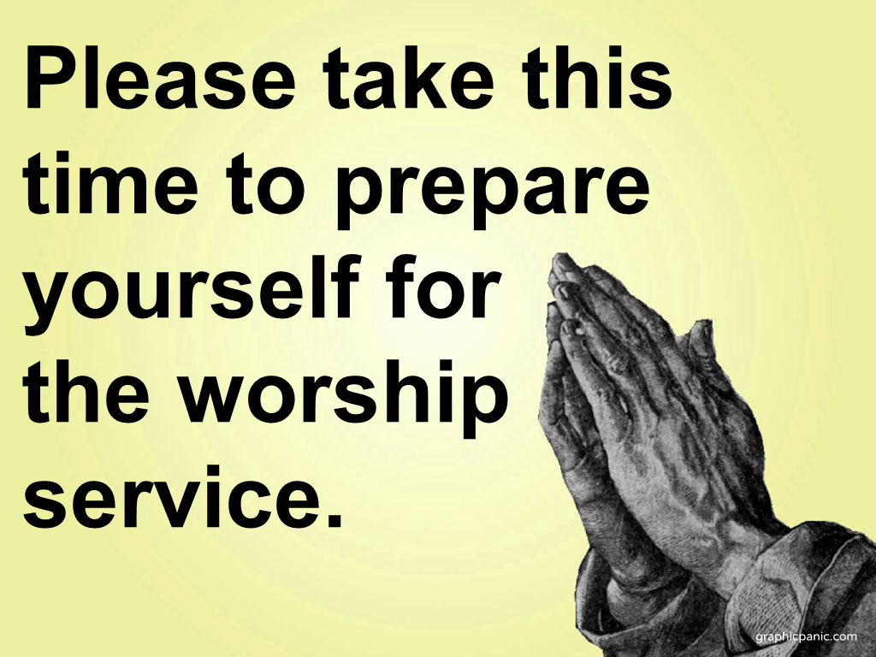

Slide 2
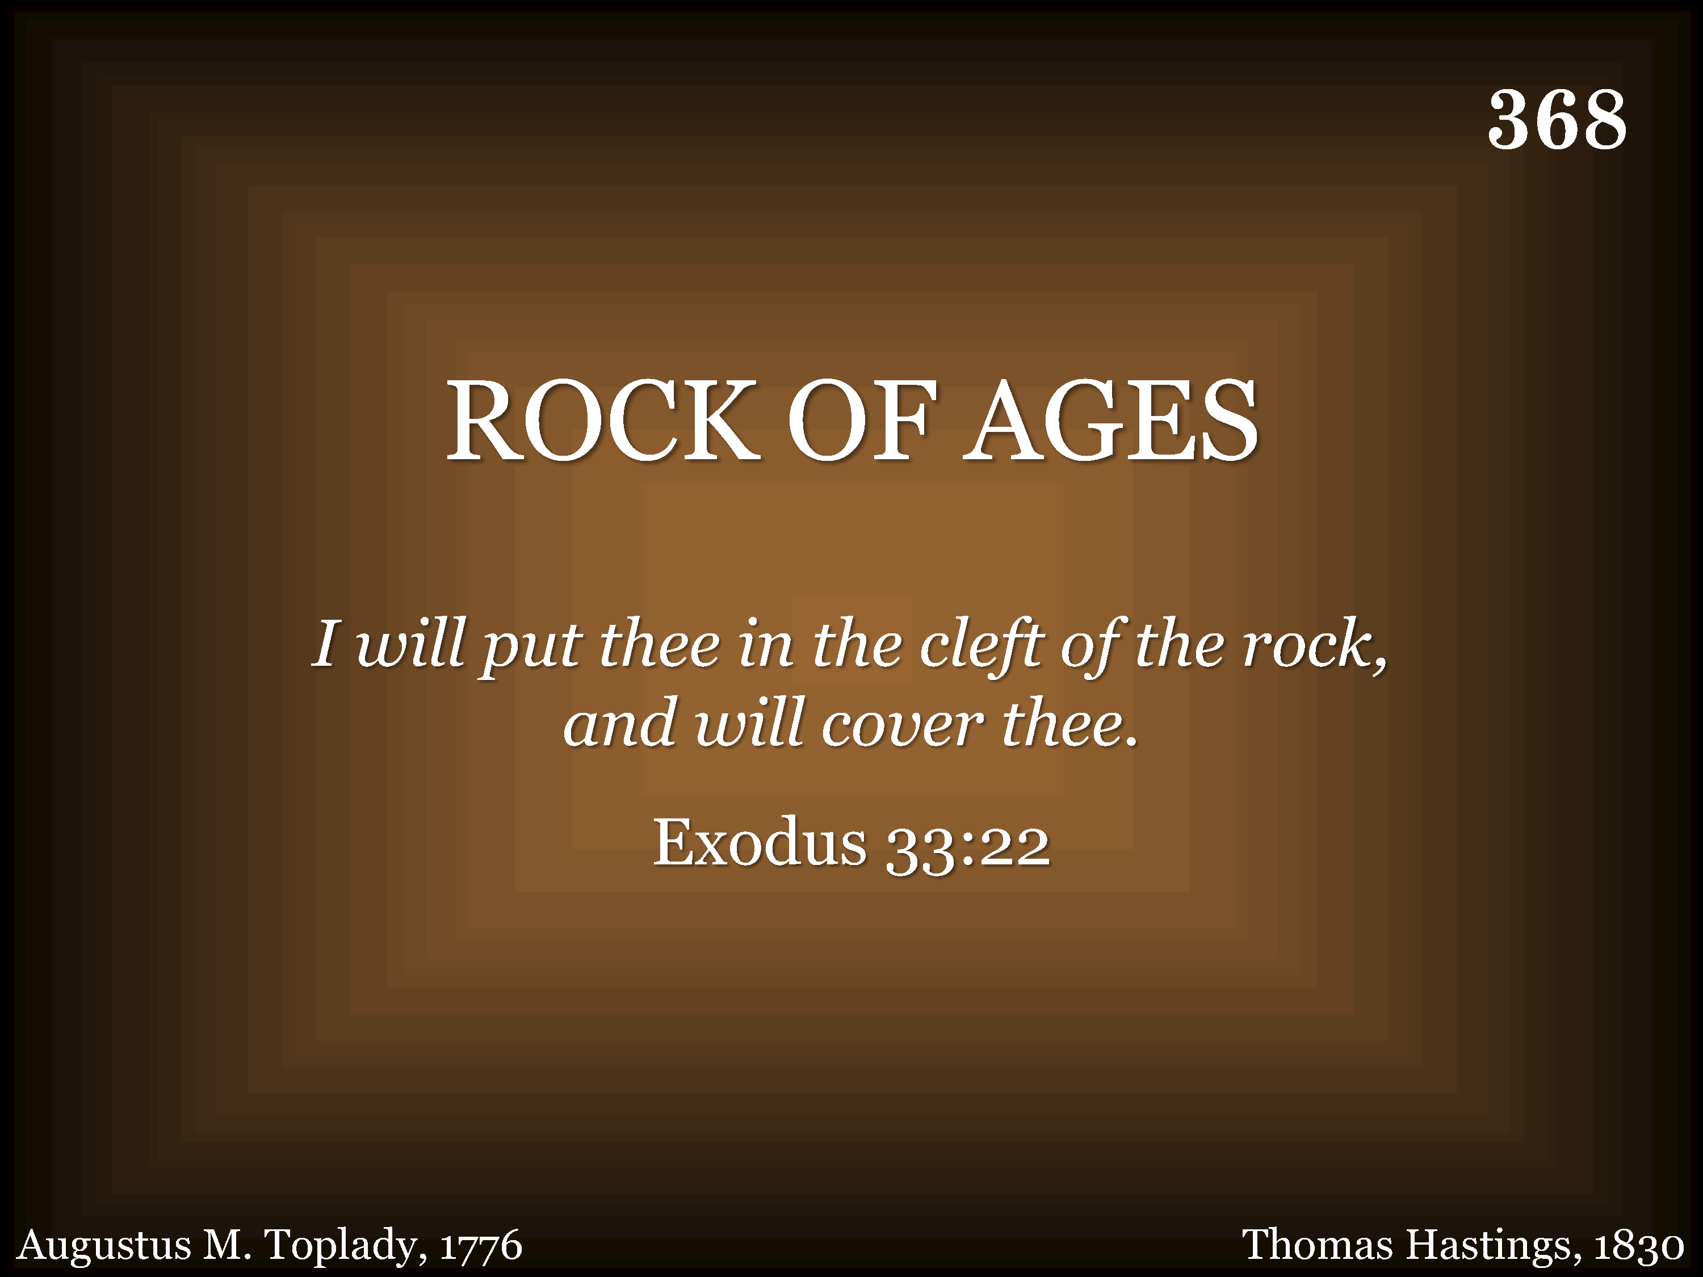
368 - Rock Of Ages - Title

Slide 3
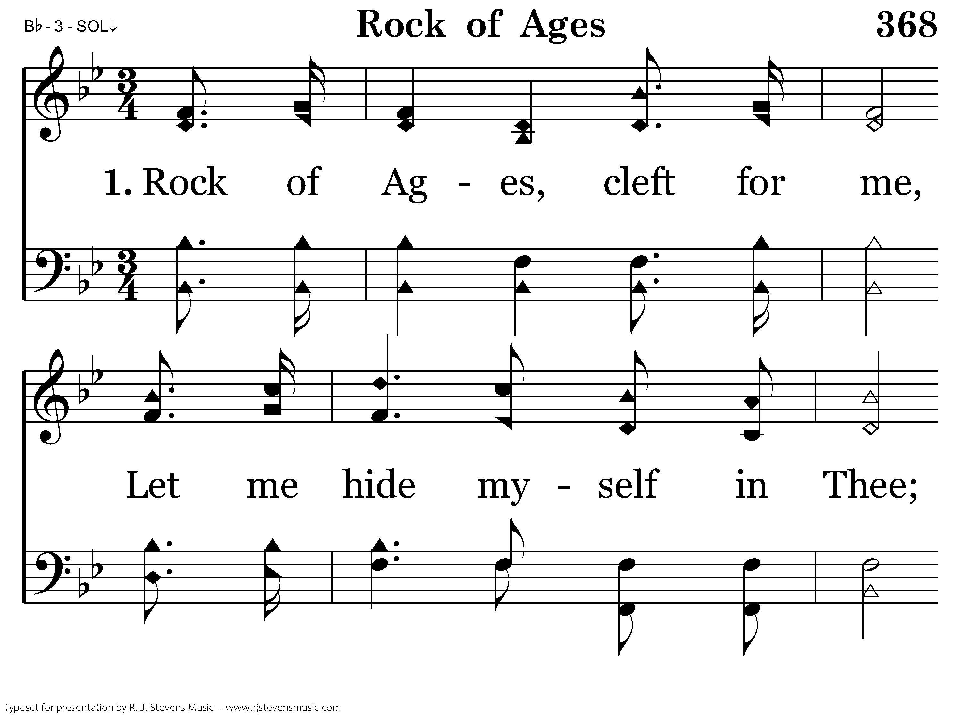
368 - Rock Of Ages - 1.1

Slide 4
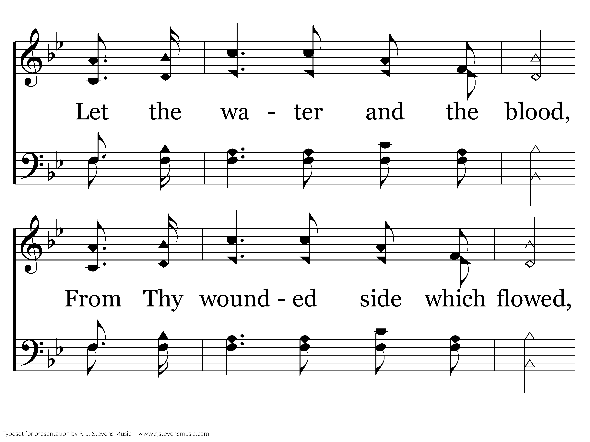
368 - Rock Of Ages - 1.2

Slide 5
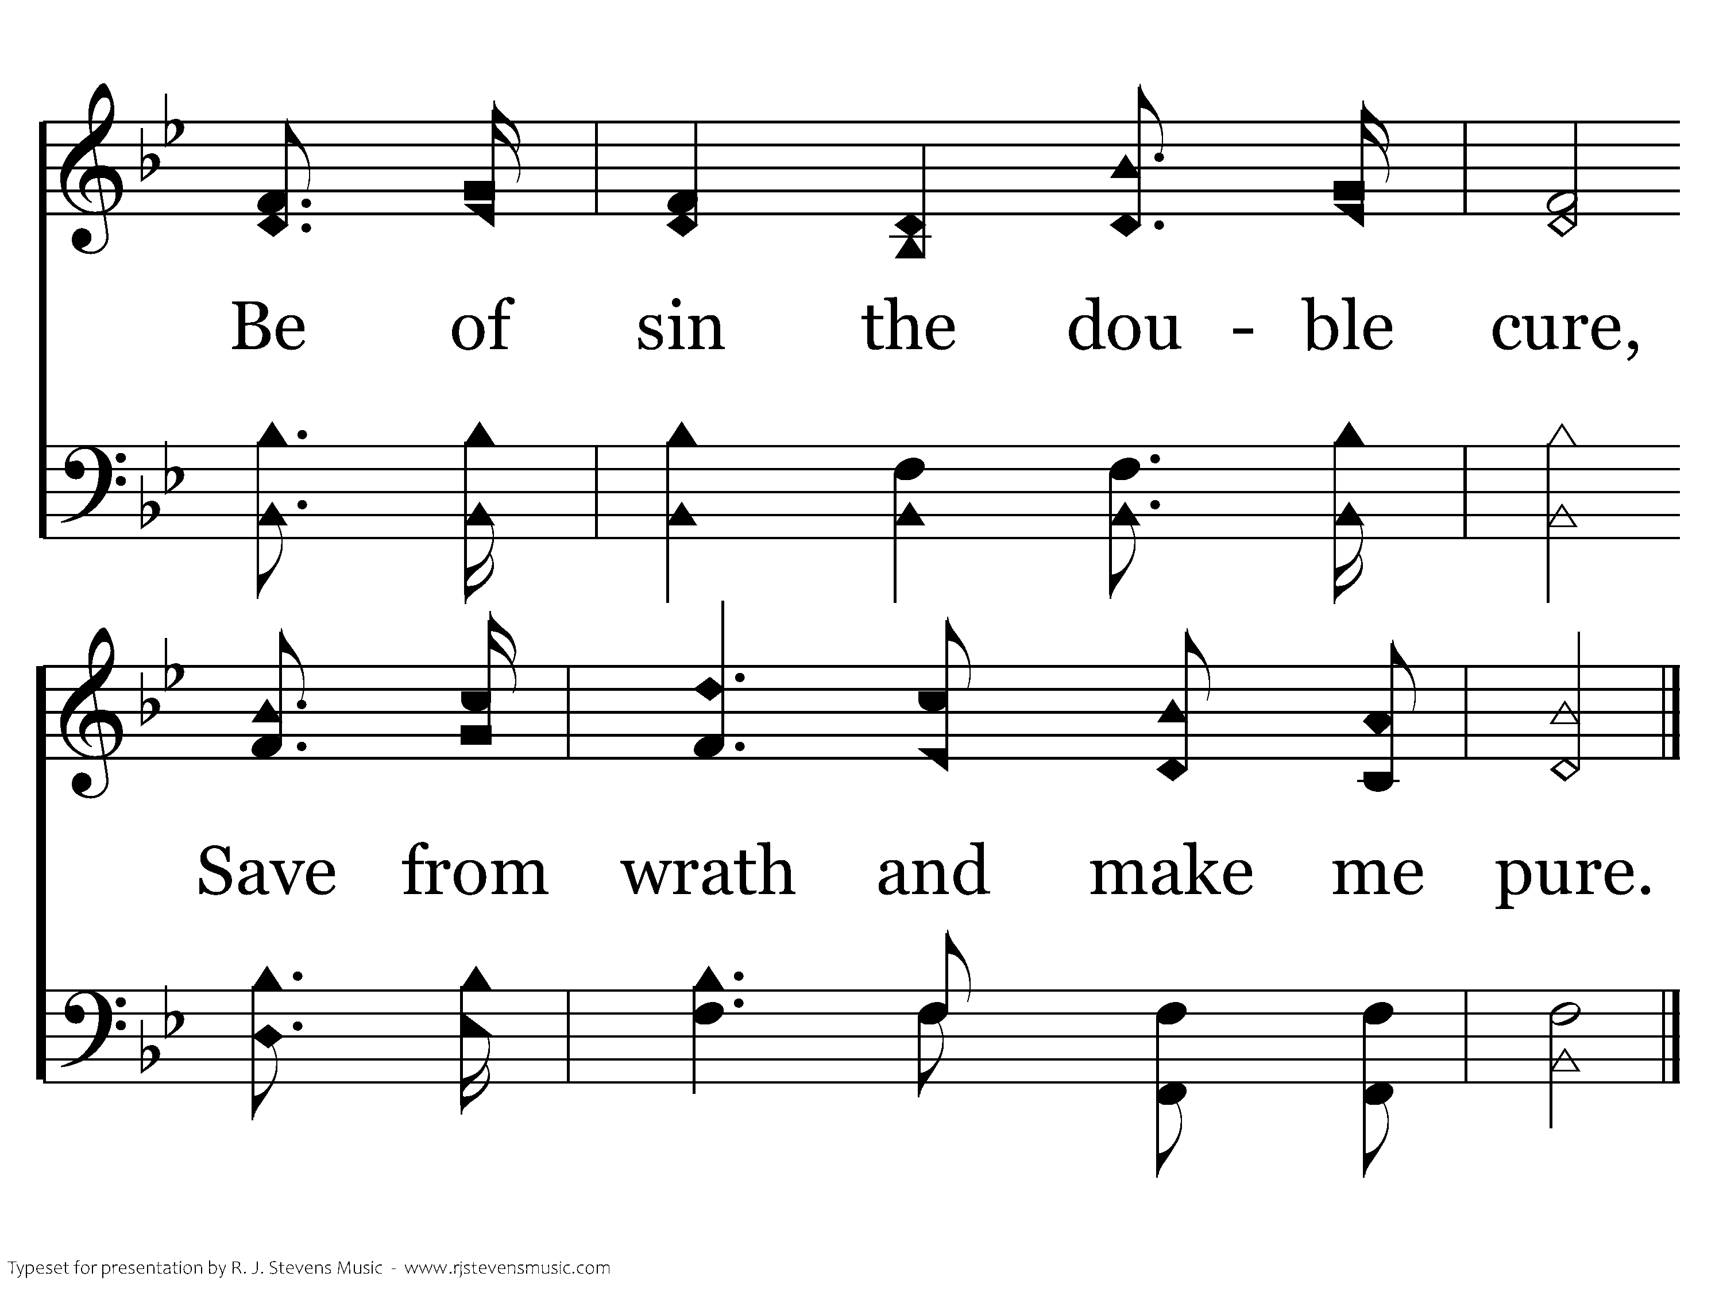
368 - Rock Of Ages - 1.3
End of Verse 1

Slide 6
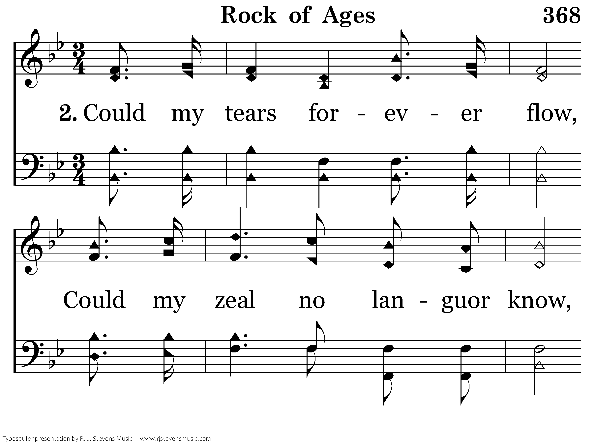
368 - Rock Of Ages - 2.1

Slide 7
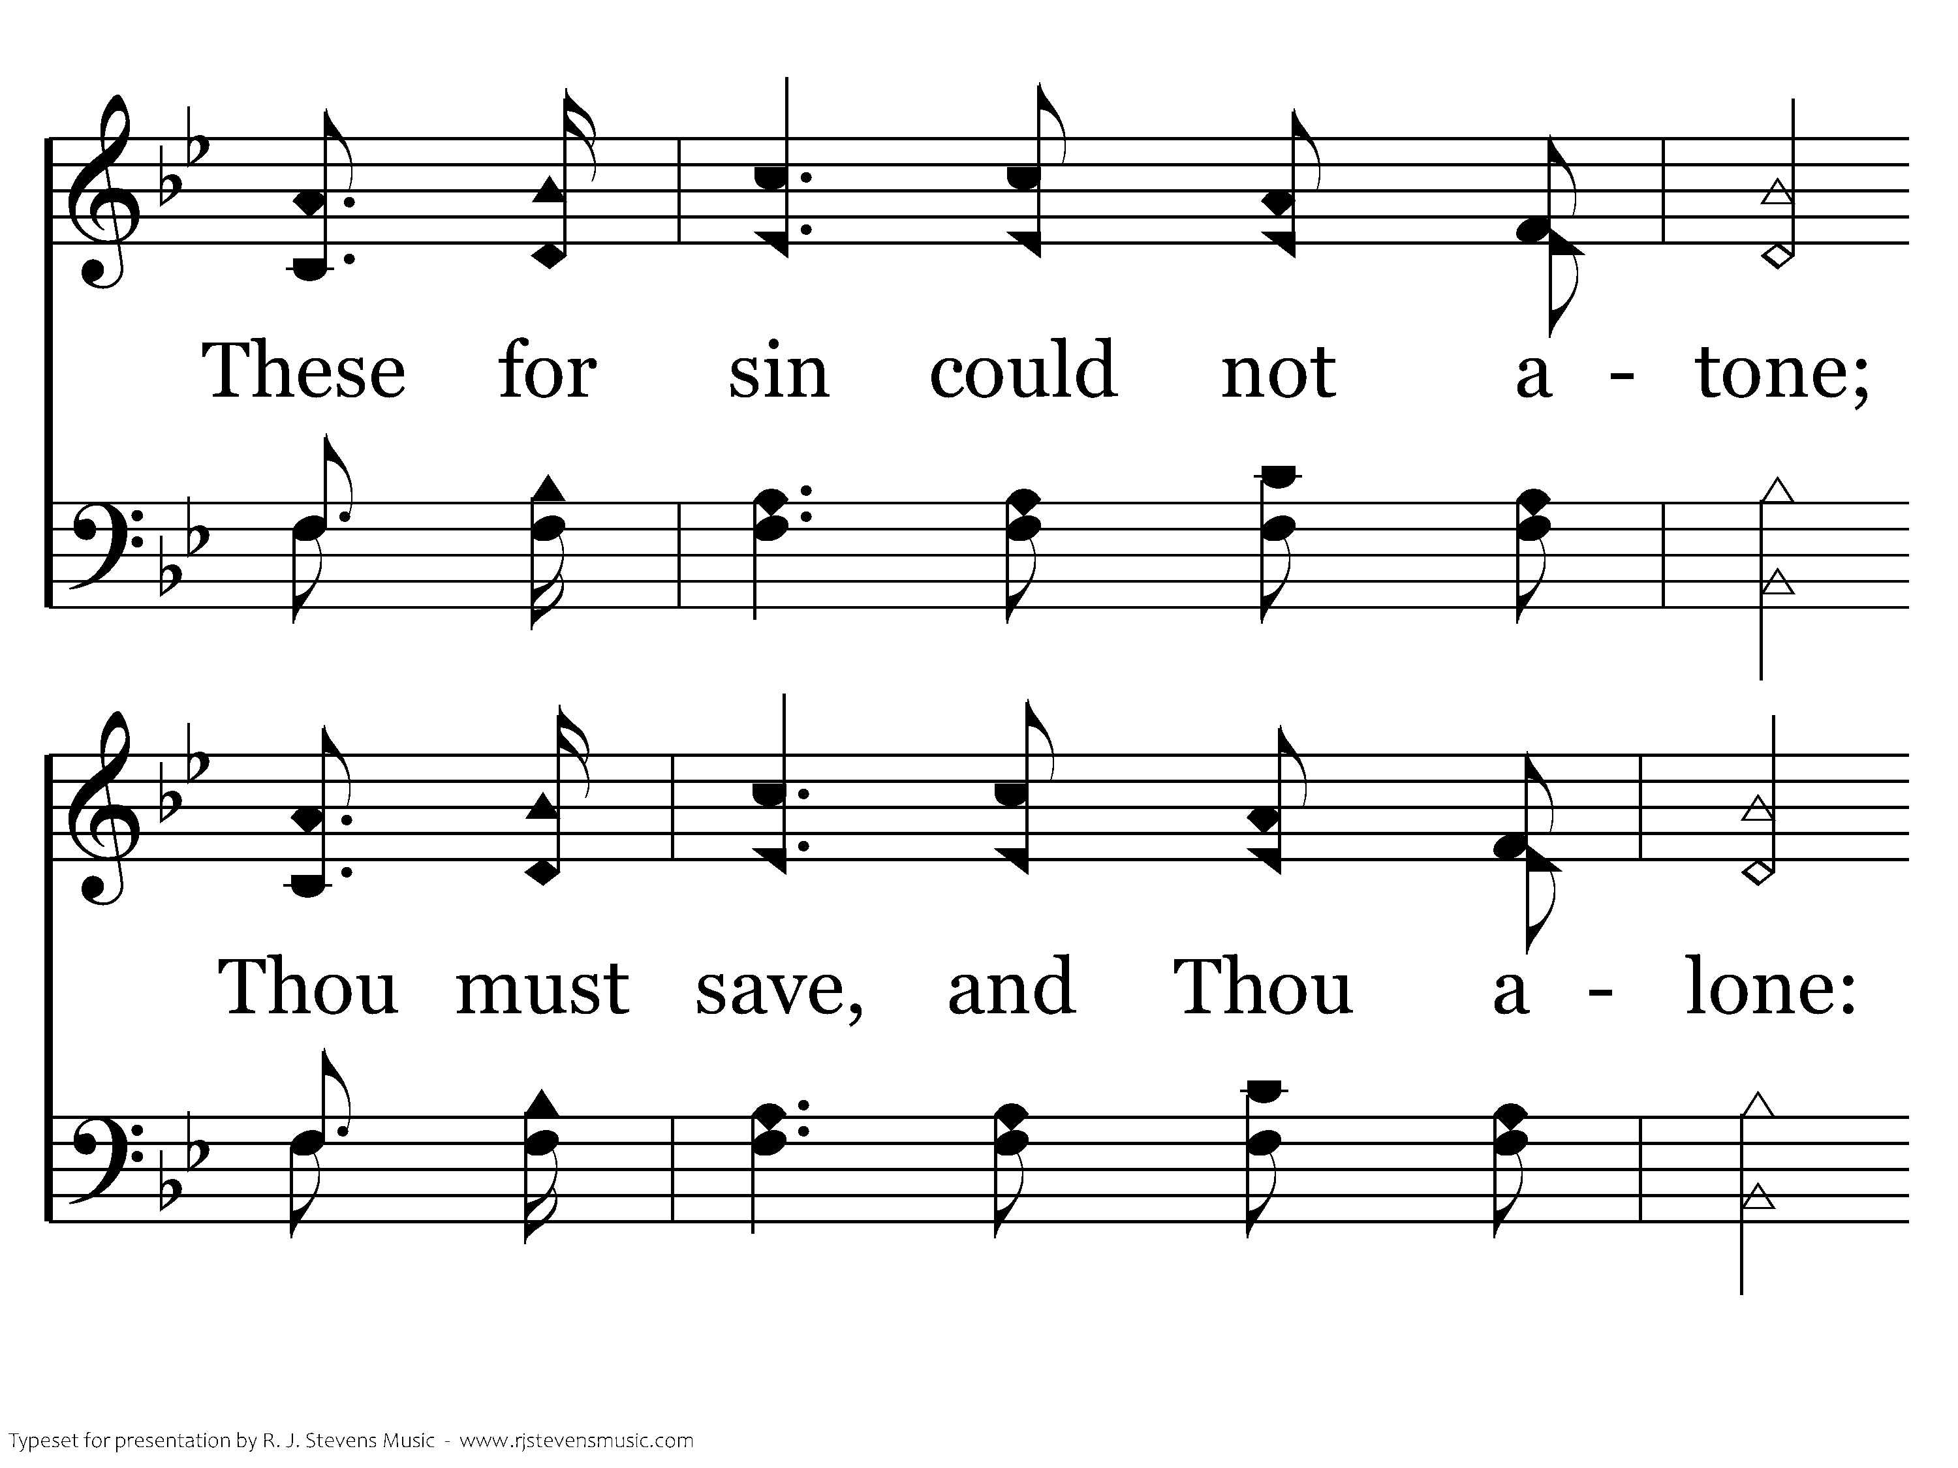
368 - Rock Of Ages - 2.2

Slide 8
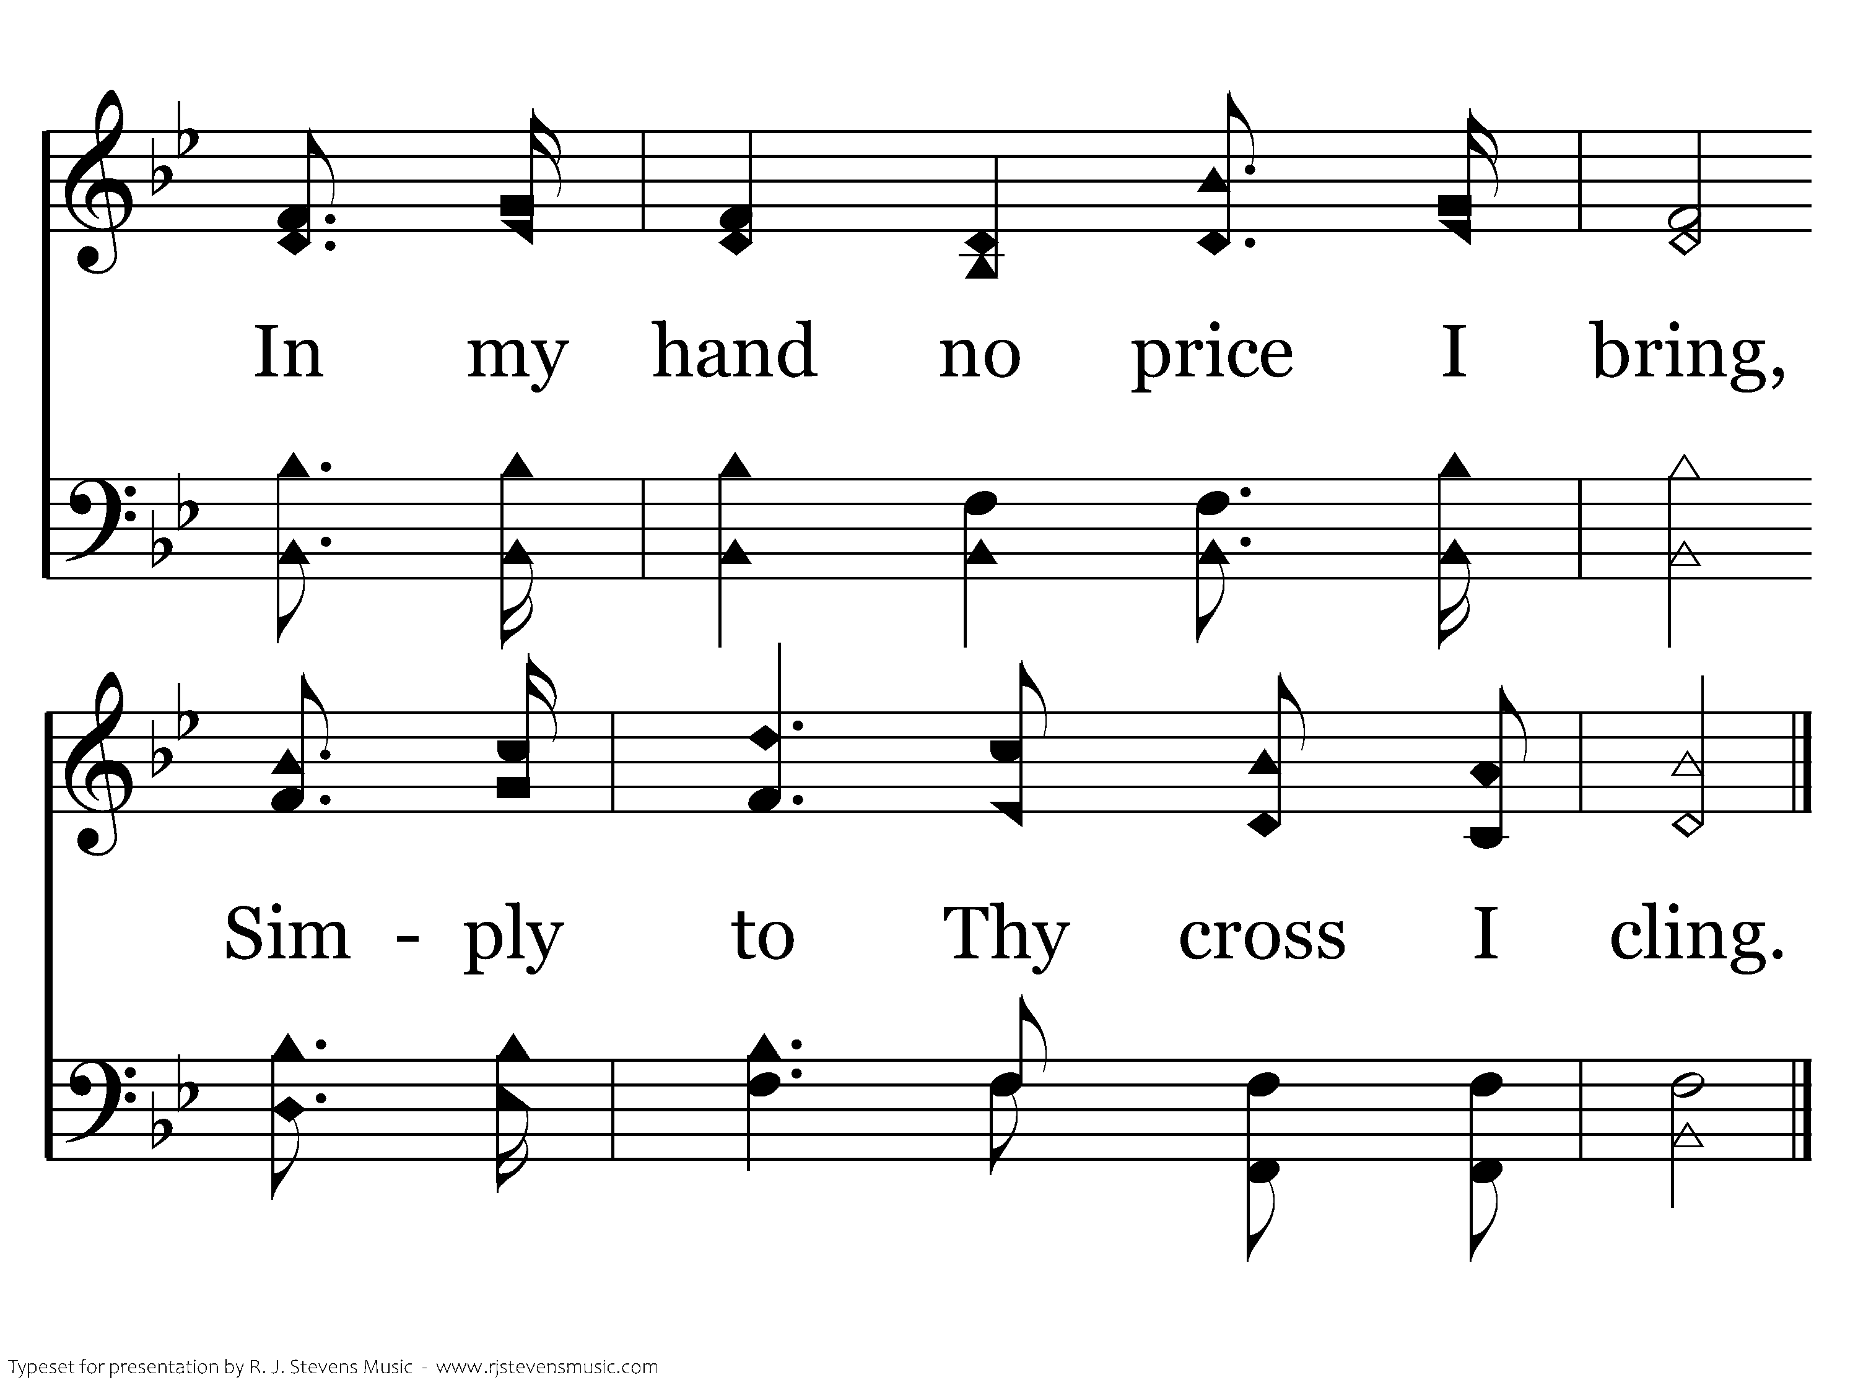
368 - Rock Of Ages - 2.3
End of Verse 2

Slide 9
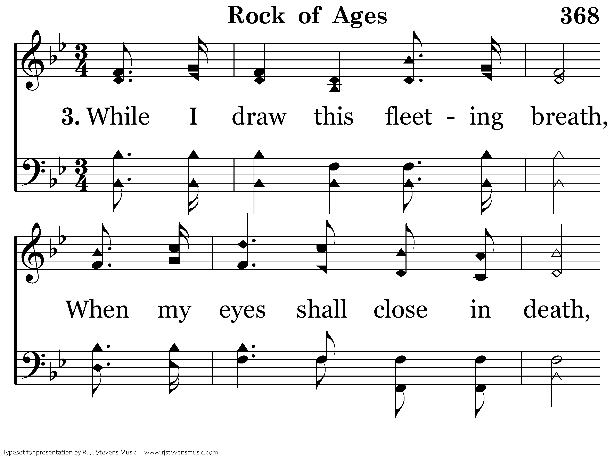
368 - Rock Of Ages - 3.1

Slide 10
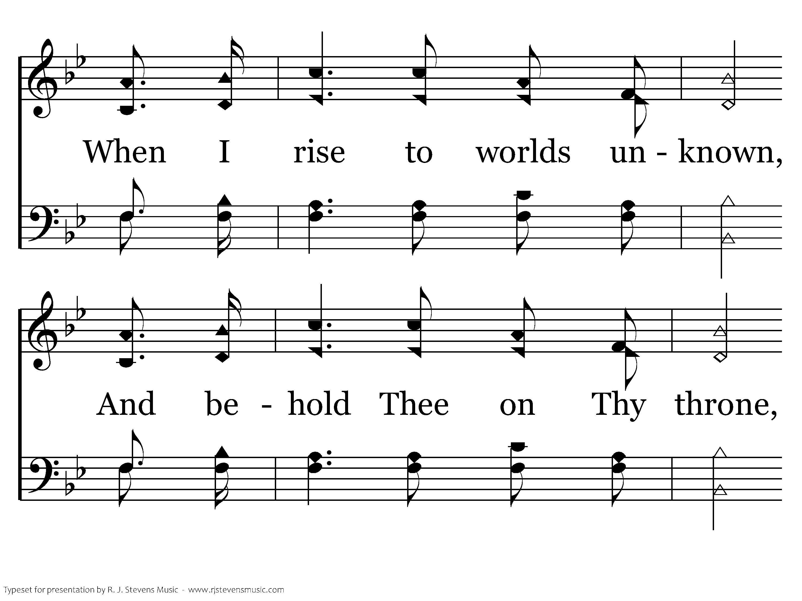
368 - Rock Of Ages - 3.2

Slide 11
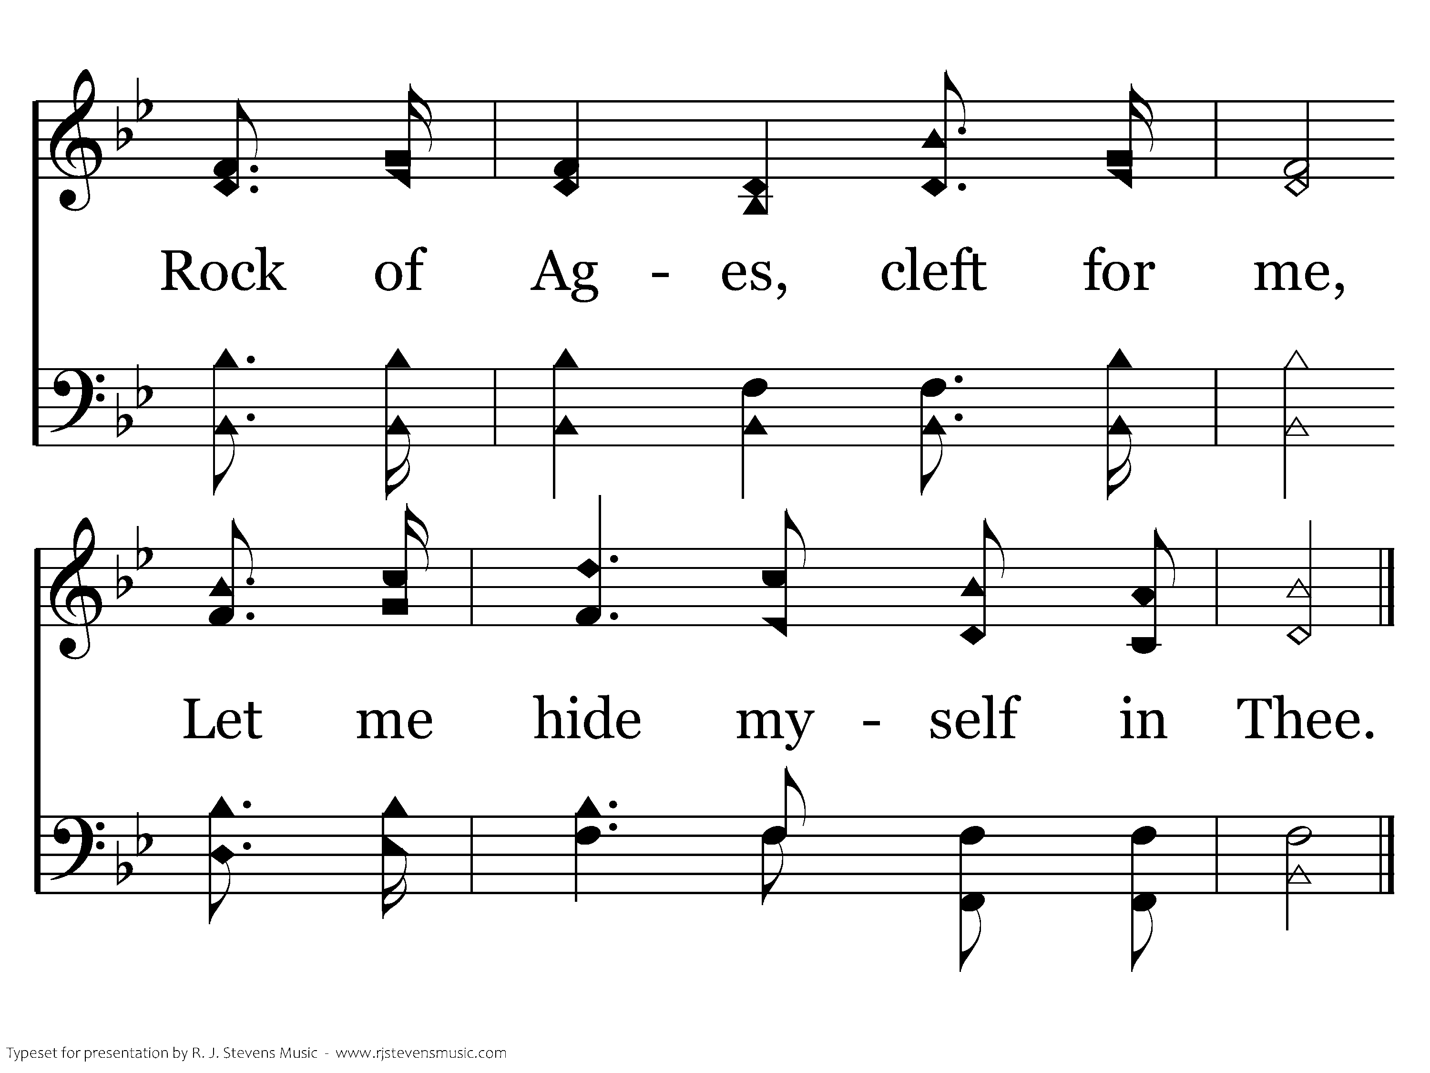
368 - Rock Of Ages - 3.3
End of Song

Slide 12
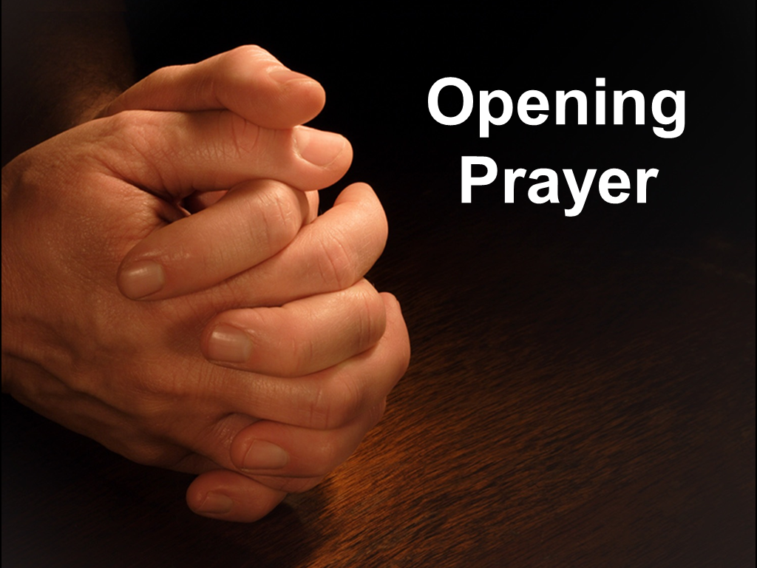

Slide 13


Slide 14
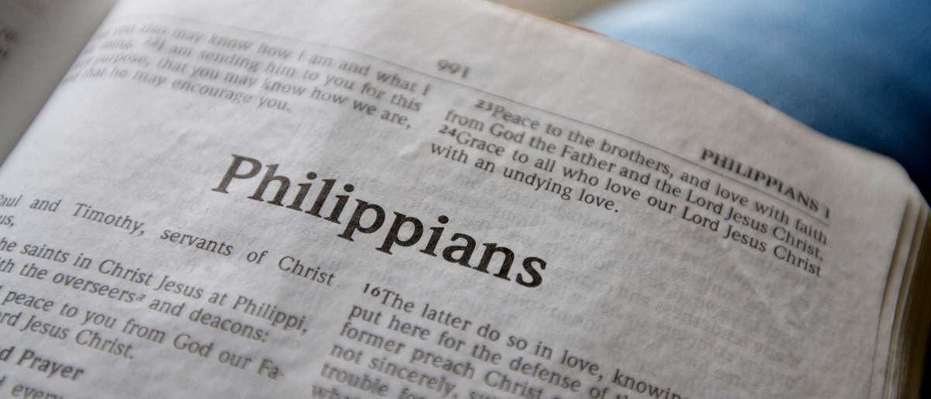
Counting All Things Loss for Christ
Philippians 3:1-11

Slide 15
Warning
Beware of dogs, beware of evil workers, beware of the mutilation!
For we are the circumcision, who worship God in the Spirit, rejoice in Christ Jesus, and have no confidence in the flesh,
though I also might have confidence in the flesh. If anyone else thinks he may have confidence in the flesh, I more so:
Philippians 3:1-3

Slide 16
Overcoming Religious Arrogance
circumcised the eighth day, of the stock of Israel, of the tribe of Benjamin, a Hebrew of the Hebrews; concerning the law, a Pharisee;
concerning zeal, persecuting the church; concerning the righteousness which is in the law, blameless.
Philippians 3:5-6

Slide 17
Overcoming Religious Arrogance
circumcised the eighth day, of the stock of Israel, of the tribe of Benjamin, a Hebrew of the Hebrews; concerning the law, a Pharisee;
concerning zeal, persecuting the church; concerning the righteousness which is in the law, blameless.
Philippians 3:5-6

Slide 18
Overcoming Religious Arrogance
circumcised the eighth day, of the stock of Israel, of the tribe of Benjamin, a Hebrew of the Hebrews; concerning the law, a Pharisee;
concerning zeal, persecuting the church; concerning the righteousness which is in the law, blameless.
Philippians 3:5-6

Slide 19
Overcoming Religious Arrogance
circumcised the eighth day, of the stock of Israel, of the tribe of Benjamin, a Hebrew of the Hebrews; concerning the law, a Pharisee;
concerning zeal, persecuting the church; concerning the righteousness which is in the law, blameless.
Philippians 3:5-6

Slide 20
Overcoming Religious Arrogance
circumcised the eighth day, of the stock of Israel, of the tribe of Benjamin, a Hebrew of the Hebrews; concerning the law, a Pharisee;
concerning zeal, persecuting the church; concerning the righteousness which is in the law, blameless.
Philippians 3:5-6

Slide 21
Overcoming Religious Arrogance
circumcised the eighth day, of the stock of Israel, of the tribe of Benjamin, a Hebrew of the Hebrews; concerning the law, a Pharisee;
concerning zeal, persecuting the church; concerning the righteousness which is in the law, blameless.
Philippians 3:5-6

Slide 22
Overcoming Religious Arrogance
circumcised the eighth day, of the stock of Israel, of the tribe of Benjamin, a Hebrew of the Hebrews; concerning the law, a Pharisee;
concerning zeal, persecuting the church; concerning the righteousness which is in the law, blameless.
Philippians 3:5-6

Slide 23
Overcoming Religious Arrogance
circumcised the eighth day, of the stock of Israel, of the tribe of Benjamin, a Hebrew of the Hebrews; concerning the law, a Pharisee;
concerning zeal, persecuting the church; concerning the righteousness which is in the law, blameless.
Philippians 3:5-6

Slide 24
Overcoming Religious Arrogance
circumcised the eighth day, of the stock of Israel, of the tribe of Benjamin, a Hebrew of the Hebrews; concerning the law, a Pharisee;
concerning zeal, persecuting the church; concerning the righteousness which is in the law, blameless.
Philippians 3:5-6
We can fall into the same trap!

Slide 25
Changing Our Values
But what things were gain to me, these I have counted loss for Christ.
Yet indeed I also count all things loss for the excellence of the knowledge of Christ Jesus my Lord, for whom I have suffered the loss of all things, and count them as rubbish, that I may gain Christ.
Philippians 3:7-8

Slide 26
Changing Our Values
But what things were gain to me, these I have counted loss for Christ.
Yet indeed I also count all things loss for the excellence of the knowledge of Christ Jesus my Lord, for whom I have suffered the loss of all things, and count them as rubbish, that I may gain Christ.
Philippians 3:7-8

Slide 27
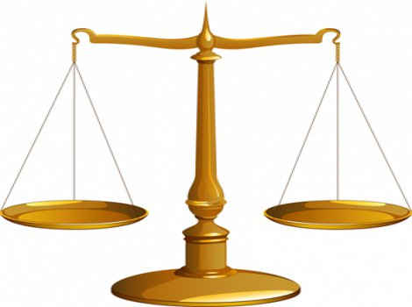
Changing Our Values
But what things were gain to me, these I have counted loss for Christ.
Yet indeed I also count all things loss for the excellence of the knowledge of Christ Jesus my Lord, for whom I have suffered the loss of all things, and count them as rubbish, that I may gain Christ.
Philippians 3:7-8

Slide 28
Gaining Christ
and be found in Him, not having my own righteousness, which is from the law, but that which is through faith in Christ, the righteousness which is from God by faith;
that I may know Him and the power of His resurrection, and the fellowship of His sufferings, being conformed to His death,
if, by any means, I may attain to the resurrection from the dead.
Philippians 3:9-11

Slide 29
Gaining Christ
and be found in Him, not having my own righteousness, which is from the law, but that which is through faith in Christ, the righteousness which is from God by faith;
that I may know Him and the power of His resurrection, and the fellowship of His sufferings, being conformed to His death,
if, by any means, I may attain to the resurrection from the dead.
Philippians 3:9-11

Slide 30
Gaining Christ
and be found in Him, not having my own righteousness, which is from the law, but that which is through faith in Christ, the righteousness which is from God by faith;
that I may know Him and the power of His resurrection, and the fellowship of His sufferings, being conformed to His death,
if, by any means, I may attain to the resurrection from the dead.
Philippians 3:9-11

Slide 31
Gaining Christ
and be found in Him, not having my own righteousness, which is from the law, but that which is through faith in Christ, the righteousness which is from God by faith;
that I may know Him and the power of His resurrection, and the fellowship of His sufferings, being conformed to His death,
if, by any means, I may attain to the resurrection from the dead.
Philippians 3:9-11

Slide 32
Gaining Christ
and be found in Him, not having my own righteousness, which is from the law, but that which is through faith in Christ, the righteousness which is from God by faith;
that I may know Him and the power of His resurrection, and the fellowship of His sufferings, being conformed to His death,
if, by any means, I may attain to the resurrection from the dead.
Philippians 3:9-11

Slide 33
We can rejoice in the Lord if…
We have come to realize that such things as birthright, pedigree, and personal accomplishments don’t make us right before God.
Have we counted all things loss for Christ?
“Rejoice in the Lord always, Again I will say, rejoice!”

