Slide 1


Slide 2
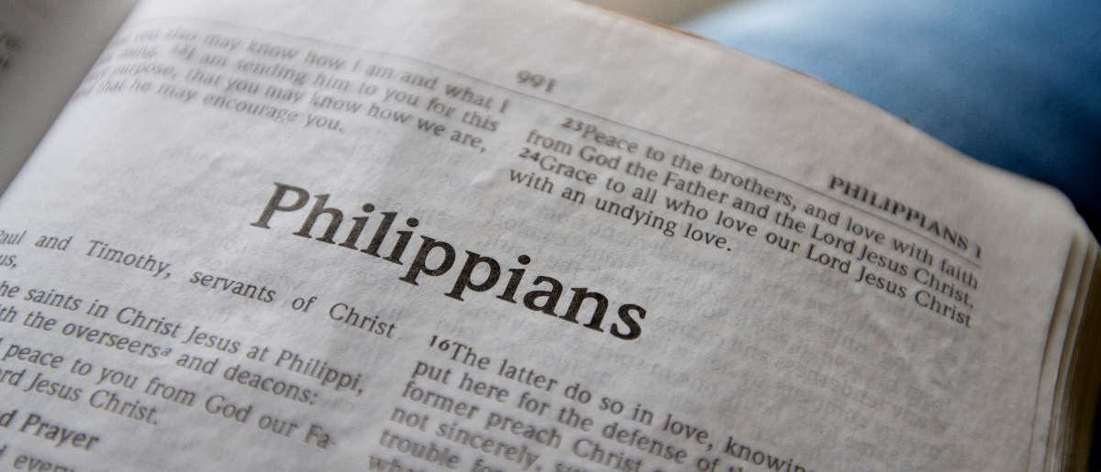
The Proven Character of Timothy
Philippians 2:19-24

Slide 3
But I trust in the Lord Jesus to send Timothy
to you shortly, that I also may be encouraged when I know your state.
Philippians 2:19

Slide 4
Timothy’s Background
Then he came to Derbe and Lystra. And behold, a certain disciple was there, named Timothy, the son of a certain Jewish woman who believed, but his father was Greek.
He was well spoken of by the brethren who were at Lystra and Iconium.
Acts 16:1-2

Slide 5
Timothy’s Background
Timothy traveled with Paul throughout his entire second journey.
Paul’s third journey: he was with Paul at Ephesus and was among those accompanying him on his return to Rome (Acts 20:3-5).
He was with Paul during his first imprisonment.
He was called to be with Paul during his second imprisonment.

Slide 6

Timothy’s Proven Character
But you know his proven character, that as a son with his father he served with me in the gospel.
Philippians 2:21

Slide 7
Timothy’s Proven Character
Timothy had been careful to follow what he had seen and learned from Paul.
  2 Tim. 3:10-15
He was faithful to teach only these things to others.
  1 Cor. 4:17

Slide 8
Timothy’s Service in the Gospel
But you know his proven character, that as a son with his father he served with me in the gospel.
Philippians 2:21

Slide 9
Timothy’s Service in the Gospel
Preach the word of God (2 Tim. 4:1-2).
Instruct the brethren (1 Tim. 4:6).
Be an example (1 Tim. 4:12).
Teach others to teach (2 Tim. 2:2).
Appoint elders (1 Tim. 3:1-13; Titus 1:5).
Rebuke elders when necessary (1 Tim. 5:19-23).

Slide 10
Timothy’s Service in the Gospel
Timothy also served as Paul’s messenger.
Paul sent him to Corinth (1 Cor. 4:17; 16:10-11).
Paul sent him to Thessalonica (1 Thess. 3:1-2, 6-7).
Paul hoped to send him to Philippi (Phil. 2:19-21).

Slide 11
Timothy’s Service in the Gospel
But I trust in the Lord Jesus to send Timothy to you shortly, that I also may be encouraged when I know your state.
For I have no one like-minded, who will sincerely care for your state.
For all seek their own, not the things which are of Christ Jesus.
Philippians 2:19-21

Slide 12
Timothy’s Service in the Gospel
But I trust in the Lord Jesus to send Timothy to you shortly, that I also may be encouraged when I know your state.
For I have no one like-minded, who will sincerely care for your state.
For all seek their own, not the things which are of Christ Jesus.
Philippians 2:19-21

Slide 13
We can always “rejoice in the Lord!”
Isn’t it an added blessing when we can also rejoice in other people?
  Let’s thank God for these special
  people in our lives.
  Let’s strive to be these kind of
  people to others.
“Rejoice in the Lord always, Again I will say, rejoice!”

