Slide 2
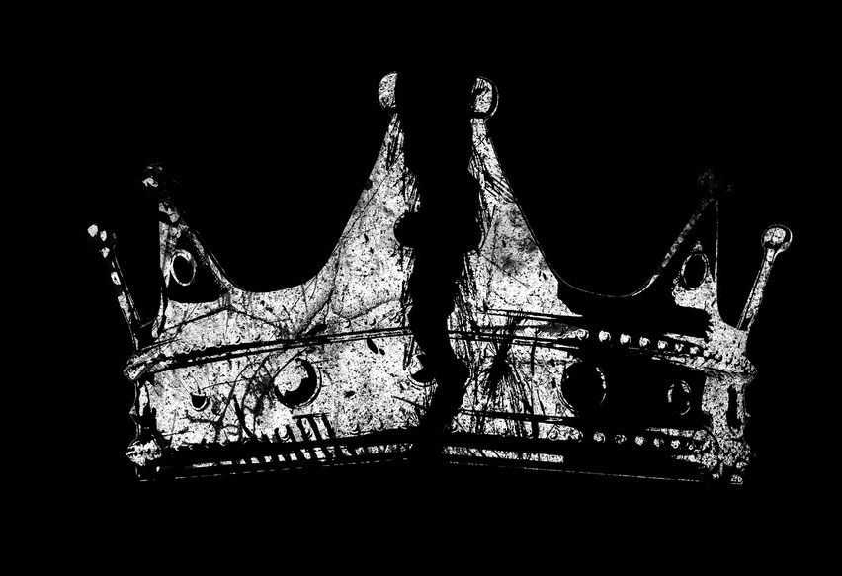
Royal Fail
King Saul
1 Samuel 11-31

Slide 3

Saul’s Challenges
He was the first king.
No administration in place.
No experienced counselors to help.
First man since Joshua to be a
national leader (400 years prior).
None of the judges had been
able to unite more than six tribes
at a time.

Slide 4

Saul’s Downward Spiral
Delivers Jabesh Gilead (11)
Offers priestly sacrifice (13)
Foolish oath weakens army (14)
Spares Agag and animals (15)
Fears Goliath (17)
Seeks David’s life (18-31)
Tried to kill his son Jonathan (20)
Murders the priests (22)
Consults a medium (28)
Commits suicide (31:4)
Philistines hang his corpse on a wall (31: 9-10)

Slide 5
Where Did Saul Go Wrong?
He Did Not Walk By Faith
He Did Not Seek First the Kingdom of God
He Did Not Accept Redemption

