Slide 2
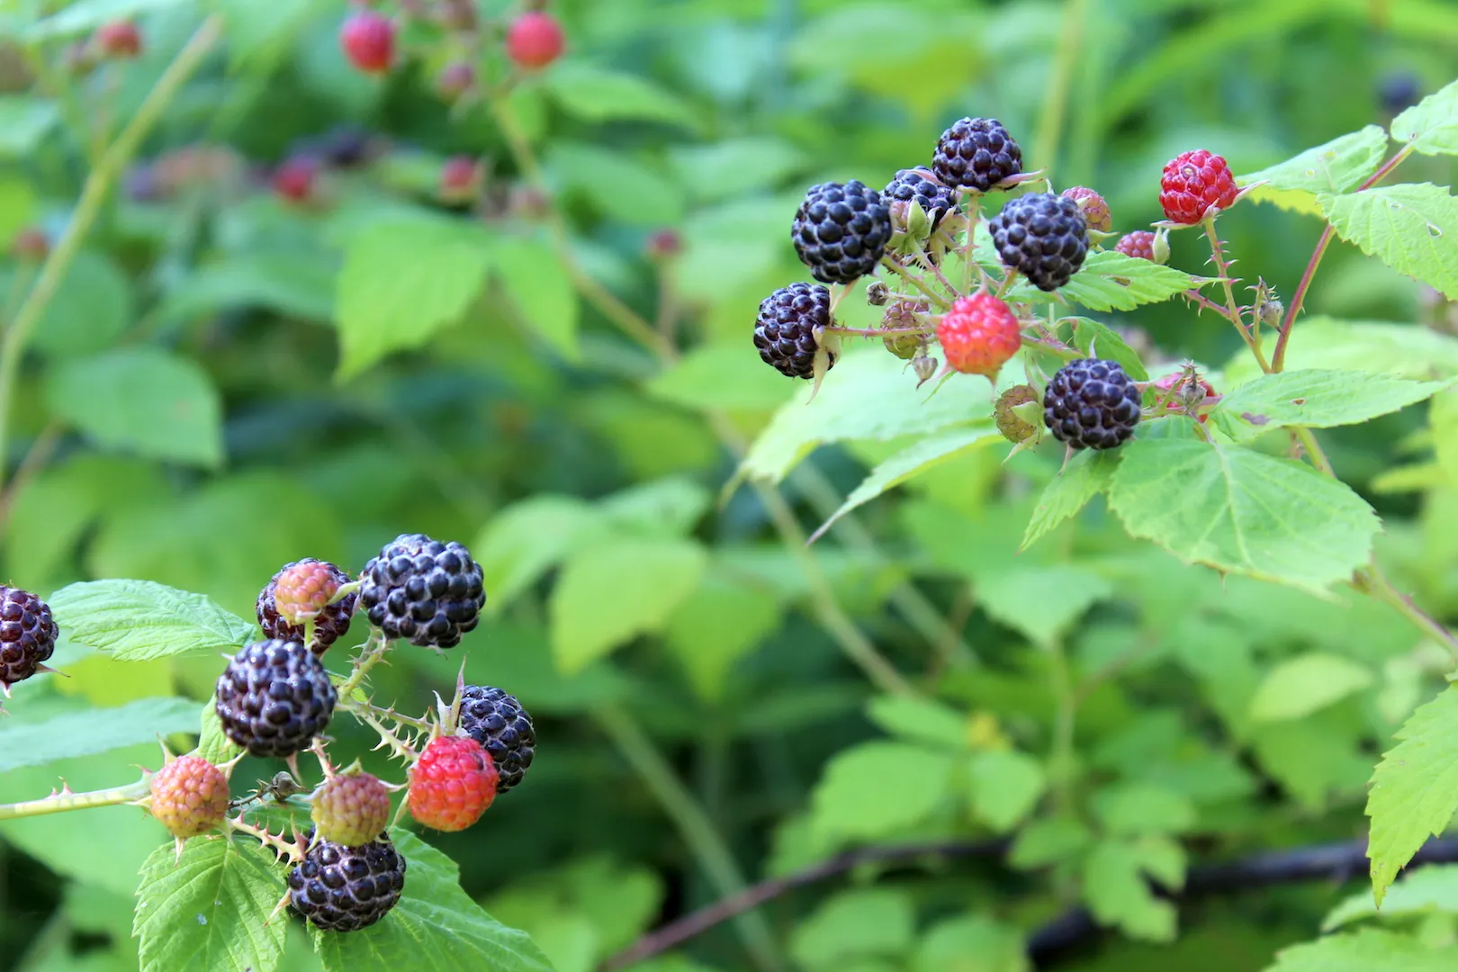
How to Pick Raspberries

Slide 3
Ecclesiastes 3:1-2 ESV
(1) For everything there is a season, and a time for every matter under heaven: (2) a time to be born, and a time to die; a time to plant, and a time to pluck up what is planted;

Slide 4
How to Pick Raspberries
Do the work

Slide 5
How to Pick Raspberries
Do the work
Change your perspective

Slide 6
Ephesians 3:7-10 ESV
(7) Of this gospel I was made a minister according to the gift of God's grace, which was given me by the working of his power. (8) To me, though I am the very least of all the saints, this grace was given,

Slide 7
Ephesians 3:7-10 ESV
to preach to the Gentiles the unsearchable riches of Christ, (9) and to bring to light for everyone what is the plan of the mystery hidden for ages in God, who created all things, (10) so that through the church the manifold wisdom of God might now be made known to the rulers and authorities in the heavenly places.

Slide 8
2 Corinthians 8:9 ESV
(9) For you know the grace of our Lord Jesus Christ, that though he was rich, yet for your sake he became poor, so that you by his poverty might become rich.

Slide 9
How to Pick Raspberries
Do the work
Change your perspective
Lower yourself

Slide 10
Philippians 2:1-8 ESV
(1) So if there is any encouragement in Christ, any comfort from love, any participation in the Spirit, any affection and sympathy, (2) complete my joy by being of the same mind, having the same love, being in full accord and of one mind. (3) Do nothing from selfish ambition or conceit, but in humility count others more significant than yourselves.

Slide 11
Philippians 2:1-8 ESV
(4) Let each of you look not only to his own interests, but also to the interests of others. (5) Have this mind among yourselves, which is yours in Christ Jesus, (6) who, though he was in the form of God, did not count equality with God a thing to be grasped,

Slide 12
Philippians 2:1-8 ESV
(7) but emptied himself, by taking the form of a servant, being born in the likeness of men. (8) And being found in human form, he humbled himself by becoming obedient to the point of death, even death on a cross.

Slide 13
Romans 12:16
[KJV] (16) Be of the same mind one toward another. Mind not high things, but condescend to men of low estate. Be not wise in your own conceits.
[ESV] (16) Live in harmony with one another. Do not be haughty, but associate with the lowly. Never be wise in your own sight.

Slide 14
How to Pick Raspberries
Do the work
Change your perspective
Lower yourself

