Slide 2
The
Christian
Race

Slide 3
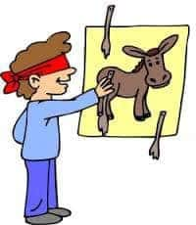
Look eye, always look eye!
Baseball
  Basketball
    Football
      Track
        Archery

Slide 4
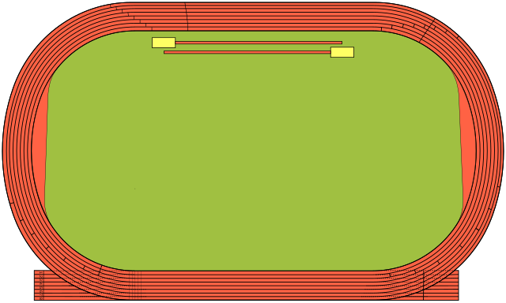
The Christian Race
Witnesses

Slide 5
Witness List
People | Event
Abel | Passover
Enoch | Red Sea
Noah | Jericho
Abraham | stopped the mouths of lions
Isaac | quenched the violence of fire
Jacob
Joseph
Moses
Rahab
Gideon
Barak
Samson
Jephthah
David
Samuel

Slide 6
The Right Race
Godliness is the only race with imperishable crown
Many other races being run under different rules
Other races more popular 1 Pet. 4:3-4
Other races more “profitable”

Slide 7
Advice
One prize in athletic race – Run to win Col 3:23
Discipline Body – Train Practice, practice, practice
Eat right – Heb 5:14
Ours is a better crown -- imperishable

Slide 8
“Run” by the Rules
Three Rule books – High School, College, Pro
Many Sports
Playing Rules, equipment regulations, playing field
  Better appreciation for 2 Tim 3:17
One race – one set of rules

Slide 9
A Runner’s Epitaph
I got into the right race.
I disciplined my spiritual body.
I was temperate in all things, progressing to solid food.
I ran heartily expecting to win.
I ran by the rules.
The crown that is laid up for me can be yours also.

