Slide 2


Slide 3
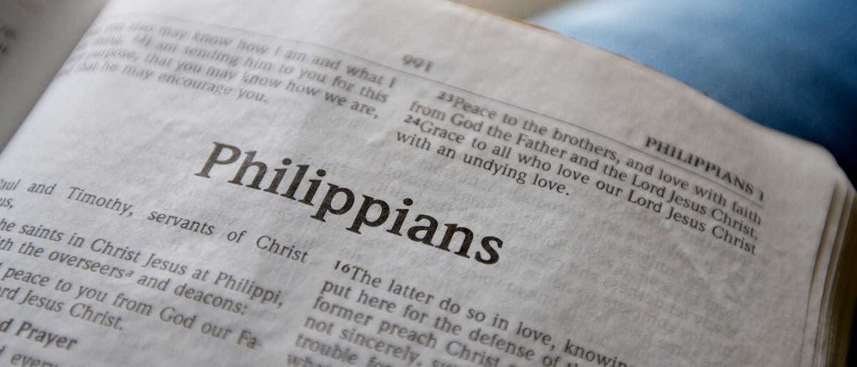
A Life or Death Contemplation
Philippians 1:19-26

Slide 4
Paul’s Attitude Toward Life
“to live is Christ” (v. 21)
“fruit from my labor” (v. 22)

Slide 5
Paul’s Attitude Toward Death
“to die is gain” (v. 21)
“to depart and be with Christ” (v. 23)

Slide 6
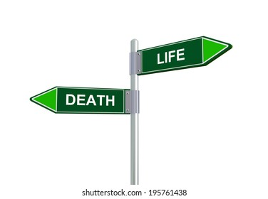
Either Way…
Christ will be magnified (v. 20).
Paul will be rewarded.
The saints should rejoice.

Slide 7
What can you say?
“To live is _________”
“To die is _________”
“Rejoice in the Lord always, Again I will say, rejoice!”

