Slide 2
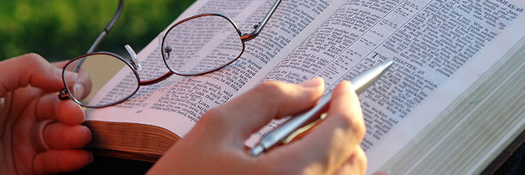
Why I Believe Jesus is the Son of God
The Biblical Evidence That Jesus
is the Son of God

Slide 3

Pilate said to them, “What then shall I do with Jesus who is called Christ?”
Matthew 27:22

Slide 4
When Jesus came into the region of Caesarea Philippi, He asked His disciples, saying, “Who do men say that I, the Son of Man, am?”
So they said, “Some say John the Baptist, some Elijah, and others Jeremiah or one of the prophets.”
He said to them, “But who do you say that I am?”
Matthew 16:13-15

Slide 5
The Way Jesus Spoke

Slide 6
The Way Jesus Spoke
Then the officers came to the chief priests and Pharisees, who said to them, “Why have you not brought Him?”
The officers answered, “No man ever spoke
like this Man!”
John 7:45-46

Slide 7
The Way Jesus Spoke
And so it was, when Jesus had ended these sayings, that the people were astonished at His teaching, for He taught them as one having authority, and not as the scribes.
Matthew 7:28-29

Slide 8
His Claims
He was the Messiah - John 4:25-26
He was equal with God - John 5:17-18
He was the Son of God - John 10:30-36
He had power to forgive sins - Mark 2:5

Slide 9
Miracles That Verified His Claims
Mark 2:5-12

Slide 10
Miracles That Verified His Claims
Men of Israel, hear these words: Jesus of Nazareth, a Man attested by God to you by miracles, wonders, and signs which God did through Him in your midst, as you yourselves also know –
Acts 2:22

Slide 11
Miracles That Verified His Claims
This man came to Jesus by night and said to Him, “Rabbi, we know that You are a teacher come from God; for no one can do these signs that You do unless God is with him.”
John 3:2

Slide 12
Miracles That Verified His Claims
His enemies could not deny that Jesus performed miracles (John 11:47).
But, instead of believing Jesus, they tried to cover up the evidence (John 12:9-11) and credit His power to Satan (Matt. 9:34; 12:24).

Slide 13
What Others Said About Him
His mother - John 2:3-5; 19:25
Peter - Matthew 16:16
John - 1 John 1:1-4
Thomas - John 20:24-29
Paul - Gal. 1:23
Centurion - Matthew 27:54

Slide 14
Fulfilled Prophecy
His death and resurrection - Matt. 20:17-19
Peter’s denial - Mark 14:30
Destruction of Jerusalem - Matthew 24

Slide 15
Fulfilled Prophecy
His birthplace - Micah 5:2
Born of a virgin - Isaiah 7:14
A forerunner - Malachi 3:1
Ride on a donkey - Zechariah 9:9
Betrayed for 30 pieces of silver - Zech. 11:12-13
Buried in rich man’s tomb - Isaiah 53:9
His hands and feet pierced - Psalm 22:16
Cast lots for His clothing - Psalm 22:18

Slide 16
Fulfilled Prophecy
His birthplace - Micah 5:2
Born of a virgin - Isaiah 7:14
A forerunner - Malachi 3:1
Ride on a donkey - Zechariah 9:9
Betrayed for 30 pieces of silver - Zech. 11:12-13
Buried in rich man’s tomb - Isaiah 53:9
His hands and feet pierced - Psalm 22:16
Cast lots for His clothing - Psalm 22:18
The mathematical odds of one person fulfilling just eight prophecies is 1 in 10¹⁷

Slide 17
Does He Fit the Profile?
Omniscient
Omnipresent
Omnipotent
Holy
Sovereign
Eternal
Immutable
Forgiving
God is…

Slide 18
Does He Fit the Profile?
Omniscient - John 16:30
Omnipresent - Matthew 28:20
Omnipotent - Matthew 28:18
Holy - 1 Peter 2:22
Sovereign - Colossians 1:15
Eternal - John 1:1
Immutable - Hebrews 13:8
Forgiving - Mark 2:5-12

Slide 19
Does He Fit the Profile?
Omniscient - John 16:30
Omnipresent - Matthew 28:20
Omnipotent - Matthew 28:18
Holy - 1 Peter 2:22
Sovereign - Colossians 1:15
Eternal - John 1:1
Immutable - Hebrews 13:8
Forgiving - Mark 2:5-12
“For in Him dwells all the fullness of the Godhead bodily.”
Col. 2:9

Slide 20
And truly Jesus did many other signs in the presence of His disciples, which are not written in this book; but these are written that you may believe that Jesus is the Christ, the Son of God, and that believing you may have life in His name.
John 20:30-31

