Slide 2
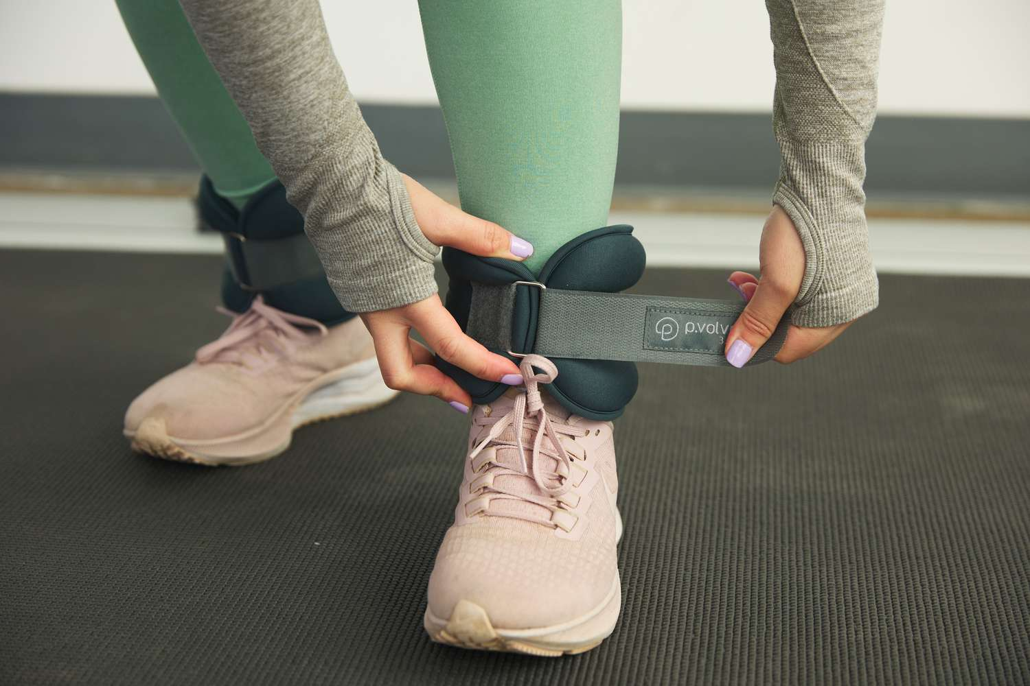

Lay Aside Every WEIGHT
Hebrews 12:1-2

Slide 3
Worldliness
1 John 2:15-17
1 Peter 2:11-12
Matthew 13:22

Slide 4
Excuses
Luke 9:59-62; 14:15-24
1 Samuel 15:20-21

Slide 5
Ignorance
Hosea 4:6
Ephesians 5:15-17
2 Timothy 2:5

Slide 6
Grumbling
1 Peter 4:9
Philippians 2:14-15

Slide 7
Hypocrisy
Romans 12:9
1 Timothy 1:5
Revelation 22:14-15

Slide 8
Temptation
Romans 13:14
1 Corinthians 10:13
Hebrews 12:1

Slide 9

“Lay Aside Every WEIGHT”
Worldliness
Excuses
Ignorance
Grumbling
Hypocrisy
Temptation

