Slide 2
“Why do You speak to them in parables?”
Matthew 13:10

Slide 3
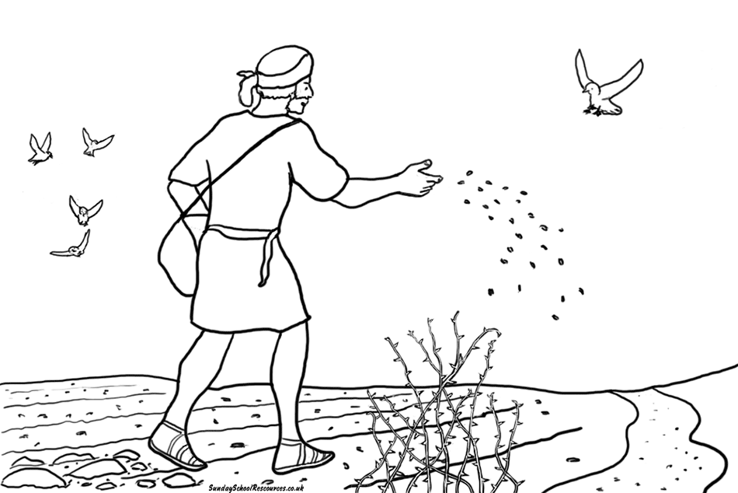
What is a Parable?
“An earthly story with a heavenly meaning.”

Slide 4
What is a Parable?
PARABOLE
para - “near, beside, with”
ballo - “to throw”
“to cast alongside for the purpose of comparison”

Slide 5
What is a Parable?
PARABOLE
If you can you can
understand understand
this, that.
Earthly Heavenly

Slide 6
Jesus’ Use of Parables
Revealed the character of the kingdom, God, and the kingdom citizen.
Used in public teaching, private instruction of the 12, and debates with His enemies.
Jesus was not the first to use parables, but He perfected the art.

Slide 7
Properly Understanding Parables
Parables, even the complex ones, were often used to make a single point.
Allow the parable to make the point and move on.
Some details are “stage props.”
Useless and even harmful to try apply spiritual significance to every detail.

Slide 8
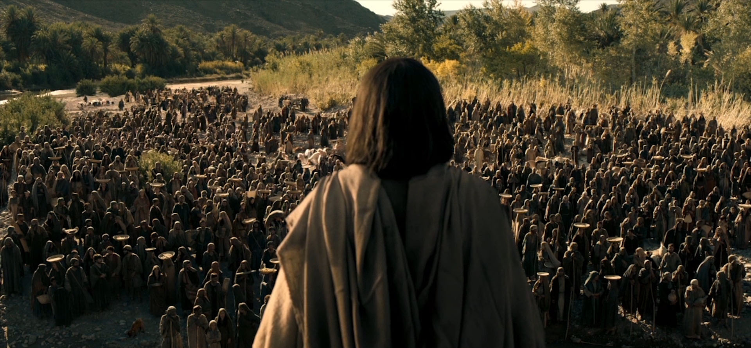
Why Jesus Used Parables
Easy to Remember
Illustrate and Reveal His Message to Others
Conceal His Message from Others - Matt. 13:11-17

Slide 9

Let’s Get Ready to Investigate the Parables!
The Sower
The Prodigal Son
The Talents
The Good Samaritan
The Wise and Foolish Builders

