Slide 2
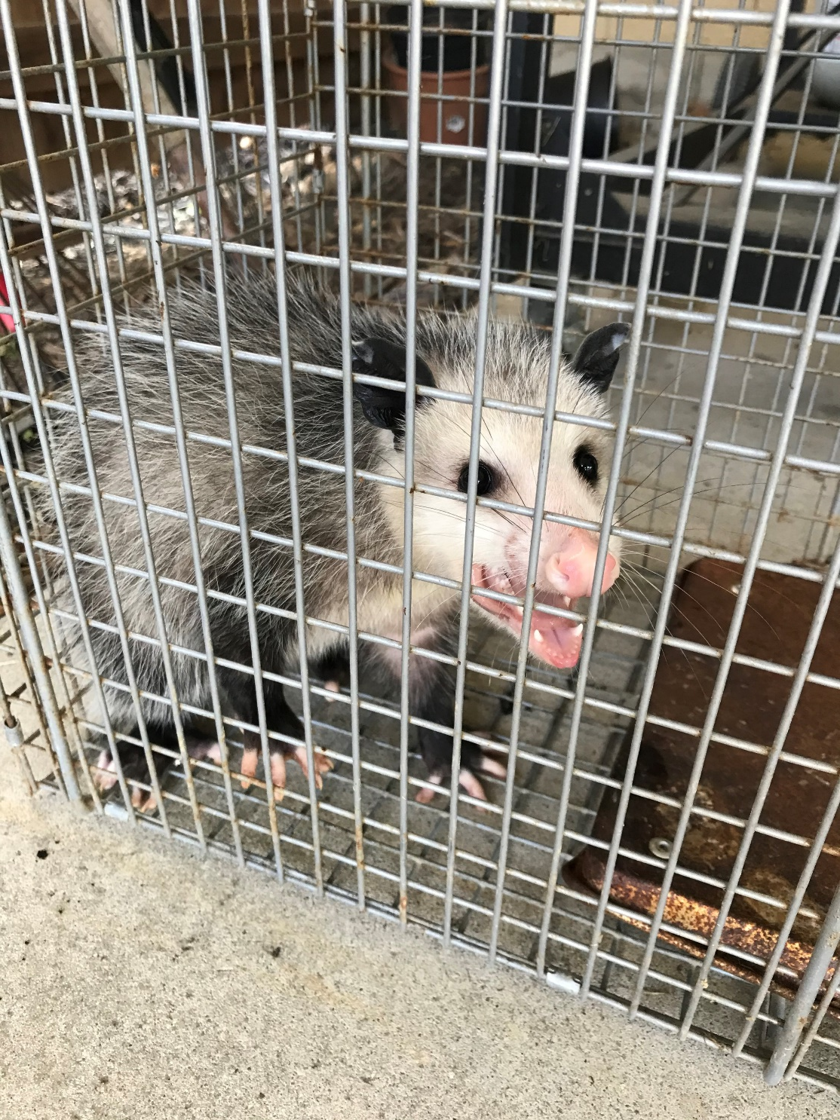
Lessons we can Learn from a Possum

Slide 3
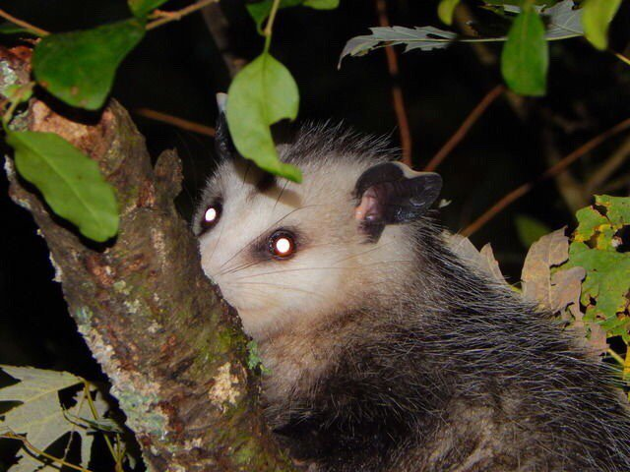
Nocturnal: Live At Night
Eph. 5:8-14
Rom. 13:12
1 Thess. 5:5-9

Slide 4
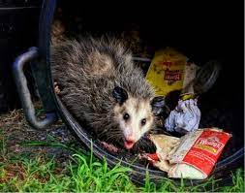
Dig Through Garbage for Food
Prov. 18:8
Prov. 16:28
Prov. 11:13

Slide 5
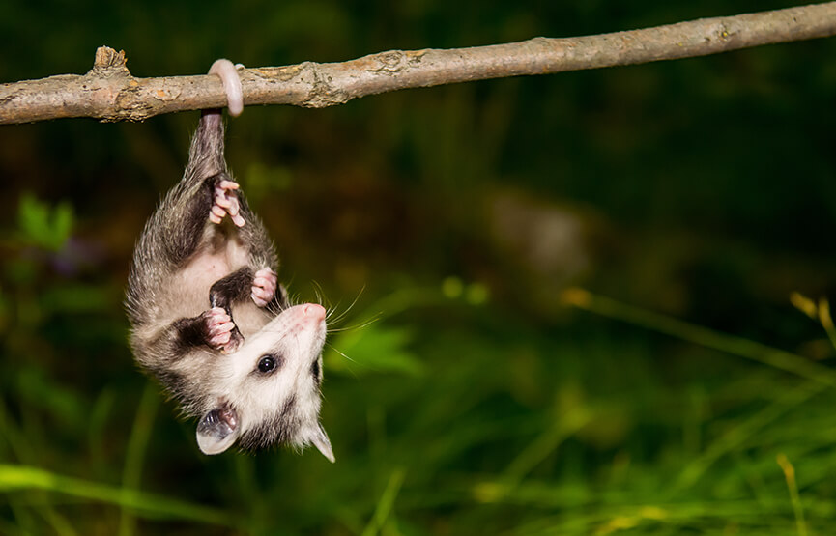
Hang Upside Down

Slide 6
Hang Upside Down
Woe to those who call evil good, and good evil;
Who put darkness for light, and light for darkness;
Who put bitter for sweet, and sweet for bitter!
Isaiah 5:20

Slide 7
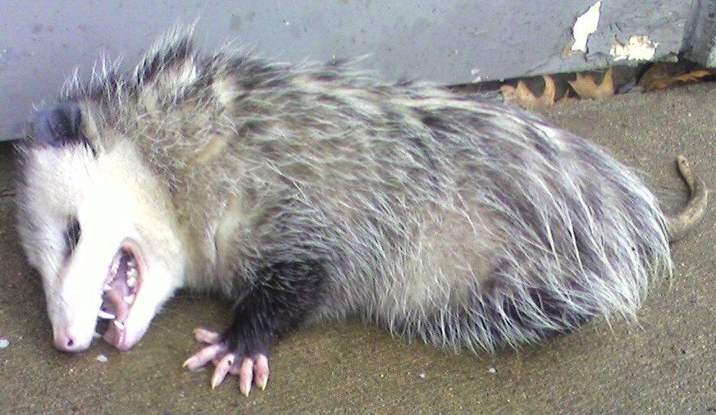
Play Dead When Threatened
1 Tim. 6:12
1 Pet. 3:15
Jude 3

Slide 8
Don’t Be Like A Possum

