Slide 2


Slide 3
We must never take our salvation for granted!

Slide 4
We must never take our salvation for granted!
“Not everyone who says to Me, ‘Lord, Lord,’ shall enter the kingdom of heaven, but he who does the will of My Father in heaven.”
Matthew 7:21

Slide 5
We must never take our salvation for granted!
“You have become estranged from Christ, you who attempt to be justified by law; you have fallen from grace.”
Galatians 5:4
“Therefore let him who thinks he stands take heed lest he fall.”
1 Corinthians 10:12

Slide 6
We must never take our salvation for granted!
“Therefore we must give the more earnest heed to the things we have heard, lest we drift away.
For if the word spoken through angels proved steadfast, and every transgression and disobedience received a just reward,
how shall we escape if we neglect so great a salvation…”
Hebrews 2:1-3

Slide 7
We must never take our salvation for granted!
“Now ‘If the righteous one is scarcely saved, where will the ungodly and the sinner appear?’”
1 Peter 4:18

Slide 8
We must never take our salvation for granted!
“If I get to Heaven.”
“I hope I get to Heaven.”
“I don’t know for sure if I will be among the saved.”

Slide 9
Improper Sources of Assurance
Our Feelings
  Jer. 17:9; Prov. 14:12
Creeds of Men
  Matt. 15:9; John 12:48
Words of Others
  1 John 4:1; Acts 17:11

Slide 10
Improper Sources of Assurance
Our Feelings
  Jer. 17:9; Prov. 14:12
Creeds of Men
  Matt. 15:9; John 12:48
Words of Others
  1 John 4:1; Acts 17:11
The Only Proper Source of Assurance for Salvation:
- The Word of God -
“So then faith comes by hearing, and hearing by the word of God”
(Rom. 10:17).

Slide 11
God wants everyone to be saved.

Slide 12
God wants everyone to be saved.
“Say to them: ‘As I live,’ says the Lord God, ‘I have no pleasure in the death of the wicked, but that the wicked turn from his way and live. Turn, turn from your evil ways! For why should you die, O house of Israel?’”
Ezekiel 33:11

Slide 13
God wants everyone to be saved.
“For God so loved the world that He gave His only begotten Son, that whoever believes in Him should not perish but have everlasting life.”
John 3:16

Slide 14
God wants everyone to be saved.
“For this is good and acceptable in the sight of God our Savior, who desires all men to be saved and to come to the knowledge of the truth.”
1 Timothy 2:3-4

Slide 15
God wants everyone to be saved.
“The Lord is not slack concerning His promise, as some count slackness, but is longsuffering toward us, not willing that any should perish but that all should come to repentance.”
2 Peter 3:9

Slide 16
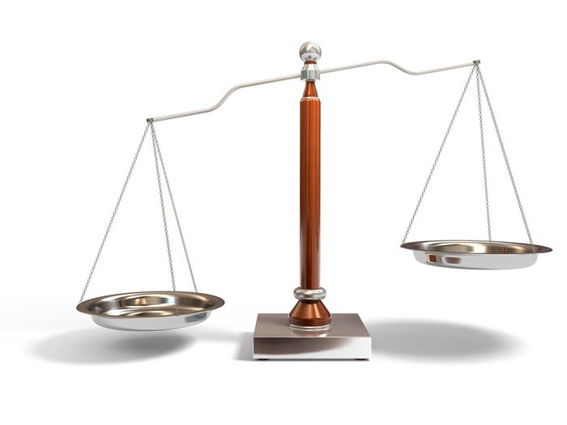
We are saved by faith, not merit.

Slide 17
We are saved by faith, not merit.
“Not by works of righteousness which we have done, but according to His mercy He saved us, through the washing of regeneration and renewing of the Holy Spirit.”
Titus 3:5

Slide 18
We are saved by faith, not merit.
“But God, who is rich in mercy, because of His great love with which He loved us, even when we were dead in trespasses, made us alive together with Christ (by grace you have been saved).”
Ephesians 2:4-5

Slide 19
We are saved by faith, not merit.
We are sons of God through faith, which led us to be baptized into Christ, thus making us heirs of God’s promise (Gal. 3:26-29).

Slide 20
We are saved by faith, not merit.
Christians don’t earn salvation through perfection, but receive forgiveness through confession and walking in the light
(1 John 1:7-2:2).

Slide 21
We can know we have eternal life.

Slide 22
We can know we have eternal life.
“These things I have written to you who believe in the name of the Son of God, that you may know that you have eternal life, and that you may continue to believe in the name of the Son of God.”
1 John 5:13

Slide 23
We can know we have eternal life.
“The Spirit Himself bears witness with our spirit that we are children of God,
and if children, then heirs - heirs of God and joint heirs with Christ, if indeed we suffer with Him, that we may also be glorified together.”
Romans 8:16-17

Slide 24
How does this work?
Holy Spirit says…
Believe - John 8:24
Repent - Luke 13:3
Confess my faith in Christ - Rom. 10:9-10
Baptized - Mark 16:16
Live faithful to the Lord - Heb. 10:36

Slide 25
How does this work?
Holy Spirit says…
My spirit says…
Believe - John 8:24
Repent - Luke 13:3
Confess my faith in Christ - Rom. 10:9-10
Baptized - Mark 16:16
Live faithful to the Lord - Heb. 10:36
If I can honestly say, “I have done that,” then I can know that I am saved!

Slide 26
Assurance of Salvation
Holy Spirit says…
My spirit says…
Believe - John 8:24
Repent - Luke 13:3
Confess my faith in Christ - Rom. 10:9-10
Baptized - Mark 16:16
Live faithful to the Lord - Heb. 10:36
If I can honestly say, “I have done that,” then I can know that I am saved, and I can trust God to keep His promises!

