Slide 1


Slide 2
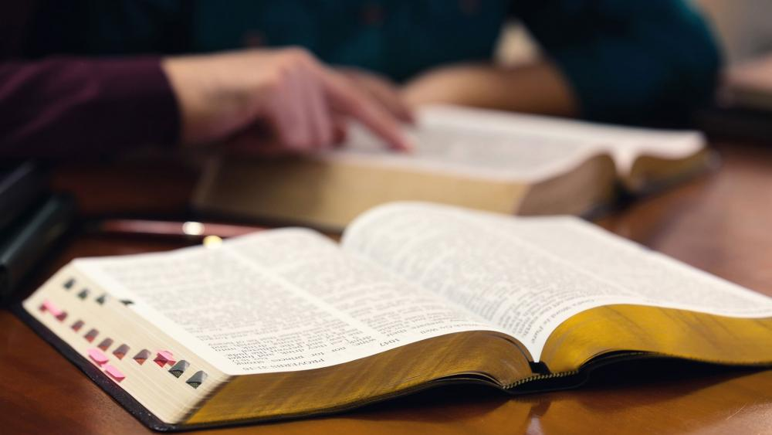
Teaching a Home Bible Study

Slide 3

“How I kept back nothing that was helpful, but proclaimed it to you, and taught you publicly and from house to house.”
Acts 20:20

Slide 4

Lessons:
Getting to Know God
God Communicates with You
The Body of Christ
God’s Plan of Salvation
Learning from the Conversions in Acts

Slide 5
Appendixes:
Does God Exist?
Can the Bible Be Trusted?
Using the Bible’s Chapter and Verse System
Four Reasons to Become a Christian Today

Slide 6
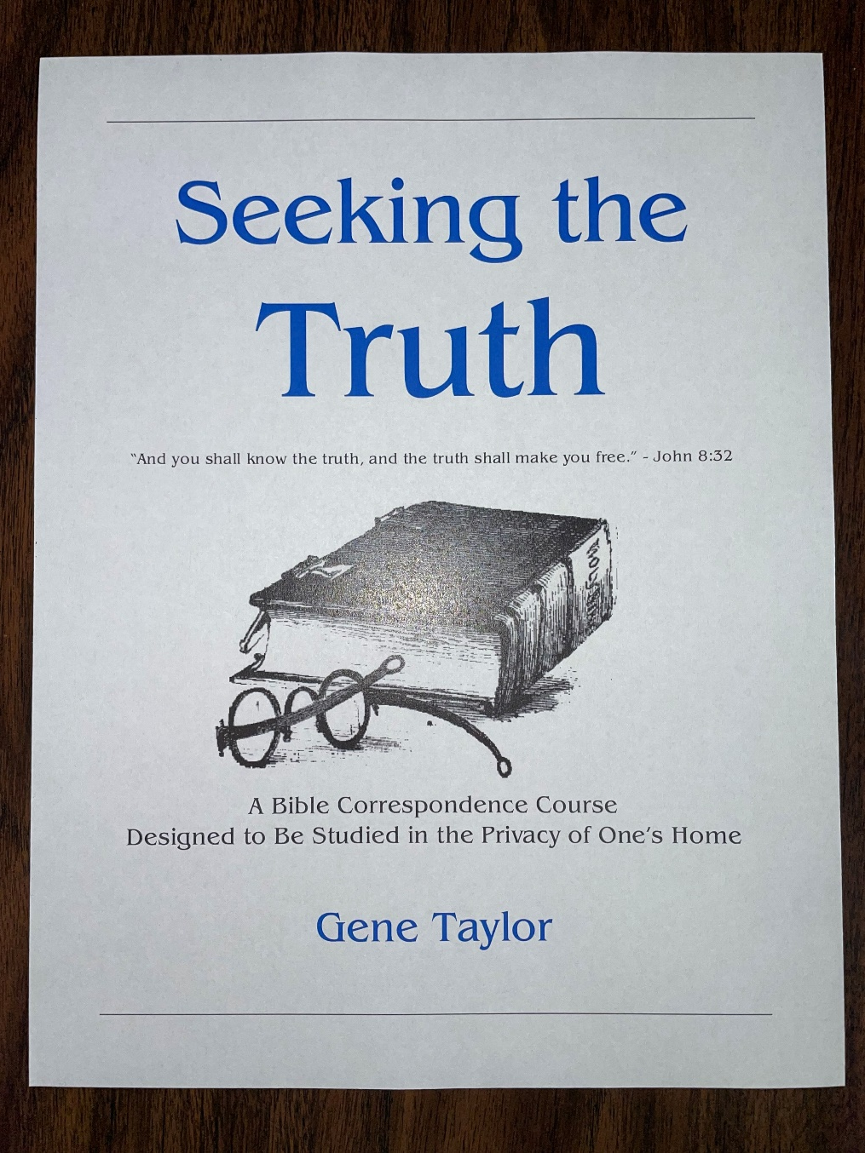
Lessons:
The Reality of God
The Validity of the Bible
Jesus – the Son of God
Salvation – Our need and Source
Faith, Repentance, Confession
Baptism
The Church of the Lord

Slide 7

Lessons:
Authority in Religion
God’s Plan for Saving Man
The Church
The Worship of the Church

Slide 8
Keys to a Good Bible Study
Ask the student to have the lesson prepared beforehand.
Start each study with prayer.
Work through the lesson, looking up the Scriptures that are used.
Ask them to read and answer the questions; have them involved as much as possible.
Encourage them to make comments and ask questions.
Always set up time and place for the next study.

