Slide 2
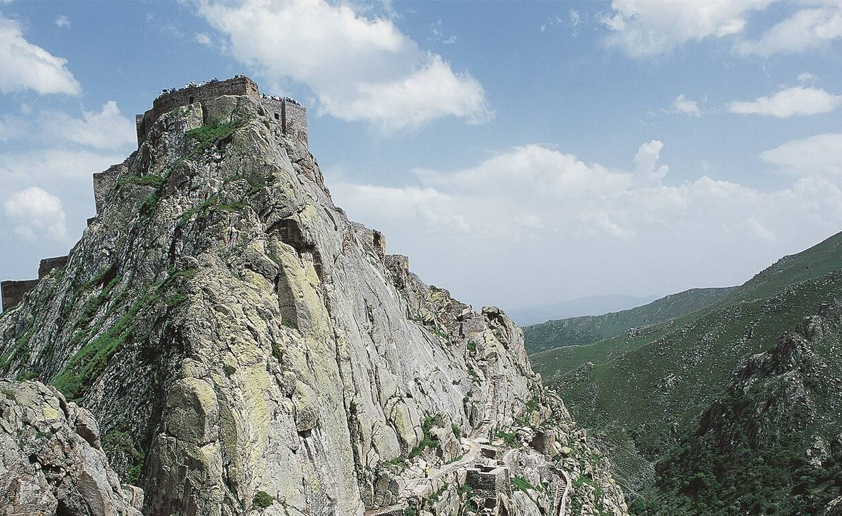
God is Our Refuge and Strength
Psalm 46

Slide 3
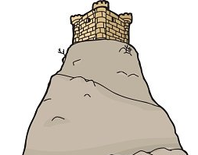
1. God is a Refuge from Natural Catastrophes vs. 1-3
God is our refuge and strength,
a very present help in trouble.

Slide 4
1. God is a Refuge from Natural Catastrophes vs. 1-3
God is our refuge and strength,
a very present help in trouble.

Slide 5
1. God is a Refuge from Natural Catastrophes vs. 1-3
God is our refuge and strength,
a very present help in trouble.

Slide 6
1. God is a Refuge from Natural Catastrophes vs. 1-3
God is our refuge and strength,
a very present help in trouble.

Slide 7
1. God is a Refuge from Natural Catastrophes vs. 1-3
Therefore we will not fear, even though the earth be removed, and though the mountains be carried into the midst of the sea;
Though its waters roar and be troubled, though the mountains shake with its swelling.
Selah

Slide 8
1. God is a Refuge from Natural Catastrophes vs. 1-3
Therefore we will not fear, even though the earth be removed, and though the mountains be carried into the midst of the sea;
Though its waters roar and be troubled, though the mountains shake with its swelling.
Selah

Slide 9
1. God is a Refuge from Natural Catastrophes vs. 1-3
Therefore we will not fear, even though the earth be removed, and though the mountains be carried into the midst of the sea;
Though its waters roar and be troubled, though the mountains shake with its swelling.
Selah

Slide 10
2. God is a Refuge from Military Attack vs. 4-7
Though its waters roar and be troubled, though the mountains shake with its swelling.
Selah
There is a river whose streams shall
make glad the city of God, the holy place of the tabernacle of the Most High.

Slide 11
2. God is a Refuge from Military Attack vs. 4-7
There is a river whose streams shall
make glad the city of God, the holy place of the tabernacle of the Most High.
God is in the midst of her, she
shall not be moved; God shall help her, just at the break of dawn.

Slide 12
2. God is a Refuge from Military Attack vs. 4-7
There is a river whose streams shall
make glad the city of God, the holy place of the tabernacle of the Most High.
God is in the midst of her, she
shall not be moved; God shall help her, just at the break of dawn.

Slide 13
2. God is a Refuge from Military Attack vs. 4-7
There is a river whose streams shall
make glad the city of God, the holy place of the tabernacle of the Most High.
God is in the midst of her, she
shall not be moved; God shall help her, just at the break of dawn.
A figure of God’s deliverance:
Ex. 14:27; Matt. 28:1

Slide 14
2. God is a Refuge from Military Attack vs. 4-7
The nations raged, the kingdoms were moved; He uttered His voice, the earth melted.
The Lord of hosts is with us; the God of Jacob is our refuge.
Selah

Slide 15
2. God is a Refuge from Military Attack vs. 4-7
The nations raged, the kingdoms were moved; He uttered His voice, the earth melted.
The Lord of hosts is with us; the God of Jacob is our refuge.
Selah

Slide 16
2. God is a Refuge from Military Attack vs. 4-7
The nations raged, the kingdoms were moved; He uttered His voice, the earth melted.
The Lord of hosts is with us; the God of Jacob is our refuge.
Selah

Slide 17
3. God is Exalted Among the Nations vs. 8-11
Come, behold the works of the Lord,
Who has made desolations in the earth.
He makes wars cease to the end of the earth; He breaks the bow and cuts the spear in two; He burns the chariot in the fire.

Slide 18
3. God is Exalted Among the Nations vs. 8-11
Be still, and know that I am God;
I will be exalted among the nations,
I will be exalted in the earth!
The Lord of hosts is with us; the God of Jacob is our refuge.
Selah

Slide 19
What Psalm 46 teaches us about our God!
Our Refuge, Strength, Present Help (v. 1)
Our Peace (v. 4)
Our Stability and Deliverance (v. 5)
God is Sovereign – over all the earth and the kingdoms of men (v. 6)

Slide 20
What Psalm 46 teaches us about our God!
Our Refuge, Strength, Present Help (v. 1)
Our Peace (v. 4)
Our Stability and Deliverance (v. 5)
God is Sovereign – over all the earth and the kingdoms of men (v. 6)
Have you made the God of Jacob
your refuge and strength?

