Slide 2
The Choice of a New Generation
Deuteronomy 30:15-20

Slide 3
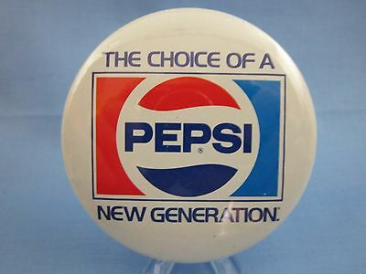

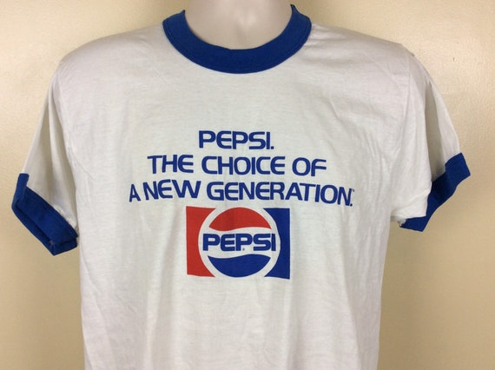

Slide 4
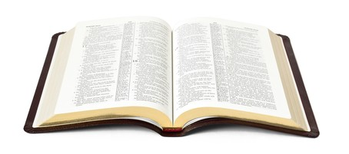
“I call heaven and earth as witnesses today against you, that I have set before you life and death, blessing and cursing; therefore choose life, that both you and your descendants may live.”
Deuteronomy 30:19

Slide 5
The Nature of the Choice

Slide 6
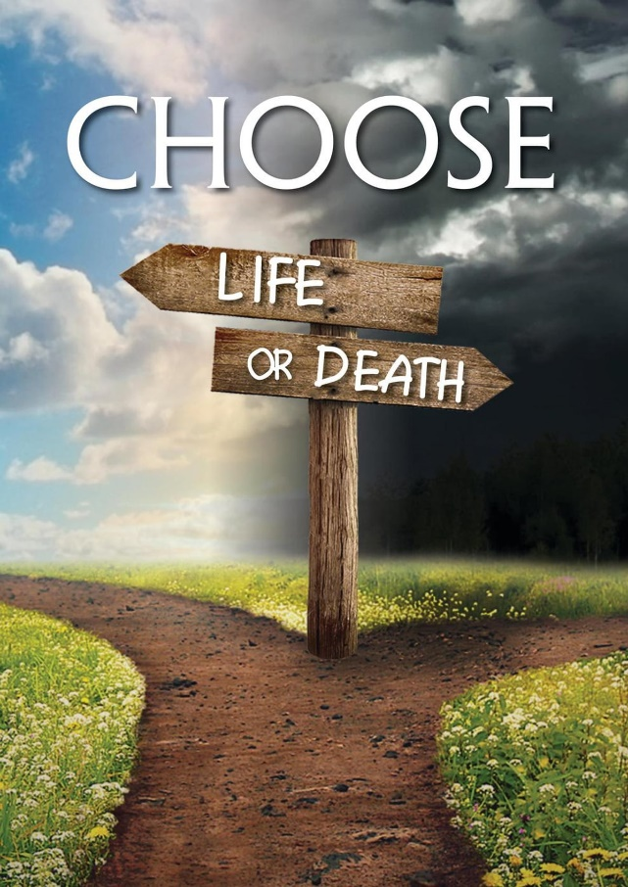
The Nature of the Choice
It was a clear choice.

Slide 7
The Nature of the Choice
It was a clear choice.
“And the Lord God commanded the man, saying, ‘Of every tree of the garden you may freely eat; but of the tree of the knowledge of good and evil you shall not eat, for in the day that you eat of it you shall surely die.’”
Genesis 2:16-17

Slide 8
The Nature of the Choice
It was a clear choice.
“Now you shall say to this people, ‘Thus says the Lord: “Behold, I set before you the way of life and the way of death.”’”
Jeremiah 21:8

Slide 9
The Nature of the Choice
It was a clear choice.
“Enter by the narrow gate; for wide is the gate and broad is the way that leads to destruction, and there are many who go in by it. Because narrow is the gate and difficult is the way which leads to life, and there are few who find it.”
Matthew 7:13-14

Slide 10
The Nature of the Choice
It was a clear choice.
It was a personal choice.

Slide 11
The Nature of the Choice
It was a clear choice.
It was a personal choice.
It was a critical choice.

Slide 12
How Do We Choose Life?
“by loving the Lord your God, by obeying His voice, and by holding fast to Him; for this is your life and the length of your days, that you may live in the land which the Lord swore to your fathers, to Abraham, Isaac, and Jacob, to give them.”
Deut. 30:20, NASU

Slide 13
1. By Loving the Lord
Love allows us to keep the entirety of God’s law.
  Matt. 22:40; Rom. 13:8-10
Obedience without love is nothing.
  1 Cor. 13:1-3
We love God because He first loved us.
  1 John 4:10, 19

Slide 14
2. By Obeying His Voice
They failed to enter the Promised Land because they did not obey.
  Heb. 3:16-19
The promise of Heaven is dependent on our obedience.
  Heb. 4:11
Our faith will save us when it moves us to obey God’s commands.
  James 2:21-24

Slide 15
3. By Holding Fast To Him
Stresses continued faithfulness and loyalty to God.
We must cling to the Lord because “He is your life and the length of your days.”
Illustrated well in John 6:66-69.

Slide 16

We have an important choice to make!
In believing and obeying the Gospel, we are choosing life and blessing.
In rejecting the Gospel, we are choosing death and an eternal curse.

