Slide 2


Slide 3
Praying for
Evangelism
“The harvest truly is great, but the laborers are few; therefore pray the Lord of the harvest to send out laborers into His harvest.
Go your way; behold, I send you
out as lambs among wolves.”
Luke 10:2-3

Slide 4
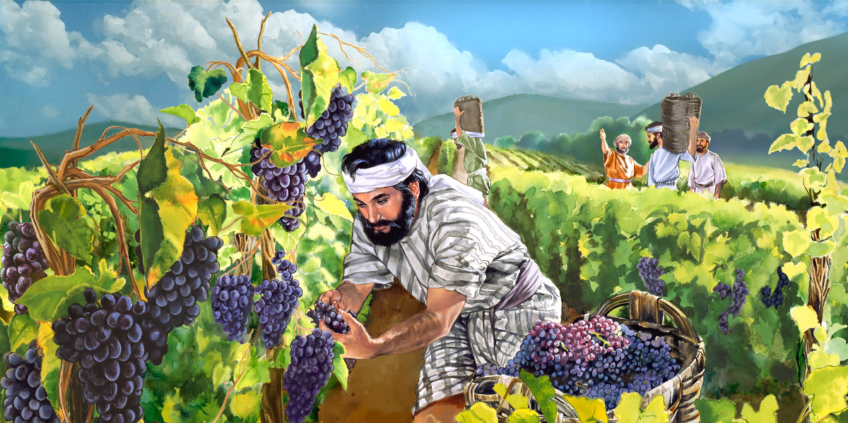
1. Pray for Laborers
Luke 10:2

Slide 5

2. Pray for Peace and the Swift Advance of the Gospel
1 Timothy 2:1-4
2 Thessalonians 3:1-2
Acts 8:1-4

Slide 6

3. Pray for Opportunities to Teach Others
Colossians 4:2-4
Revelation 3:8
Acts 19:10

Slide 7

4. Pray for the Salvation of Specific People
Romans 10:1

Slide 8

5. Pray for Boldness
Acts 4:23-30

Slide 9
Praying for
Evangelism
Laborers
Swift Advance of Gospel
Opportunities to Teach
Salvation of Specific People
Boldness

