Slide 1


Slide 2
Concern for
Lost Souls
“For what profit is it to a man if he gains the whole world, and loses his own soul? Or what will a man give in exchange for his soul?”
Matthew 16:26

Slide 3
We Have a Responsibility
Ezekiel 33:2-9
Acts 18:5-6
Romans 10:13-15

Slide 4
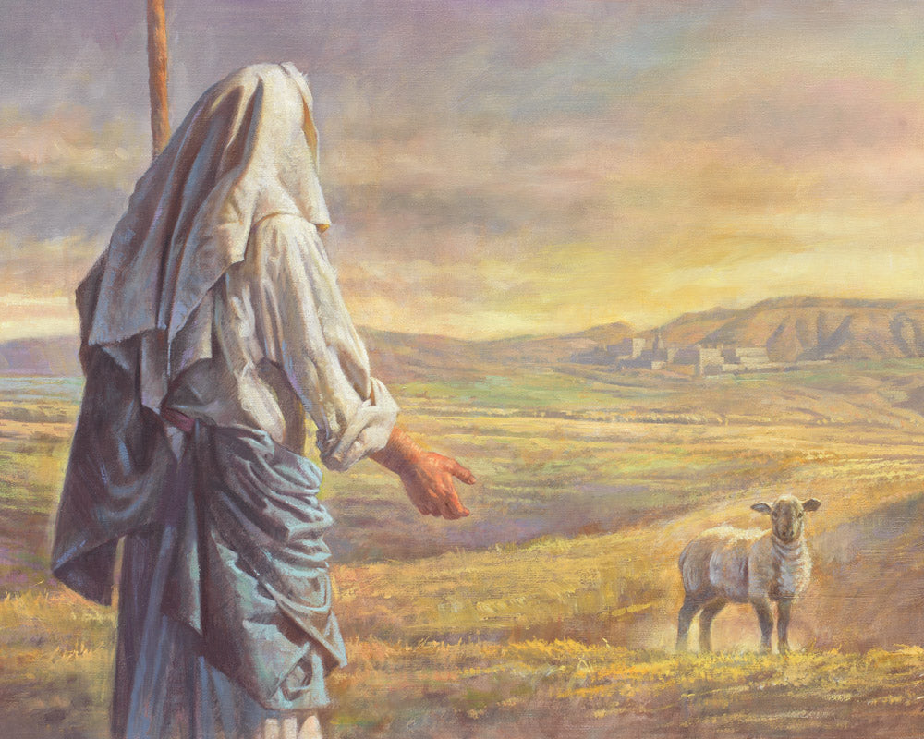
Our Lord’s Concern for Lost Souls
1 Timothy 1:15
Luke 19:10
Luke 15:4-7

Slide 5
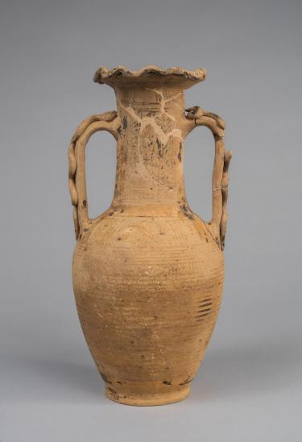
Our Concern for Lost Souls
“But we have this treasure in earthen vessels, that the excellence of the power may be of God
and not of us.”
2 Corinthians 4:7

Slide 6
Concern for Our Own Soul
“When I say to the wicked, ‘O wicked man, you shall surely die!’ and you do not speak to warn the wicked from his way, that wicked man shall die in his iniquity; but his blood I will require at your hand.
Nevertheless if you warn the wicked to turn from his way, and he does not turn from his way, he shall die in his iniquity; but you have delivered your soul.”
Ezekiel 33:8-9

Slide 7
Concern for
Lost Souls
“For what profit is it to a man if he gains the whole world, and loses his own soul? Or what will a man give in exchange for his soul?”
Matthew 16:26

