Slide 2
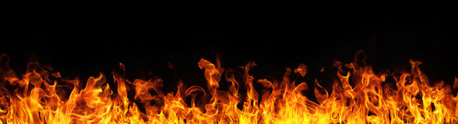
Zealous for Good Works
Titus 2:14

Slide 3

What is Zeal?
“great energy or enthusiasm in
pursuit of a cause or objective”
Translated from Greek
word zelos.
“to be hot, or heat”

Slide 4

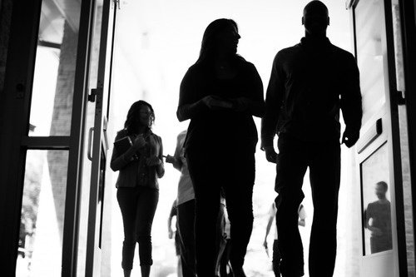
How We Treat Our Visitors

Slide 5

1. What Visitors See and Hear
1 Corinthians 14:22-25
All things are to be done decently and in order (vs. 33, 40).
Our misbehavior in services can distract everyone – including our visitors.

Slide 6
2. How Visitors Are Received
James 2:2-4

Slide 7
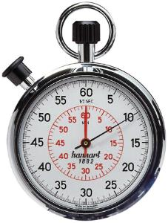
Did you know?
Visitors form an opinion about…
whether or not a congregation is friendly,
whether or not they will return,
within the first 2-10 minutes!

Slide 8
What Can You Do?
Give them a personal welcome.
Help them.
Contribute to welcoming atmosphere.
Don’t embarrass them.
Get to know them.

