Slide 1
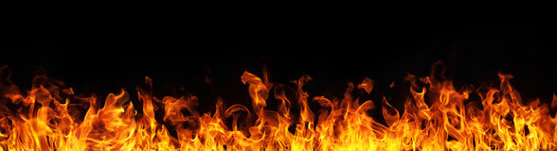
Zealous for Good Works
Titus 2:14

Slide 2

What is Zeal?
“great energy or enthusiasm in
pursuit of a cause or objective”
Translated from Greek
word zelos.
“to be hot, or heat”

Slide 3

Helping the Sick and Grieving

Slide 4
Helping the Sick

Slide 5
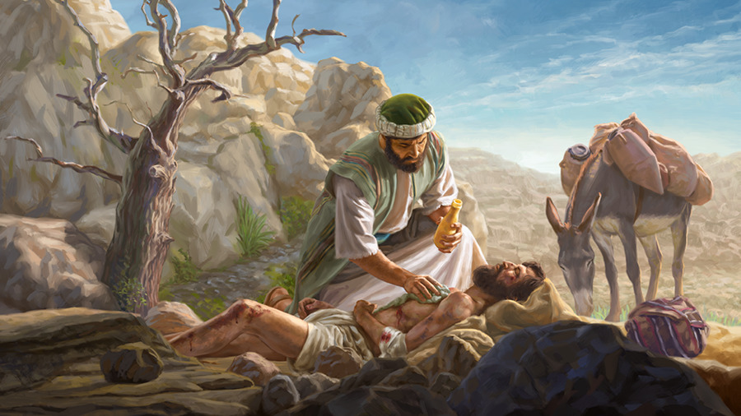
Helping the Sick
We are to love our neighbor.
  Luke 10:30-37

Slide 6
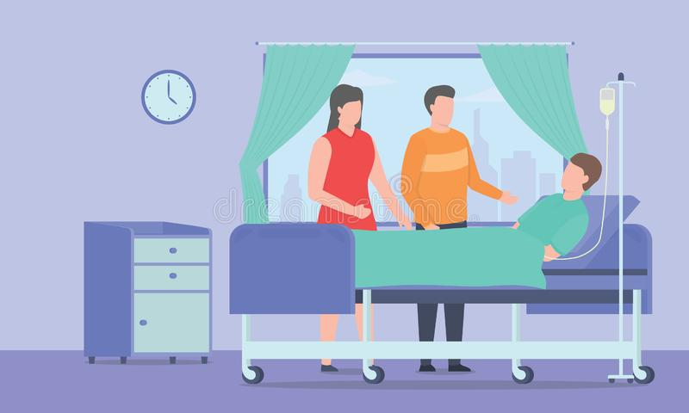
Helping the Sick
We are to “visit” those who are sick.
  Matthew 25:36, 43
  “visit” – episkeptomai
  “to look upon in order to help or benefit”

Slide 7

Helping the Grieving
“What are we to do when death calls?
We – the church – come alive!”
Paul L. Walker

Slide 8
Helping the Grieving
Acknowledge their right to grieve.
  Eccl. 3:2, 4; John 11:35-36
Be a good listener, not advisor.
  James 1:19; Job 2:11-13; 16:2
Be understanding.
  2 Cor. 1:3-4
Think before you speak.
  James 1:19; Col. 4:6; Prov. 25:11
Maintain your support after the funeral.

