Slide 2
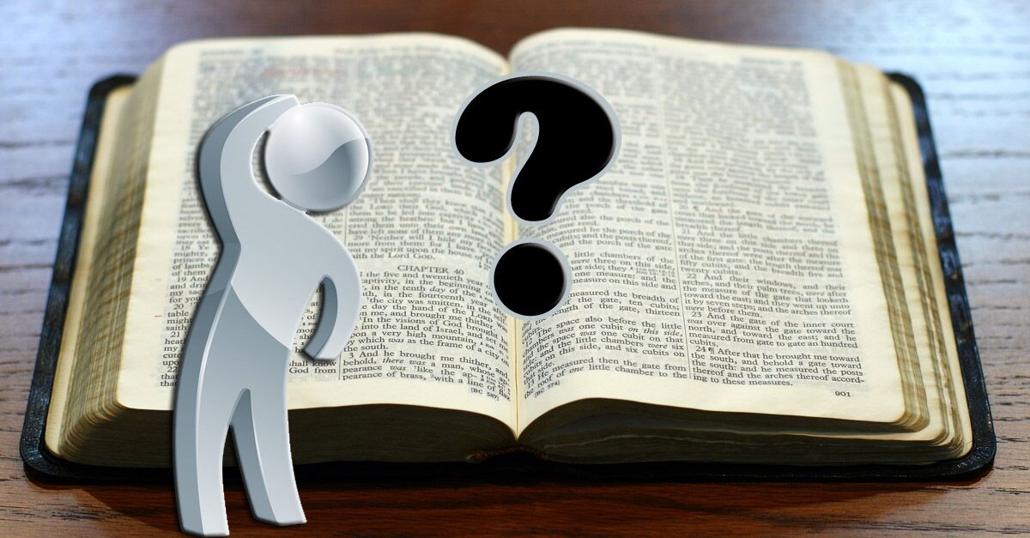
Questions About
Christians Drinking Alcohol

Slide 3

“For we have spent enough of our past lifetime in doing the will of the Gentiles - when we walked in lewdness, lusts, drunkenness, revelries, drinking parties, and abominable idolatries.”
1 Peter 4:3

Slide 4
“For we have spent enough of our past lifetime in doing the will of the Gentiles - when we walked in lewdness, lusts, drunkenness, revelries, drinking parties, and abominable idolatries.”
1 Peter 4:3

Slide 5
“For we have spent enough of our past lifetime in doing the will of the Gentiles - when we walked in lewdness, lusts, drunkenness, revelries, drinking parties, and abominable idolatries.”
1 Peter 4:3

Slide 6
“Whoever causes one of these little ones who believe in Me to sin, it would be better for him if a millstone were hung around his neck, and he were drowned in the depth of the sea. Woe to the world because of offenses! For offenses must come, but woe to that man by whom the offense comes!”
Matthew 18:6-7

Slide 7
Did Jesus drink wine?
Can you find the verse that tells us Jesus drank wine?
He was accused of being a “winebibber” by His enemies (Matt. 11:19; Luke 7:34).
He called the drink at Passover “fruit of the vine,” not wine.

Slide 8
Bible Use of the Word “Wine”
Old Testament – yayin
New Testament – oinos
Generic terms designating the juice of the grape in all its stages.
  Fermented/intoxicating - Gen. 9:21
  Fresh grape juice – “new wine” - Matt. 9:17
  Still in the cluster - Is. 65:8

Slide 9
Did the Jews know how to preserve unfermented grape juice?
The grape juice could be filtered, removing the solid parts that contained most of the natural yeast.
The grape juice could be boiled, removing all the yeast and increasing the sugar content – making fermentation impossible.
Grape juice was boiled into a thick syrup, kept in jars under cool water, and mixed with water at a later time to be consumed.

Slide 10
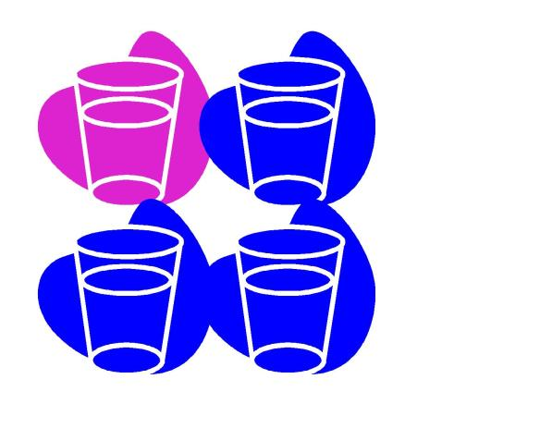
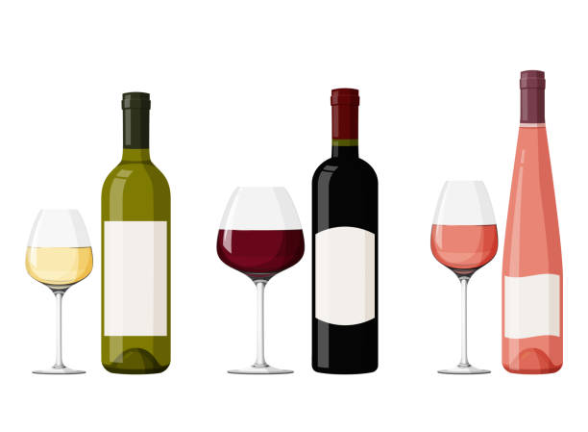
Alcohol Content of Ancient Wines
It was the practice to mix wine with water.
1 part wine to 3 parts water.
Never exceeded 5-8% alcohol.
Most modern wines have an alcohol content of at least
12-13%

Slide 11
Jesus Turned Water into Wine
John 2:1-11
How could drinking wine be wrong
if Jesus made wine?

Slide 12
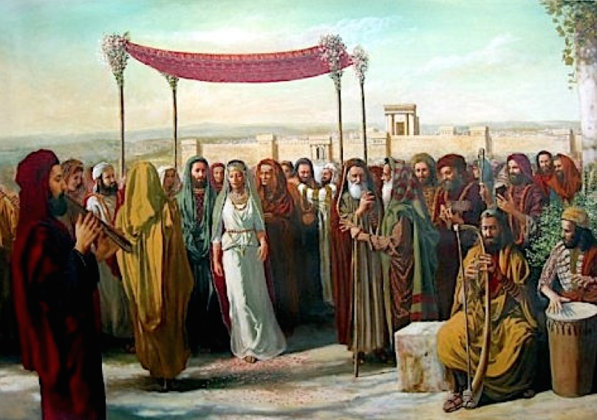
Marriage feasts usually lasted seven days, with guests arriving each day.
Failure to provide enough refreshments for the feast would result in social disgrace.
This prompted Mary’s words to Jesus,
“They have no
wine” (v. 3).

Slide 13
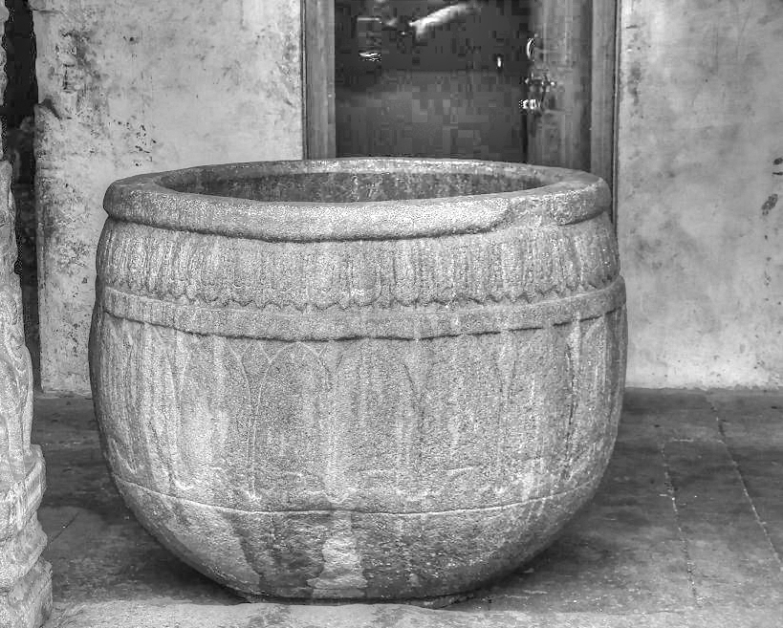
There were six waterpots, each holding
20-30 gallons.
Jesus commanded these to be filled to the brim with water, some drawn out, and taken to the master of the feast.
Jesus turned water
into wine, but
emphasis is placed
on the quality – He
made the best.

Slide 14
Oinos refers to the juice of the grape in all its stages.
If Jesus turned this water into fermented wine, He made 120-180 gallons of alcohol for people who had already been drinking.

Slide 15
“Woe to him who gives drink to his neighbor, pressing him to your bottle, even to make him drunk, that you may look on his nakedness” (Habakkuk 2:15).
“Woe to men mighty at drinking wine, woe to men valiant for mixing intoxicating drink” (Isaiah 5:22).

Slide 16
1 Peter 4:1-4
Therefore, since Christ suffered for us in the flesh, arm yourselves also with the same mind, for he who has suffered in the flesh has ceased from sin,
that he no longer should live the rest of his time in the flesh for the lusts of men, but for the will of God.
For we have spent enough of our past lifetime in doing the will of the Gentiles — when we walked in lewdness, lusts, drunkenness, revelries, drinking parties, and abominable idolatries.
In regard to these, they think it strange that you do not run with them in the same flood of dissipation, speaking evil of you.

