Slide 2
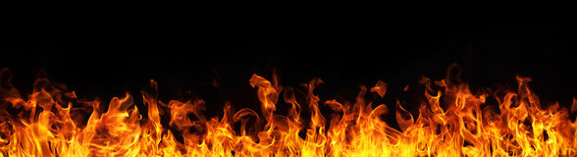
Zealous for Good Works
Titus 2:14

Slide 3

What is Zeal?
“great energy or enthusiasm in
pursuit of a cause or objective”
Translated from Greek
word zelos.
“to be hot, or heat”

Slide 4
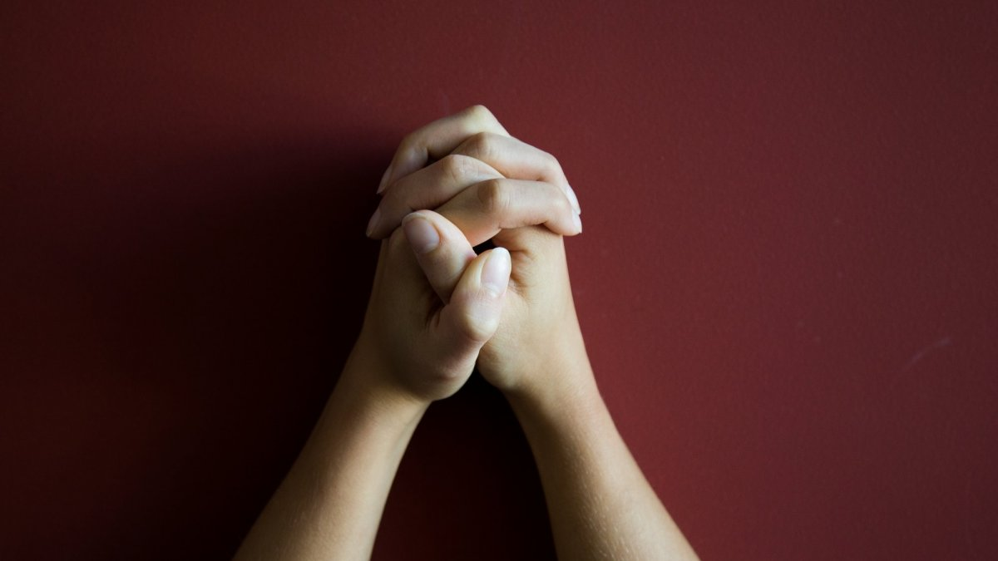
Prayer

Slide 5
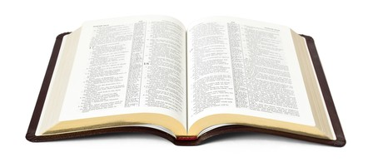
James 5:16 b
“The effectual fervent prayer of a righteous man availeth much” (KJV).
“The effective, fervent prayer of a righteous man avails much” (NKJV).
“The prayer of a righteous person has great power as it is working” (ESV).

Slide 6
James 5:16 b
“effective, fervent”
  energeo
  “to be active, efficient” (Strong)
  “to be operative, be at work, put forth power” (Thayer).

Slide 7
Members of the early church were zealously devoted to prayer.
Acts 1:14 – between ascension and Pentecost.
Acts 2:42 – the newborn church.
Acts 4:24-31 – in the face of opposition.
Acts 6:2-4 – the apostles continued in prayer.
Acts 12:5, 12 – church prayed for Peter.
Acts 13:2-3 – before sending Paul and Barnabas.
Acts 14:21-23 – strengthening and organizing.

Slide 8

Christians and Churches can pray for…
Open doors for spreading the gospel -
  Col. 4:3; Rom. 10:1
Those preaching the gospel - Col. 4:4
The sick - James 5:14-16
Our enemies - Matt. 5:43-44
Government leaders - 1 Tim. 2:1-2

