Slide 2
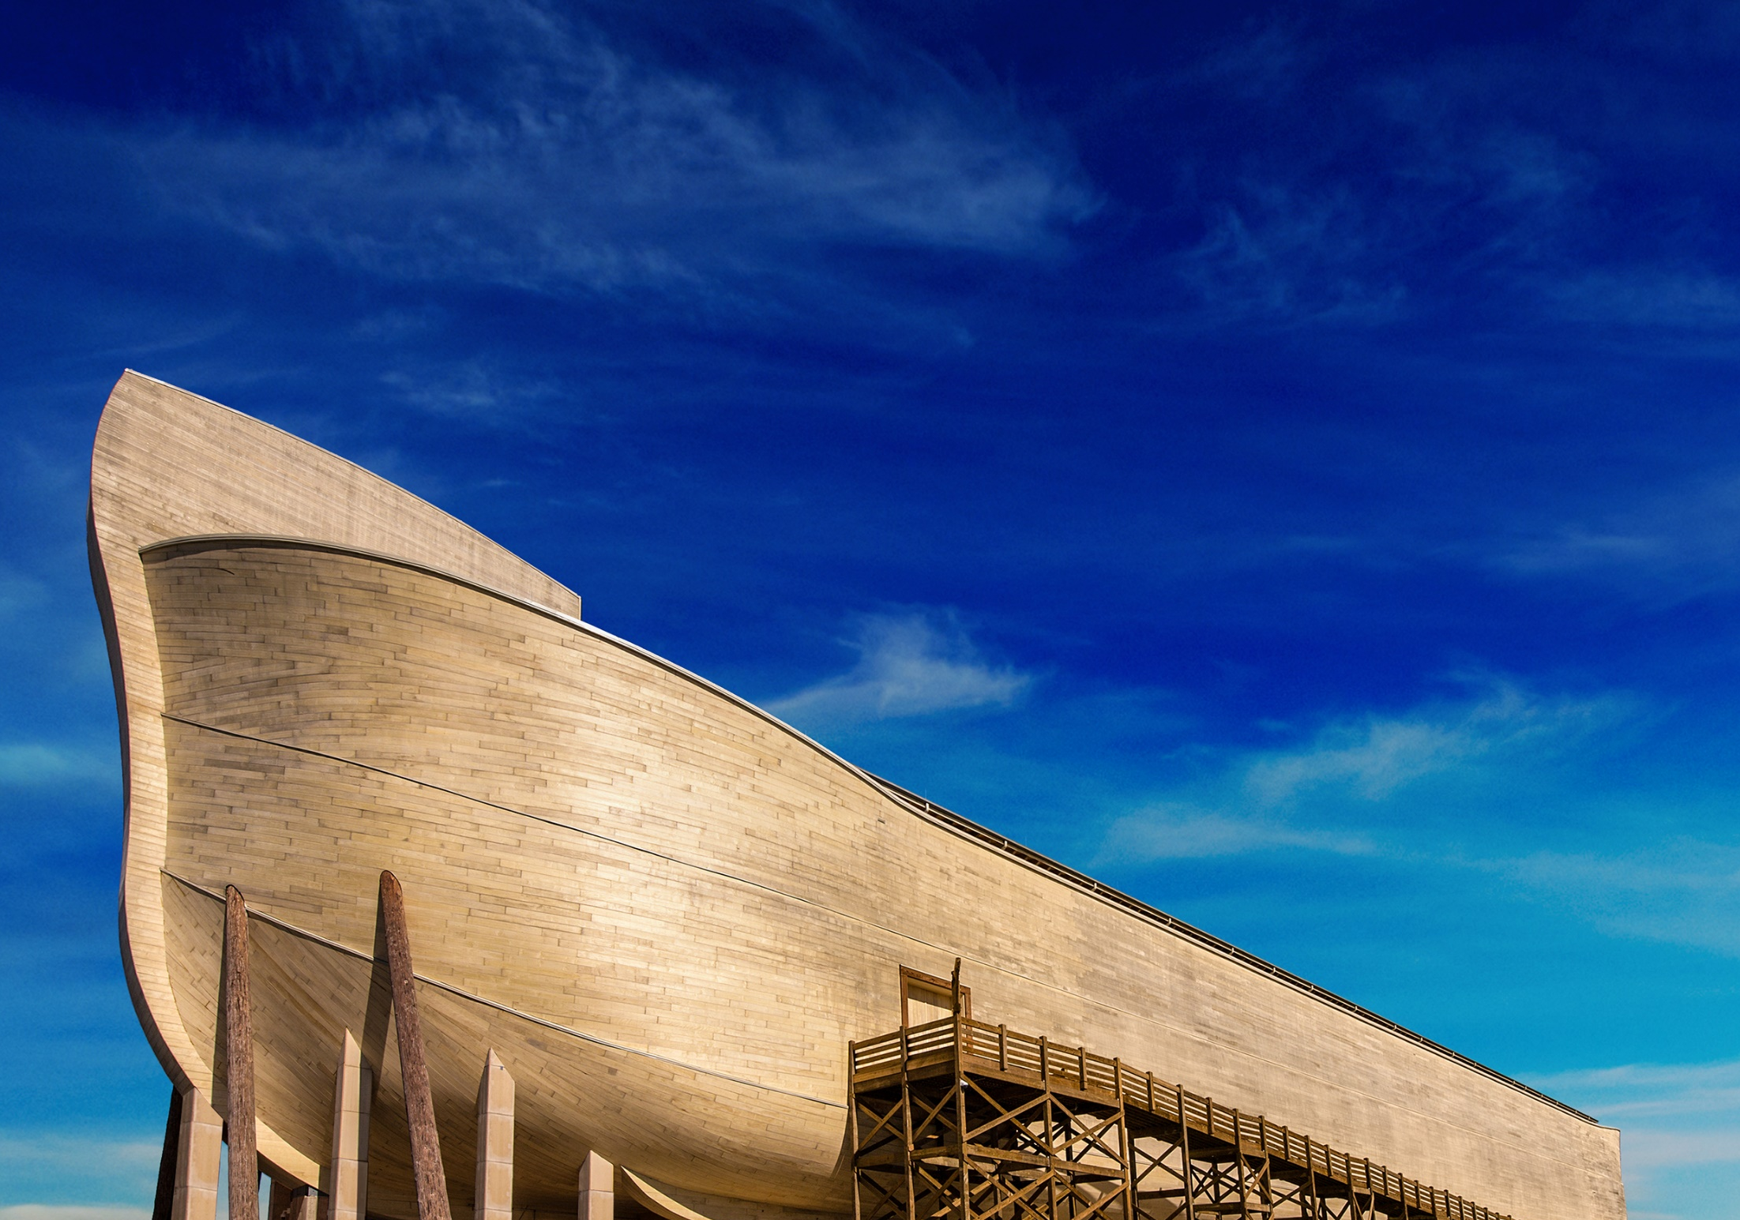
Noah Walked with God

Slide 3
1. Noah Believed God
“By faith Noah, being divinely warned of things not yet seen…” (Heb. 11:7).
Faith is “evidence of things not seen” (Heb. 11:1).
Genesis 6:13-21
2 Corinthians 5:7

Slide 4
2. Noah Feared God
“…moved with godly fear…” (Heb. 11:7).

Slide 5
2. Noah Feared God
Respect God’s Wisdom and Power
Respect God’s Authority
Expressed in Our Humility
Expressed in Our Worship

Slide 6
3. Noah Obeyed God
“…prepared an ark…” (Heb. 11:7).

Slide 7
3. Noah Obeyed God
Noah’s obedience was Exact
Noah’s obedience was Personal
Noah’s obedience was Complete

Slide 8

Noah Walked
With
God
1. Noah Believed God
2. Noah
Feared God
3. Noah Obeyed God

