Slide 2

The Truth About Lying

Slide 3
What is a Lie?
“to make a statement that one knows is false, especially with intent to deceive” (Webster’s Dictionary).
“In Scripture the word is used to designate all the ways in which men deny or alter the truth in word or deed” (The New Unger’s Bible Dictionary).

Slide 4
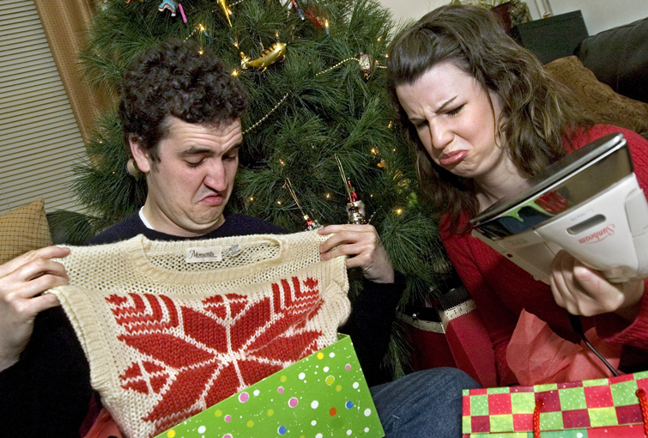

Is it Always Wrong to Lie?
Can we lie to spare someone’s feelings or to save a life?
What about “white lies,” “stories,” or “fibs”?

Slide 5
Is it Always Wrong to Lie?
Abraham - Gen. 12:11-19; 20:2
Sarah - Gen. 18:15
Isaac - Gen. 26:7-9
Jacob - Gen. 27:19-20, 24
Rahab - Joshua 2:4-6
David - 1 Sam. 21:2
Peter - Matt. 26:69-75

Slide 6
Why is Lying Wrong?

Slide 7
Why is Lying Wrong?
1. Lies Originate with Satan
“You are of your father the devil, and the desires of your father you want to do. He was a murderer from the beginning, and does not stand in the truth, because there is no truth in him. When he speaks a lie, he speaks from his own resources, for he is a liar and the father of it.”
John 8:44

Slide 8
Why is Lying Wrong?
2. Lies Destroy Mankind
“You are of your father the devil, and the desires of your father you want to do. He was a murderer from the beginning, and does not stand in the truth, because there is no truth in him. When he speaks a lie, he speaks from his own resources, for he is a liar and the father of it.”
John 8:44

Slide 9
Why is Lying Wrong?
3. Lies Destroy the Quality of Our Lives
Your tongue devises destruction, like a sharp razor, working deceitfully.
You love evil more than good, lying rather than speaking righteousness.
You love all devouring words, you deceitful tongue.
Psalm 52:2-4

Slide 10
Why is Lying Wrong?
3. Lies Destroy the Quality of Our Lives
“For ‘He who would love life and see good days, let him refrain his tongue from evil, and his lips from speaking deceit.’”
1 Peter 3:10

Slide 11
Why is Lying Wrong?
4. Lies Oppose the Identity and Work of Christ
Jesus is the embodiment of truth -
John 14:6
Jesus came to bear witness to the truth -John 18:37
Jesus brings the truth that sets us free from sin - John 8:31-32

Slide 12
Why is Lying Wrong?
5. God Hates Lying
Proverbs 6:16-19
Lying is contrary to God’s holy nature
  Titus 1:2; Heb. 6:18
God promises to punish all liars in Hell
  Revelation 21:8

Slide 13
“Therefore, putting away lying,
‘Let each one of you speak truth
with his neighbor,’ for we are
members of one another.”
Ephesians 4:25

