Slide 2
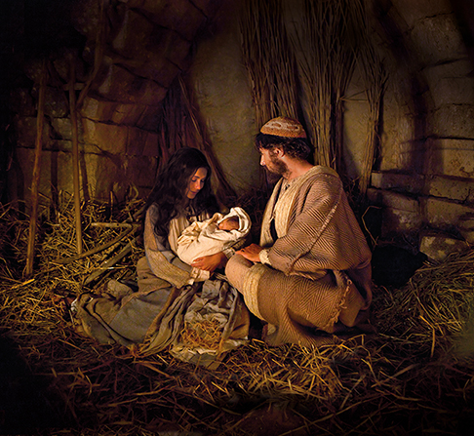
No Room for Jesus
Luke 2:7

Slide 3

“And she brought forth her firstborn Son, and wrapped Him in swaddling cloths, and laid Him in a manger, because there was no room for them in the inn.”
Luke 2:7

Slide 4
Who Had “No Room” for Jesus?
His Hometown of Nazareth - Luke 4:16-30
The Gentiles in the Gadarenes - Luke 8:26-37
The Samaritans - Luke 9:51-56
The Rich Young Ruler - Luke 18:18-23
Israel - Luke 23:13-25

Slide 5
Who Has “No Room” for Jesus Today?
Those who are offended.
Those who are afraid.
Those who are prejudiced.
Those who love something else.
Those who are misled.
Could this be me?

