Slide 2

Zealous for Good Works
Titus 2:14

Slide 3
Zealous for Good Works
Source for Zeal
Protecting our Zeal
Zealous for the Right Things
The Zeal of Jesus
How Jesus makes us “Zealous for Good Works”
Praising God and Encouraging Others
Evangelism
Helping Others
Prayer
Helping the Sick and Grieving

Slide 4
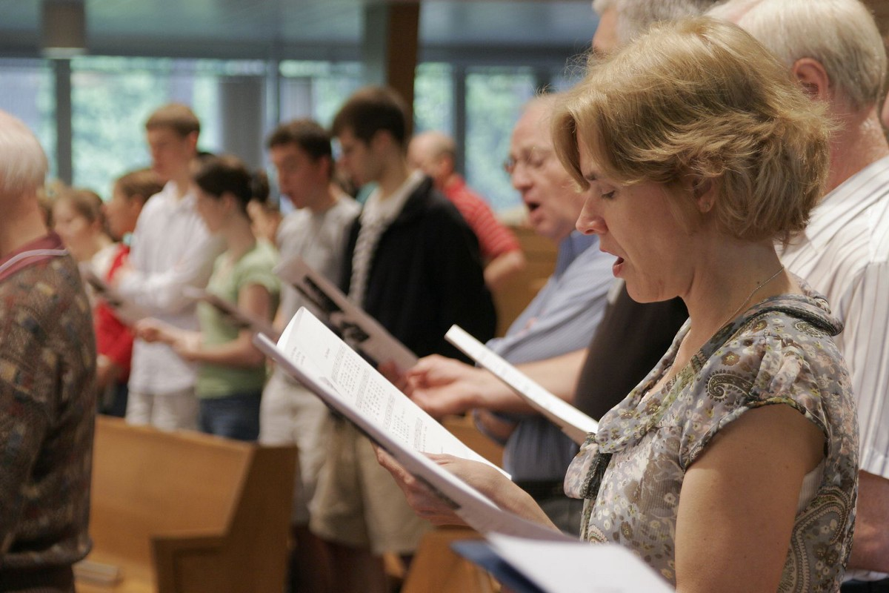
Encouraging One Another Through Singing

Slide 5

What is Zeal?
“great energy or enthusiasm in
pursuit of a cause or objective”
Translated from Greek
word zelos.
“to be hot, or heat”

Slide 6

“Let the word of Christ dwell in you richly in all wisdom, teaching and admonishing one another in psalms and hymns and spiritual songs, singing with grace in your hearts to the Lord.”
Colossians 3:16

Slide 7
“Let the word of Christ dwell in you richly in all wisdom, teaching and admonishing one another in psalms and hymns and spiritual songs, singing with grace in your hearts to the Lord.”
Colossians 3:16

Slide 8
“Let the word of Christ dwell in you richly in all wisdom, teaching and admonishing one another in psalms and hymns and spiritual songs, singing with grace in your hearts to the Lord.”
Colossians 3:16

Slide 9
“Let the word of Christ dwell in you richly in all wisdom, teaching and admonishing one another in psalms and hymns and spiritual songs, singing with grace in your hearts to the Lord.”
Colossians 3:16

Slide 10
“Let the word of Christ dwell in you richly in all wisdom, teaching and admonishing one another in psalms and hymns and spiritual songs, singing with grace in your hearts to the Lord.”
Colossians 3:16

Slide 11
To accomplish this…
We must be present.
We must be participating.
Songs must be scriptural.

Slide 12
“Let the word of Christ dwell in you richly in all wisdom, teaching and admonishing one another in psalms and hymns and spiritual songs, singing with grace in your hearts to the Lord.”
Colossians 3:16

Slide 13

To accomplish this…
We must be present.
We must be participating.
Songs must be scriptural.
Songs must be understood.

