Slide 2
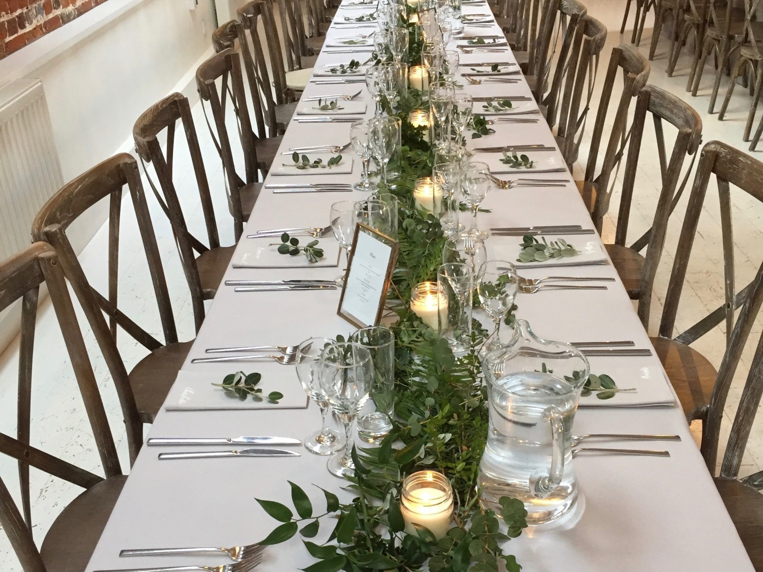
The Man Who Came to Dinner
Luke 14:1-24

Slide 3

“Now it happened, as He went into the house of one of the rulers of the Pharisees to eat bread on the Sabbath, that they watched Him closely.”
Luke 14:1

Slide 4
But Jesus did not commit Himself to them, because He knew all men,
and had no need that anyone should testify of man, for He knew what was in man.
John 2:24-25

Slide 5
Jesus Exposed Their Pride
The False Piety of the Host - Luke 14:1-6
The Guests Wanting Honor - vs. 7-11
The Host Wanting Honor - vs. 12-14
The False Expectation and
Security of the Jews - vs. 15-24

Slide 6
Are we manifesting the presence of pride in our hearts?
Putting on a show; acting pious before others?
Desire to be recognized and honored?
Desire to place others in obligation to us?
False sense of security before God?

