Slide 2
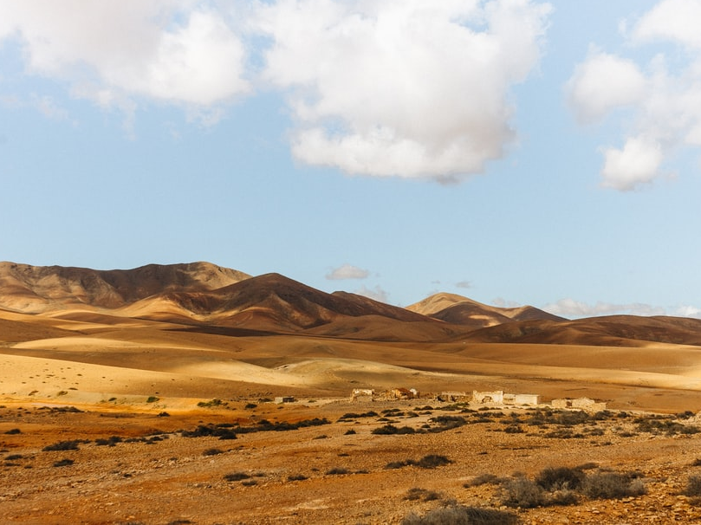
The Conversion of the Ethiopian Eunuch
Acts 8:26-40

Slide 3
Some things about this man.
He was a man of good character (v. 27).
He was religious (v. 27).
He was devout.
He was searching (vs. 30-34).
A Potential Convert!

Slide 4
Man’s Role in God’s
Plan of Salvation
The gospel is God’s power to salvation (Rom. 1:16).
God has chosen to save the lost through the preaching of the gospel (1 Cor. 1:21).
This important work has been given entirely to mankind (Rom. 10:13-15).

Slide 5
Baptism is Part of Preaching Jesus

Slide 6
Baptism is Part of Preaching Jesus
Then Philip opened his mouth, and beginning at this Scripture, preached Jesus to him.
Now as they went down the road, they came to some water. And the eunuch said, “See, here is water. What hinders me from being baptized?”
Acts 8:35-36

Slide 7
The Eunuch Didn’t Wait to Obey
Then Philip opened his mouth, and beginning at this Scripture, preached Jesus to him.
Now as they went down the road, they came to some water. And the eunuch said, “See, here is water. What hinders me from being baptized?”
Acts 8:35-36

Slide 8
Baptism is Immersion

Slide 9
Baptism is Immersion
Acts 8:38-39
…both Philip and
the eunuch went down into the water…
…they came up out of the water…
…he baptized him…

Slide 10
Rejoicing Comes After Baptism
“Now when they came up out of the water, the Spirit of the Lord caught Philip away, so that the eunuch saw him no more; and he went on his way rejoicing” (Acts 8:39).
“And now why are you waiting? Arise and be baptized, and wash away your sins, calling on the name of the Lord”
(Acts 22:16).

