Slide 2

NAHUM
“Behold, I Am Against You”

Slide 3
Nahum
Written against Nineveh, about 100 years after Jonah.
The name “Nahum” means “comfort” or “consolation.”
This book helps us to “consider the goodness and severity of God”
(Rom. 11:22).

Slide 4
God’s Anger and Wrath
God is jealous, and the Lord avenges;
The Lord avenges and is furious.
The Lord will take vengeance on His adversaries,
And He reserves wrath for His enemies;
Nahum 1:2

Slide 5
God’s Anger and Wrath
God is jealous, and the Lord avenges;
The Lord avenges and is furious.
The Lord will take vengeance on His adversaries,
And He reserves wrath for His enemies;
Nahum 1:2

Slide 6
God’s Anger and Wrath
God is jealous, and the Lord avenges;
The Lord avenges and is furious.
The Lord will take vengeance on His adversaries,
And He reserves wrath for His enemies;
Nahum 1:2

Slide 7
God’s Anger and Wrath
God is jealous, and the Lord avenges;
The Lord avenges and is furious.
The Lord will take vengeance on His adversaries,
And He reserves wrath for His enemies;
Nahum 1:2
Romans 5:8-10
But God demonstrates His own love toward us, in that while we were still sinners, Christ died for us.
Much more then, having now been justified by His blood, we shall be saved from wrath through Him.
For if when we were enemies we were reconciled to God through the death of His Son, much more, having been reconciled, we shall be saved by His life.

Slide 8
God’s Anger and Wrath
God is jealous, and the Lord avenges;
The Lord avenges and is furious.
The Lord will take vengeance on His adversaries,
And He reserves wrath for His enemies;
Nahum 1:2
Colossians 3:5-6
Therefore put to death your members which are on the earth: fornication, uncleanness, passion, evil desire, and covetousness, which is idolatry.
Because of these things the wrath of God is coming upon the sons of disobedience.

Slide 9
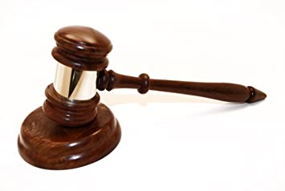
God’s Anger and Wrath
The Lord is slow to anger
And great in power,
And will not at all acquit the wicked.
Nahum 1:3

Slide 10

God’s Goodness
The Lord is good,
A stronghold in the day of trouble;
And He knows those who trust in Him.
Nahum 1:7

Slide 11
What Do We Learn?
The faithfulness of one generation can be quickly forgotten by the next.
God is love - but is capable of jealousy, vengeance, fury, and wrath.
God’s patience must never be misunderstood to mean He will not punish us for our sins.
God is good to those who trust Him.
God can either be against us (Nah. 2:13; 3:5) or for us (Rom. 8:31).

