Slide 1

“THE GOD I KNOW…”
Psalm
50:16-23

Slide 2

Masters at Rationalization
God clarifies the issue!
“But to the wicked God says: What right have you to declare My statutes, Or take My covenant in your mouth.”
Psalm 50:16

Slide 3
Masters at Rationalization
God clarifies the issue!
“Seeing you hate instruction and cast My words behind you.”
Psalm 50:17

Slide 4
Masters at Rationalization
God clarifies the issue!
“When you saw a thief, you consented with him... give your mouth to evil… sit and speak against your brother…”
Sin
Upon
Sin!
Psalm 50:18-20

Slide 5
Masters at Rationalization
God clarifies the issue!
“These things you have done, and I kept silent; You thought that I was altogether like you; But I will rebuke you, And set them in order before your eyes.”
Psalm 50:21

Slide 6
Masters at Rationalization
God clarifies the issue!
“Now consider this, you who forget God, Lest I tear you in pieces, And there be none to deliver…And to him who orders his conduct aright I will show the salvation of God.”
Punishment
Or
Reward:
It’s
Our
Choice!
Psalm 50:
22,23

Slide 7
Man Makes God in His Image
Romans 1:20-25,28
“The God I know…or “My God…”
The God of the Bible debunks the false hopes of all the false gods men invent in their minds
We had better listen to and obey the words of the true God
Not the “false gods” we make in our own image

Slide 8
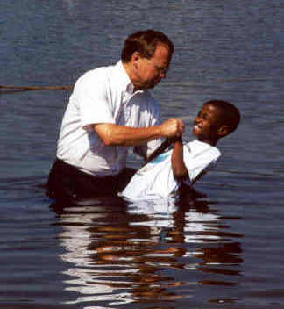
“My God…will save me without baptism.”
John 3:16
“The God I know…
“Thief on the cross was not baptized!” (Luke 5:24)
Thief was not commanded by Jesus to be baptized…WE ARE! Luke 6:46; (Hebrews 9:16,17)
God of the Bible: Water baptism is essential for one’s salvation…
  Mark 16:15,16;
  Acts 2:38
  1 Peter 3:21

Slide 9
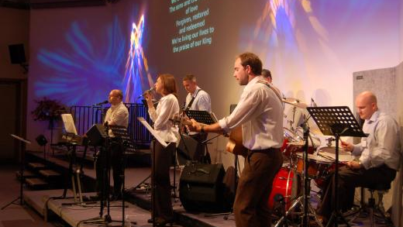
“My God…wants me to worship Him with instruments of music.”
2 Chronicles 29:25
“The God I know…
God of the Bible: SING!
  Ephesians 5:19; Colossians 3:16
How does one KNOW what God wants?
  1 Corinthians 2:10,11
Who are you to ADD to God’s word?
  1 Corinthians 4:6
Who are you to DEFINE true worship?
  John 4:23,24

Slide 10
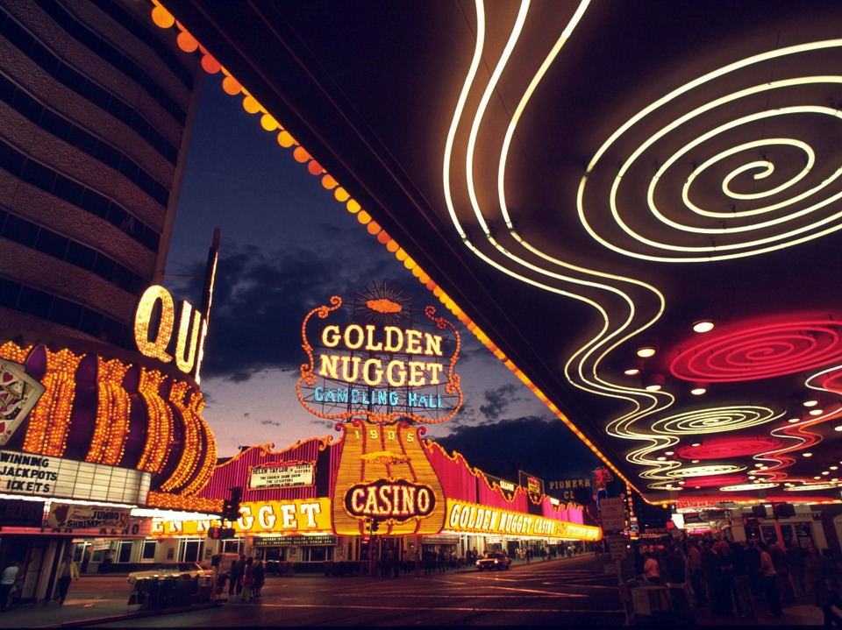
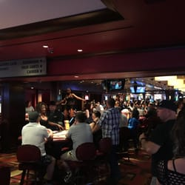

“My God…would not expect me to give up all the fun things of life to follow Him.”
“The God I know…
Things like social drinking, gambling, dancing, fornication, immodest clothing and conduct… James 4:4
Who is defining your FUN? 2 Timothy 3:4; Galatians 5:19-21; 1 John 2:15-17; 1 Peter 4:1-3
God of the Bible: KILL THE FLESH!…
  Colossians 3:5-10

Slide 11
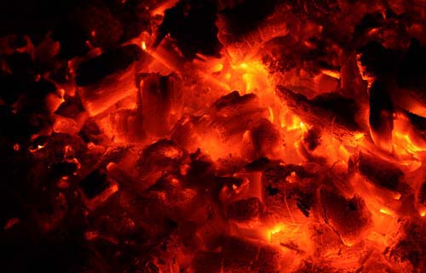
“My God…would not send good people to hell. (religious, moral, kind, charitable…)
Matthew 7:22, 23
“The God I know…
Who is defining “good”?… Hebrews 13:20,21
All have sinned, and all who are in sin are LOST! Romans 3:9-12; 23; 6:23
God of the Bible: Sent His Son to save “good” people, too!
  Mark 10:17-22; Acts 10:1-6; 11:14; Luke 19:10

Slide 12
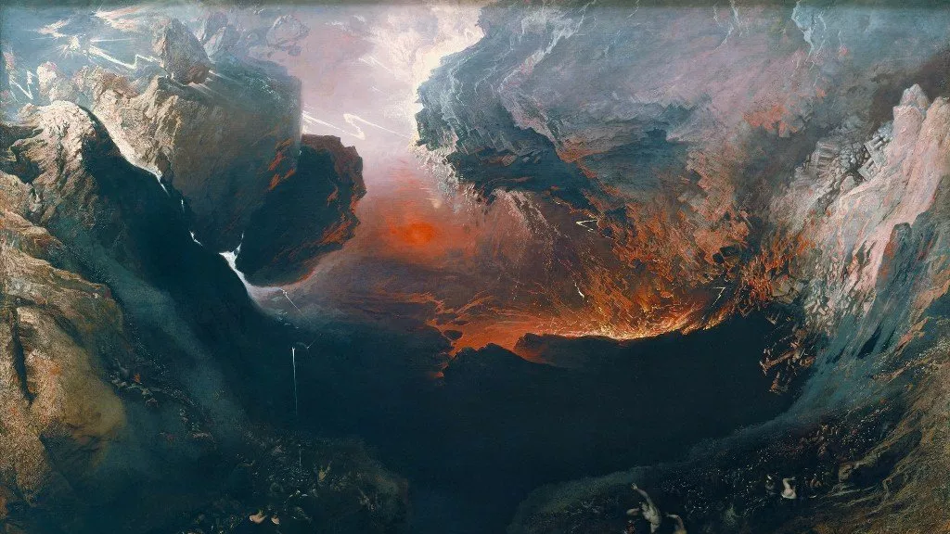
“My God…will save me even with (in spite of my) sin.”
Revelation 22:15
“Continual cleansing” error says grace will save you in spite of your sins… Romans 6:1,2,15
Grace greater than sin does not teach us to keep on sinning! Romans 5:20,21; Titus 2:11-13
God of the Bible: Will not save in spite of sin!
  Matthew 25:46

Slide 13
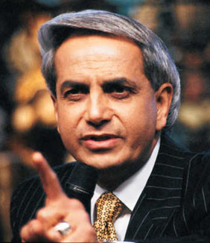

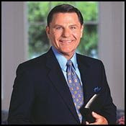
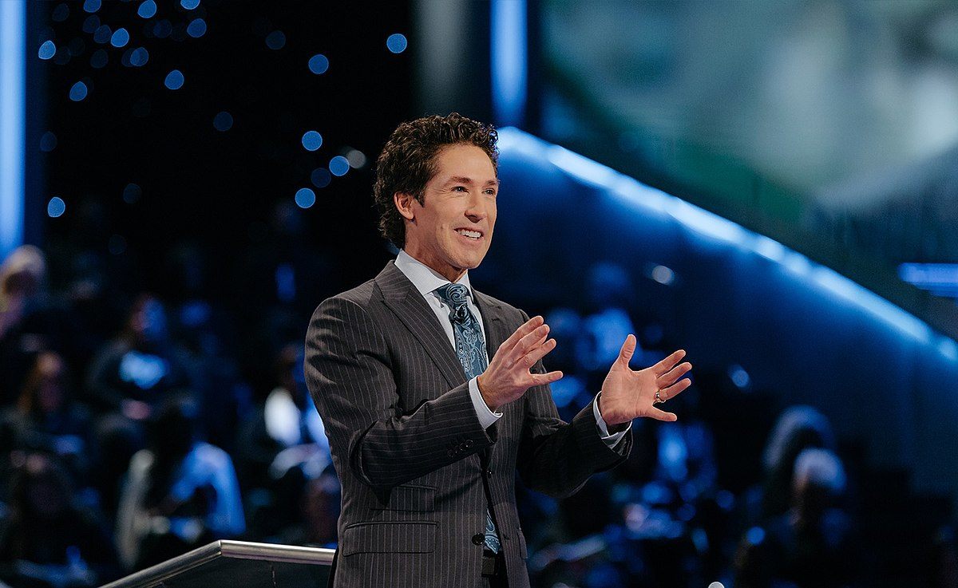
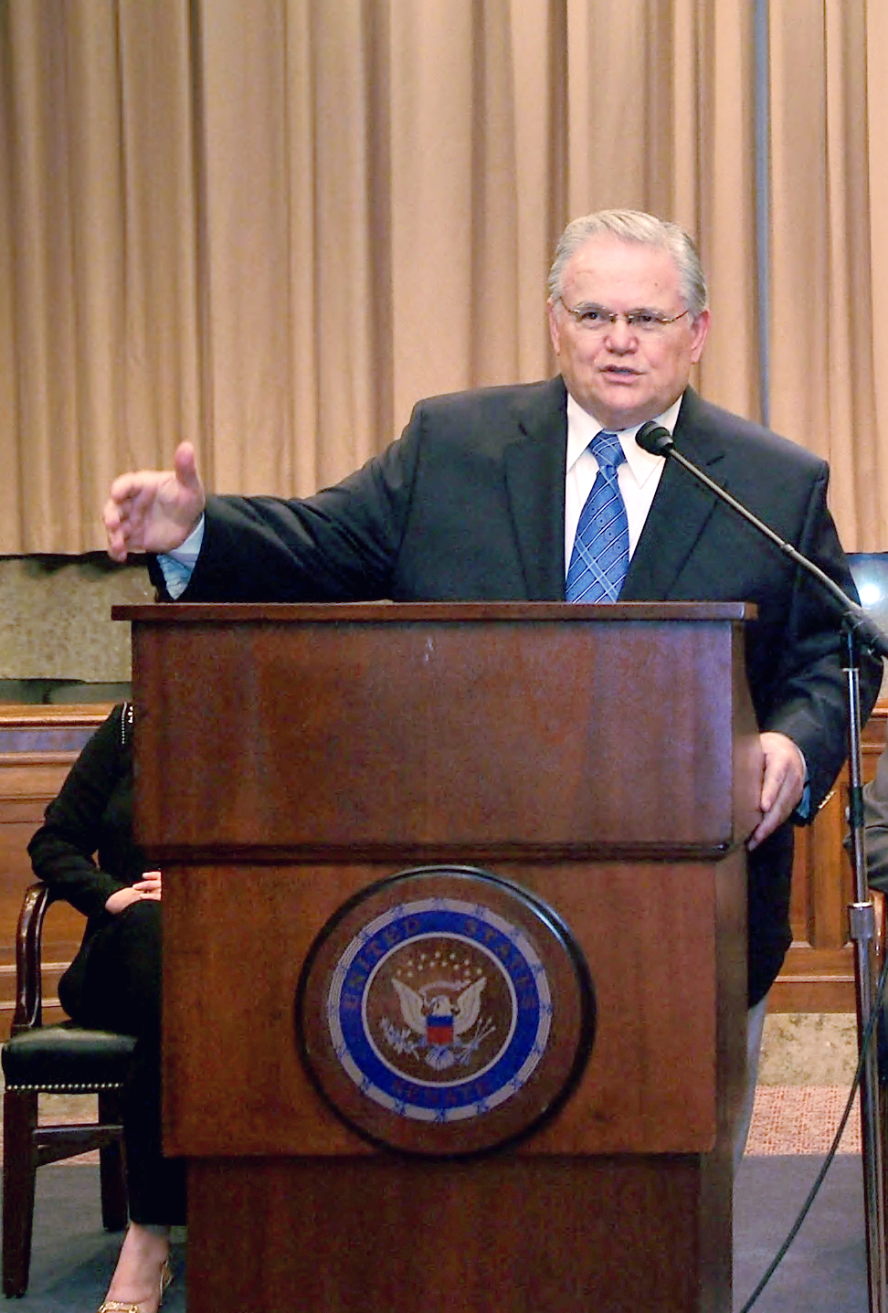

“My God…will save me even with my doctrinal error.”
1 John 4:1
“The God I know…
Our doctrine cannot contradict Christ’s doctrine… Romans 6:17,18
We do not have God when we go beyond the doctrine of Christ! 2 John 9-11; Colossians 3:17
God of the Bible: No, He will never do that!
  Matthew 7:21

Slide 14
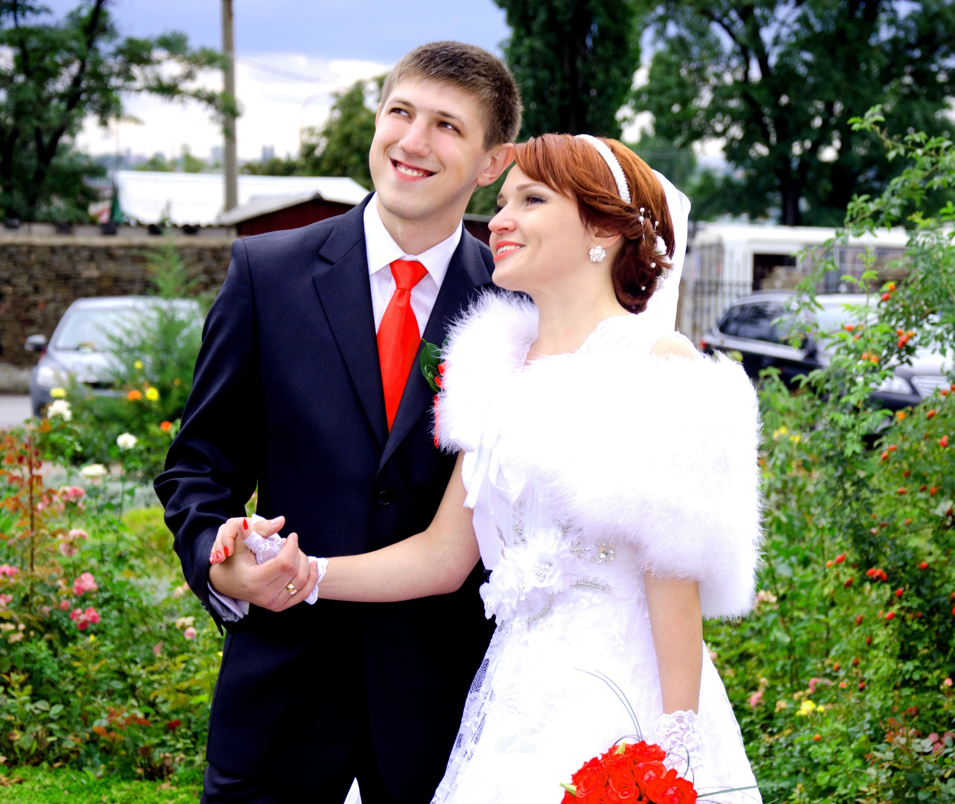
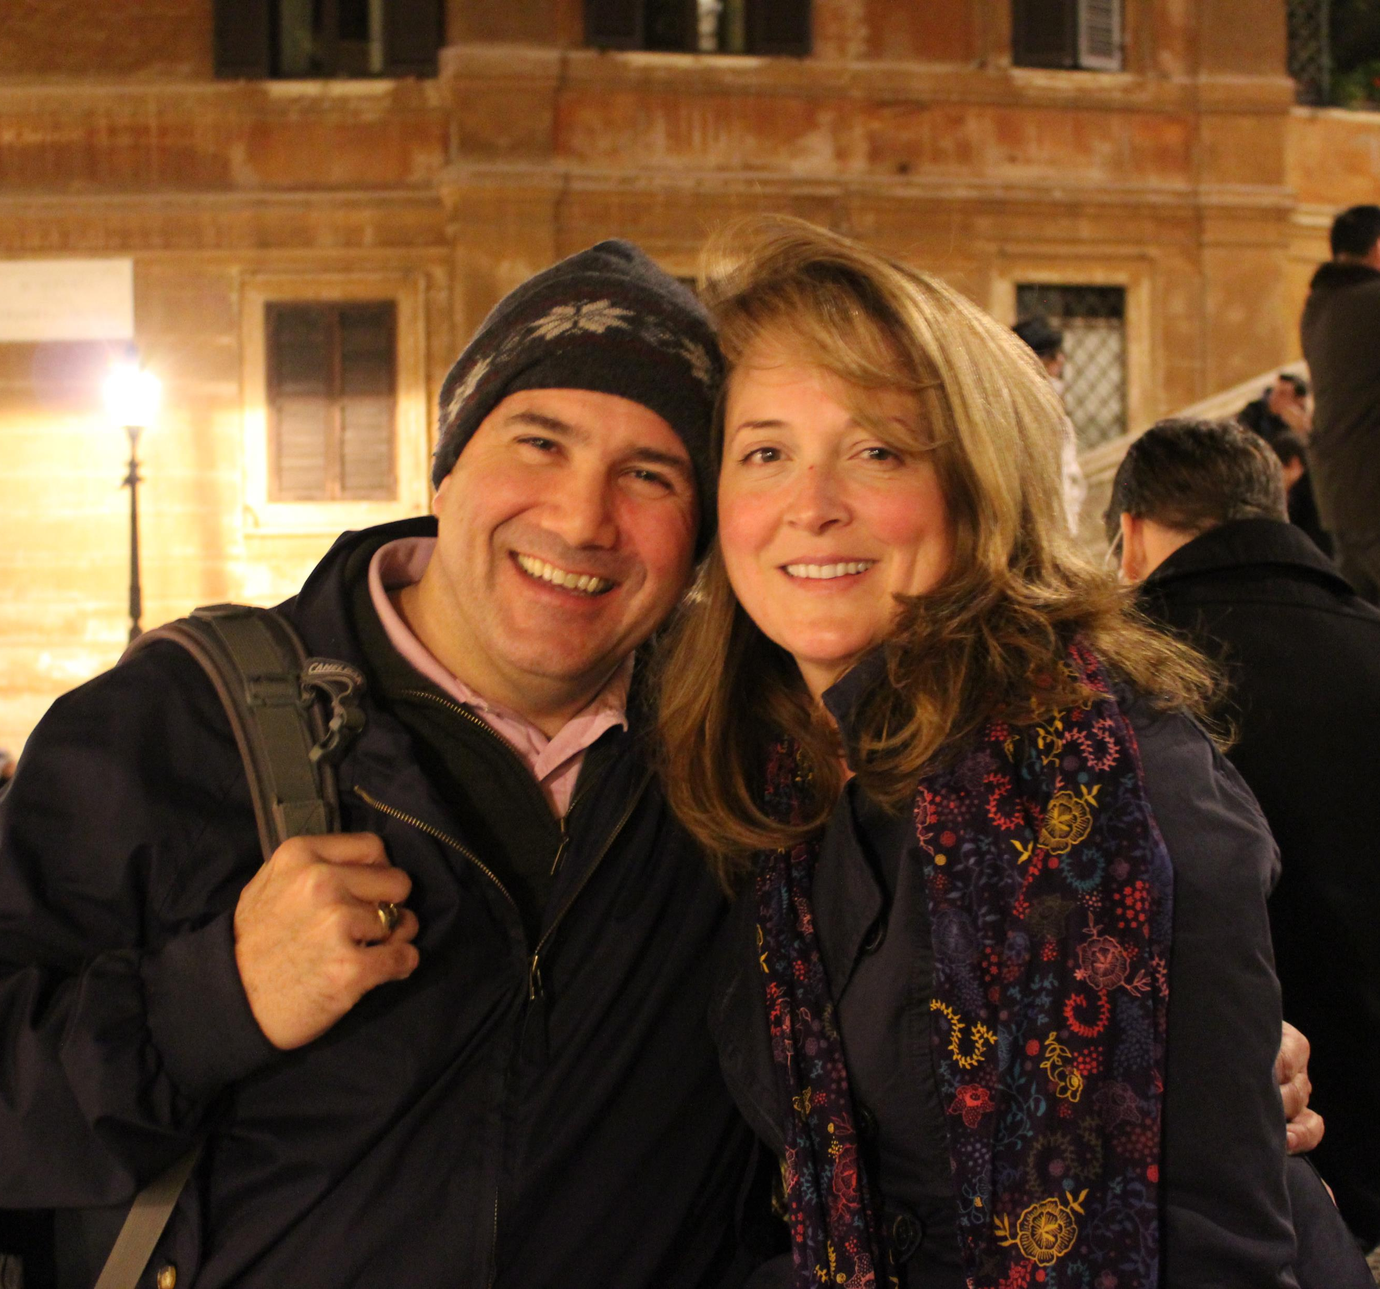
“My God…would not expect me to end my marriage to be right with Him.”
Genesis 2:24
Men approve many marriages Jesus said are adultery… Matthew 19:9; Mark 6:17,18; Luke 16:18
Those who accept the teaching of Jesus will become eunuchs for salvation. Matthew 19:10-12
God of the Bible: He already has!
  Ezra 9:1,2; 13-15; 10:1-4, 10-12 (44)

Slide 15
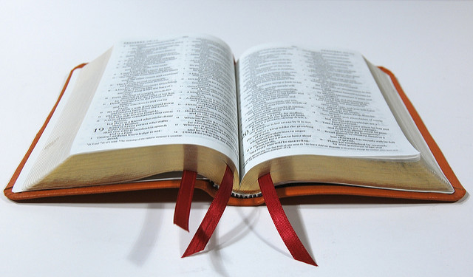
THE GOD I KNOW
Acts 17:30,31
The God we know must be the God of the Bible
We become idolaters, trusting in a false god to save us!
Idolaters worship false gods and are warned to
repent and prepare for judgment

